Slide 1
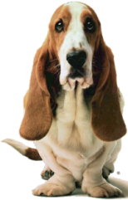

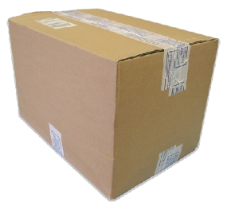



A virtual world for promoting embodied representations of second language spatial terms
Nora Presson
Brian MacWhinney
Michael Heilman
Carnegie Mellon University

Slide 2
L2 Learning and embodiment
Total Physical Response
Gesture-speech linkages
Mental models
Acting out
Virtual worlds

Slide 3
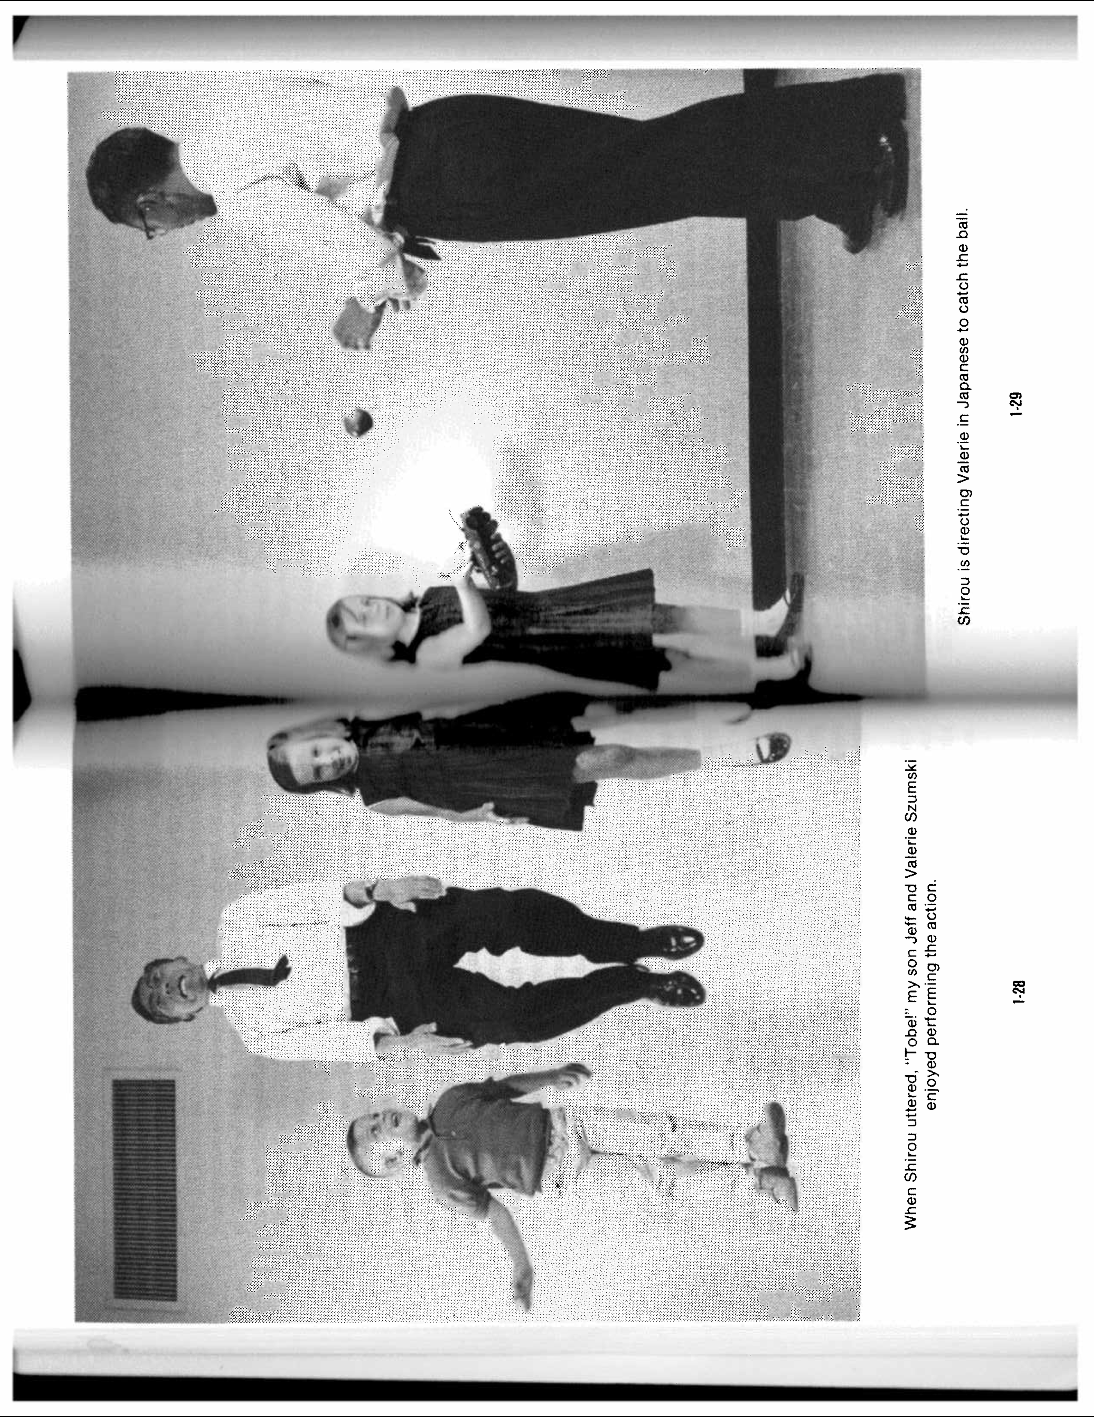
Total Physical Response (Asher, 1977)
Instructional strategy based on the imperative
Modeling and Demonstration
“When the target language is followed by a physical action, one understands what was said.”
Notes:
3-33: Q: If I play to the right brain of my students, are there any risks? A: The only risk is that the left brain may be “jealous” since instruction is usually directed, in school situations, to the left brain.

Slide 4
Gesture-speech linkages
Spencer Kelly
Jim Lantolf
Amy Hubbard
McNeill: growing points
Slobin-Gulberg-Cadierno: Thinking for Speaking

Slide 5
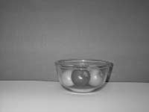
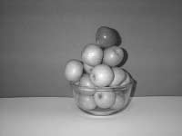
Mental models
Coventry, Bowerman, Lakoff, Regier ……

Slide 6
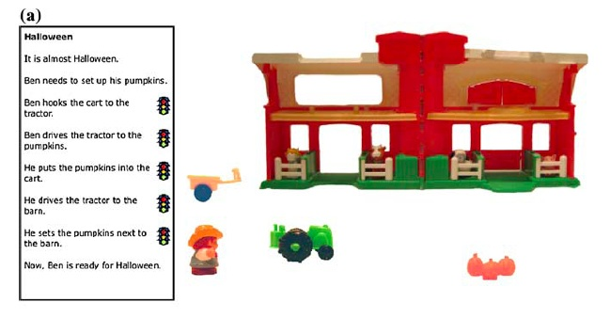
Acting Out
Glenberg’s Computerized Acting Out

Slide 7
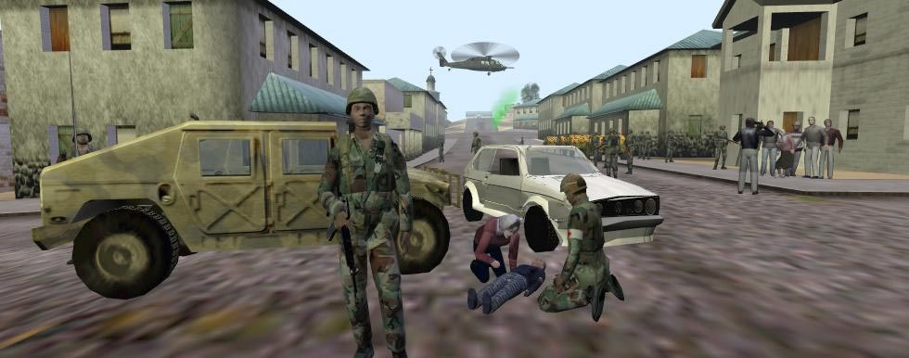
Virtual reality

Slide 8
Unified Competition Model:
Internalization
  Sentence interpretation depends on cognitive simulations
  Simulations can be virtual (Perspective Theory)
  Thinking and acting in L2 improves fluency of L2 access
Resonance:
  Multiple recall cues improve performance
  Physical movement triggers the perception-action cycle

Slide 9
Why Spatial Prepositions?
  Spatial prepositions are problematic for learners
  L1 presentation is not required
  Prepositions are grounded (e.g., Regier & Carlson, 2001) and embodied (Coventry & Garrod, 2004)
Limits on which prepositions we could represent
  No through, out of, por / para, or any non-spatial prepositions
  Biased toward easy items

Slide 10
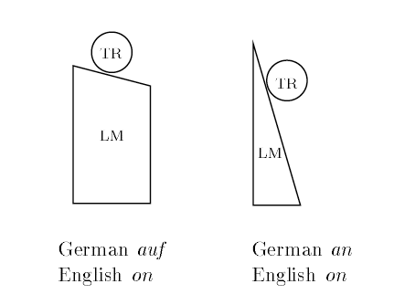
Mismatches (from Regier, 1995)

Slide 11
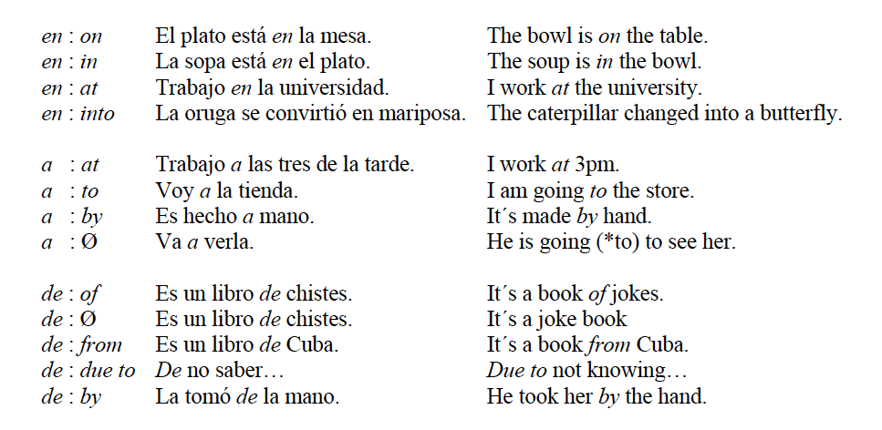
Alignment Between Spanish & English Prepositions
(From Huerta, 2009)

Slide 12
Prepositions Practiced
en (in / on /at / into)
enfrente de (in front of)
a la izquierda de (to the left of)
a la derecha de (to the right of)
bajo (under)
entre (between)
detrás de (behind)
cerca de (near)

Slide 13
Specific Aims
Within the virtual worlds framework, we want to use spatial representations to allow learners to practice L2 preposition use (with no L1 needed).
Improve student performance using spatial prepositions by giving them practice that is dependent on their own movement through the (virtual) world.
Create a multiple virtual room interface that automatically generates practice tasks.

Slide 14
Tutor Trial Framework
Present a room filled with objects:
  Some fixed (landmarks)
  Some moveable (target items)
Read a sentence like: “Put the ball on the chair.”
Click to pick up, click to drop
Correctness feedback only

Slide 15
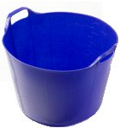
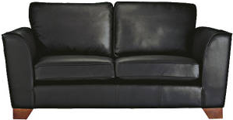
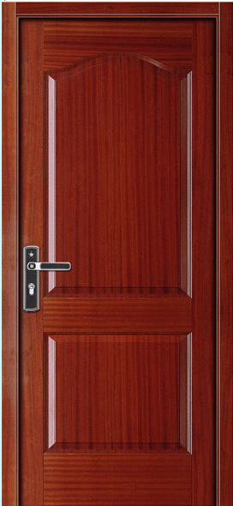
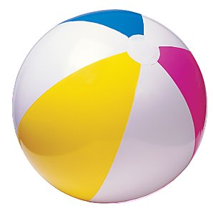
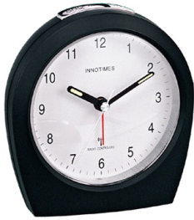
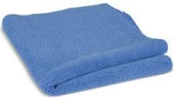

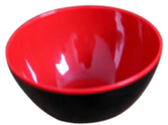
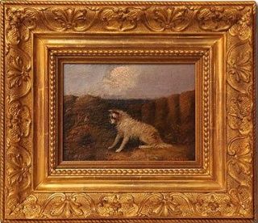
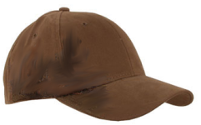
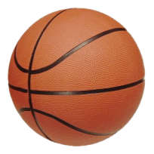
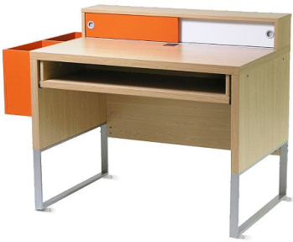

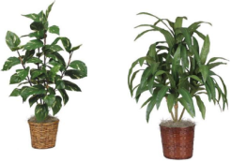

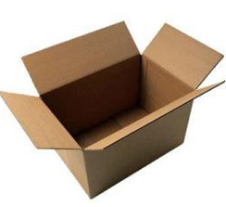
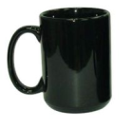

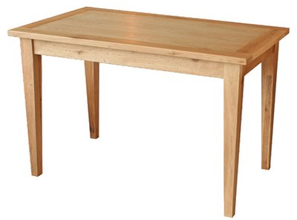
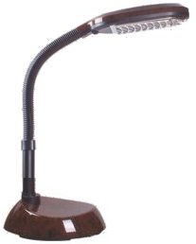
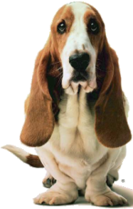
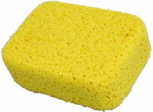
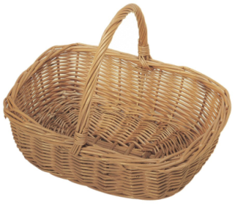
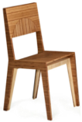
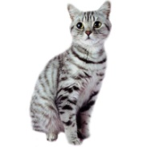
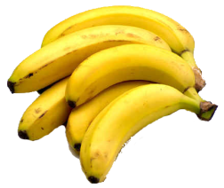
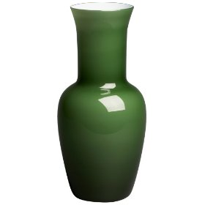
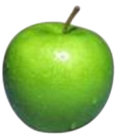

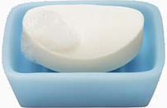

Moveable Items Fixed Items

Slide 16
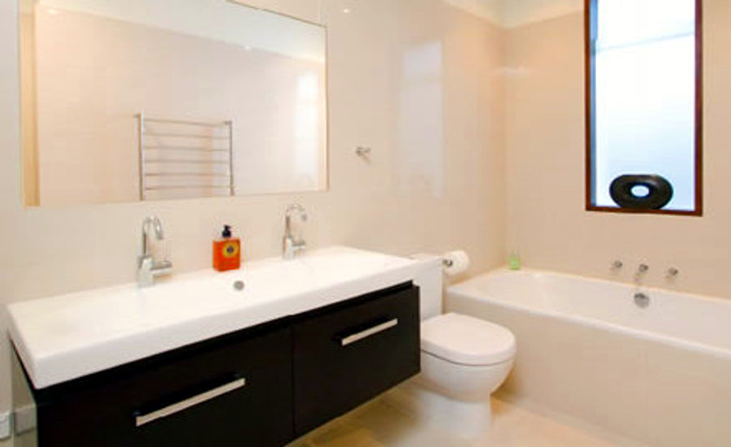
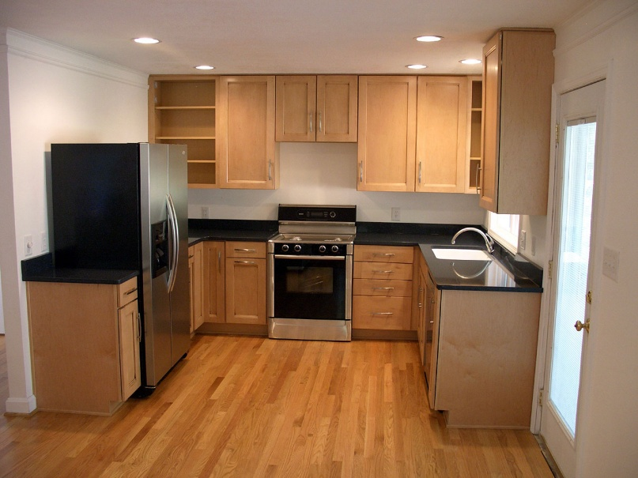
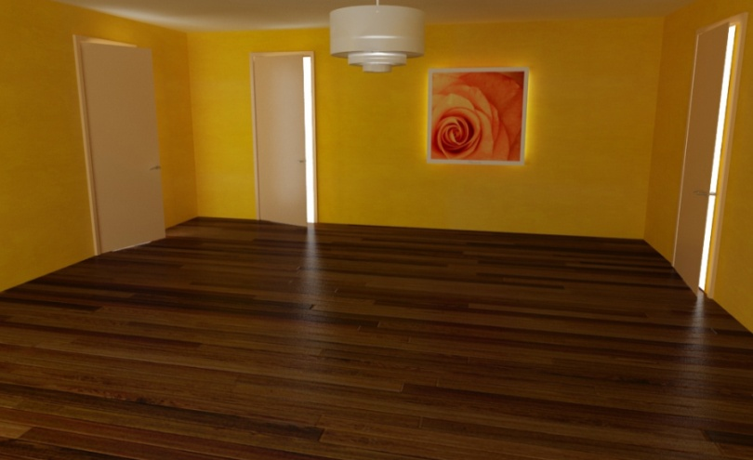

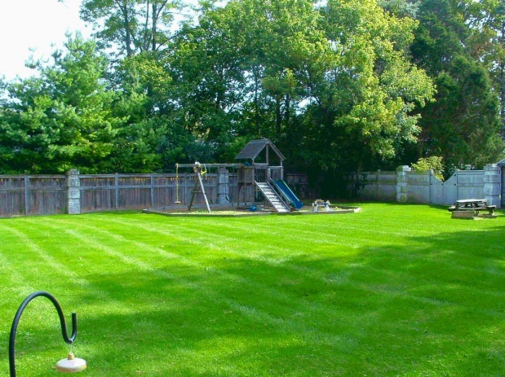
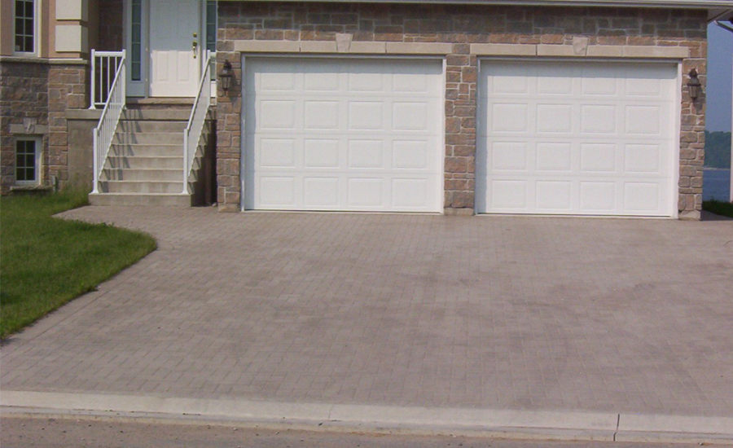


Slide 17
Task Generation
  Tasks are pseudo-randomly generated.
    Pro: easier than fully manual authoring .
    Pro: unlimited practice.
    Con: actions are less plausible.
  Manual Effort:
    Define locations for each room.
    Define spatial relations for each item.
    Specify a few semantic constraints (e.g., in/outdoors, wall/floor)

Slide 18
Spanish Constructions
Drawn from native giving movement instructions in initial pilot
Construction A:
Pon la esponja que está en la mesa en la caja en la cocina.
Put the sponge that is on the table in the box in the kitchen.
Construction B:
Recoge la esponja que está en la mesa y ponla en la caja en la cocina.
Pick up the sponge that is on the table and put it in the box in the kitchen.
When necessary, modifiers resolve ambiguity (e.g., in the kitchen).

Slide 19
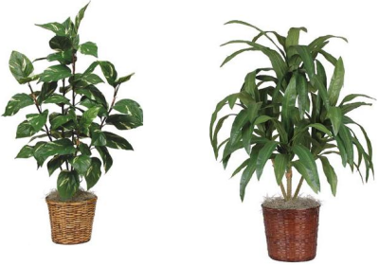
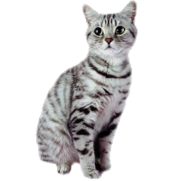

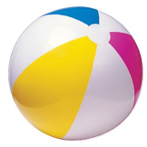
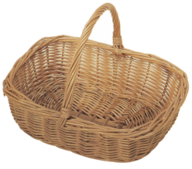
Notes:
“Pon el gato que está a la derecha de la canasta entre las plantas.”
“Recoge el balón que está cerca del cubo y ponlo a la derecha de la canasta.”
“Pon el perro que está a la izquierda de las plantas enfrente del cubo.”

Slide 20
Usability Pilot
N = 17 students in Spanish 1 and 2 at CMU
Trained for ~25 minutes ; pre/post test
Two tutor versions: 1 sentence trials/ 3 sentence trials(in order to investigate storage effects)
Training led to higher accuracy for 1 sentence blocks only:
And lower response time for both groups (.43 min pre-test vs. .20 min post-test; F(1,15) = 219, p < .0001)

Slide 21
Lessons from the Pilot
Restrict tutor design to 1-sentence trials
To reduce ceiling effect, time-limit exposure to sentence
Comparison condition goals:
  Preserve complex visual stimulus of room + objects
  Do not require enactment

Slide 22
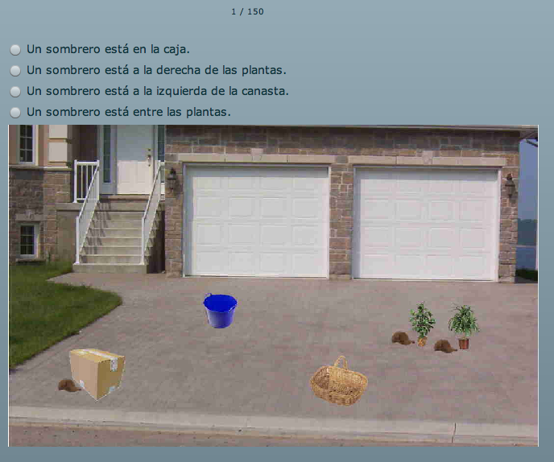
Study 2: Two Task Types
Tutor Interface: Follow instructions to move objects
Multiple Choice: See a picture, choose the correct description

Slide 23
Study Design
N = 32 beginning Spanish students
  Native English speakers who took beginning or intermediate Spanish in the last 2 years
  (drop 1 for missing data)
Dependent Variables: Elapsed Time (per trial), Accuracy (% correct)
One 40-minute training session
Training Types (between-subjects)
  Tutor
  Multiple Choice
Test Types (within-subjects)
  Tutor
  Multiple Choice
Pre-Test / Post-Test

Slide 24
Results
Use linear regression models instead of simple ANOVA to capture trial-level data (low N)
  Binomial outcome for accuracy
Design:
  Probability Correct ~ Test Time + Training Condition + Test Time x Condition
  Latency* ~ Test Time + Training Condition + Test Time x Condition
*Correct responses only

Slide 25
Descriptive Statistics
 |  | Tutor Tests |  | Multiple Choice Tests
 |  | Accuracy | Latency | Accuracy | Latency
Tutor Training | Pre-Test | .37 | 13.08s | .64 | 21.97s
 | Post-Test | .69 | 7.05s | .74 | 16.66s
MC Training | Pre-Test | .49 | 11.84s | .65 | 26.99s
 | Post-Test | .62 | 7.51s | .72 | 13.66s
Grand Mean |  | .55 | 10.18s | .69 | 18.58s
Notes:
High accuracy at pre-test for MC test
Even accuracy at post-test across test types!!!
Slower at MC tests than tutor tests (disappearing sentences, 4 vs. 1 sentence to read)

Slide 26
Source Prepositions
 | Tutor Pre-Test | Tutor Post-Test
a la derecha de | .63 | .63
a la izquierda de | .45 | .71
bajo | .22 | .52
cerca de | .45 | .66
detrás de | .00 | .47
en | .44 | .67
enfrente de | .39 | .65
entre | .43 | .88

Slide 27
Target Prepositions
 | Tutor Pre-Test | Tutor Post-Test
a la derecha de | .51 | .68
a la izquierda de | .35 | .67
bajo | .32 | .62
cerca de | .33 | .58
detrás de | .07 | .25
en | .41 | .69
enfrente de | .60 | .74
entre | .73 | .82

Slide 28
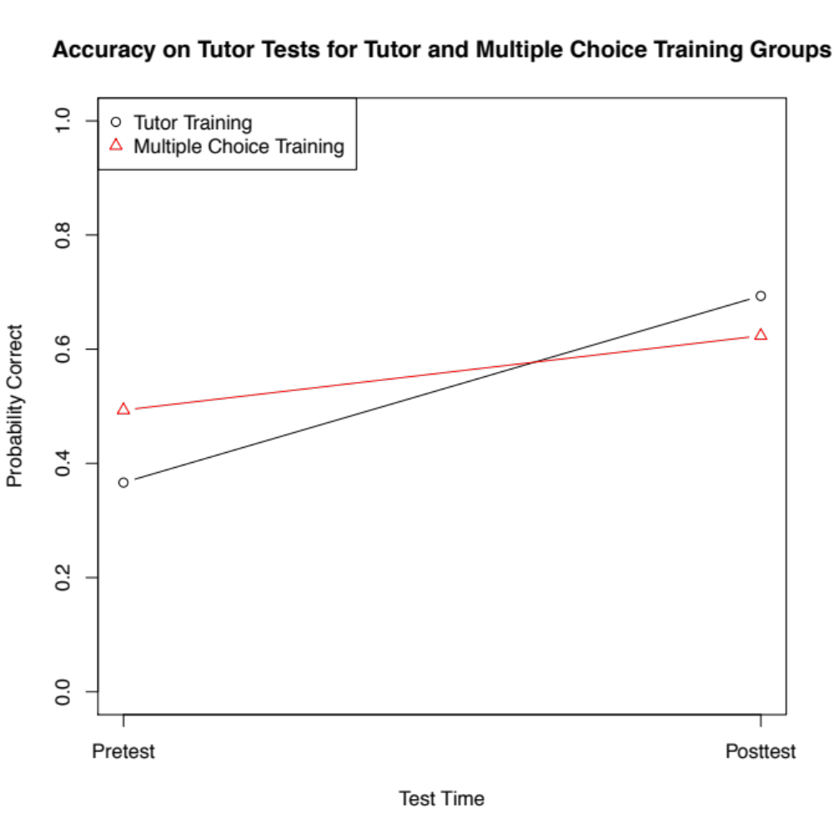
Coefficients (binomial logistic):
Pre-Test β = -0.53, p < .0001
Tutor Training β = 0.31, p = .02
Tutor x Pre-Test β = -.83, p < .0001

Slide 29
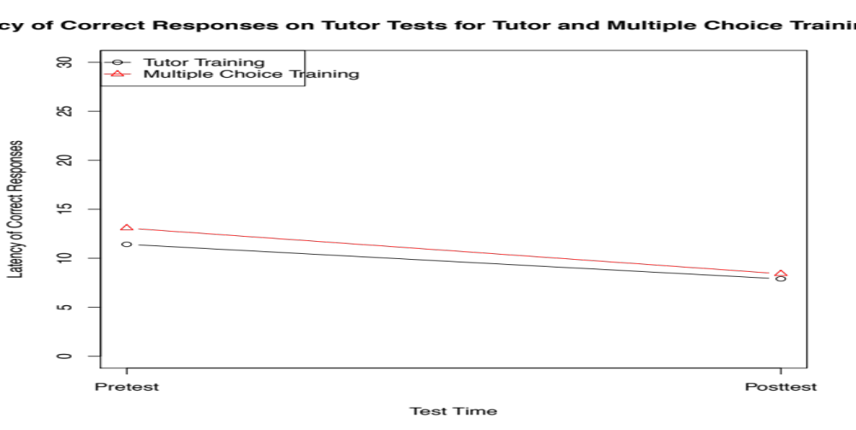
Response Latency on Tutor Tests
Coefficients (linear):
Pre-Test β = 4.66, p < .0001
Tutor Training β = -.50, p = .34
Tutor x Pre-Test β = -1.16, p = .124

Slide 30
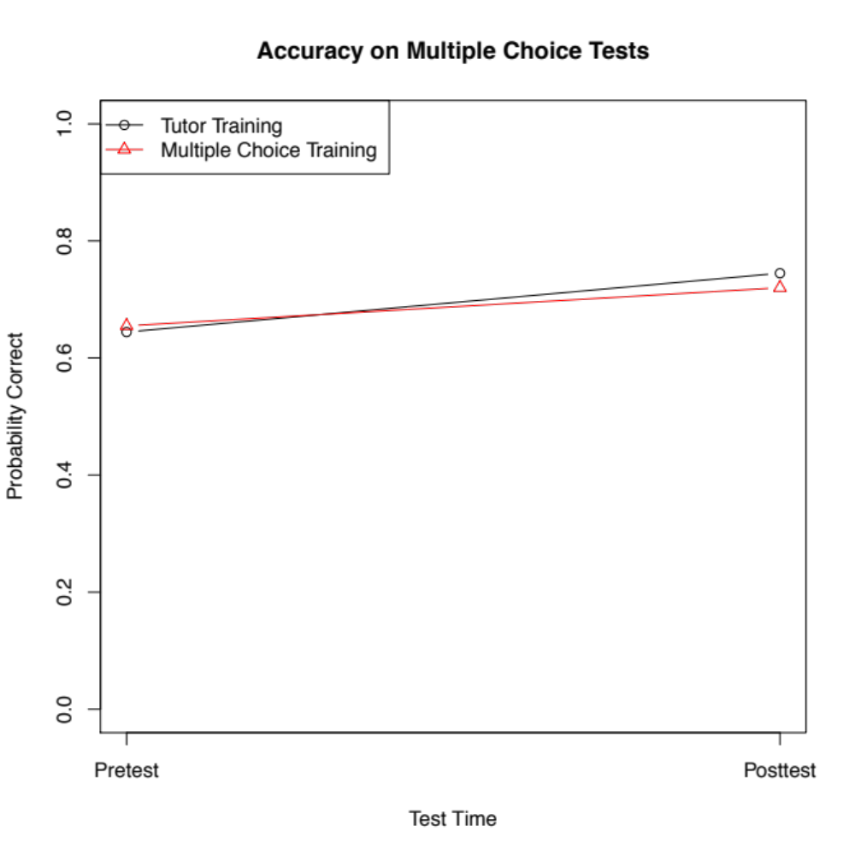
Coefficients (binomial logistic):
Pre-Test β = -0.31, p = .03
Tutor Training β = 0.13, p = .39
Tutor x Pre-Test β = -.17, p = .39

Slide 31
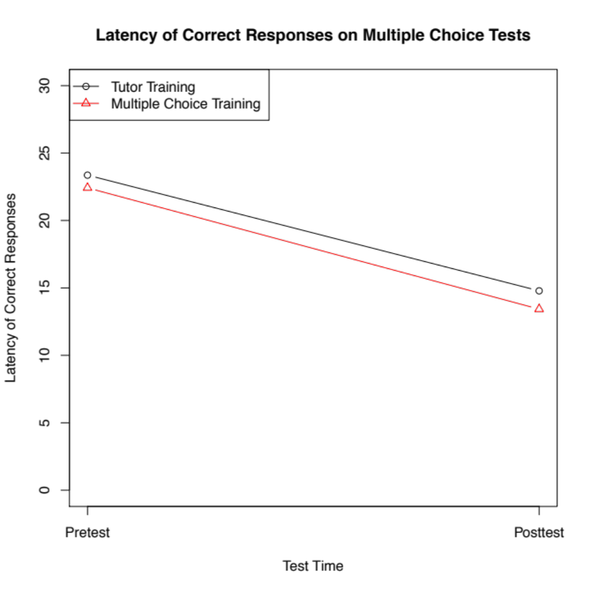
Coefficients (linear):
Pre-Test β = 8.99, p < .0001
Tutor Training β = 1.36, p = .14
Tutor x Pre-Test β = -.41, p = .75

Slide 32
Conclusions
Students benefit from bothtypes of practice, showing room for improvement in their skill using prepositions. Both conditions promote internalization.
Tutor training led to better performance on tutor post-test and equal performance on the multiple-choice post-test. This is in accord with the role of resonance.
Difference between training conditions showed up in accuracy, not latency
  Latency might be reduced at higher levels of proficiency

Slide 33
Future Directions
  Additional comparison conditions - Suggestions encouraged!
  4 vs. 1 sentence
  Time pressure in reading and enacting instructions
Targeting cross-linguistic mismatches
(e.g., en → in & on)
Related Linguistic Phenomena:
  Path descriptions (e.g., “through the door”)
  Agents (e.g., “Make Bob put…”)
    Compare egocentric perspective with forced perspective-taking
  Manner (e.g., “run” versus “walk”)
More languages
Learner modeling and adaptation

Slide 34
Thanks!
Vincent Aleven
Art Glenberg
John Kowalski
This work was supported in part by a Graduate Training Grant awarded to Carnegie Mellon University by the Department of Education (#R305B040063)
Partly funded by NSF award SBE-0354420

Slide 35

Narrative Post-Test

Slide 37
High Baseline Accuracy
Simple ANOVA with all participants is noisy
Remove 9 participants with > 90% multiple-choice pre-test, then run ANOVA (new N = 21)
  New mean pre-test MC accuracy: .54 (SD = .21)
Now ANOVA shows tutor training advantage for accuracy on tutor tests: F (1, 19) = 5.34, p = .032
  All 4 ANOVAs (latency & accuracy for MC and tutor tests) show improvement over time: smallest F(1,19) = 13.72, p = .002

