Slide 1
The Cultural Structure of the American First Date
Yiyao

Slide 2

Cultural Domain: “First Date Behavior”
Key components:
Initiation
The date itself
Payment
Physical interaction
Post-date communication

Slide 3
Rules
An invitation must be framed in a manner appropriate to the social distance between participants.
Escalation of intimacy must not exceed reciprocal signaling.
Personal information is disclosed in culturally ordered increments.
Financial responsibility is assigned according to perceived relational structure.
Post-date communication must signal calibrated interest through timing.
Direct rejection must be minimized to preserve social harmony.

Slide 4
Decision Tree Example: Who Pays?
Was this initiated by you?
Is this framed as egalitarian?
Do you identify as the more dominant party?
They pay
No
No
No
Yes
Yes
Split
You pay
Yes

Slide 5
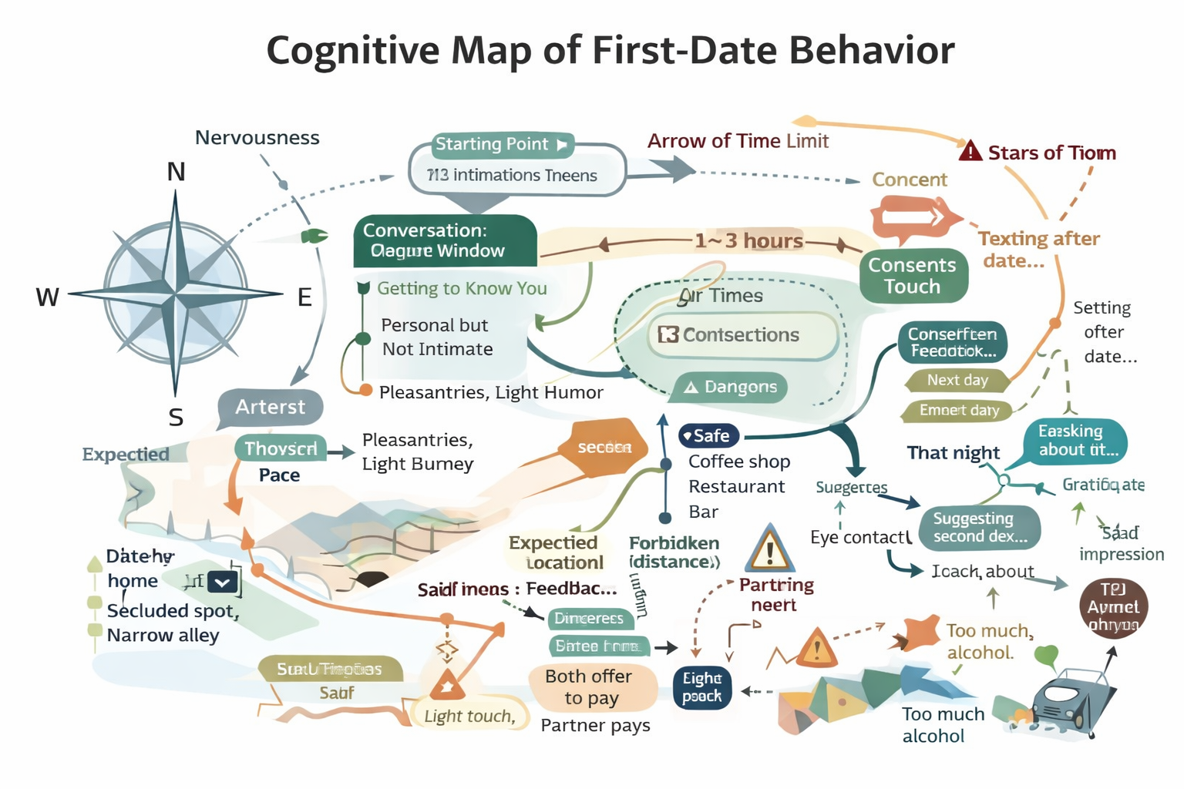
The Cognitive Map
First date participants navigate:
Space (restaurant, coffee shop, bar)
Time (how long to stay)
Physical proximity
Emotional disclosure levels

Slide 6
The Plan
Goal:
Secure second date / evaluate compatibility
Conditions:
Mutual interest?
Safety?
Attraction?
Techniques:
Self-presentation
Humor
Strategic vulnerability
Controlled physical touch
Conditions for Selection:
If partner reciprocates → escalate
If partner withdraws → reduce intensity

Slide 7
Navigation under the Big Bird Model
First Date as Cultural Dead Reckoning
Initial Course: framed intention (casual, serious, exploratory)
Maintaining Course: track micro-signals such as tone, reciprocity, proximity
Currents: anxiety, norms, gender roles
Reefs: topic pivots, environment choice, exit strategies
Homing In: mutual escalation → second date
Puluwat Navigation Model
Set initial course
Maintain direction en route
Correct for drift
Use conservative safeguards
Home in once close

Slide 8
Feature Grid Example
Behavior | High Interest | Moderate Interest | No Interest
Eye contact | Sustained | Intermittent | Avoidant
Touch | Light touch | None | Defensive
Text timing | Same day | 1–2 days | No message

Slide 9
Conclusion
First-date behavior is:
Rule-governed (Spradley)
Map-based (Wallace)
Navigational (Gladwin)
Feature-defined (Hage)

Slide 10
References
Spradley, J. P. (Foundations of Cultural Knowledge).
Spradley, J. P. (Beating the Drunk Charge).
Wallace, A. F. C. (Driving to Work).
Hage, P. (Münchner Beer Categories).
Gladwin, T. (Navigation under the Big Bird).
ChatGPT

