Slide 1
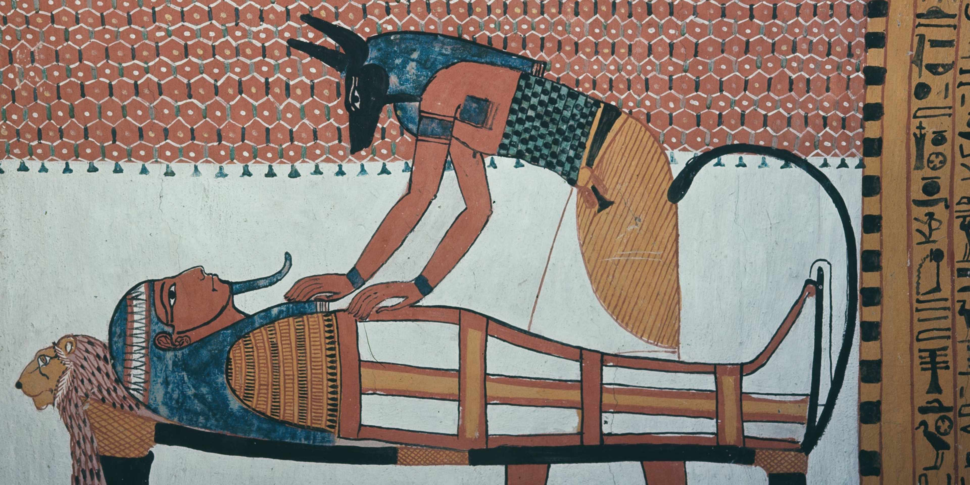
Egyptian Mummification and Structuralism
Presentation by Solomon Wechter

Slide 2
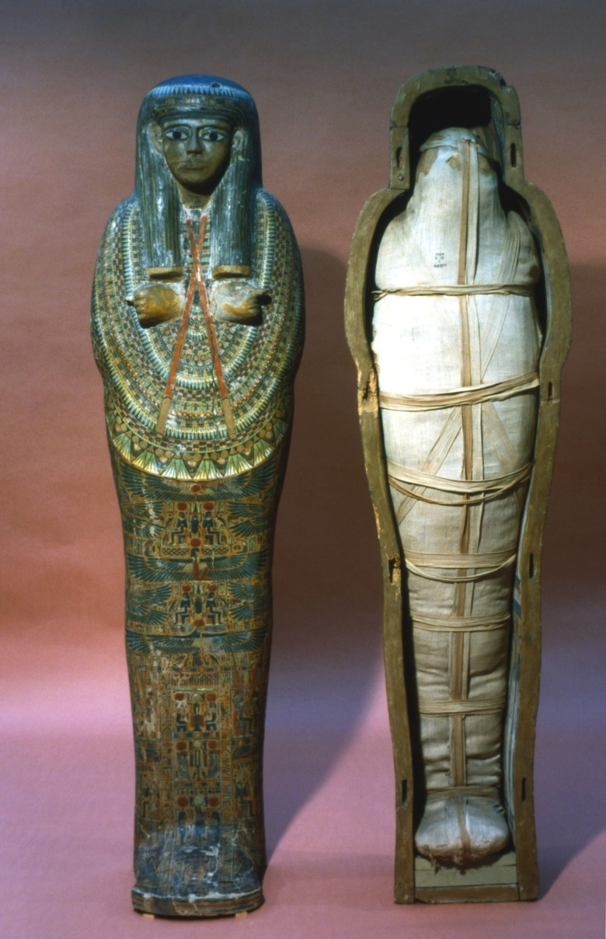
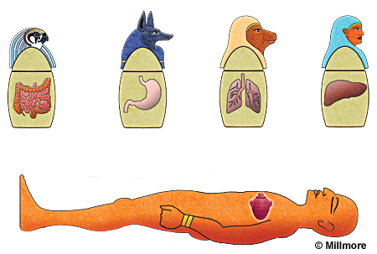
Ancient Egyptian Mummification
Prepares the dead for afterlife
Internal organs were preserved separately in canopic jars, each associated with protective deities
  Heart left in body because heart was left in the body because it was believed to be the seat of thought, memory, intention, and moral character. Unlike the brain (which was typically removed and discarded), the heart was considered essential for the afterlife.
Followed standardized ritual stages performed by trained embalmers.

Slide 3
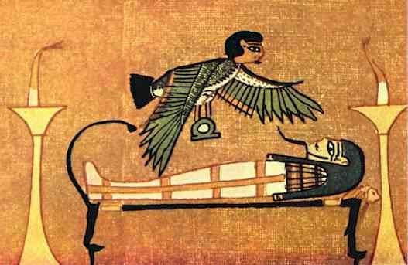
Structural Oppositions
Life / death
Earthly body / eternal self (ka)
Human / Divine
  Through ritual and wrapping, the deceased is gradually aligned with divine imagery and mythic patterns

Slide 4
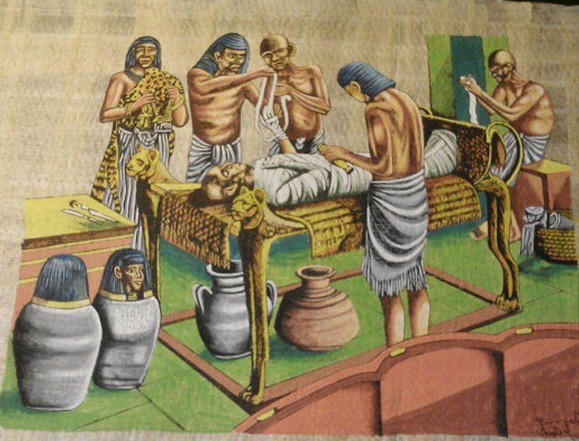
Rules and Roles
Specialized roles
  Embalmers carried out distinct tasks, and priests performed accompanying rites
Fixed sequence
  Organ removal → desiccation (~40 days in natron) → stuffing and reshaping → wrapping in layers of linen → coffin placement → tomb deposition
Funerary spells (such as those later compiled in the Book of the Dead) were included to guide the deceased through judgment and the afterlife journey

Slide 5
Branching
Status-based branching
  Elites received more elaborate preservation, multiple coffins, and richly furnished tombs, more ritual complexity, etc
  lower-status individuals received simplified versions
  Elite household servants sometimes received basic embalming if their patron or family paid for it.
  Lower-status laborers were often buried with minimal preparation — sometimes simple wrapping, sometimes little more than interment in a coffin or pit.
  Full, high-quality mummification (organ removal, extensive resins, decorated coffins) was generally limited to wealthier individuals.
Age, cause of death, geographic region, etc.,

Slide 6
Sources
Buckley, S. A., & Evershed, R. P. (2001). Organic chemistry of embalming agents in Pharaonic and Graeco-Roman mummies. Nature, 413(6858), 837–841. https://doi.org/10.1038/35101588
Buckley, S. A., Clark, K. A., Evershed, R. P., & others. (2014). Complex mortuary rituals and body treatments in prehistoric Egypt. PLOS ONE, 9(1), e86740. https://doi.org/10.1371/journal.pone.0086740
Wade, A. D., Nelson, A. J., Garvin, G. J., & Zink, A. R. (2012). Radiological and chemical investigation of ancient Egyptian mummification materials. Journal of Archaeological Science, 39(8), 2689–2699. https://doi.org/10.1016/j.jas.2012.03.033
Ikram, S. (1995). Choice cuts: Meat production in ancient Egypt and its relevance to mummification. Journal of Egyptian Archaeology, 81, 93–106.
Chatgpt.com

