Slide 1
To Tip or Not to Tip: a cultural comparison of US, Spain, and Japan
Kate Smigie
Unspoken Rules
*A rule learned through symbolic interactions

Slide 2
Cultural dimensions (power distance, uncertainty avoidance, masculinity)
Personality traits (extraversion)
Corruption levels (bribery)
Social-psychological factors (impression management concerns, religiosity)
Exposure to tipping cultures (travel to the U.S., tipping levels in neighboring countries)
Institutional practices (use of service charges)
Economic conditions (purchasing power parity, income inequality, tax burden)
Lynn,2025
Cross-Cultural Overview
Tip vs Service
“When people tip: service has already been provided by the time the tip is given, and so the tip is a voluntary payment that does not buy something real (such as improved service) in return” (Azar, 2009).

Slide 3
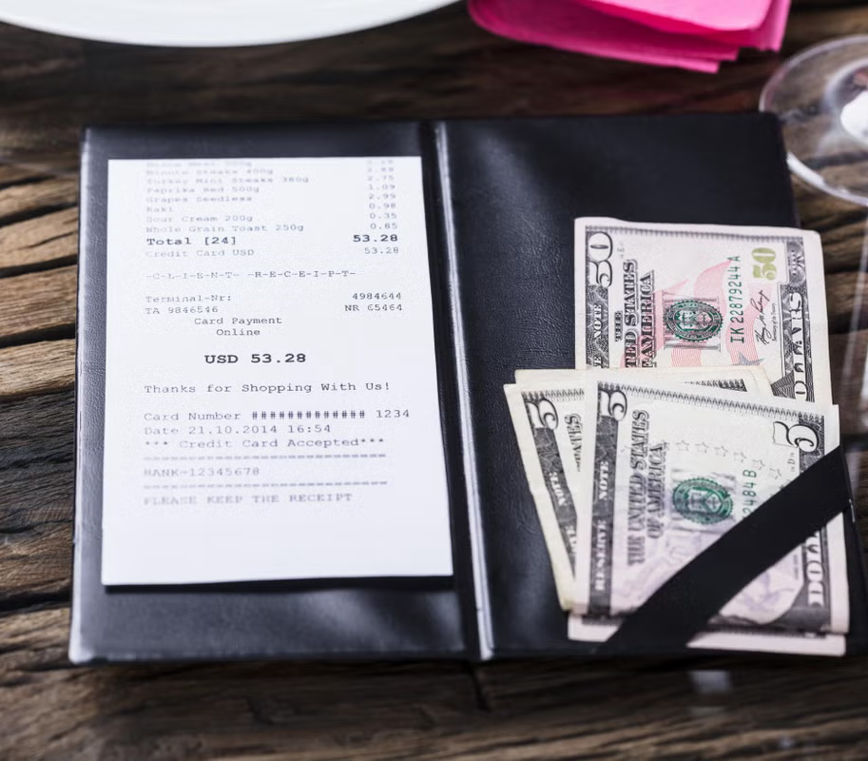
United States
Motivations:
  Social norm
  Desire to show gratitude for service provided
  Awareness that waiters depend on tips as a source of income
  Fear to feel guilty or embarrassed if they do not tip
(Azar,2009).
Tip Size:
  “Social norms in the United States that call for tipping 15 to 20 percent of he bill size, restaurant patrons leave larger dollar tip amounts the larger their bills”(Lynn et al).
Unspoken Rule: Tipping is a moral obligation/evaluation
(especially in restaurants)

Slide 4
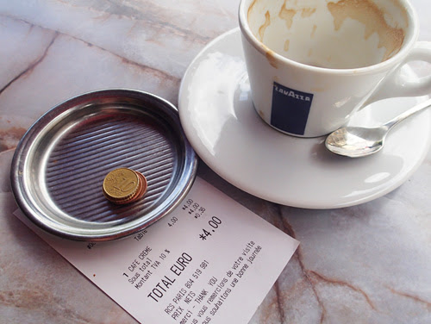
Spain
Motivations:
Workers are expected to be making a fair wage
A service charge is often included
If someone is feeling more fulfilled, kind, or is more affluent
Unspoken Rule: Tipping is optional and often a courtesy
“Propina” Size:
Sometimes no tip
The bill is rounded up/ small change or a few euros are left
Generous tips are about 5-10%
A service charge is there sometimes in lieu

Slide 5
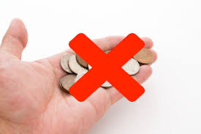
Japan
Motivations:
“Ototenashi” the act of sincere hospitality often anticipating customer needs (rooted in the Japanese tea ceremony)
  Workers take pride in their work and providing excellent service
(Leingpibul, Thaweephan, et al, 2025)
“Giri”(duty) or social obligation to engage in reciprocal activities and “On” (favor) a debt of gratitude that requires repayment
Tip Size:
Service charge is typically included
“Kokoroduzke” - sometimes people will give some money discreetly before the service is provided, typically in a “fancy” place(situational/semi-historic practice)
(Shirota & Yano, 2017)
Unspoken Rule: Tipping is often considered not acceptable and can be taken offensively

Slide 6
Sources
Azar, Ofer H. “Tipping motivations and behavior in the U.S. and Israel.” Journal of Applied Social Psychology, vol. 40, no. 2, Feb. 2009, pp. 421–457, https://doi.org/10.1111/j.1559-1816.2009.00581.x.
Michael Lynn, George M. Zinkhan, Judy Harris, Consumer Tipping: A Cross-Country Study, Journal of Consumer Research, Volume 20, Issue 3, December 1993, Pages 478–488, https://doi.org/10.1086/209363
Lynn, Michael. “Measuring and predicting national differences in tipping customs: A critical review.” International Journal of Hospitality Management, vol. 131, Oct. 2025, p. 104343, https://doi.org/10.1016/j.ijhm.2025.104343.
https://as.com/actualidad/sociedad/la-psicologia-explica-por-que-muchos-no-dejan-propinas-en-los-restaurantes-y-ninguna-razon-alude-a-tacaneria-n/
https://www.tenerifenews.com/tip-in-spain
https://papers.iafor.org/wp-content/uploads/papers/accs2017/ACCS2017_35585.pdf?utm_source=chatgpt.com
https://exploreve.com/japan-culture-guide-etiquette-history-and-essential-travel-tips/
Leingpibul, Thaweephan, et al. “The role of Omotenashi in developing committed customer relationships in Japanese retail establishments.” The International Review of Retail, Distribution and Consumer Research, vol. 35, no. 5, 8 June 2025, pp. 625–651, https://doi.org/10.1080/09593969.2025.2515421.

Slide 7
THANK YOU!
Would you like to leave a tip?
18% 20% 22% 25%

