Slide 1
The Structure of The Supermarket
Estelle Spira
01

Slide 2

Supermarkets as a Maze
Supermarkets are a physical manifestation of cultural taxonomy
To shop effectively you have to know how the items are categorized.

Slide 3
The Layout of Goods
The Taxonomic Structure: Items are not placed randomly; they follow a hierarchical classification system.
Level 1 (Perimeter vs. Interior): Fresh/Perishable vs. Processed/Stable.
Level 2 (Department): Produce, Dairy, Meat, Frozen, Dry Goods.
Level 3 (Sub-category): Within "Produce," we have "Leafy Greens" vs. "Root Vegetables."

Slide 4
Plan and Decision Tree
  The Sequencing: Shopping follows a strict "recipe" or "plan."
  Step 1: Acquisition of Tool: Selecting a cart vs. a basket
  Step 2: Navigation: Most shoppers follow a "counter-clockwise" or "perimeter-first" rule.
  Step 3: Evaluation: This involves a Decision Tree.
Is the item on the list? → Yes/No.
Is the price acceptable? → Yes/No.
Is there a substitute? (e.g., store brand vs. name brand).
  Rules of Conduct: There are unwritten rules for cart "traffic" (staying to the right) and "aisle etiquette" (not blocking the shelves)

Slide 5
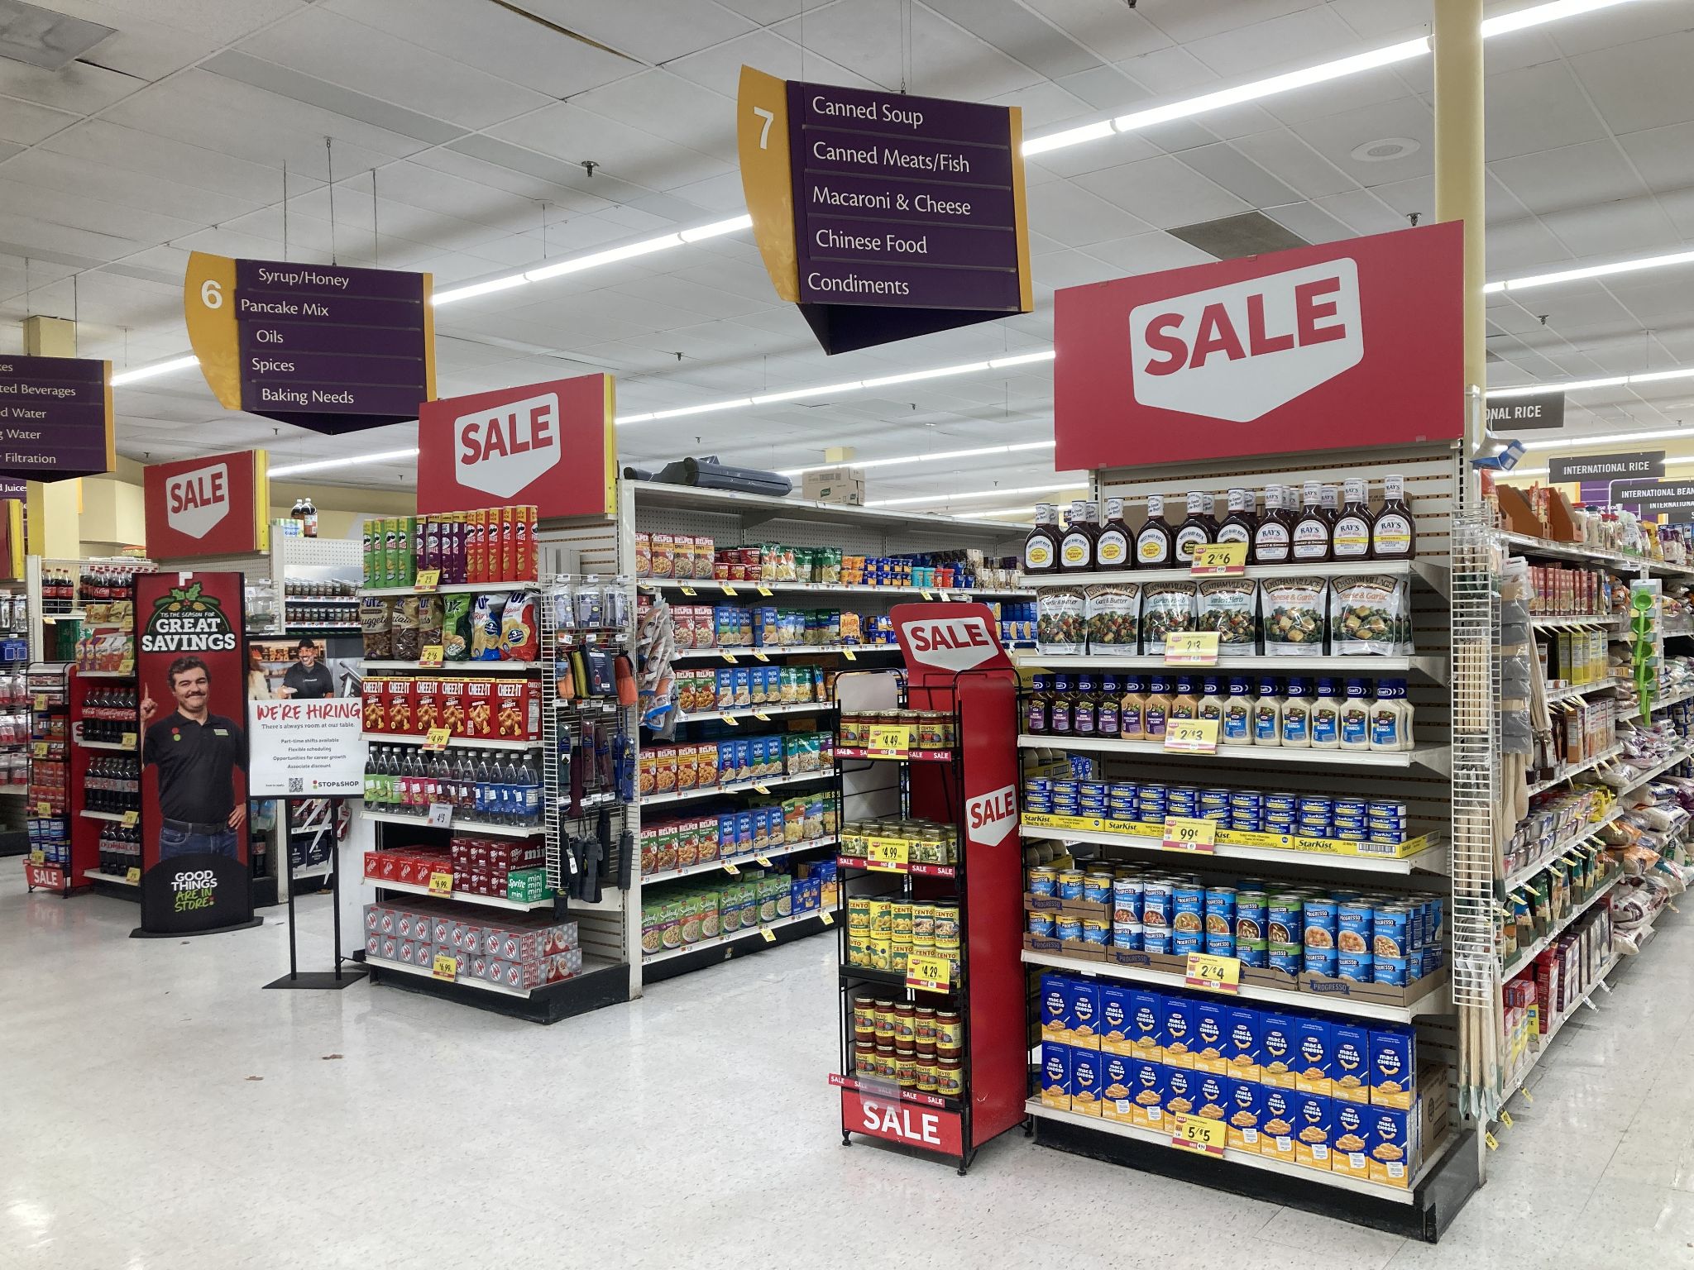
Cultural Values and Conclusion
The structure reflects the value of choice and categorization.
When the layout of a grocery store is changed, shoppers feel a sense of cognitive dissonance because their internal "map" no longer matches the environment.

Slide 6
Sources
https://en.wikipedia.org/wiki/Supermarket
https://www.greatgardensoftheworld.com/the-amazing-world-mazes/
https://www.goodrx.com/well-being/diet-nutrition/grocery-store-layout?srsltid=AfmBOopqWk46gzdtBNrf3mEh1vFBGwoRHLEJPZyWv26T6G2plVYSC3up
https://appliedpsychologydegree.usc.edu/blog/psychology-of-the-grocery-store
https://cayugadisplays.com/us/blog/the-psychology-behind-store-layouts

