Slide 1
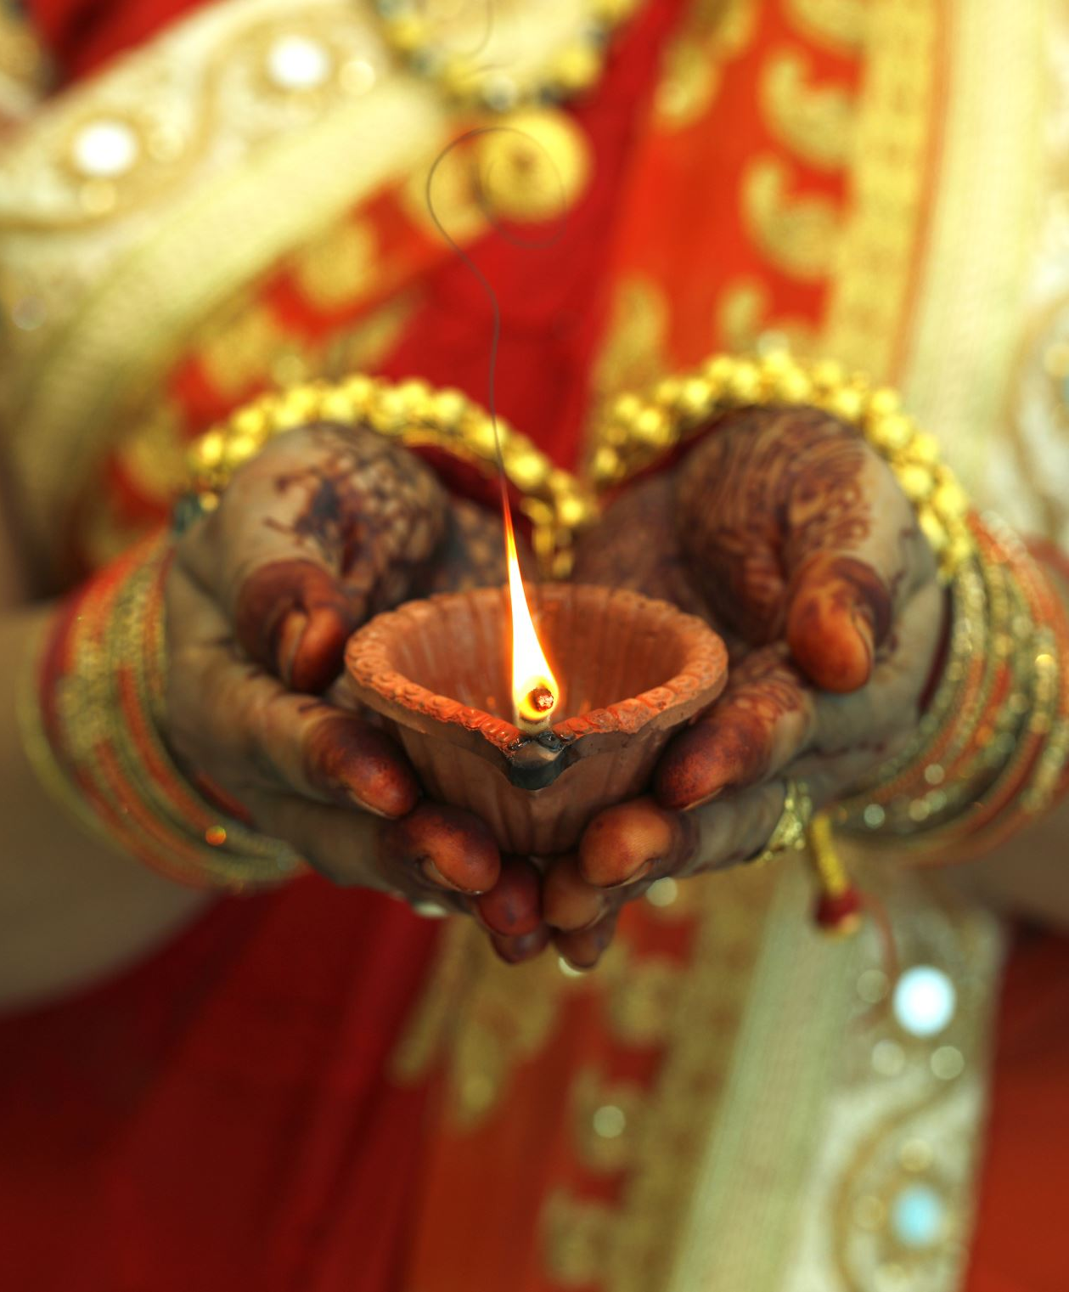
Hindu Wedding Customs
Deeya Bachani

Slide 2
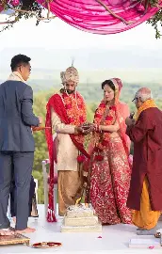
Hindu weddings as a structure
Ritual transformation of status (daughter-wife)
An exchange between kin groups (families)
A rule-governed sequence of actions
Organized around symbolism

Slide 3
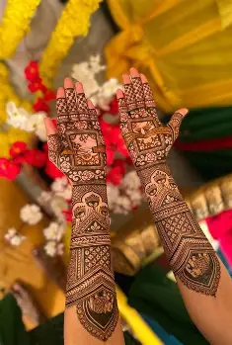
Three phases
Three phases:
  Preparation and purification: Mehndi, Haldi, Sangeet
  Sacred union: Mandap, Fire, Saptapadi
  Transfer from bride’s home to groom’s home: Vidaai, Griha Pravesh
The goal is to legitimize the marriage
Each ritual prepares for the next
Notes:
Hindu weddings follow a rule-based sequence — similar to what Wallace describes as a cultural “plan.”
Phase 1: Preparation & Purification
Rituals like Mehndi and Haldi prepare the bride and groom.
Haldi involves applying turmeric paste to cleanse and purify them before marriage.
Mehndi involves applying henna designs, symbolizing luck and marital love.
The sangeet is a pre-wedding celebration where both families come together to sing, dance, and celebrate the upcoming marriage, symbolizing the joyful uniting of the two families.
Phase 2: Sacred Union
The ceremony happens under the mandap, centered around fire.
The Saptapadi — seven steps around the fire — formalizes marriage.
Phase 3: Transfer & Incorporation
Vidaai is when the bride leaves her parents’ home.
Griha Pravesh is when she enters the groom’s home.
This structured progression shows that marriage is not sudden — it is a carefully managed transition.

Slide 4
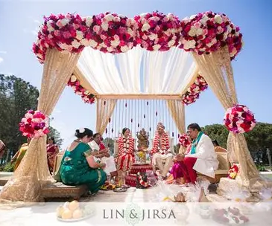
The Mandap
Ceremonial structure where the wedding occurs
Includes four pillars which can represent
  The four goals of life
  The four stages of life
  The support of parents
The center is fire
  Fire acts as a divine witness
Couple circles fire, symbolizing eternity and cosmic order
Notes:
Marriage is a sacrament, not just a legal contract. The mandap becomes the symbolic center of the ritual system

Slide 5
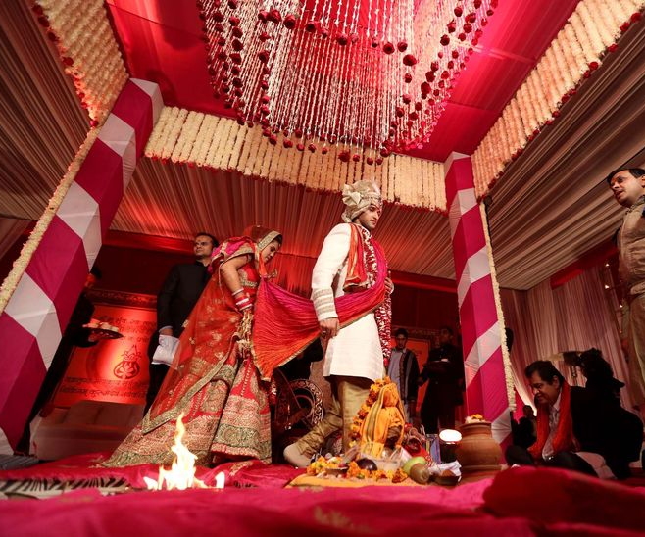
Saptapadi (seven steps)
The couple takes seven steps or circles around the fire
Each step represents a vow: food, strength, prosperity, family, offspring, health and friendship
Marriage defined as shared responsibility
Friendship is emphasized as the foundation
After the seventh step, they are considered married

Slide 6
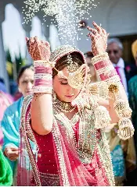
Bride’s home vs groom’s home
Vidaai – departure
  During Vidaai, the bride throws rice behind her as she leaves her parents
  This represents gratitude and repayment to her family
Griha Pravesh – arrival
  During Griha Pravesh, she enters the groom’s home and kicks over a pot of rice
  This symbolizes prosperity entering the new household
Giving daughter/receiving wife

Slide 7
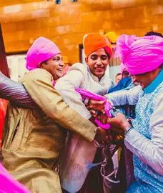
Role structure
Each participant has a defined role
  Bride is transitioning between families and moving between these two social identities
  The groom receives her into his lineage
  The father performs Kanyadaan where he places her hand into the groom’s hand “giving away the bride”
  The priest chants prayers and ensures the ritual follows all rules
  The bride’s sisters steal the groom’s shoes, symbolically testing his generosity

Slide 8
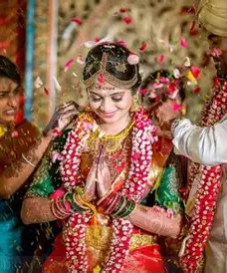
Visible Symbols
Visible symbols mark the bride’s transformation
Red attire represents fertility and prosperity
Mangalsutra is a sacred necklace placed on the bride
Sindoor, red power is placed in the hair parting, signaling marital status
Markers publicly announce her new identity

Slide 9
References
Mackey, Jaimie, and Sharbari Bose. “14 Hindu Wedding Ceremony Traditions.” Brides, 18 Nov. 2025, www.brides.com/hindu-wedding-ceremony-rituals-traditions-4795869.
Thevivaan. “Hindu Wedding Rituals Step by Step Guide in 2025.” Vivaan Hotel Karnal, 10 Feb. 2025, thevivaan.com/blog/hindu-wedding-rituals-step-by-step-guide/.
Johnson, Chapelle. “Don’t Start Planning Your Hindu Wedding without Knowing These 37 Traditions.” Theknot.Com, 27 Mar. 2024, www.theknot.com/content/hindu-wedding-traditions.

