Slide 1
Burakumin: Japan’s Hidden Outcaste System
Roy Park

Slide 2
What is Burakumin Discrimination?
A historically marginalized group in Japan
Not ethnically different, discrimination is socially constructed
Originates from feudal caste hierarchy
Associated with “impure” occupations (death-related work)

Slide 3
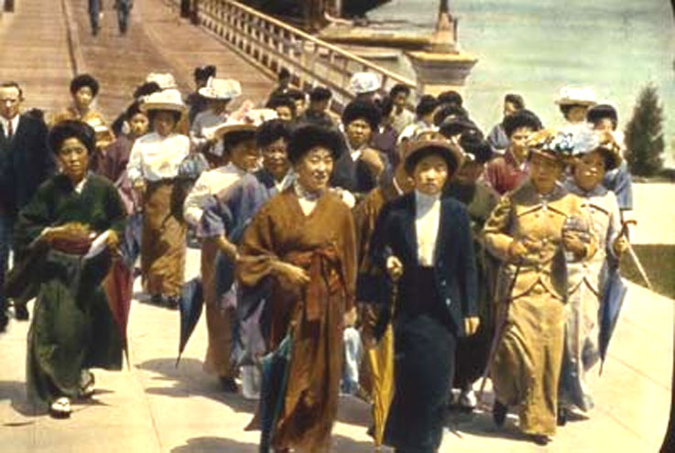
Economic and Social Basis
Economic Foundations:
- Confined to stigmatized jobs (butchery, leatherwork, execution)
- Limited upward mobility → generational poverty
- Employment discrimination persists even today
Social Foundations:
- Rooted in Japan’s feudal class system (Edo period)
- Labeled as “unclean” due to beliefs tied to death
- Residential segregation into Buraku (separate communities)

Slide 4
Justifications
Religious/Cultural Justifications:
Social Justifications:
Modern Justifications (Implicit):
- Influenced by Buddhism and Shinto ideas of purity vs. pollution
- Death seen as spiritually contaminating
- Belief that status is inherited and fixed
- Maintaining “social harmony” by keeping hierarchy intact
- Denial that discrimination exists
- Framing it as a “historical issue” rather than ongoing

Slide 5
Resistance and Fight Back
Organized Activism:
Legal and Political Action
Social Resistance:
Modern Activism:
Buraku Liberation League
Campaigns for legal protection and social awareness
Anti-discrimination laws and government programs
Efforts to improve housing and education
Public education campaigns
Challenging hiring discrimination
Fighting online doxxing of Buraku communities
Advocacy against digital discrimination databases

Slide 6
Change Over Time
Meiji Restoration
Legal equality exists
Discrimination persists in:
Marriage (family background checks)
Employment
Online harassment
Formal abolition of caste status
BUT discrimination continues socially
Pre-1800s
20th Century
Late 1800s
Today
Feudal Era
Strict caste system (Burakumin as outcasts)
Legal and social exclusion
Urbanization reduces visibility but not stigma
Activist movements gain traction

Slide 7
Why This Case Matters
Shows oppression without racial or visible differences
Demonstrates how social stigma can outlive legal systems
Highlights the power of cultural beliefs in sustaining inequality

Slide 8
Key Takeaway
Oppression doesn’t need visible difference, social labels alone can create generations of inequality.

