Slide 1

Mass Incarceration,
the “War on Drugs”,
& systematic oppression

Slide 2
Psychological framework behind punishment
Moral outrage: anger that comes from a moral standard being violated
Often self-serving, rooted in biases, and even irrational
Other emotions to note: fear, hate, & contempt
Derivative and retributive justice → Humans will incur personal costs just to punish wrongdoers
Key idea of deterrence is to “teach people a lesson”
Key idea of retribution is for the criminals to “suffer”
Notes:
Even if the action does not directly affect you, it still leads to this type of anger – an “us vs them” mindset, it is who we are.. But it does not have to be if we learn how to avoid this
A need to “restore balance”

Slide 3
Louisiana State Penitentiary & the “Angola 3”
Humans should not be in isolation more than 15 days (international rules set by the UN based on scientific studies)
Each served for > 40 years each in solitary confinement (Longest period in US prison history )
Albert Woodfox and Herman Wallace were convicted of killing a prisons correctional officer
They had set up a Black Panther party branch in Angola prison (3 years prior to conviction)
Forensic evidence on the scene did not implicate Woodfox or Wallace
They both had ample alibis
Evidence against them was from an inmate that was paid off
All white jury convicted them in less than an hour
Angola used to be a cotton plantation before a prison. Prisoners were segregated. They picked cotton for two cents an hour.
Notes:
(international rules set by the UN based on scientific studies)
Psychological damage that can be irreversible or even fatal (panic, depression, hallucinations, self harm, etc)
From the Guardian: “There was ample forensic evidence at the scene of the murder, including a bloody fingerprint, yet none of it implicated Woodfox and Wallace. Both men, who were serving separate sentences for robbery at the time, had alibis. It emerged after the trial that the main state witness against them, a fellow prisoner, had been paid for his testimony in cigarettes and promises of a reduced sentence.
Despite all that, and many other discrepancies, all-white juries took less than an hour to convict both men in separate trials.
Three years before they were framed for Miller’s death, Woodfox and Wallace set up an Angola prison branch of the Black Panther party.
They saw it as a way to fight for racial justice in an environment in which none existed. Angola was built on the site of an old cotton plantation where slaves were bred and put to work in the fields. The location was named after the African country that supplied most of the slaves.
In 1971, when Woodfox formed the Panther chapter, the prison continued to operate a system of slave labour in all but name. Black prisoners, segregated from white inmates, were sent out into the baking sun to pick cotton for two cents an hour.”

Slide 4
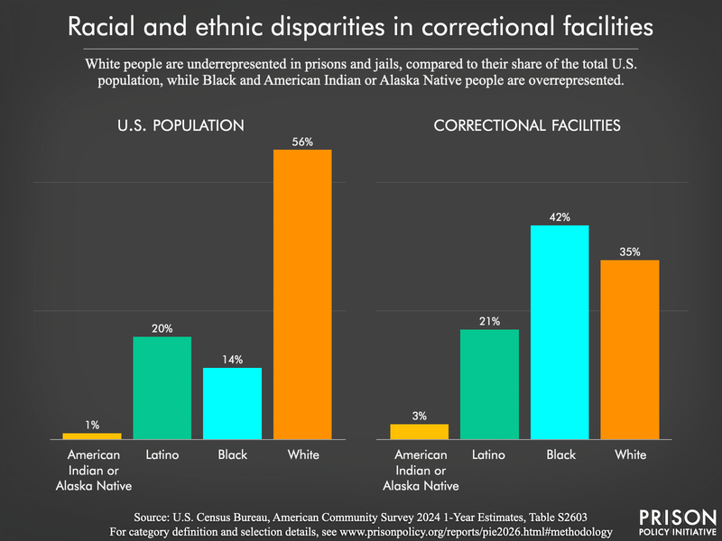
Social Bias
“As of 2023, the most recent data, Black youth were 5.6 times as likely to be placed (i.e., detained or committed) in juvenile facilities as their white peers. The disparity is now at an all-time high, based on data that starts in 1997”*
“In 2019, Black Americans represented 14% of the total U.S. population, 33% of the total prison population, and 46% of the prison population who had already served at least 10 years”*
*data from the prison sentencing project

Slide 5
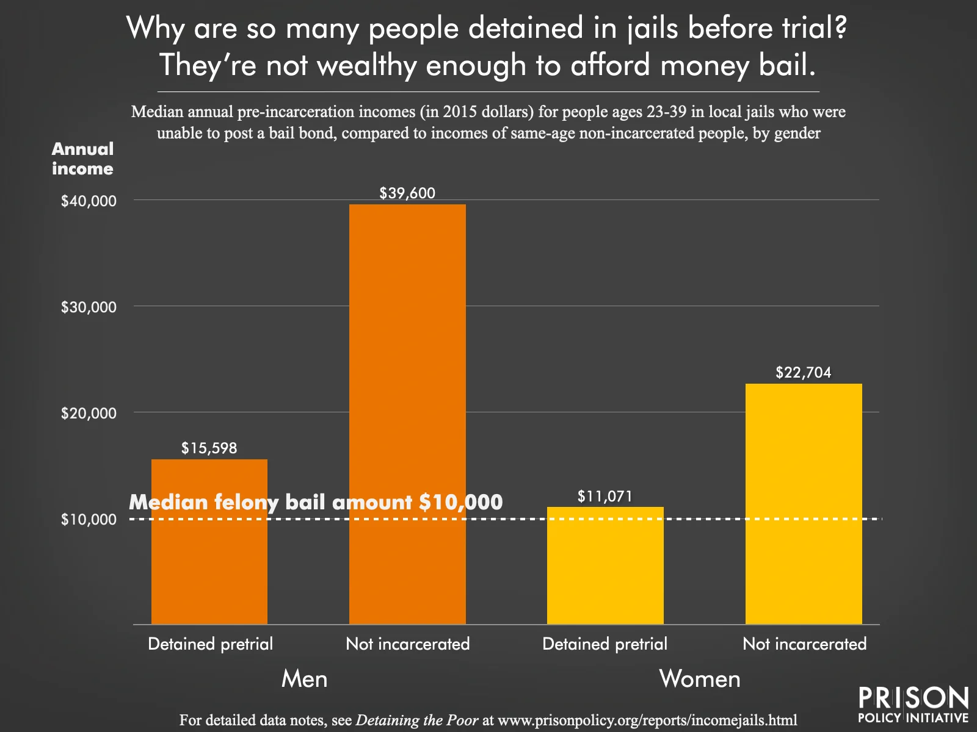
Pretrial detention can lead to a 32.2 percent increase in the likelihood of future felony charges
Notes:
People are “punished” for poverty, leads to the cycle of poverty because when people are detained even if they are innocent and eventually not convicted they are losing money

Slide 6
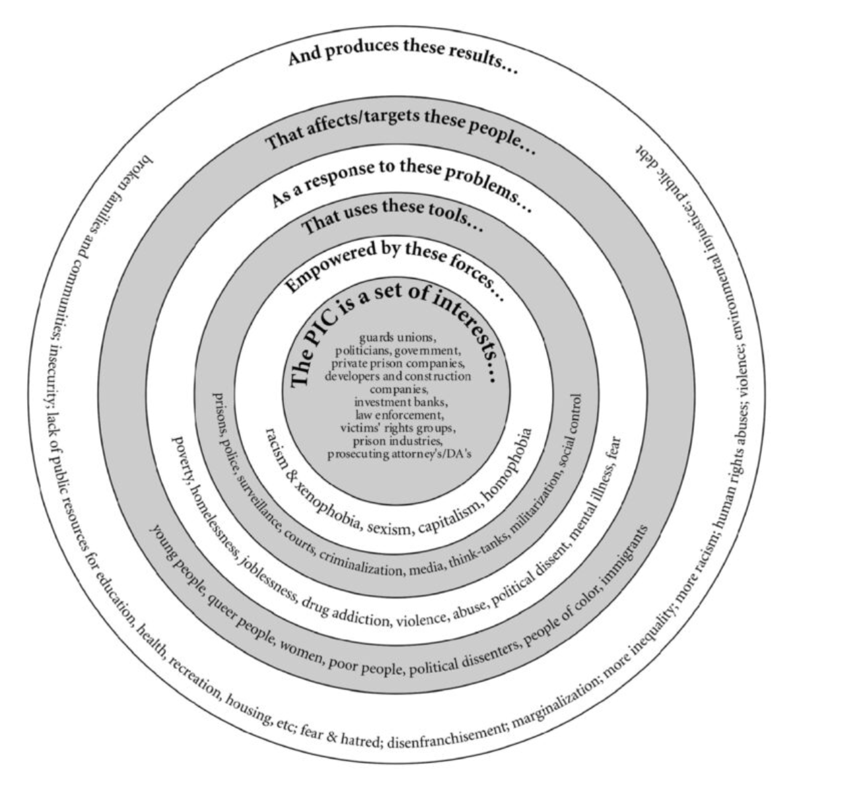
Thirteenth Amendment & the Prison Industrial Complex
Section 1. Neither slavery nor involuntary servitude, except as a punishment for crime whereof the party shall have been duly convicted, shall exist within the United States, or any place subject to their jurisdiction.
Notes:
“ prison industrial complex (PIC) is a term we use to describe the overlapping interests of government and industry that use surveillance, policing, and imprisonment as solutions to economic, social and political problems.
Through its reach and impact, the PIC helps and maintains the authority of people who get their power through racial, economic and other privileges. There are many ways this power is collected and maintained through the PIC, including creating mass media imagesthat keep alive stereotypes of people of color, poor people, queer people, immigrants, youth, and other oppressed communities as criminal, delinquent, or deviant. This power is also maintained by earning huge profits for private companies that deal with prisons and police forces; helping earn political gains for “tough on crime” politicians; increasing the influence of prison guard and police unions; and eliminating social and political dissent by oppressed communities that make demands for self-determination and reorganization of power in the US.”

Slide 7
Eugenics Movement
“Habitual offender” laws spread across the US in the early 1900s
  Eugenicists promoted the laws because they thought criminality was a heritable trait
  These laws would keep people in prison for long sentences so that they could not reproduce
Set the groundwork for the Federal three-strikes law:
The federal three strikes provision calls for a mandatory term of life imprisonment for defendants convicted of a serious violent felony who have two or more federal or state serious violent felony convictions or one or more of such felony conviction plus one or more federal or state serious drug conviction.

Slide 8
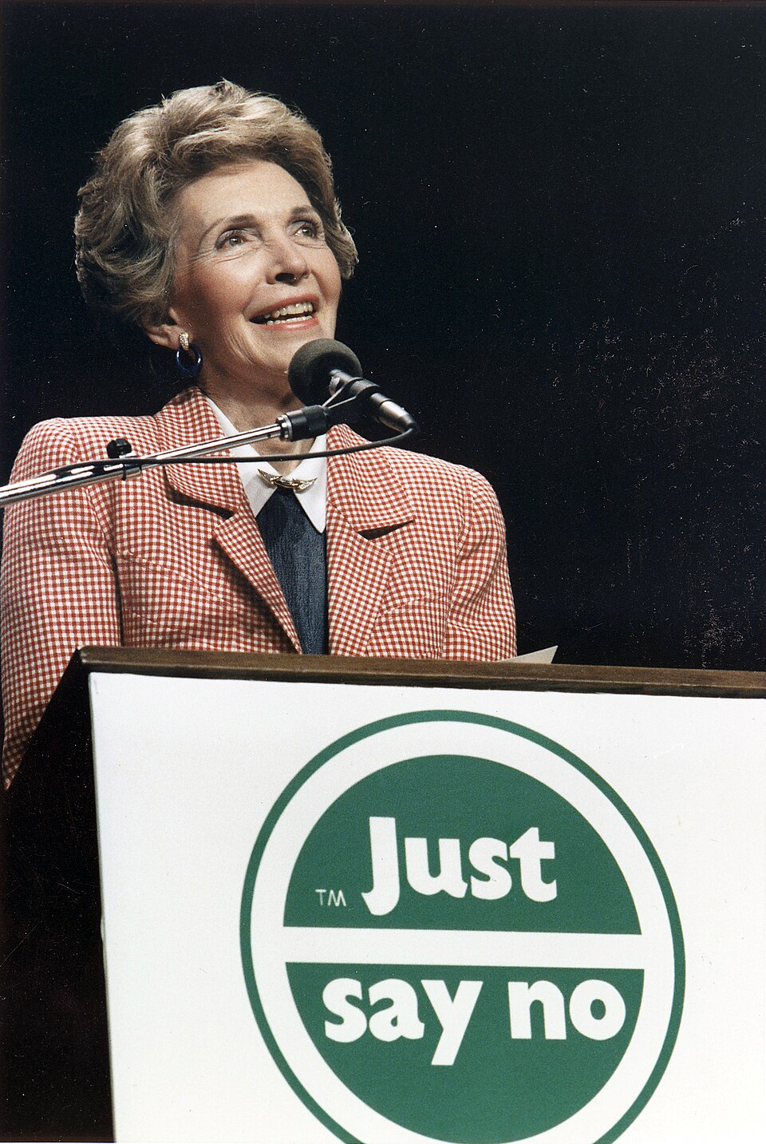
“War on Drugs”
1971- President Nixon declared drugs abuse in the US to be “Public Enemy #1” starting the an all out global offensive
1973- The US Department of Justice Drug Enforcement Administration is created
1984 - “Just Say No” campaign started by Nancy Reagan
1986- Anti-Drug Abuse Act passed establishing mandatory minimum sentences for certain drug offenses

Slide 9
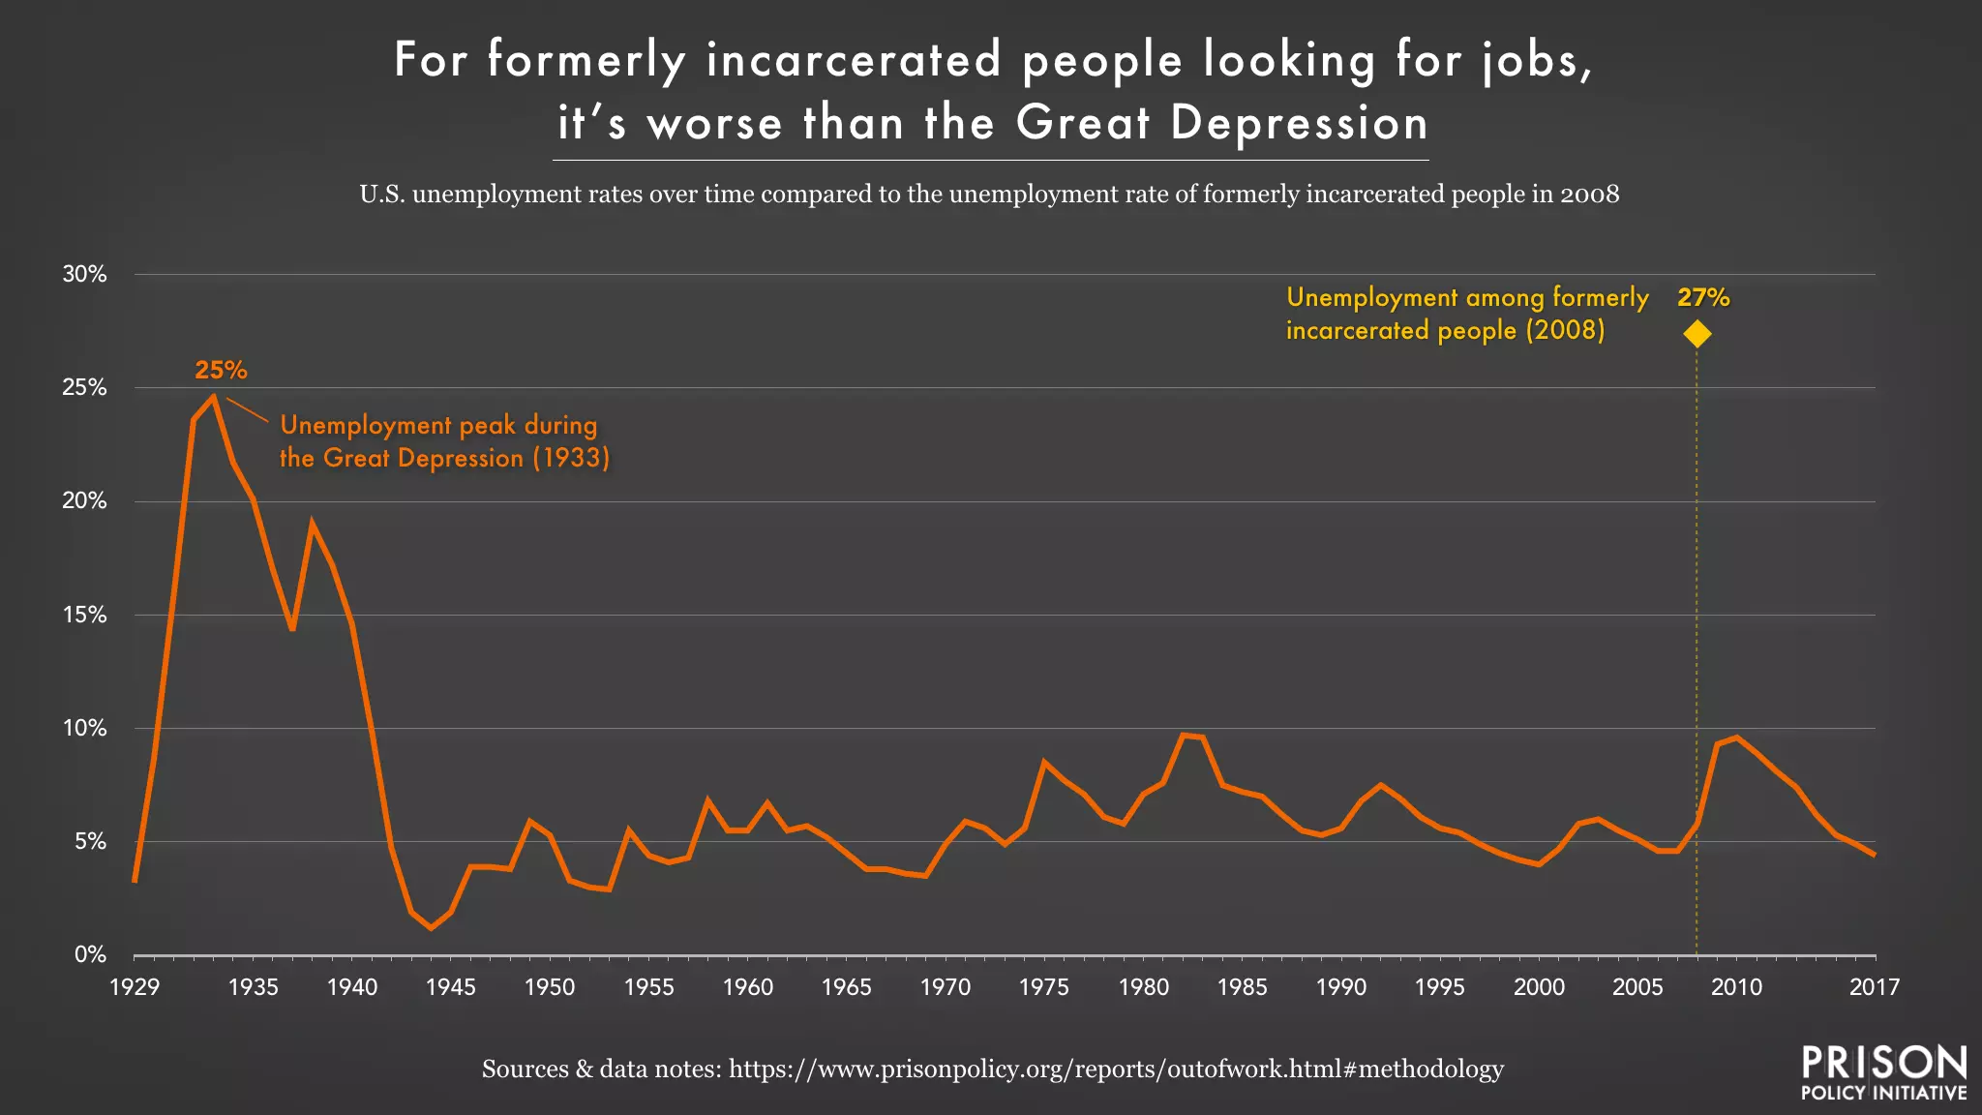
How does this lead to systematic oppression?
Loss of the right to vote
Poorer health and mortality
Decreased overall wellbeing
Financial burden
Lack of employment
Reduction in educational opportunities
Reduction in access to welfare benefits or subsidized housing
Homelessness
Food insecurity
Surveillance
Notes:
Ironically Medical care is mandated for prisoners (they have a right to healthcare like many of us do not really have)

Slide 10


On a personal note…
Financial
  Sending things to commissary
Emotional
  Sad
  Distressing
  Frustrating
Correspondence
Children affected
Ripple effects for extended family
Notes:
My mom’s cousin
In jail for 7 years, in 2010
scabies
-wrote to my mother on scraps of paper
- you were an inspiration to me keep fighting
-punishment did not fit the crime
Everyone in my family has a different relationship to it, a lot of people are really hurt by it
“She was really smart but also really dumb”

Slide 11
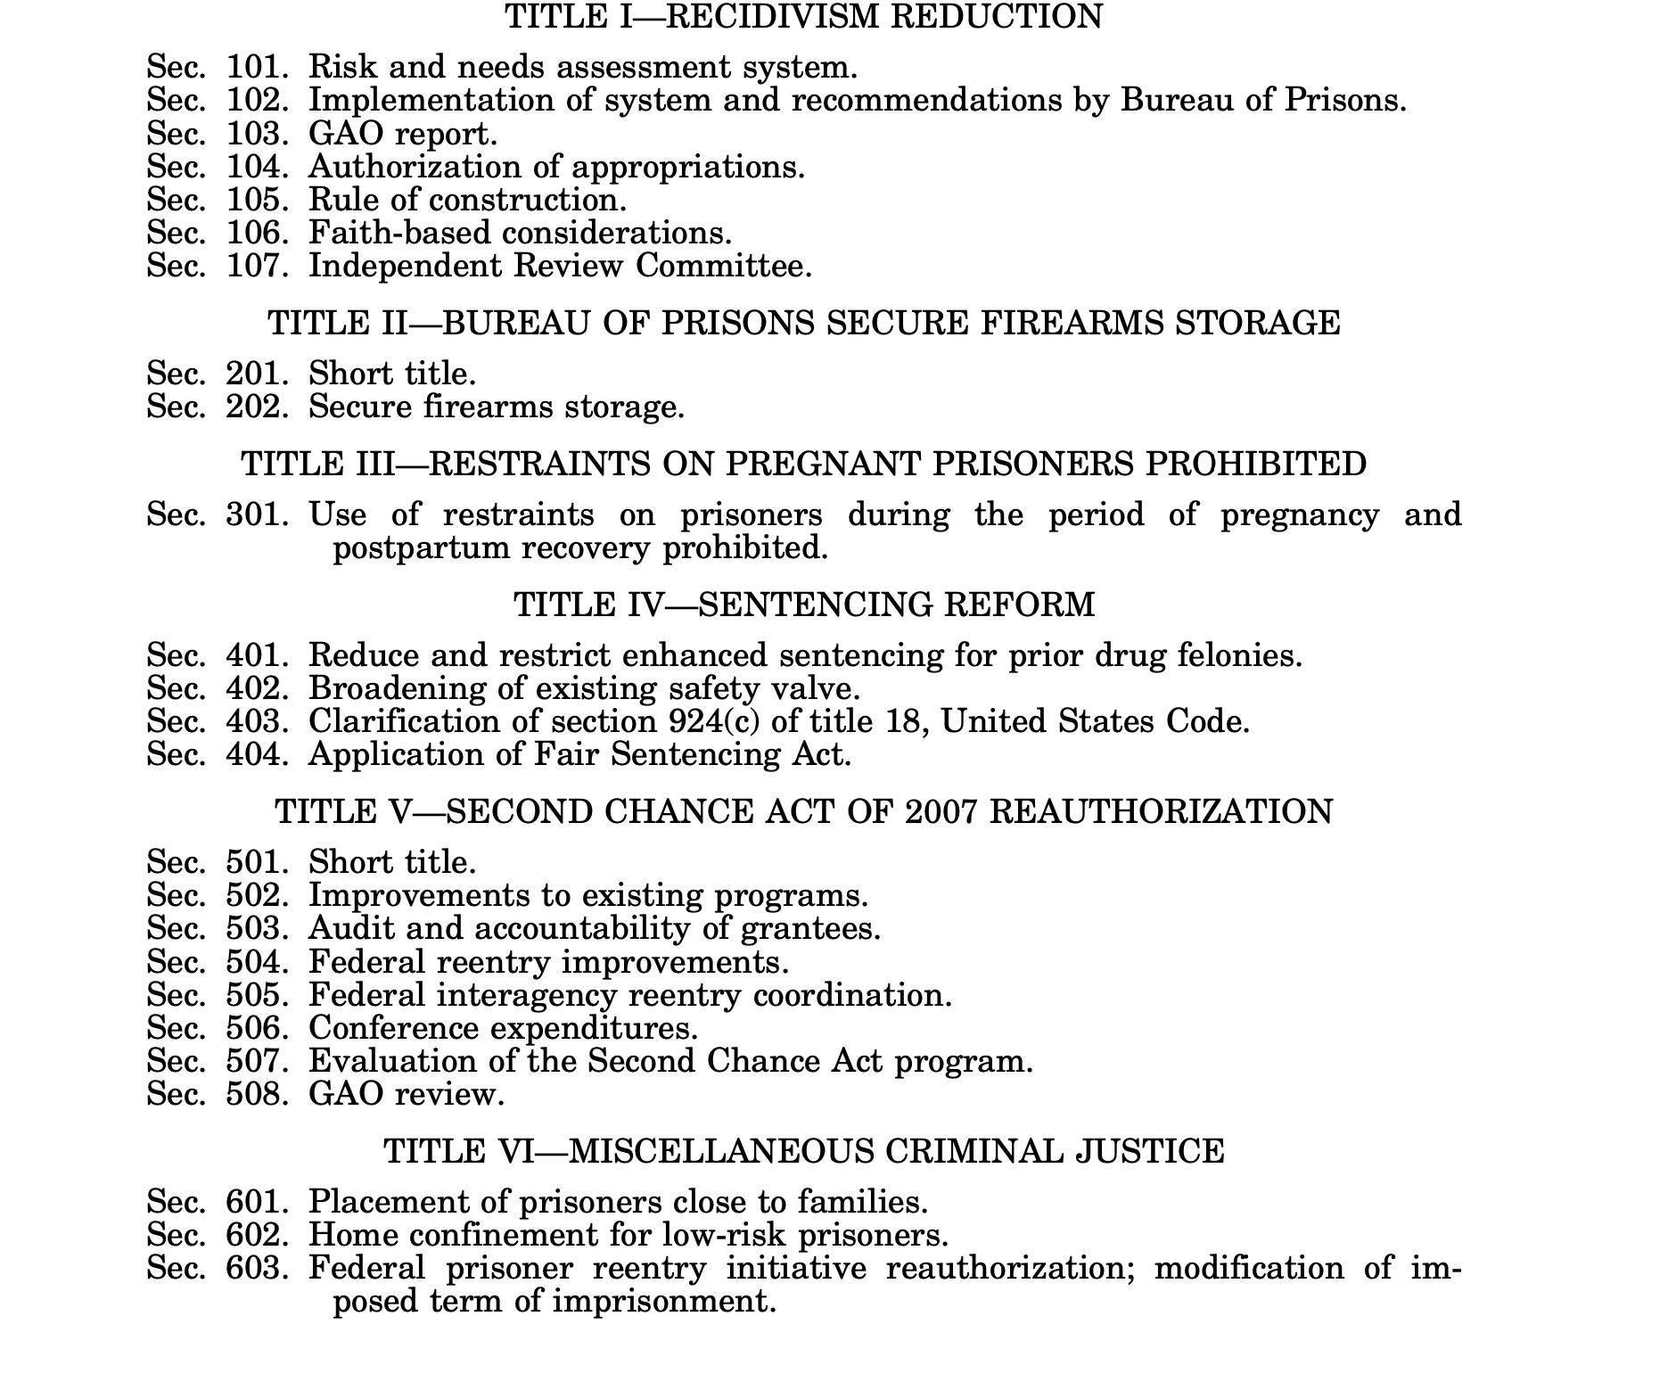
Abolition Movement
Abolitionist goal: to create lasting alternatives to punishment and imprisonment
Fair Sentencing Act(2010): created an 18:1 crack to powder ratio. Eliminated mandatory minimum sentencing for possession of crack cocaine while increasing statutory fines.
First Step Act (2018): main aim was prison reform. It moves towards reducing sentences, improving prison conditions, and focuses on rehabilitation program.
Notes:
5 grams of crack cocaine triggered the same mandatory sentence as
500 grams of powder cocaine
It took 28 grams of crack to trigger the same sentence as
500 grams of powder cocaine

Slide 12
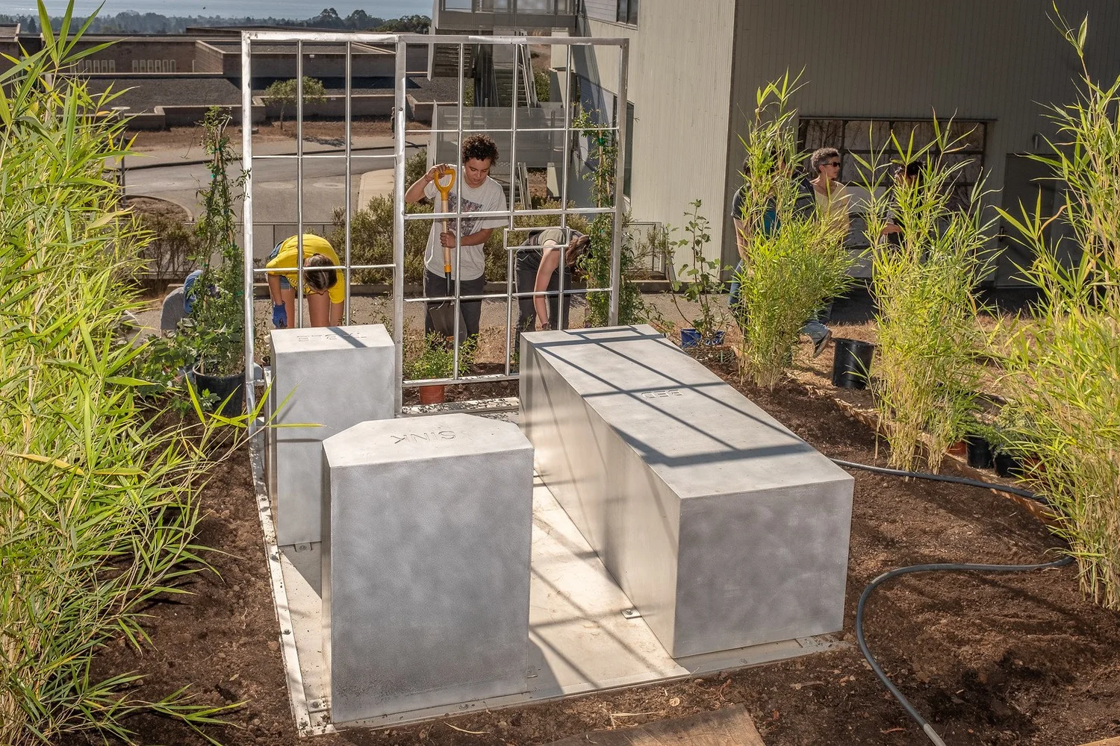
“Visualizing Abolition” a Solitary Garden with Jackie Sumell
6’ x 9’ ft cell
Social sculpture
Collaborative project between prisoners and gardeners
“As the garden beds mature, the prison architecture is overpowered by plant life, proving that nature—like hope, love, and imagination—will ultimately triumph over the harm humans impose on ourselves and on the planet”- solitarygardens.org
Notes:
From solitarygardens.org: The Solitary Gardens, are constructed from the byproducts of sugarcane, cotton, tobacco and indigo- the largest chattel slave crops- which we grow on-site, exposing the illusion that slavery was abolished in the United States. The Solitary Gardens utilize the tools of prison abolition, permaculture, contemplative practices, and transformative justice to facilitate exchanges between persons subjected to solitary confinement and volunteer proxies on the “outside.” The beds are “gardened” by prisoners, known as Solitary Gardeners, through written exchanges, growing calendars and design templates. As the garden beds mature, the prison architecture is overpowered by plant life, proving that nature—like hope, love, and imagination—will ultimately triumph over the harm humans impose on ourselves and on the planet.
The Gardens are both a park in the Lower 9th Ward of New Orleans and several host garden sites across the country where volunteer individuals, groups, and nonprofits facilitate their own exchanges with those condemned to isolation in America’s prisons. The Solitary Gardens is a social sculpture and collaborative project that cultivates conversations around alternatives to incarceration by catalyzing compassion. This project directly and metaphorically asks us to imagine a landscape without prisons.

Slide 13
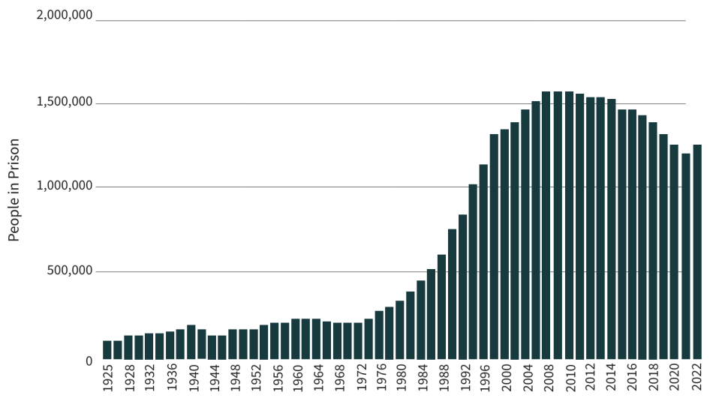
Notes:
Phase 1: Low incarceration (pre-1970s)
⬇
Phase 2: Rapid expansion (1970s–2000s)
⬇
Phase 3: Peak (2000s)
⬇
Phase 4: Slight decline but persistent inequality (today)

Slide 14
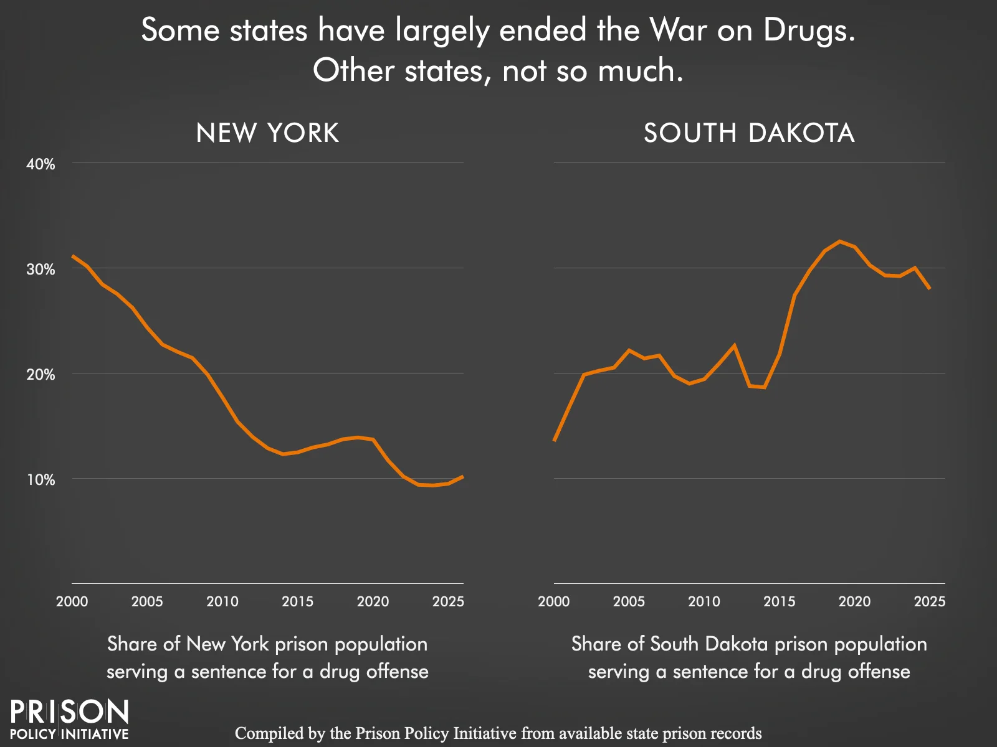

Slide 15
https://www.theguardian.com/world/2021/feb/19/albert-woodfox-interview-solitary-confinement-44-years
https://www.sentencingproject.org/reports/mass-incarceration-trends
https://pmc.ncbi.nlm.nih.gov/articles/PMC6324558
https://www.prisonpolicy.org/graphs/
https://pmc.ncbi.nlm.nih.gov/articles/PMC2518612/pdf/0980176.pdf
https://www.motherjones.com/media/2013/07/herman-wallace-house-angola-jackie-sumell/
https://solitarygardens.org/ucsc
https://www.humanrightsresearch.org/post/mass-incarceration-in-the-united-states-a-historical-context
https://pmc.ncbi.nlm.nih.gov/articles/PMC4242077
https://www.dea.gov/dea-celebrates-50-years
https://criticalresistance.org/mission-vision/not-so-common-language/
https://www.congress.gov/115/plaws/publ391/PLAW-115publ391.pdf
https://www.congress.gov/crs-product/R41461
Jiménez-Leal, W., & Cortissoz-Mora, C. (2025). Can outrage be truly moral? Theory & Psychology, 35(1), 98-116.
https://www.researchgate.net/publication/324868743_On_the_difference_between_moral_outrage_and_empathic_anger_Anger_about_wrongful_deeds_or_harmful_consequences
https://www.sciencedirect.com/science/chapter/bookseries/abs/pii/S0065260107000044?via%3Dihub
Sources

