Slide 1
Economic Deprivation in Global Garment Chains
Estelle Spira

Slide 2
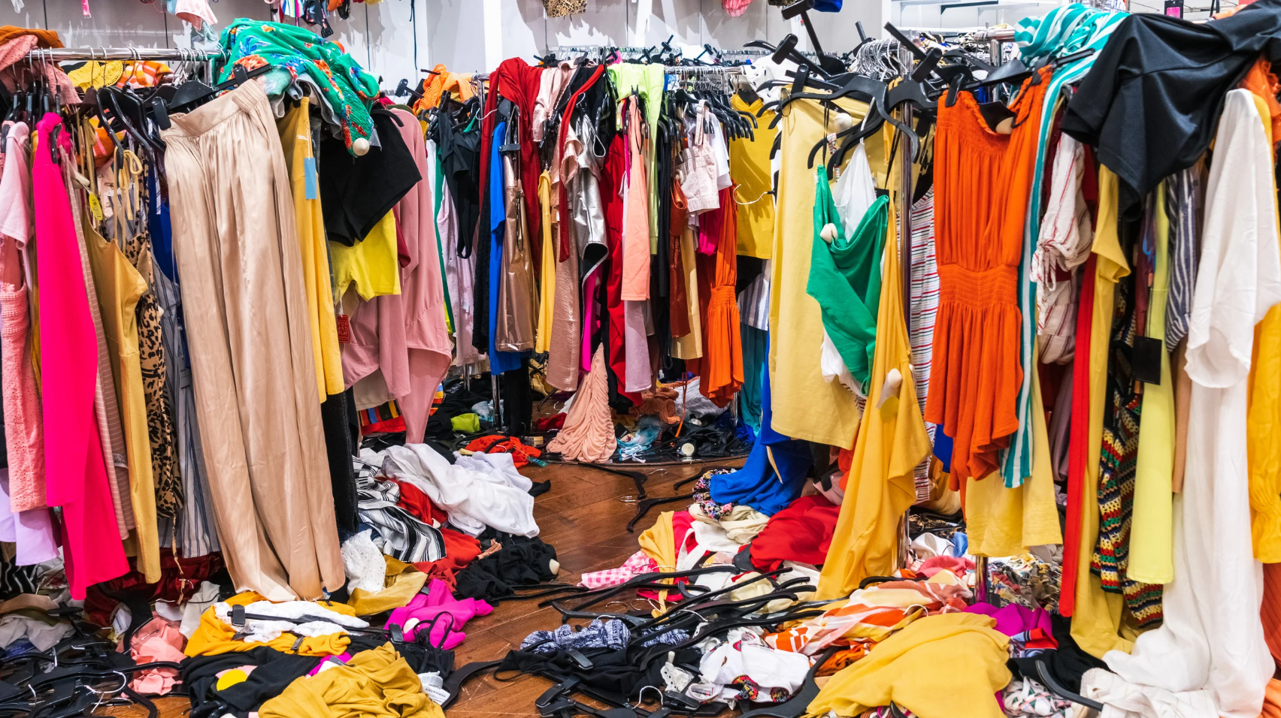
Economic and Social Basis
Global brands seek out countries with the lowest minimum wages and the weakest labor laws to maximize profit.
Roughly 80% of garment workers are women. Socially, they are often targeted because they are perceived by management as more "docile" or less likely to unionize.
Wages are often set below the living wage, meaning workers are stuck in a cycle of debt just to afford basic food and housing, despite working 12–16 hour days.

Slide 3

Ways in Which It Is Justified
Economists often justify these conditions as a necessary stage of industrialization—claiming that sweatshops are a stepping stone to a better economy.
Corporations shift the blame to the consumer, claiming that the public’s need for $5 t-shirts makes fair wages impossible.
Brands use sub-contractors to distance themselves. They justify the conditions by saying, "We don't own the factory, so we aren't responsible for the workers."

Slide 4
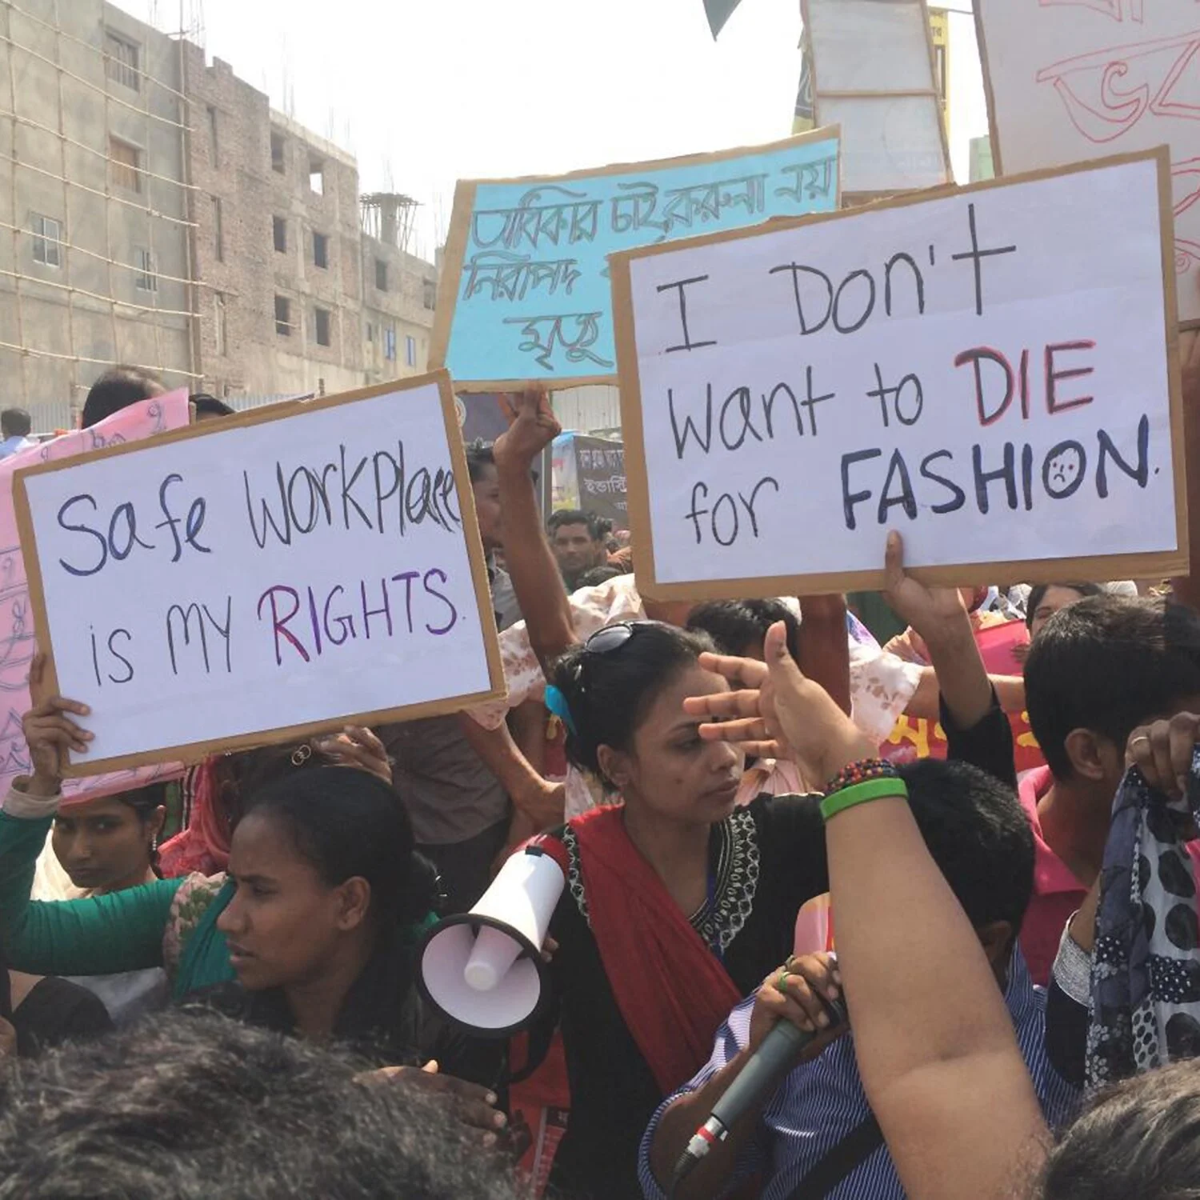
Ways The Oppressed Fight Back
Despite the threat of violence or firing, workers form underground unions to demand safer buildings.
Workers partner with international NGOs to shame major brands publicly, forcing them to sign safety accords.
Walking off the job during peak production seasons to hit the brands where it hurts most: their delivery deadlines.

Slide 5
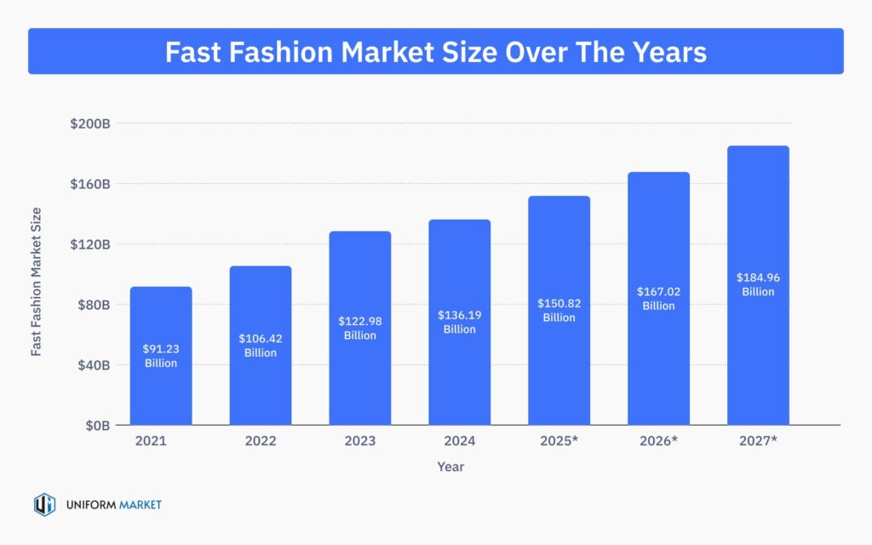
Changes Over Time
In the past, fashion had four seasons. Now, with brands like Shein or Temu, there are 52 micro-seasons, which has accelerated the pace of exploitation and environmental degradation.
Modern factories now use AI and digital sensors to track efficiency, meaning a worker's bathroom break is timed to the second—a more subtle, technical form of micro-management and oppression.

Slide 6
Sources
https://www.collectivefashionjustice.org/garment-workers
https://www.uniformmarket.com/statistics/fast-fashion-statistics
https://news.northeastern.edu/2025/04/29/tariffs-fast-fashion/
https://tsdesigns.com/the-de-minimis-loophole/

