Slide 1
India’s Caste System
Deeya Bachani

Slide 2
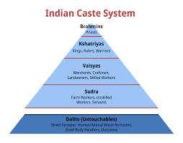
Overview of the Caste System
The caste system in India is a hierarchical social structure that assigns individuals a status at birth.
This status determines a person’s role in society and shapes their opportunities throughout life.
The system has historically organized both social relationships and economic roles.

Slide 3
Economic Basis of the Caste System
Economic roles in the caste system are tied to birth, meaning individuals are expected to work in specific occupations.
These occupations include roles such as laborers, artisans, merchants, or priests depending on caste.
This system ensures a stable division of labor but limits economic mobility for lower castes.

Slide 4
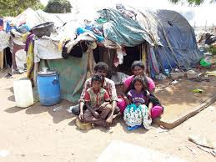
Social Structure and Inequality
The caste system enforces strict social divisions, including limits on interaction between groups.
Dalits, who are outside the main caste system, have historically faced the most severe discrimination.
Social mobility is extremely limited, as individuals are expected to remain in their caste for life.

Slide 5
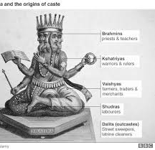
Religious Justifications
The caste system has been justified through religious interpretations of Hindu texts.
These texts describe a natural social order in which each group has a specific role.
This framing presents the system as divinely sanctioned and difficult to challenge.

Slide 6
Karma, Dharma and Social Order
Concepts like karma suggest that a person’s caste reflects actions from past lives.
Dharma emphasizes fulfilling one’s assigned role within the caste system.
Ideas of purity and pollution reinforce the hierarchy between castes.

Slide 7
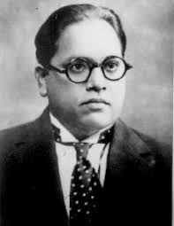
Resistance and Activism
Oppressed groups, especially Dalits, have resisted through protests and activism.
B. R. Ambedkar was a key leader who fought for equality and legal reform.
Activism has focused on gaining rights, dignity, and access to education and jobs.

Slide 8
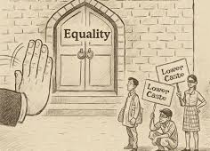
Cultural and Everyday Resistance
Resistance also occurs through cultural expression such as literature, art, and education.
These efforts challenge stereotypes and promote dignity and identity.
Everyday actions, such as pursuing education, also act as forms of resistance.

Slide 9

Legal Changes Over Time
After independence, India banned caste discrimination in its constitution.
Laws were introduced to protect lower castes and promote equality.
Reservation policies were created to improve access to education and employment.

Slide 10
The Caste System Today
The caste system has weakened in some urban and modern contexts.
However, discrimination and inequality still persist, especially in rural areas.
Today, caste continues to influence social identity, relationships, and opportunities.

