Slide 1
Oppression of Native Americans During Manifest Destiny
Arya Adusumilli

Slide 2
Economic/Social Basis
Existing perception of tribes as sovereign and sophisticated shifts to view of savagery
Societal belief in racial hierarchy, Anglo-Saxons as superior
Border tensions between white settlers and Native groups alongside economic desire for more fertile land, gold, trade routes
Native Americans as obstacles to expansion culminates in cultural belief in Manifest Destiny, religious onus for forced displacement and expansion
Indian Removal Act, noncompliance with land treaties

Slide 3
Justifications/Retaliation
Religious backing as mentioned before
By displacing Native Americans and forcing assimilation or further migration west, white settlers were “civilizing” Native tribes
Native land seen as underutilized due to variety of land uses rather than solely monoculture farming
Tecumseh’s Rebellion and pan-tribal alliance, eventual fighting alongside British in War of 1812
Judicial attempts at maintaining sovereignty, including Cherokee Nation v. Georgia, Worcester v. Georgia, leading to Trail of Tears

Slide 4
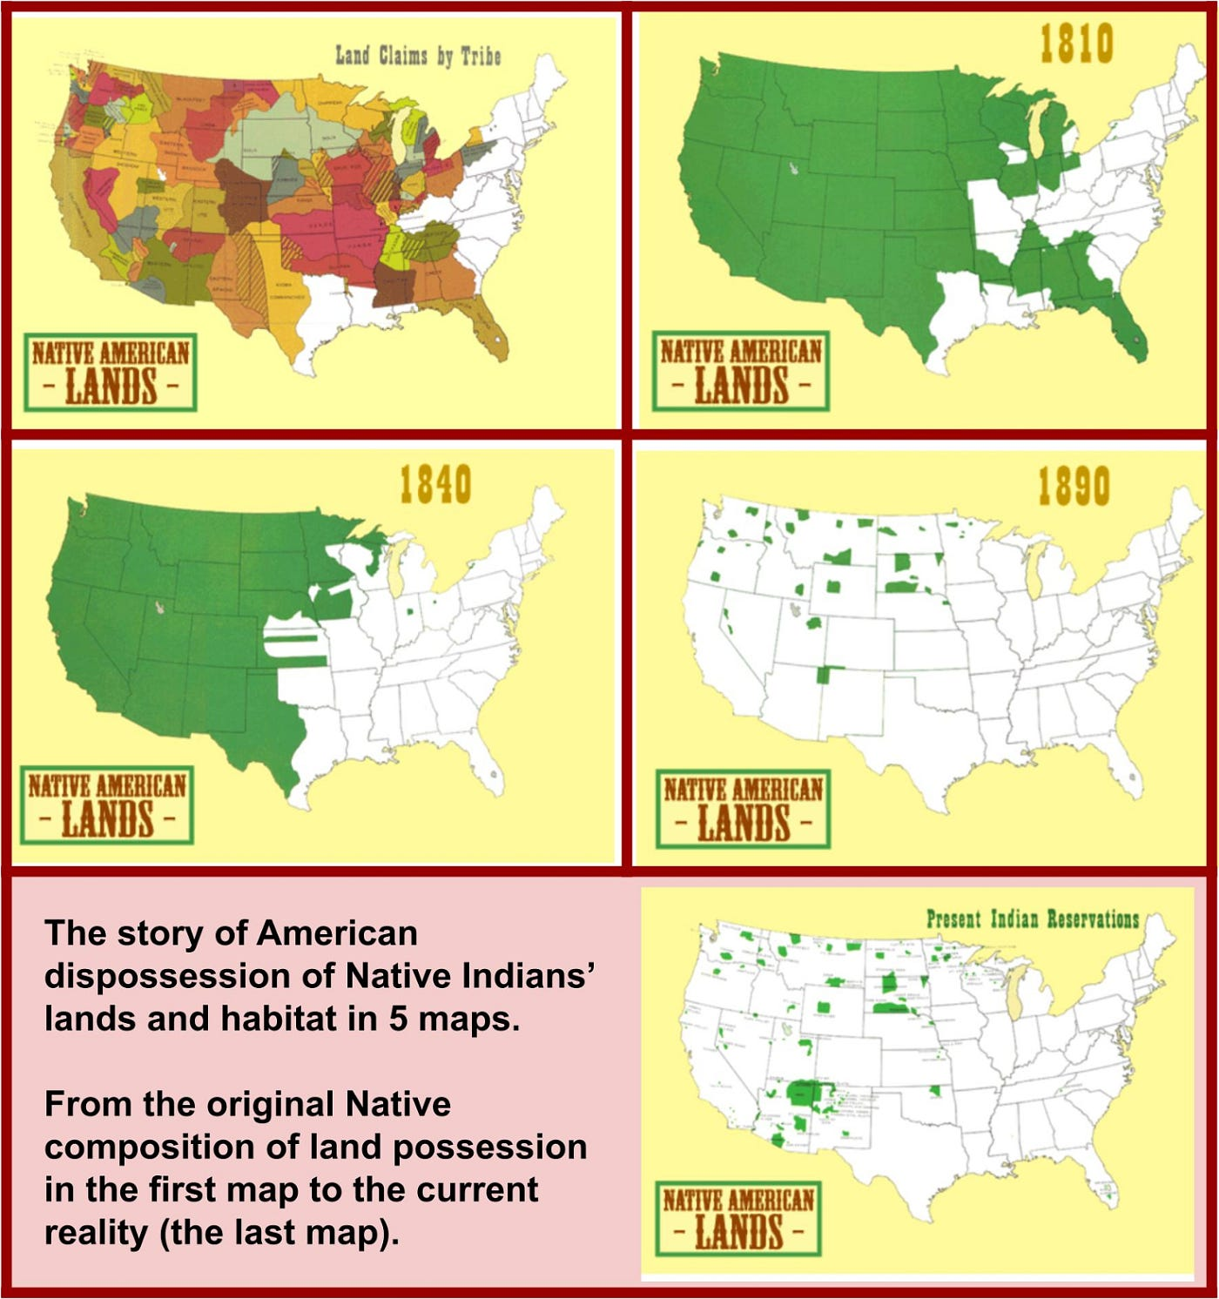
Changes Over Time
Shifted towards confinement of Native Americans in reservation system, US pushing for limited rights and citizenship
Decades of wealth inequality
Cultural marginalization, rampant stereotyping and ignorance of history today in both social and political spaces

Slide 5
References
Wikipedia contributors. (2026, March 13). Indian removal. In Wikipedia, The Free Encyclopedia. Retrieved 18:53, April 12, 2026, from https://en.wikipedia.org/w/index.php?title=Indian_removal&oldid=1343373208.
Wikipedia contributors. (2026, March 17). Tecumseh's War. In Wikipedia, The Free Encyclopedia. Retrieved 18:54, April 12, 2026, from https://en.wikipedia.org/w/index.php?title=Tecumseh%27s_War&oldid=1343934243.

