Slide 1
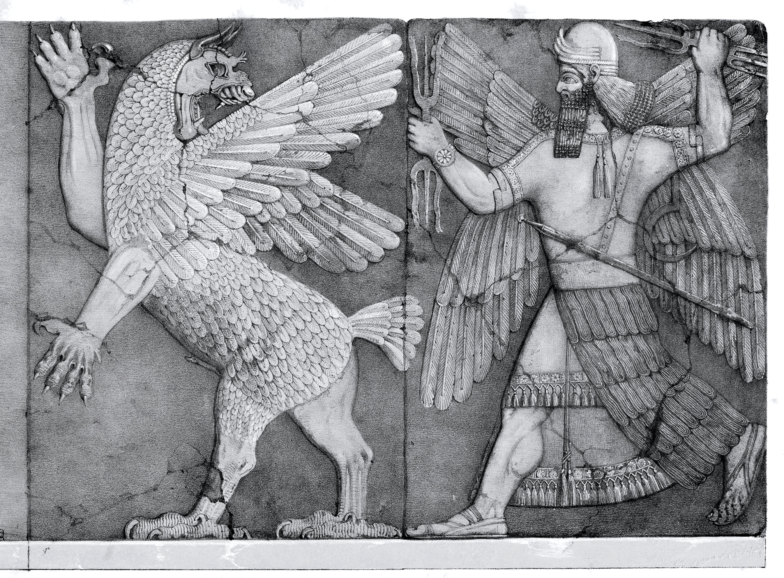
Marduk in the Enuma Elish: A Babylonian Hero/Creation Myth
Presentation by Solomon Wechter

Slide 2
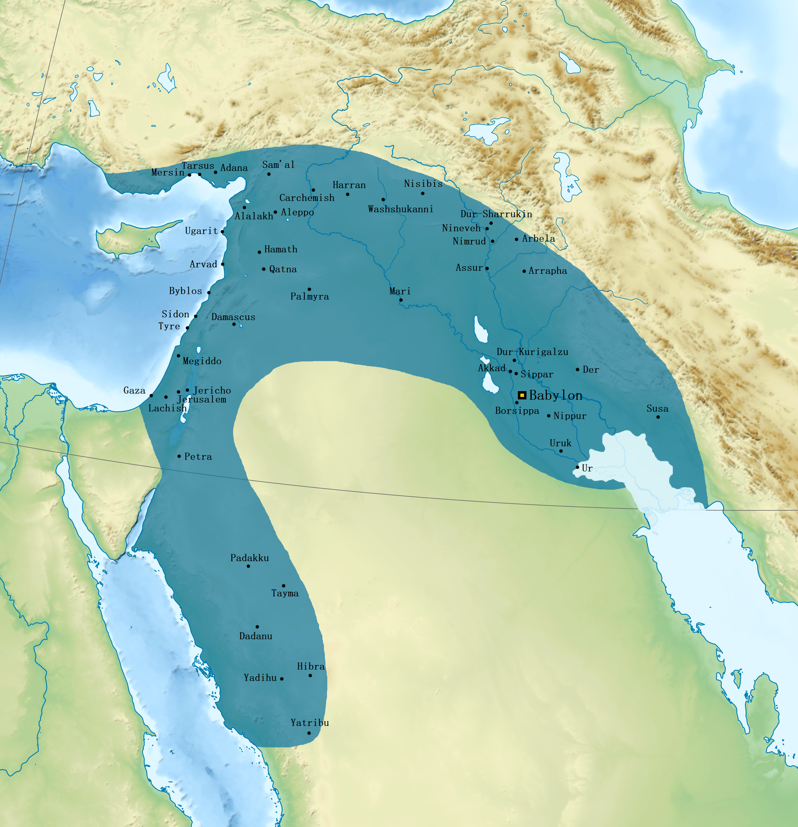
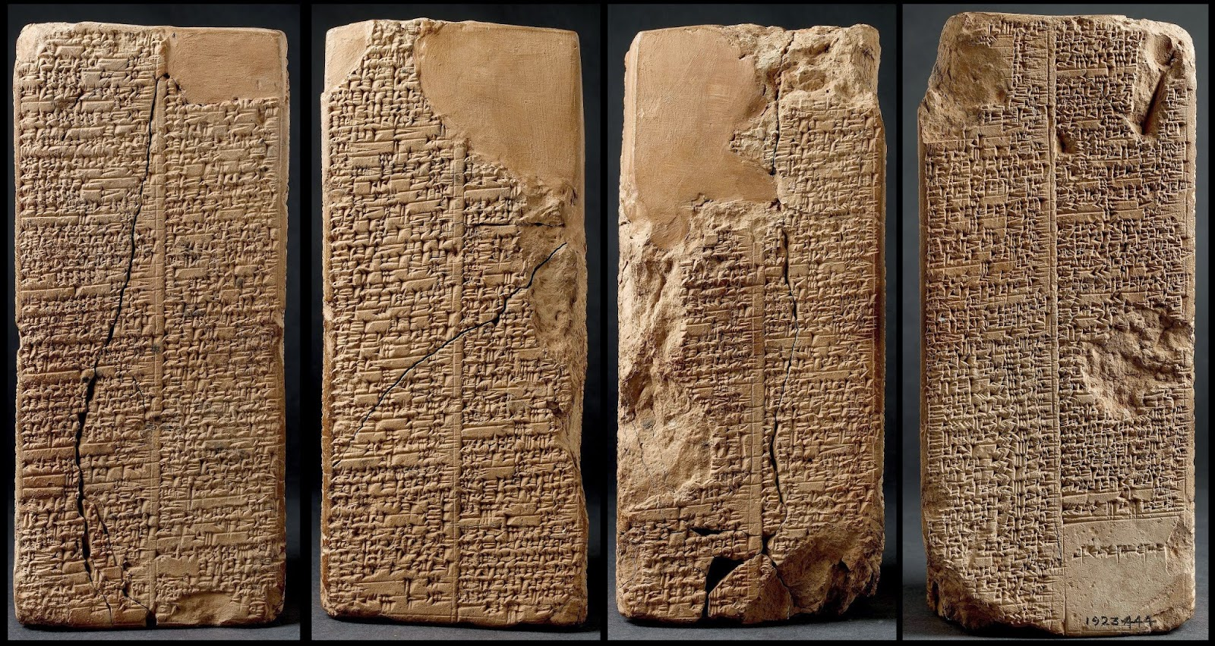
The Enuma Elish
Tells the story of the beginning of the world and the establishment of the cosmic order
From the Babylonian Empire
Often dated to be written in around the 12th century BCE
  Likely draws on even older Sumerian and Akkadian mythic material

Slide 3

Tiamat and Apsu
The beginning of all creation
Tiamat: Saltwater, female, chaos
Apsu: Freshwater, male, order
Give rise to the order of younger Gods out of their union
The younger gods disturb this perfect order and kill Apsu
Tiamat finds out and wages war on all the Gods

Slide 4
Birth of Marduk
No God can match her, until a new God named Marduk was born
  Resembles the Sun (consciousness)
Marduk said that he would go and fight her, under the condition that if he wins, he’ll be crowned the king of the Gods
Marduk is given weapons and the power of the four winds (North, East, South, West)
Together with three more winds that come to his aid, Marduk traps and kills Tiamat by shooting an arrow through her heart

Slide 5
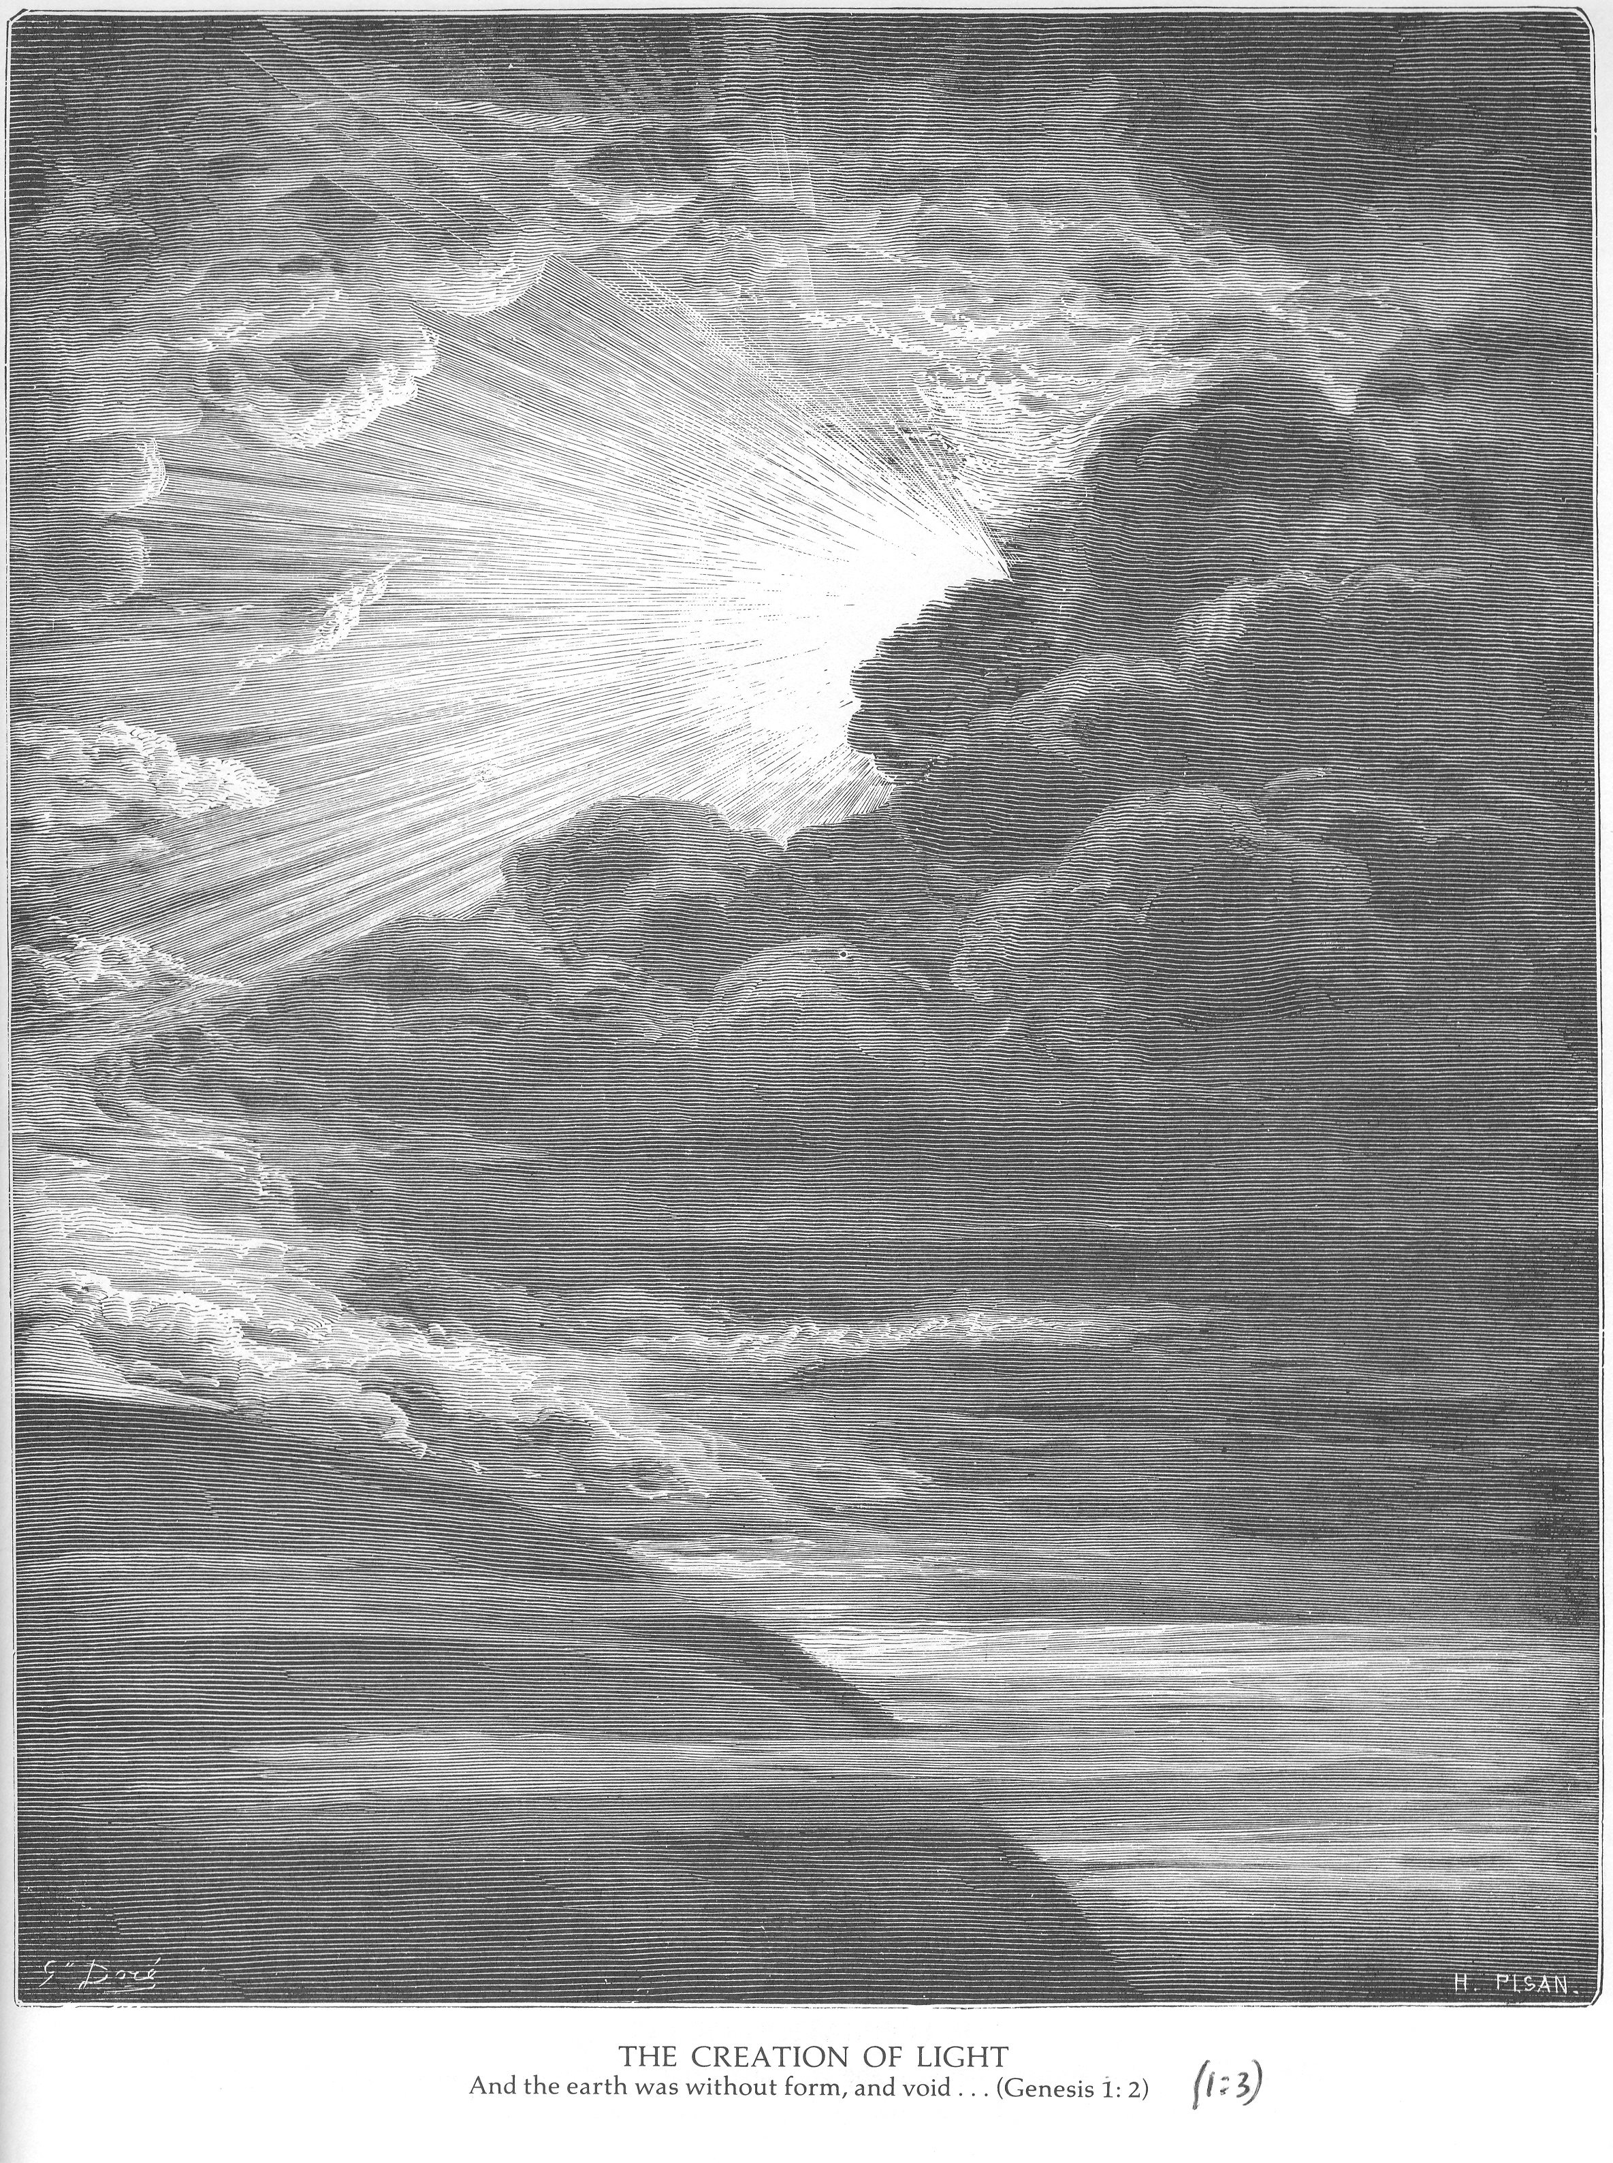
Marduk Creates the World out of Tiamat
Marduk splits up Tiamat’s remains, and makes Heaven and Earth, the gods in the constellations, and the days of the year.
He creates night and day, and the moon and the sun.
He creates clouds and rain, and their water makes the Tigris and Euphrates rivers.
“1 In the beginning God created the heaven and the earth.
² And the earth was without form, and void; and darkness was upon the face of the deep. And the Spirit of God moved upon the face of the waters.
³ And God said, Let there be light: and there was light.
⁴ And God saw the light, that it was good: and God divided the light from the darkness.
⁵ And God called the light Day, and the darkness he called Night. And the evening and the morning were the first day.” – Genesis 1; KJV

Slide 6
Daily Relevance
The many Gods as instinctual forces that rule our lives (anger, lust, power, joy, etc.)
Assimilation of many neighboring cultures into Babylonian civilization (proto modern-West)
  Competition of mythologies and Gods
  Emergence of monotheism - what principle of human nature is most important?
  New Years festival
Tiamat - the problem of life as such
  All your problems are Tiamat
Marduk is a heroic principle of human nature which solves the problem as such through confronting it
  Everything comes to his aid (the winds, the weapons from the other Gods)
Creation of the World (as in human life) out of this action
Hero Myths as a meaningful way to engage with reality
  Adventure – Luke Skywalker as Marduk/prototypical hero

Slide 7
Sources
Akitu | Mesopotamian Festival | Britannica, www.britannica.com/topic/Akitu. Accessed 26 Jan. 2026.
Chatgpt, chatgpt.com/. Accessed 26 Jan. 2026.
“Enūma Eliš.” Wikipedia, Wikimedia Foundation, 7 Nov. 2025, en.wikipedia.org/wiki/En%C5%ABma_Eli%C5%A1.
“Neo-Babylonian Empire.” Wikipedia, Wikimedia Foundation, 7 Jan. 2026, en.wikipedia.org/wiki/Neo-Babylonian_Empire.

