Slide 1
Greek Mythology
Specifically the Myth of Orpheus & Eurydice

Slide 2
Greek Mythology
A collection of stories, legends, and religious beliefs developed in ancient Greece.
  The origins of the world, the nature of the gods, human behavior, and why suffering, fate, and conflict exist.
Initially propagated in an oral-poetic tradition by Bronze Age Minoan and Mycenaean singers starting in the 18th century BC
  No singular original text, first myths were oral
Written myths were popularized with Homer’s The Iliad & The Odyssey

Slide 3
Psychological Functions of Greek Mythology
To explain naturalistic events, such as:
  Birth of the universe, why seasons occur
To teach virtues and moral wisdom:
  Bravery, love, justice, not to tempt fate
To give meaning to tragedy:
  Suffering, death, injustice, flaws
Greek Mythology is another way of understanding life.

Slide 4
Psychological Functions of Tragedy
Catharsis - the evocation of pity and fear for someone in a story.
Tragedy dives into inner turmoil, which can help people process complex emotions and ideas.
Tragedy also functions as teaching tools so we may make better decisions.

Slide 5
The Myth of Orpheus & Eurydice
Orpheus, a lyre-playing musician, fell in love with Eurydice, a beautiful and graceful woman.
Sometime after their marriage, Eurydice was bitten by snake and died.
At some point, Orpheus decided to go to the Underworld to convince Hades, the king of the Underworld, to let Eurydice return to the living.

Slide 6
The Myth of Orpheus & Eurydice (cont.)
Orpheus played Hades a song so moving that he was convinced to let Eurydice leave under two conditions:
  She must walk behind him while leaving the Underworld.
  He must not look behind him to check if she is behind him.
He eventually turns behind to look because he cannot hear her footsteps. She is sent back to the Underworld forever.
There are many variations of what happens to Orpheus.

Slide 7
Hadestown
2017 Broadway musical version of the original myth
Heavily expanded on Eurydice, Hades, Persephone, & The Fates
Differences:
  Eurydice willingly goes to an industrialized version of the Underworld, Hadestown, made to represent slavery and/or working class citizens.
  The Fates are portrayed as more villainous than Hades.
  Hermes is added as a narrator.
Hadestown serves as visual, musical representation of the myth.

Slide 8
Analysis
Hero-myth
  Orpheus faces many challenges in the Underworld
Cautionary tale
  Orpheus’s doubt causes him to lose Eurydice to the Underworld
  Trusting malicious deities, such as Hades
Love affairs / challenges
  Love and loss
  The musical version depicts Orpheus as “a poor boy with a lyre” and Eurydice as “a hungry young girl.”

Slide 9
Connections to Real Life
Grief & Loss
  Orpheus’s entire journey is motivated by grief and the refusal to accept death, which is common across cultures.
Trust vs Doubt
  Orpheus must trust Hades that Eurydice is walking behind him without solid proof.
The Fates
  The Fates are common in Greek mythology to symbolize time and destiny. Their presence as a lingering force in the musical and in other myths serves as a reminder that one’s fate is set and only time will tell.

Slide 10
Freudian Characteristics
Id - Orpheus’s desire to leave with Eurydice.
  Eurydice is his pleasure principle because she will relive his grief.
Ego - Orpheus’s journey to the Underworld and his attempt to follow Hades’s rules.
  Subject to the reality principle.
Superego - Gods and their rule.
  Hades gives Orpheus and Eurydice rules they must follow, and may be rewarded and punished.

Slide 11
Jungian Characteristics
Collective unconscious:
  Orpheus: Artist-Hero archetype
  Eurydice: Anima archetype
  The Underworld / Hades: Shadow archetype
Resolution of the story in Jungian terms:
  Creativity can express grief but not erase it
  Emotional wholeness requires an acceptance of the situation
  Failure to integrate the unconscious situation results in loss

Slide 12
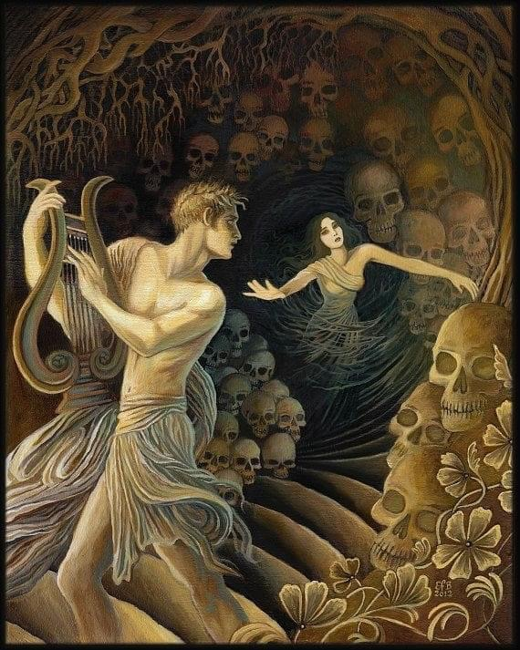
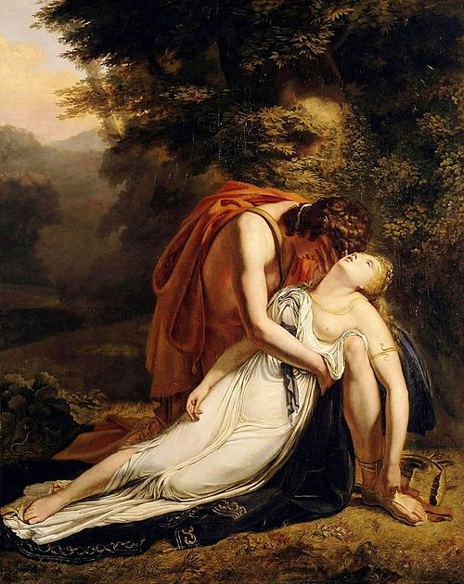
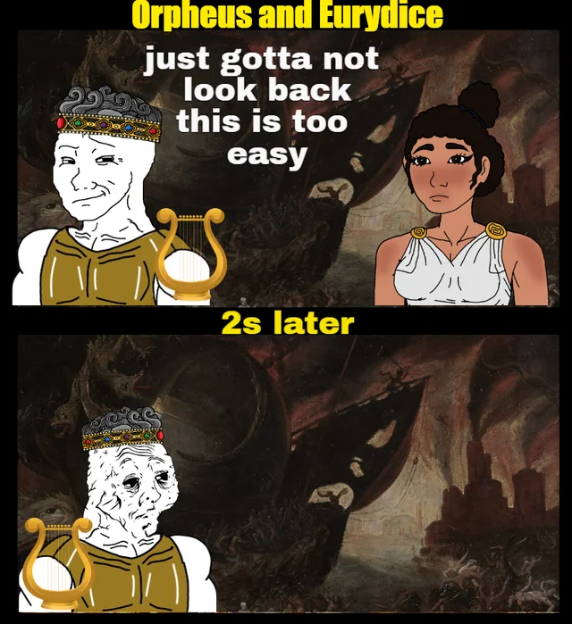
Pictures

Slide 13
References
https://en.wikipedia.org/wiki/Orpheus_and_Eurydice
https://en.wikipedia.org/wiki/Greek_mythology
Freud’s Psychoanalytic Theory from Gardner Lindzey and Calvin Hall (Eds.) (1965) Theories of Personality: Primary sources and research. Oxford: Wiley (from Canvas)
Jung’s Analytic theory: Chapter Three (from Canvas)
https://www.dpacnc.com/community/performing-arts-ambassadors/performing-arts-ambassadors-blog-2021-2023/broadway/the-mythology-that-inspired-hadestown
https://www.history.com/articles/greek-mythology

