Slide 1
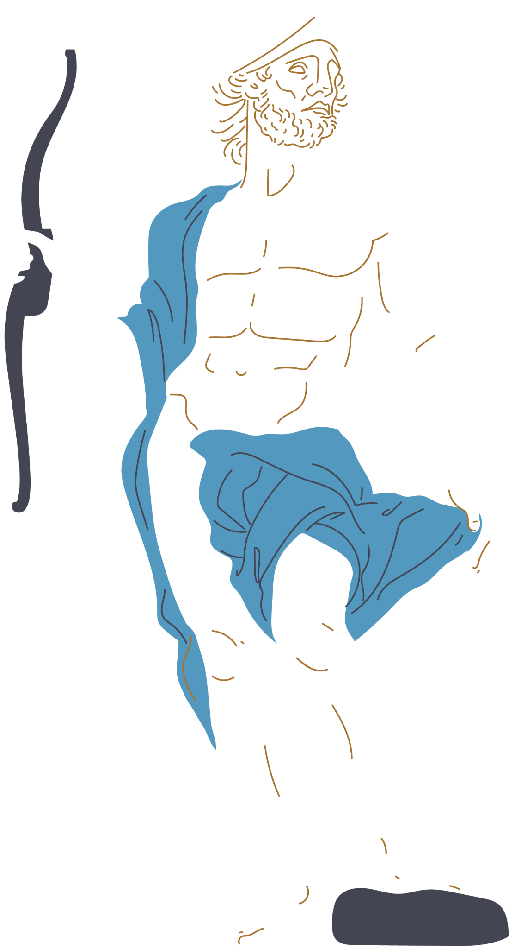
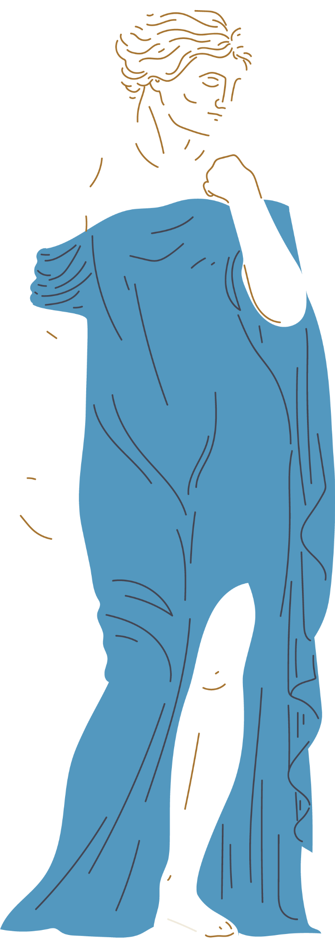
King Midas
and the
Golden Touch
A Greek Myth

Slide 2
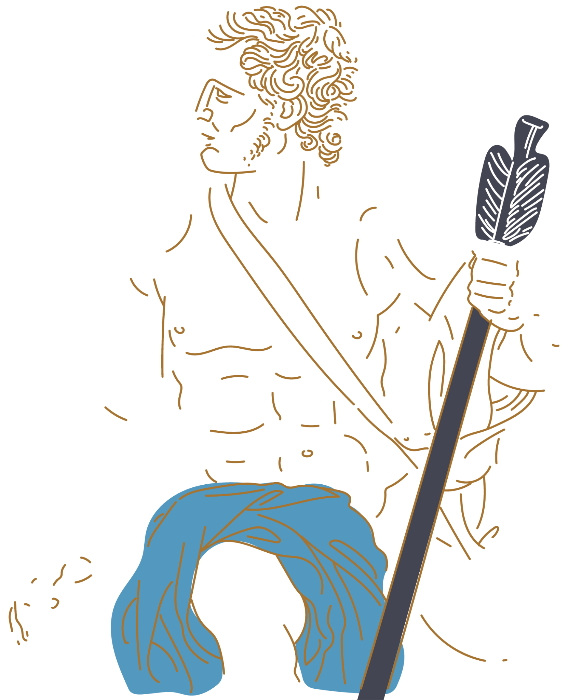
A cautionary tale: a motivation myth with ironic reversal
“Moral of the story”
Excessive pursuit of material wealth can be self destructive and lead to suffering
Greed has negative consequences
True fulfillment is not in material possessions but in intangibles such as relationships
Material achievement should be enjoyed in moderation

Slide 3
Myth Summary
King Midas is granted a wish
Midas returns Silenus( the satyr) to Dionysus who grants him a wish in return
Midas asks that everything he touches will turn to gold
At first Midas is overjoyed with the possibilities
But when Midas tries to eat, his food turns to gold making his distressed
Then, he hugs his daughter and she turns into gold
King Midas realizes the consequences
King Midas learns his lesson
Midas asks for the wish to be reversed
He washes his hands in the river
He becomes more thankful
Notes:
King Midas= actual king of modern day turkey, he was rich/highly influential, this myth is based off of the king

Slide 4
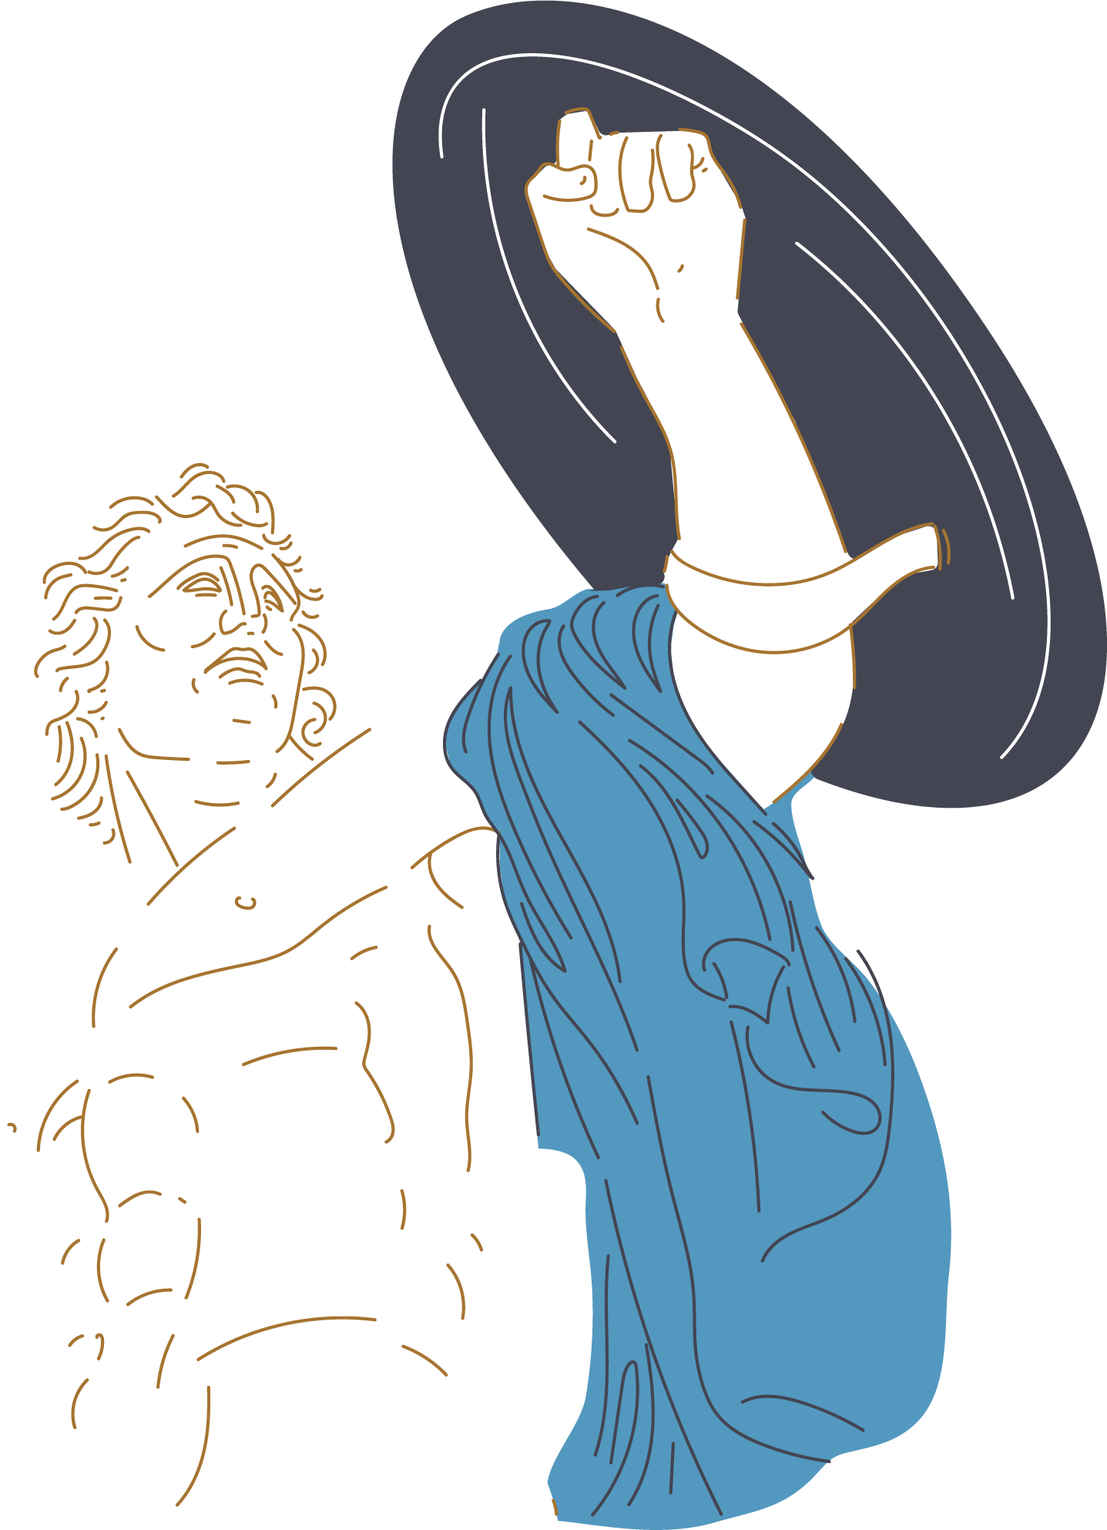
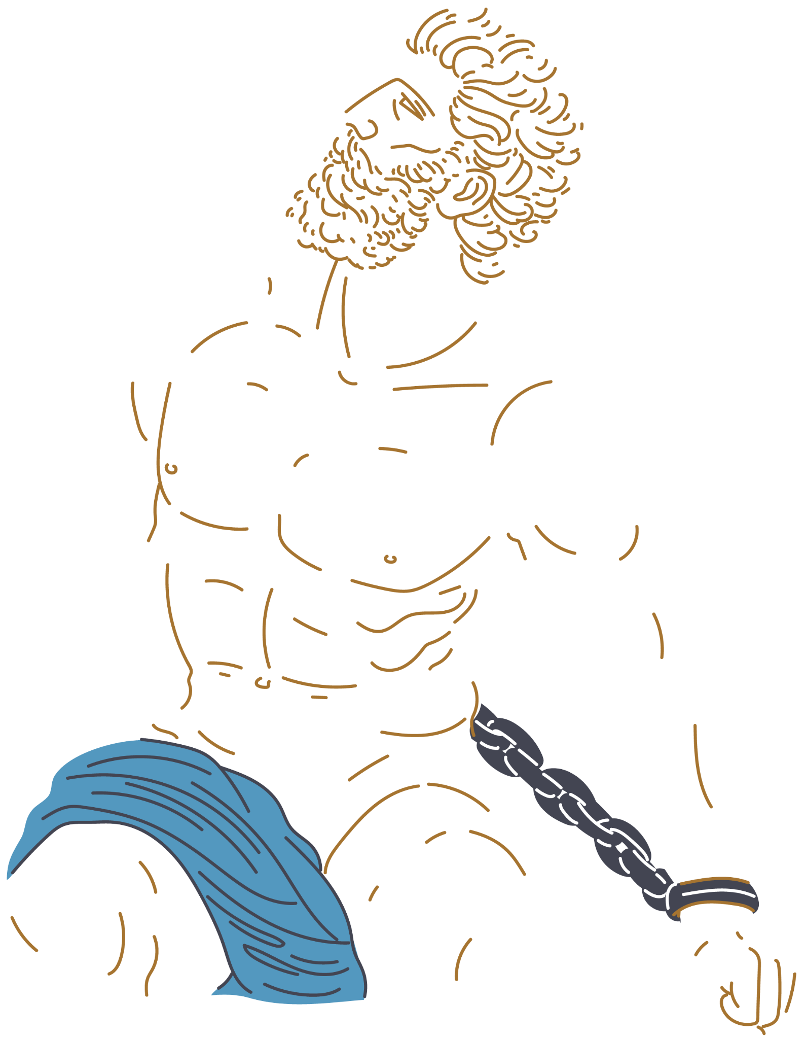
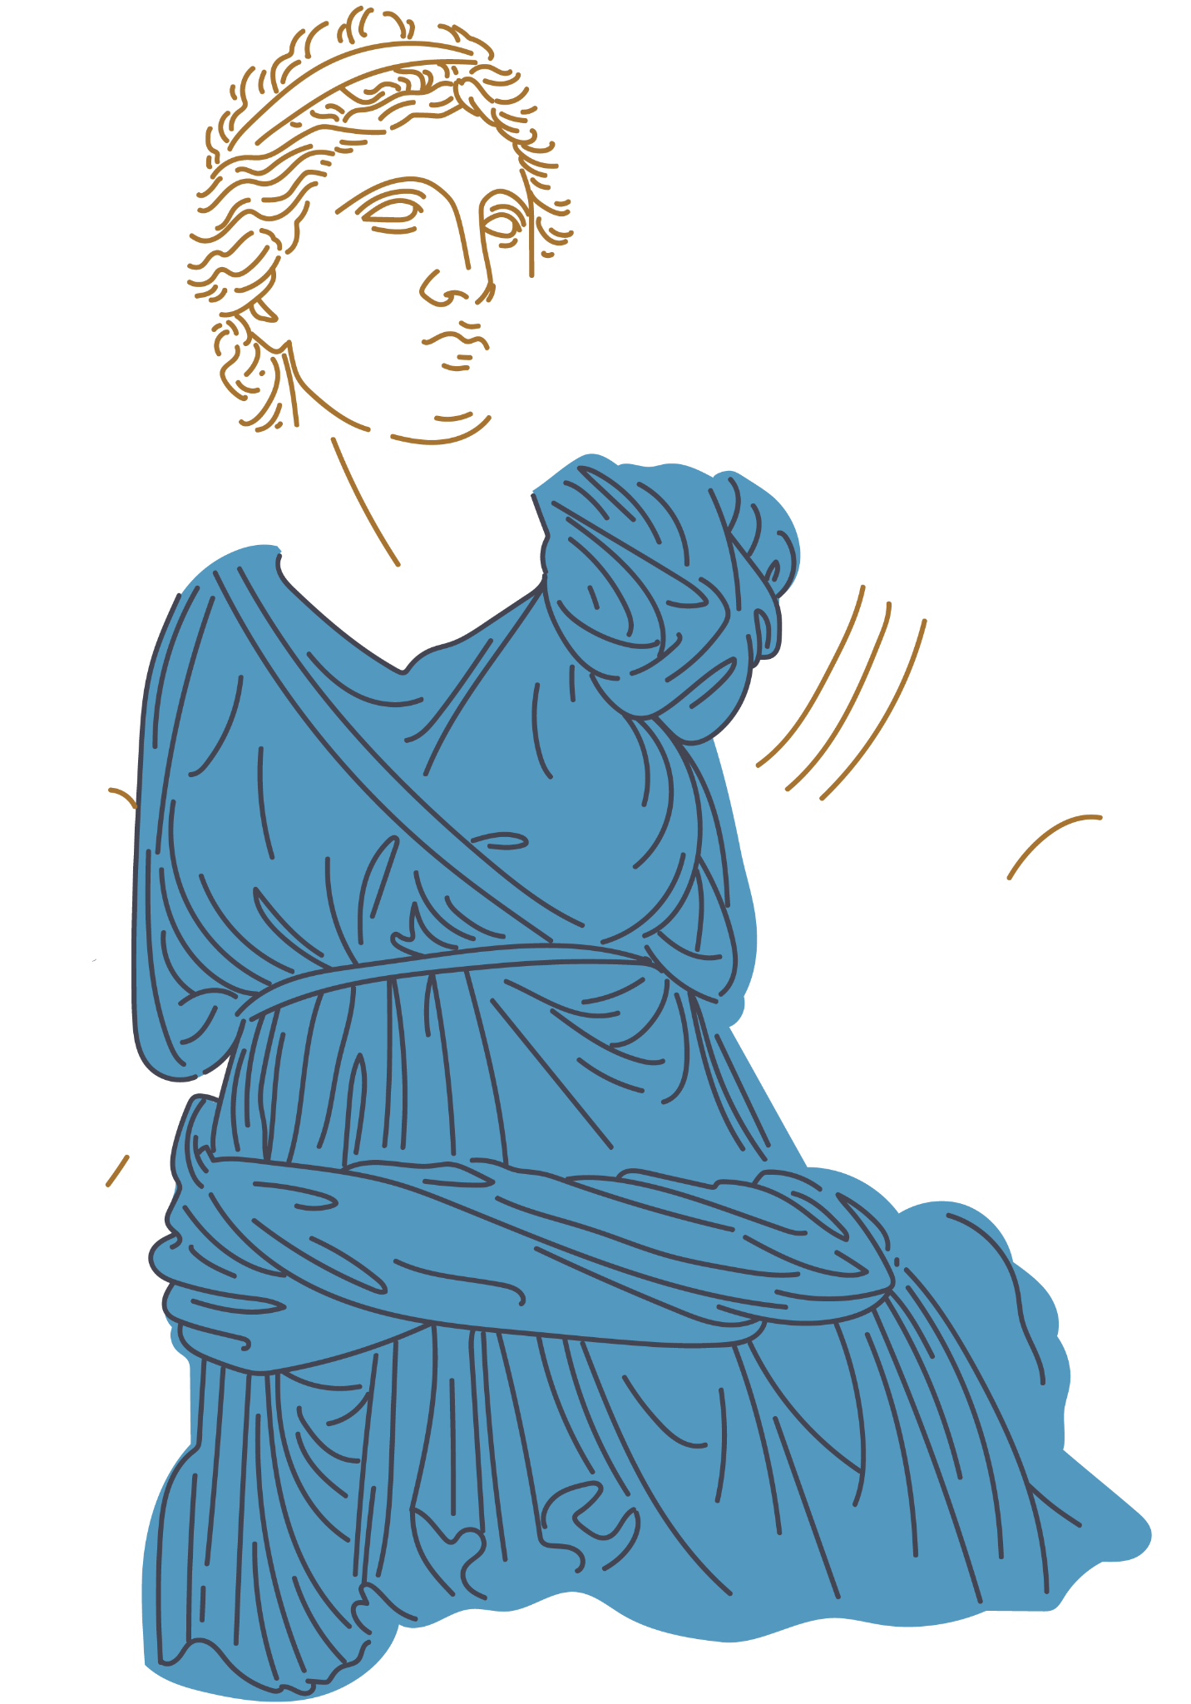
Characters
King Midas
Dionysus
Daughter
Impulsivity
Greed
Foolishness
Psychological imbalance
God associated with wine, festivity, and ecstasy
Embodiment of the “id” (freud)
Archetype of the “unconscious” (jung)
Balance among the rational(feeling/thinking) and irrational functions(sensation/intuition) (jung)

Slide 5
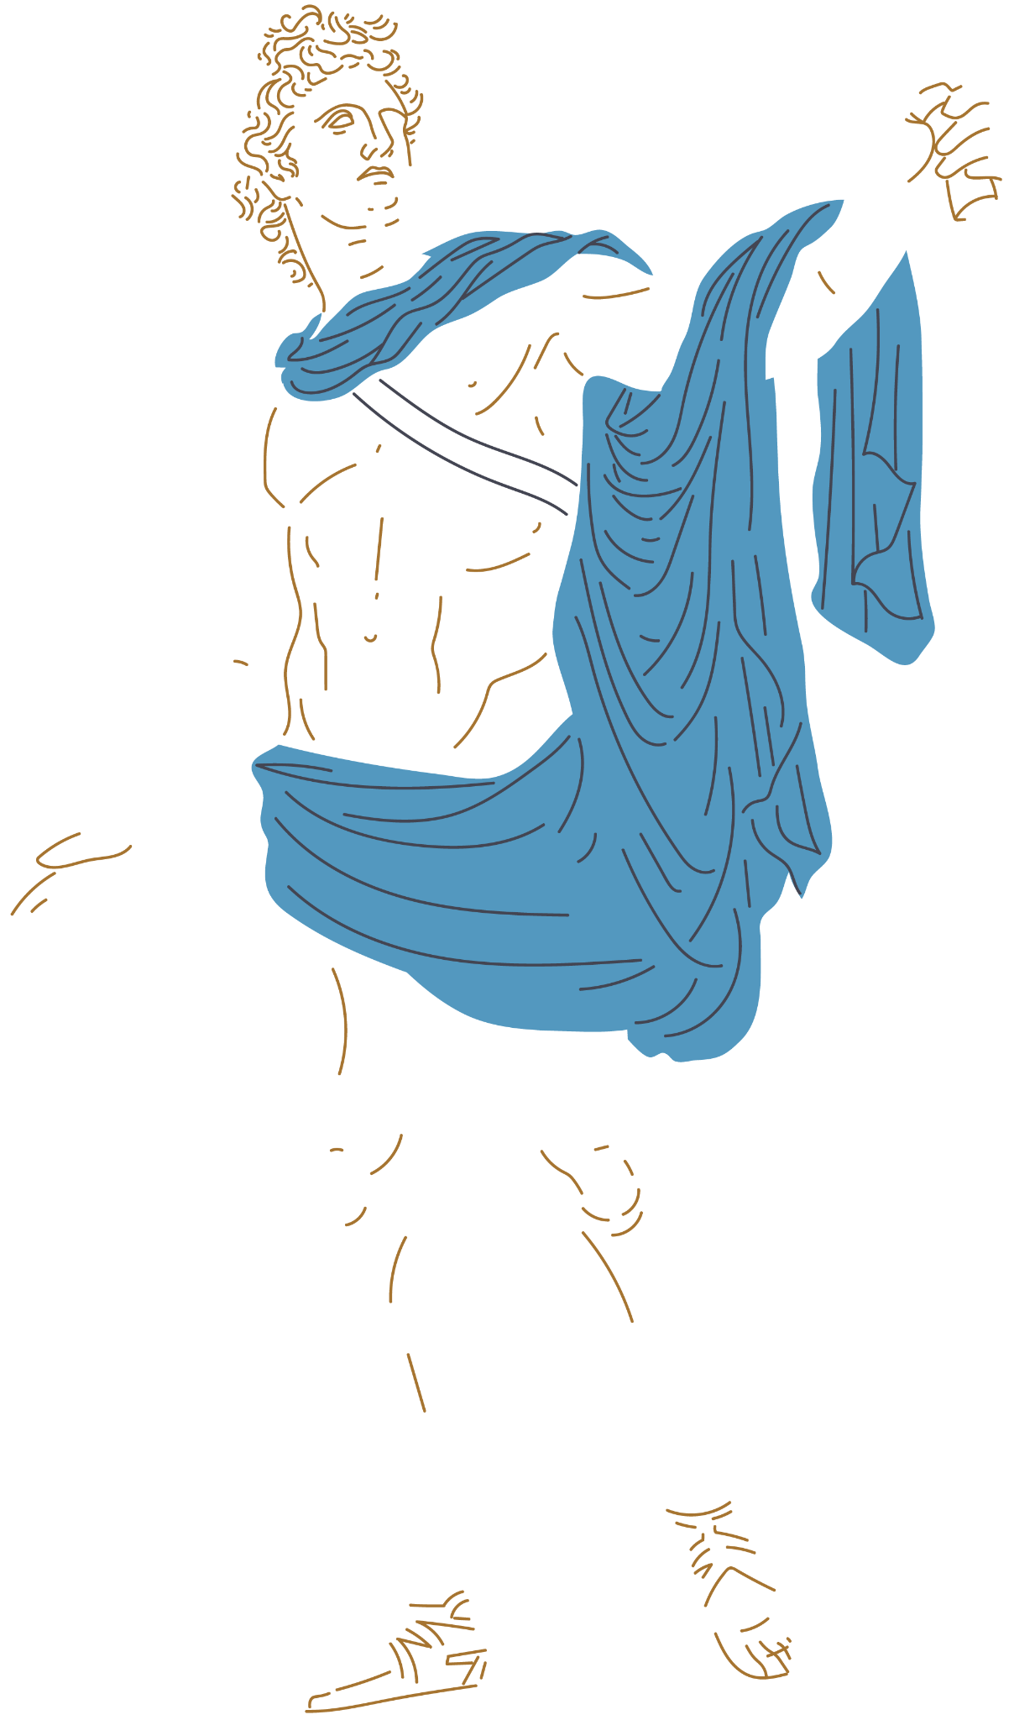
Themes and patterns
Greed: a selfish and excessive desire for more of something (such as money) than is needed- Merriam Webster Dictionary
Greed and Freud
Greed and Jung
Greed and the “id”
“Pleasure principle”/ desire, need for instant gratification
Higher “impetus” or intensity of “hunger” or desire for gold
Unchecked desire for more gold without moral concern
(the ego i.e. reality comes into play when survival is threatened/emotion loss happens)
(Superego comes into play when Midas feels remorse)
Greed and the “shadow”
Greed=desire/impulse that ego deems as bad
Persona of a “rich king” amplifies his greed
(The ego negotiates between desires and reality when there are concrete consequences)
(Individuation happens when the shadow is acknowledged and integrated, this is when Midas begs to have the wish reversed )

Slide 6
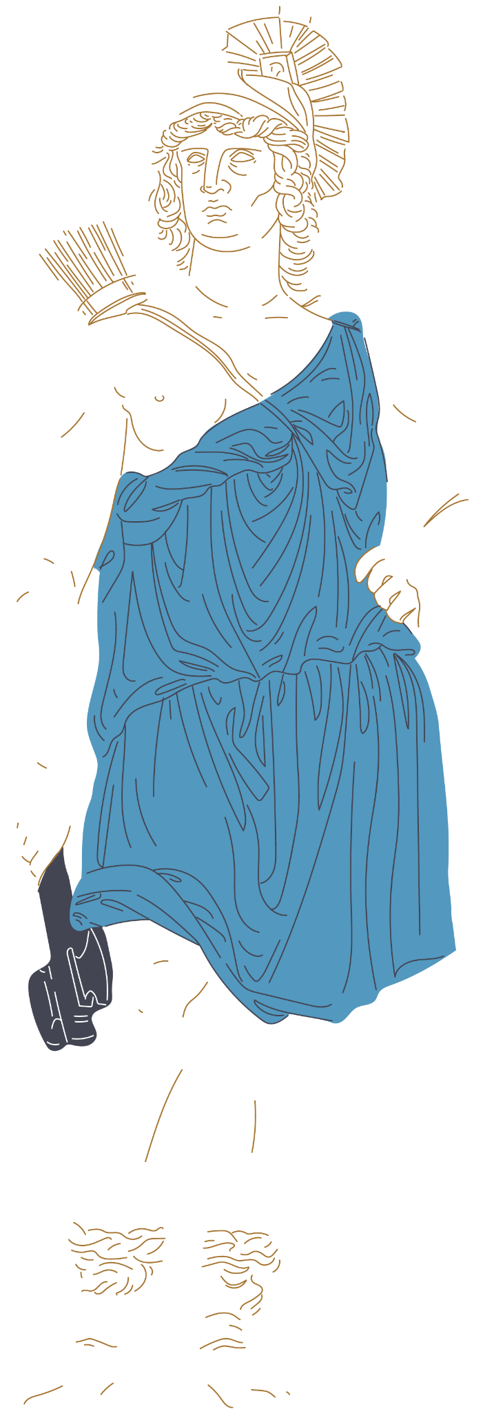
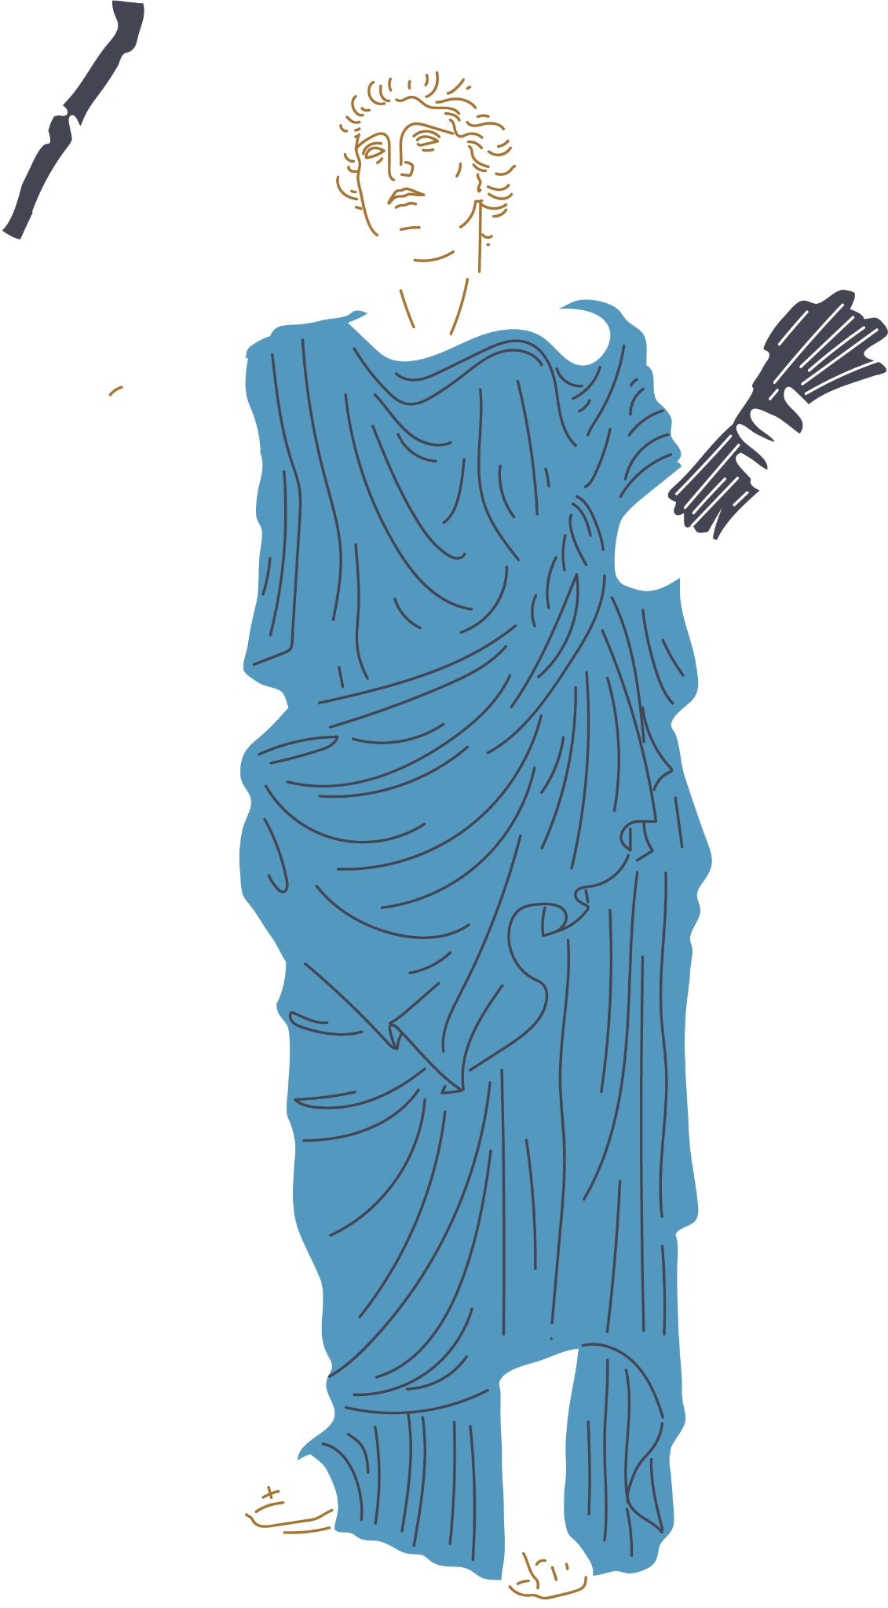
Modern Applications
Midas not thinking twice and instantly wanting gold =
Instant gratification in our modern world(social media, shopping, etc).
  By prioritizing meaningful experiences with friends and family along with delayed gratification we can combat this.
Midas loses his daughter when his greed is left unchecked = Losing relationships when chasing “success” in career
  It is important to value loved ones, community, and intangibles over money
Midas gives up the golden touch = giving up social media
  Holding on can cause more harm than good

Slide 7
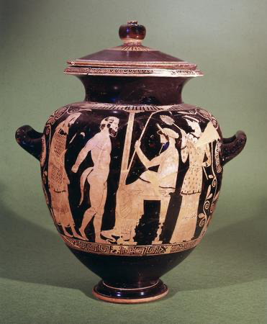
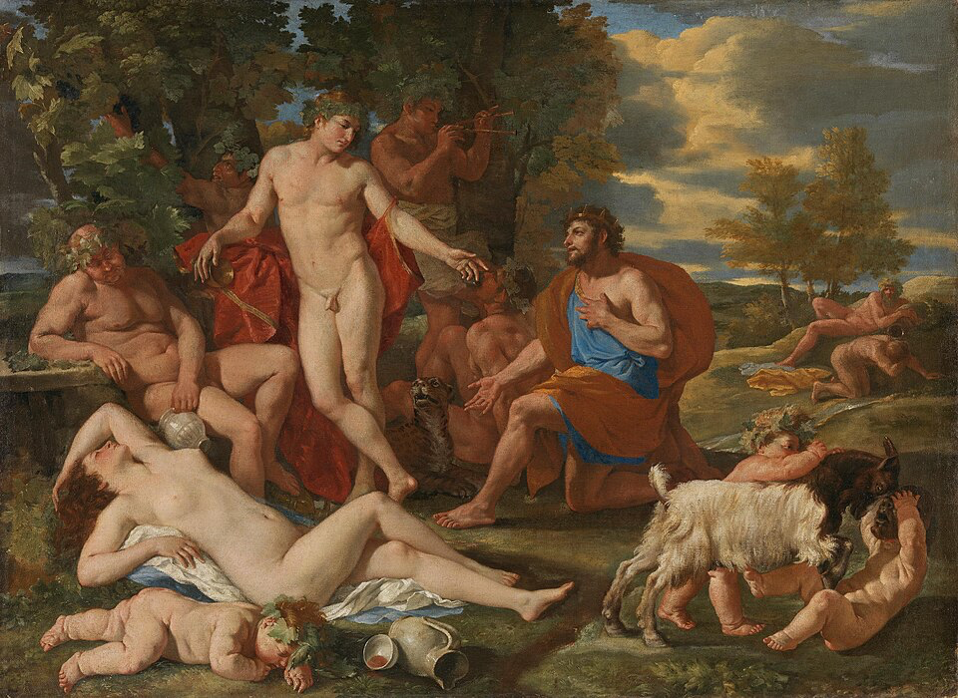
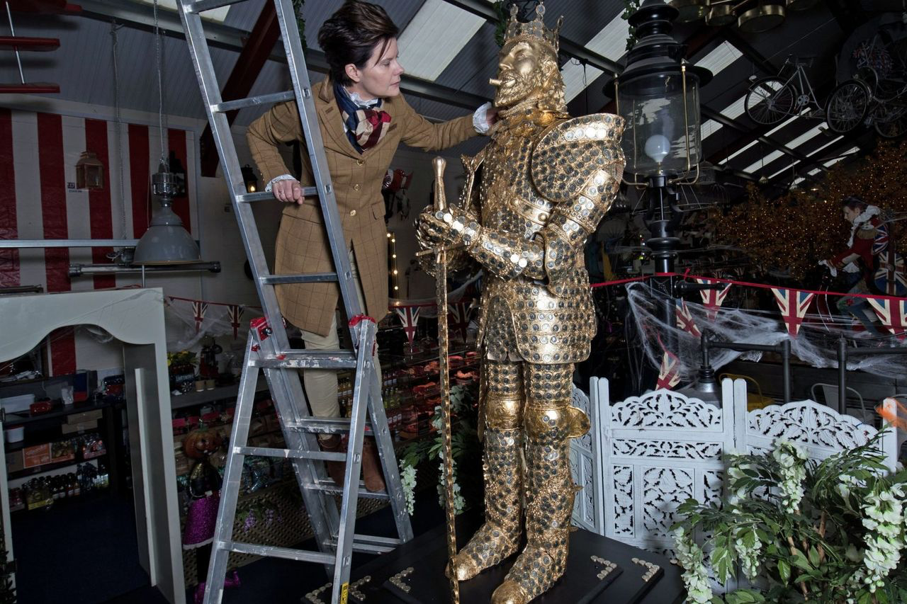
The influence of the Myth
Renaissance Painting
Contemporary Art
Ancient Pottery
Midas and Silenus
c. 440 BC
Attica, Greece
Midas and Bacchus
Nicolas Poussin
Oil on Canvas , 1624–1629
King Midas “Objection to Greed”
Debbie Rees Deacon
£1 coins

Slide 8
Thanks!
Do you have any questions?

Slide 9
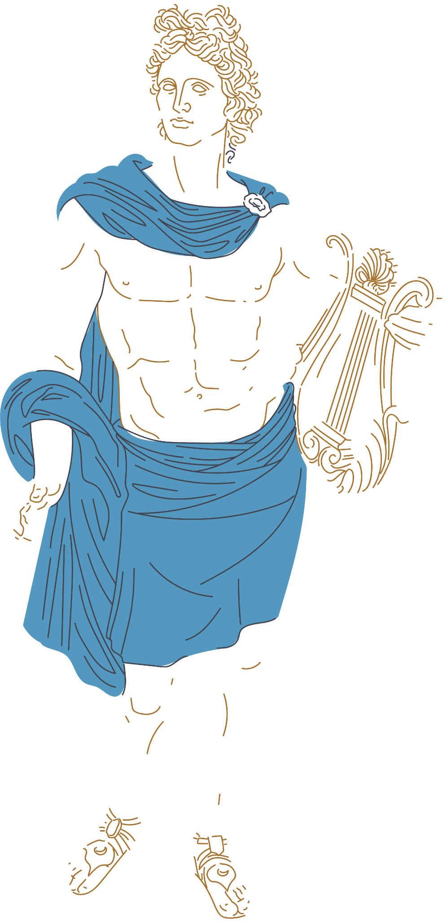
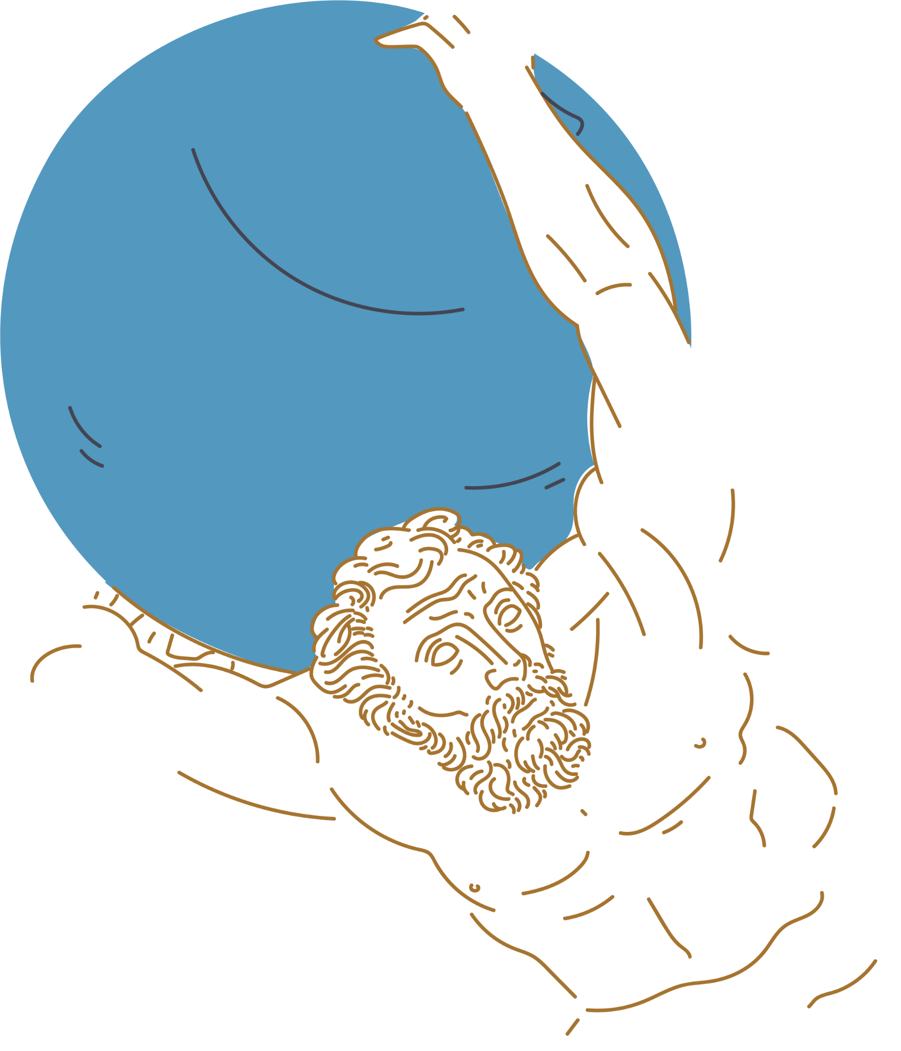
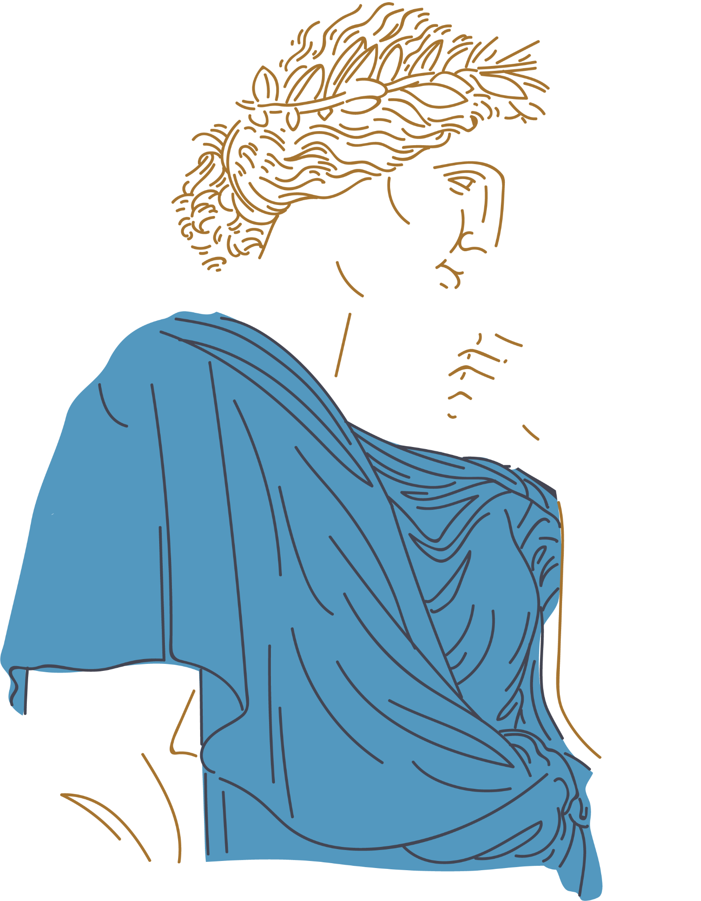
Resources
Cartwright, Mark. “Midas: The Mythical King with the Golden Touch.” World History Encyclopedia, https://www.worldhistory.org#organization, 23 June 2021, www.worldhistory.org/midas/.
“The Golden Touch1.” The Golden Touch, iscontent.byu.edu/canvas/ENGL-033/ENGL-033-003/html/01_TheGoldenTouchShortStoryforPortfolio.html. Accessed 17 Jan. 2026.
“King Midas ‘Objection to Greed’ Sculpture: Our Projects: The British Ironwork Centre.” British Ironwork Centre & Shropshire Sculpture Park, 9 Jan. 2025, www.britishironworkcentre.co.uk/projects_item/king-midas-sculpture/.

