Slide 1
Demeter and Persephone: Myth of The Seasons
Estelle Spira

Slide 2


This Greek myth explains why we have seasons and explains how we survive grief
Notes:
For this assignment, I want to look at a myth that deals with the inevitable pain of separation: the myth of Persephone and Demeter. It is a story that explains why we have seasons, but psychologically, it explains how we survive grief.

Slide 3
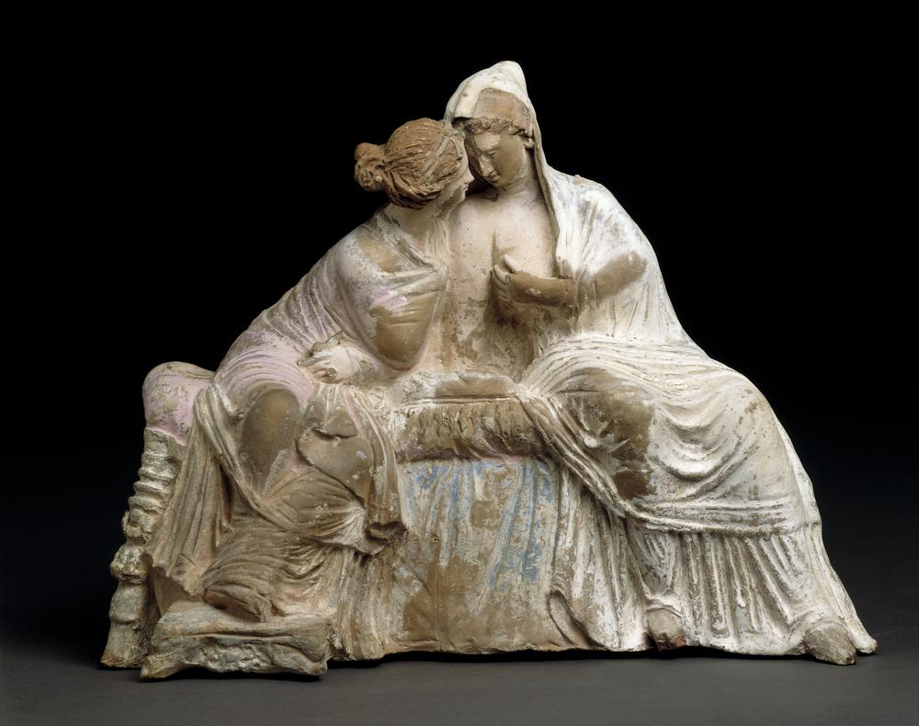
Myth Synopsis
Persephone is abducted by Hades
Her mother, Demeter, Goddess of the Harvest, falls into depression
Zeus intervenes with a compromise
Notes:
First, a quick refresher on the plot. Persephone is the daughter of Demeter, the Goddess of the Harvest. While picking flowers, she is abducted by Hades and taken to the Underworld. Demeter is heartbroken. But she doesn't just cry; she stops functioning. As the Goddess of the Harvest, she refuses to let the earth grow. The world plunges into an eternal, famine-filled Winter. Zeus eventually intervenes to save humanity. He demands Hades returns Persephone to her mom. But, because Persephone ate pomegranate seeds while in the Underworld, a binding rule keeps her there. So instead a compromise is agreed upon: Persephone spends half the year above ground (Spring/Summer) and half the year below (Winter).

Slide 4
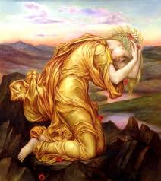
Challenges Confronted
The psychological challenge:
Separation Anxiety, Grief, and the "Empty Nest”
The Person Type:
The "Devouring Mother": A parent whose love is so strong they want to keep the child "frozen" in childhood forever
The Depressive Personality: Demeter represents how grief can shut us down completely
Notes:
So, what is the real challenge here? According to Jungian analysis, this isn't about agriculture; it’s about Separation Anxiety and Depression. We see a specific 'Person Type' here: The Over-Protective or 'Devouring' Mother. Demeter’s love is so intense that when her child separates from her, Demeter’s entire world collapses. This mirrors the real-life 'Empty Nest' syndrome. The challenge isn't the abduction; the challenge is the mother's inability to accept that her child must enter the 'Underworld' of adulthood—which is scary and unknown. Demeter represents the depressive state: cold, unmoving, and refusing to engage with life.

Slide 5

How does this myth help us with real life?
Accepting Cycles
Notes:
How does the myth resolve this? This is where the 'Coping Mechanism' comes in. The myth doesn't give us a 'Happily Ever After' where Persephone stays home forever. Instead, it offers a Compromise. The resolution teaches us that Cyclical Grief is natural. We cannot have the joy of Spring without the barrenness of Winter. The myth validates our sadness. By ritualizing this story, the Greeks gave themselves a way to handle grief. It tells the listener: 'It is okay to be sad. Your winter will pass, but it is necessary.'

Slide 6
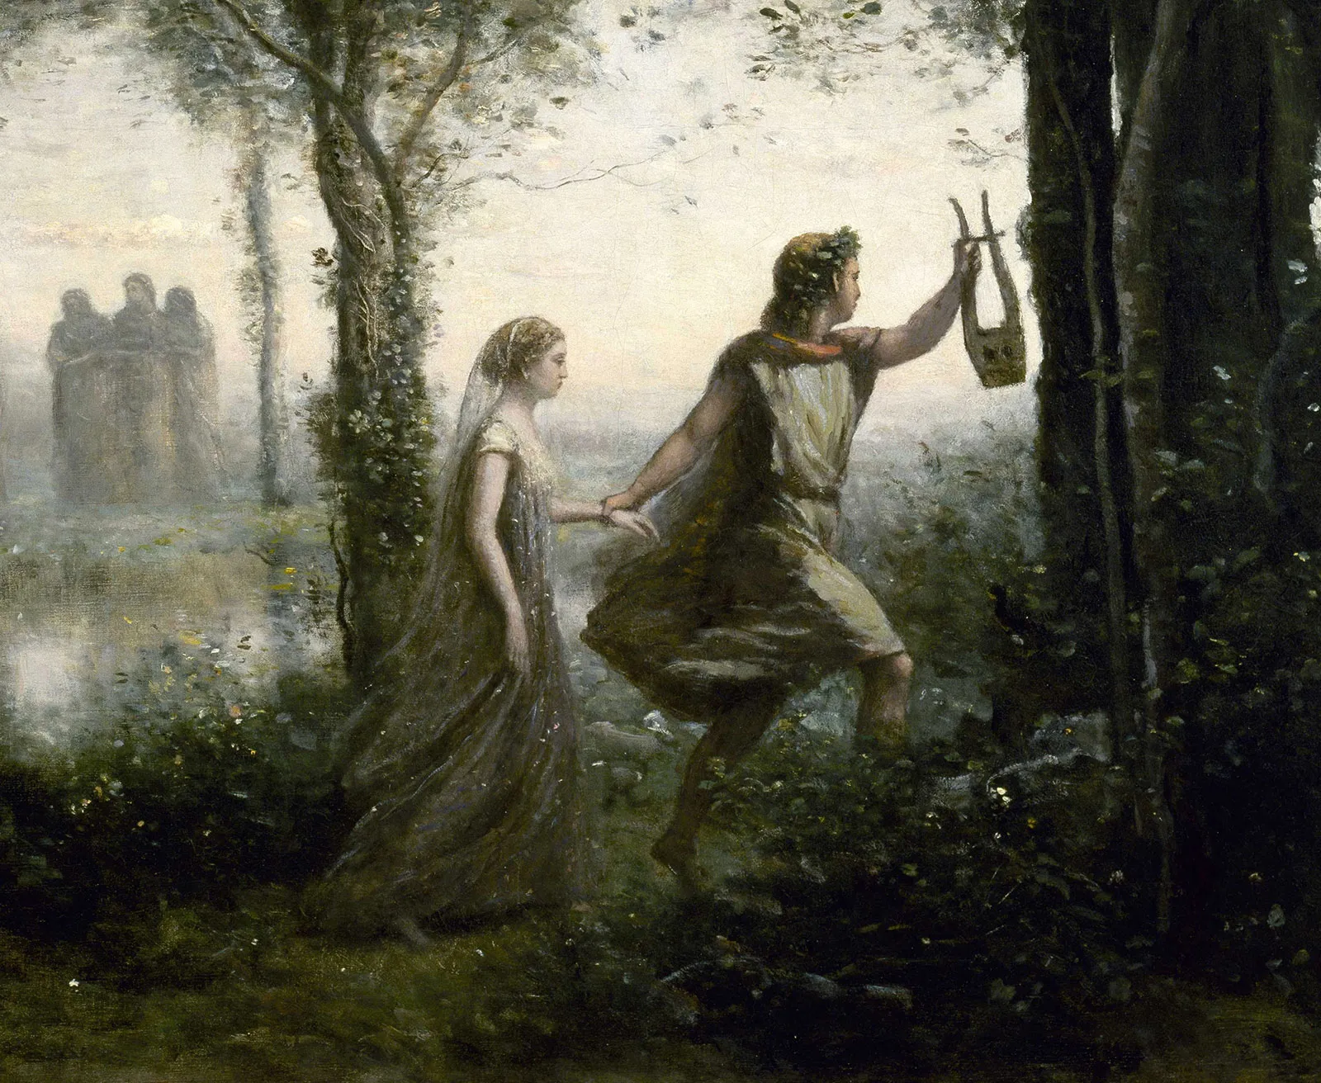
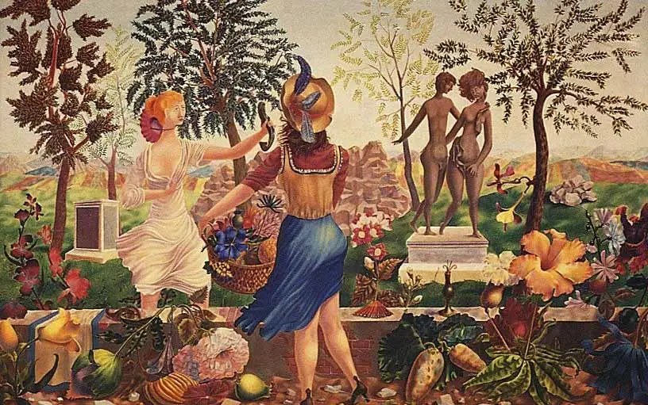
Descent Myths
Notes:
To wrap up, this myth belongs to a broader category we might call 'The Descent.' Other myths in this typology include Orpheus and Eurydice or the Sumerian myth of Inanna, where a hero must go down into the darkness to learn a hard truth.
Ultimately, Demeter and Persephone illustrate that we deal with life’s challenges not by avoiding pain, but by integrating it into the seasons of our lives.

Slide 7
Citations
https://www.pexels.com/photo/creek-running-through-lush-forest-25711199/
https://justmuddlingthroughlife.com/2019/04/a-frozen-landscape/
https://www.britishmuseum.org/collection/object/G_1885-0316-1
https://commons.wikimedia.org/wiki/File:Evelyn_de_Morgan_-_Demeter_Mourning_for_Persephone,_1906.jpg
https://www.benmedder.com/movewiththeseasons
https://www.britannica.com/topic/Orpheus-Greek-mythology
https://shinjinim.com/2021/12/20/the-descent-of-inanna-a-template-for-the-heroines-journey/
https://fitzmuseum.cam.ac.uk/learn-with-us/the-story-of-demeter-and-persephone
https://www.theoi.com/articles/what-is-the-demeter-and-persephone-story-summarized/

