Slide 1

Norse Mythology
Deeya bachani

Slide 2
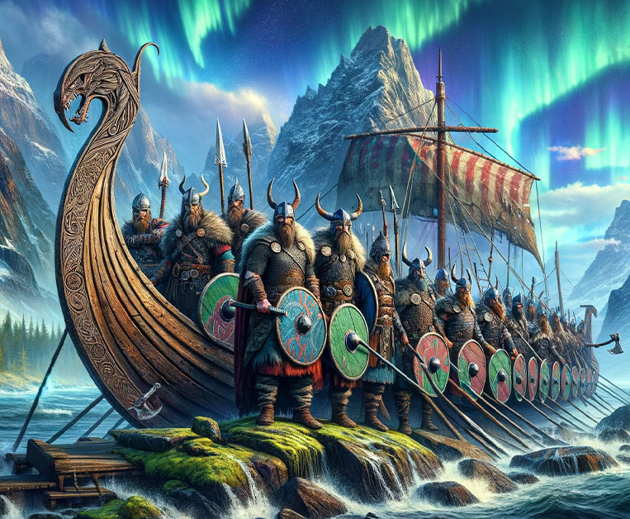
Norse Mythology History
Scandinavian Mythology during the Viking Age of 790 B.C.- 1100 B.C.
Began with the myth of Gods slaying a giant and using his body parts to create the world
Includes many gods and goddesses
Created in Viking culture to handle the struggle to survive and constant violence

Slide 3
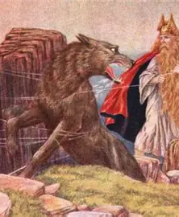
Norse Mythology in Viking Culture
Rituals of prayer and devotion to specific Gods were part of everyday life
Included Christ into their list of Gods
Prayed at temples such as Uppsala that held images of their Gods such as Thor and Odin who were sacrificed during times of need
Every 9 years, festivals were help where humans and animals were sacrificed

Slide 4
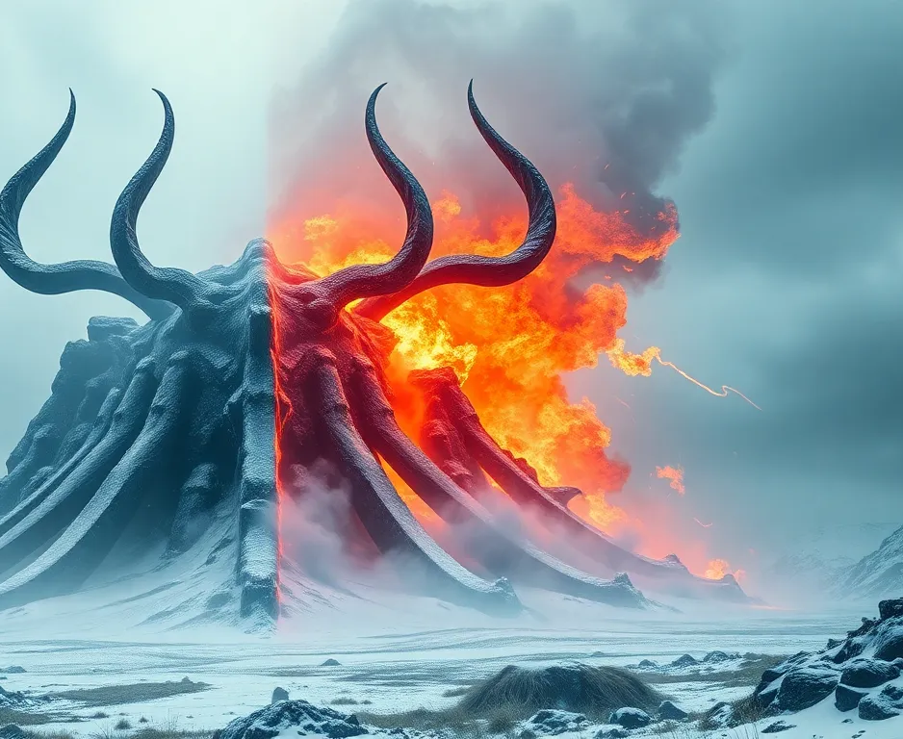
The phases
In Norse mythology there were four phases of the words
  The creation of the world
  When time was started
  The destruction of the world in Ragnarok
  The arising of a new world from the sea

Slide 5
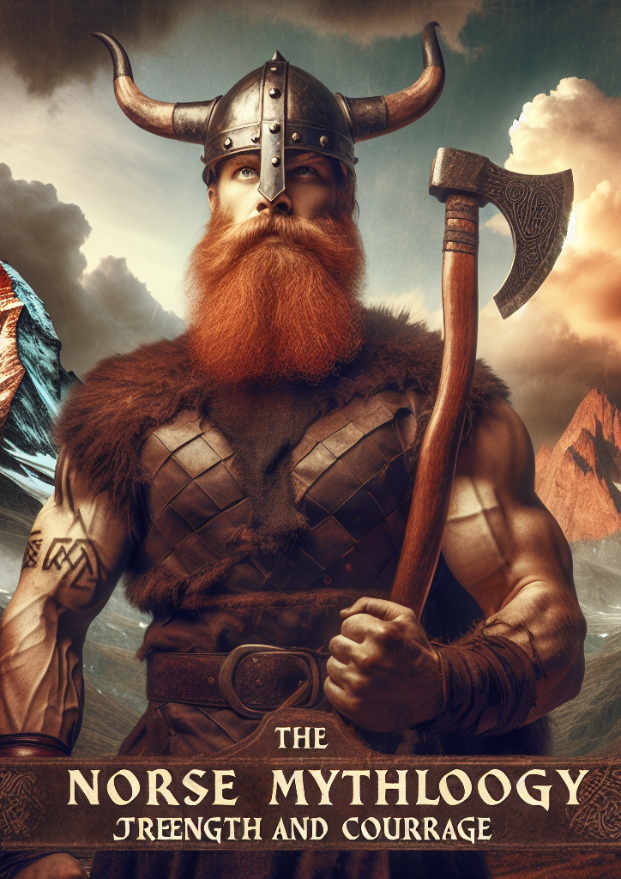
The Psychology of Norse Mythology
System of stories to help humans cope with fear, uncertainty and death
Stories focus on meaning of life despite inevitable death and loss
The myths show suffering and death as part of necessary reality
Gods are flawed making them relatable to humans

Slide 6
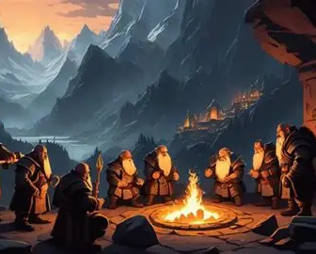
Human Psyche
Each Gorse god is a representation of archetypes from the human psyche
Examples include:
  Odin is the Wide Old Man who is willing to sacrifice himself for wisdom
  Thor is the Warrior who protects stability and order
  Loki is a Trickster/Shadow who creates chaos and acts upon impulses
Each part struggles to work together with one another

Slide 7
Ragnarok
Important creation, destruction and hero myth for the Norse
  Describes destruction of the world due to a battle between the Gods and chaos
  Despite the Gods inevitable death, they continue to fight
  Two versions of the story: one includes rebirth and the other does not
  Highlights the importance of people trying to handle the unavoidability of death
Ragnarok creates worry about death, faith and how to live life despite difficult conditions and experiences
Important to experience the conflict honorably rather than running away
Survival and winning are secondary to courage

Slide 8
Conclusions
Norse mythology used to understand and experience hardship including death and uncertainty
Recognize that facing reality helps build strength and understanding
Stories don’t always include happy ends, but instead include bravery

Slide 9
References
Mythopedia Staff. “Norse Cosmology.” Mythopedia, 29 Nov. 2022, mythopedia.com/topics/norse-cosmology/.
McCoy, Daniel. “Ragnarok.” Norse Mythology for Smart People, 1 Oct. 2018, norse-mythology.org/tales/ragnarok/.
Groeneveld, Emma. “Norse Mythology.” World History Encyclopedia, https://www.worldhistory.org#organization, 2 Nov. 2017, www.worldhistory.org/Norse_Mythology/.

