Slide 1
Kali and Raktabija
Arya Adusumilli

Slide 2
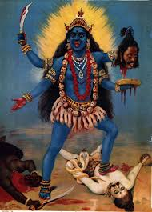
History
Appears first in Sanskrit work Devi Mahatmya (5th or 6th century)
  Chronicles goddess Durga as divine creator of the universe
Kali embodies Durga’s rage, destructive force; emerges from her forehead

Slide 3
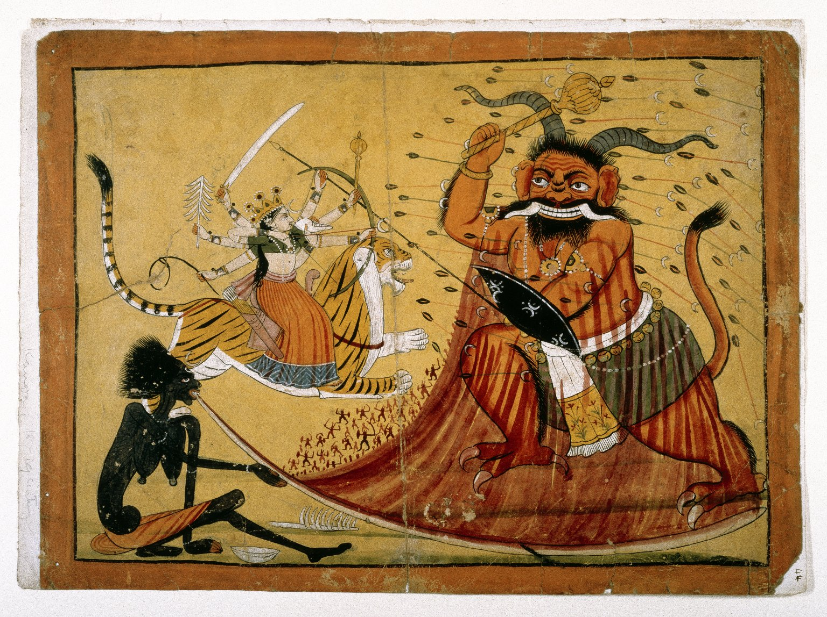
Myth of Raktabija
Most popular myth involving Kali slaying the demon Raktabija
Raktabija soon forms an army of replicate demons from drops of his blood; Kali devours all
Incites rampage, which would have culminated in the destruction of the universe
Inevitabilities of human existence

