Slide 1
Māori Haka
Yeji Kim

Slide 2
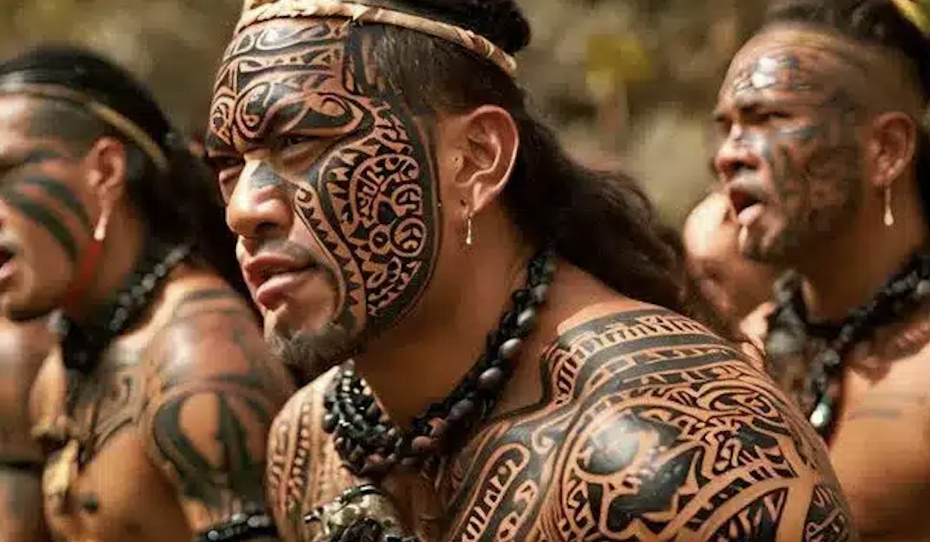
Who are the Māori?
Māori means ordinary
  A way of distinguishing themselves between the indigenous people from the newcomers
Indigenous Polynesian people of mainland New Zealand (Aotearoa)
Arrived in several waves of canoe voyages between roughly 1320-1350
Culture is built on values like Whakapapa (genealogy/connection to ancestors) and Mana (prestige, spiritual power)

Slide 3
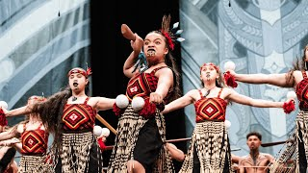

What is the Haka?
A traditional performance involving vigorous movements, facial expressions, and rhythmic chanting
Commonly known as a war dance but can also express joy, anger, sorrow, pride, welcome, grief
Includes stamping, slapping body, gestures, strong facial expressions

Slide 4
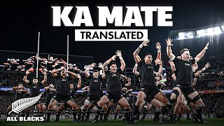
Ka Mate
Ka mate, ka mate! Ka ora, ka ora!
Ka mate, ka mate! Ka ora, ka ora!
Tēnei te tangata pūhuruhuru
Nāna nei i tiki mai whakawhiti te rā
Ā, upane! ka upane!
Ā, upane, ka upane, whiti te rā!
I die! I die! I live! I live!
I die! I die! I live! I live!
This is the hairy man
Who summons the sun and makes it shine
A step upward, another step upward!
A step upward, another... the sun shines!

Slide 5
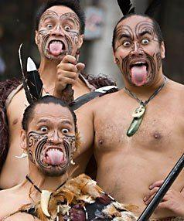
Motifs & Images
Pūkana: defiance and ferocity
Stomping:
Connects the performer to Papatūānuku (Earth Mother), drawing strength from the land
force, grounding, authority
Hand slapping:
Beating heart of the tribe
Endurance
Voice: presence, control
Synchronization:
Collective will of the community
Unity, single force
Pūkana

Slide 6
Emotions + Social Context
Emotions: joy, anger, sorrow, grief, pride, defiance, passion
Serves as a tool for Māori cultural revitalization and a symbol of national pride
Traditional:
performed before battle to prepare warriors mentally and scare the opposition
Ceremonial:
Used at Powhiri (welcome ceremonies) and Tangihanga (funerals)
Modern:
Schools, graduations, weddings
Cultural events
Political protest / public statements
Sports (especially rugby)

Slide 7
Social Obligations
Whanaungatanga (Relationships):
  Performers have commitment to the group
  A weak performance is seen as a sign of disrespect to the ancestors and the tribe
Preservation of History:
  Carries cultural significance
  Performing keeps the stories and struggles of the ancestors alive for future generations
  Protect and continue Māori identity and values
Upholding mana + Representation:
  In modern contexts (like the All Blacks rugby team), the performers represent the honor of the entire nation of New Zealand

Slide 8
Citation
Cunningham, J. M. (2025, December 5). Haka. Encyclopaedia Britannica. https://www.britannica.com/art/haka
Experience All Blacks. (n.d.). Haka words and translations. Retrieved January 13, 2026, from https://www.experienceallblacks.com/teams-and-culture/haka/haka-words-and-translations
Facts and Details. (n.d.). Māori customs: Etiquette, the Powhiri and the haka. Retrieved January 13, 2026, from https://ioa.factsanddetails.com/article/entry-941.html
New Zealand Tourism. (n.d.). Māori haka | 100% Pure New Zealand. Retrieved January 13, 2026, from https://www.newzealand.com/us/feature/haka/
Royal, T. A. C. (n.d.). Story: Māori. Te Ara: The Encyclopedia of New Zealand. Retrieved January 13, 2026, from https://teara.govt.nz/en/maori
Te Ara: The Encyclopedia of New Zealand. (1966). Haka (from An Encyclopaedia of New Zealand, A. H. McLintock, Ed.). https://teara.govt.nz/en/1966/haka
Wikipedia contributors. (n.d.). Ka Mate. Wikipedia. Retrieved January 13, 2026, from https://en.wikipedia.org/wiki/Ka_Mate

