Slide 1
Outlaw Country from the 60’s and 70’s in the American South
Presentation by Solomon Wechter

Slide 2
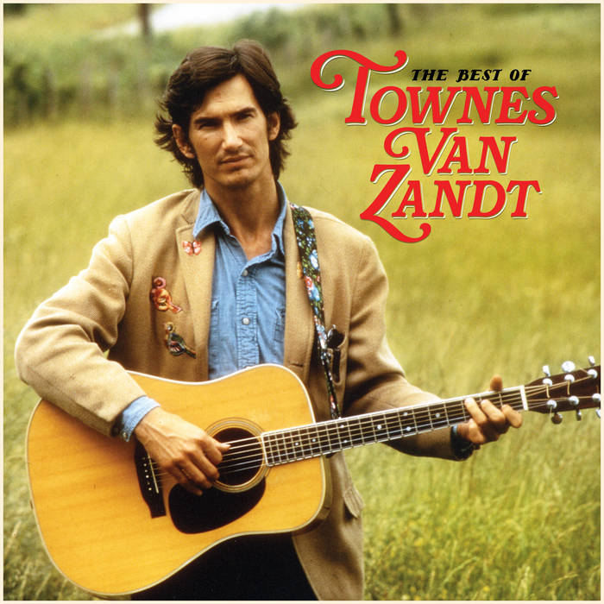
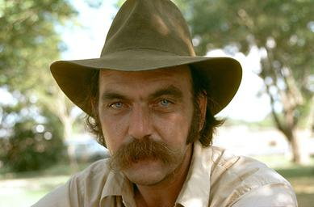
Examples of Musicians
Blaze Foley
Townes Van Zandt

Slide 3
Motifs and Images Used
Simple life: roads, bars, rooms, weather, trains
Wandering through the world, train hopping
Lost lovers
Death and tragedy
Lawlessness
Alcoholism
Murder
Poverty

Slide 4
Emotions Being Expressed
Somber Melancholy
Tenderness
Fortitude
Solitude
Simple Beauty

Slide 5
Social Obligation Suggested
No larger message
Metabolize and give voice to the difficult aspects of living
Express something beautiful about life, even if it is hard
Respite to loneliness

Slide 6
Social Context in Which the Songs Are Sung
Bars, music clubs, small venues around the American South
Late night, low to no cover
Confessional but public
Audience of peers, not spectators
  Listeners were other musicians, or regular people who shared the same working roots

