Slide 1
SOUTH KOREAN
TRADITIONAL DANCE
NONGAK (농악)
Roy Park

Slide 2
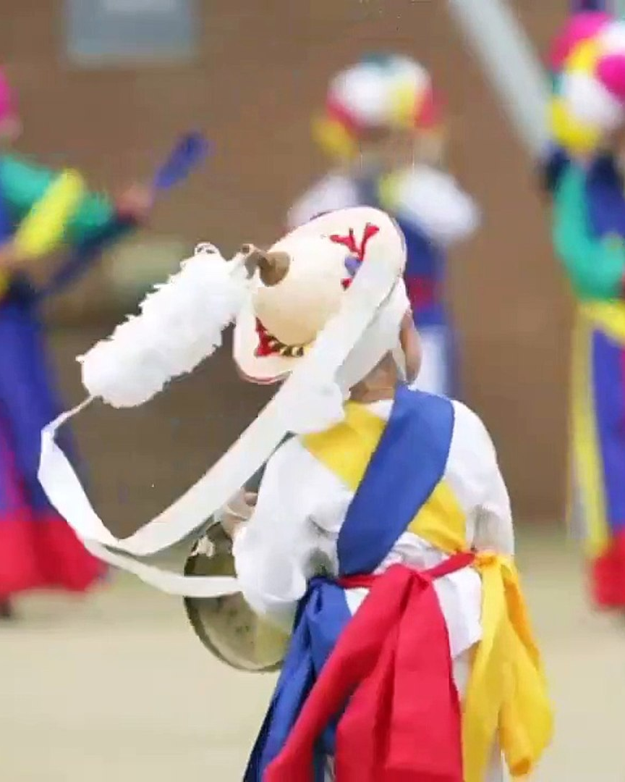
WHAT IS NONGAK?
Nongak (농악), more recently known as Pungmul (풍물), is a traditional South Korean form of dancing with various different forms per region.
Most commonly it is presented within two forms. The first having fast, acrobatic with a long, white paper streamer attached to their heads, while the latter wearing conical hats with a large flower attached.
The kkwaenggwari (꽹과리), a small flat gong, is used to set the beat and lead the dance along with the buk (북), janggu (장구), and jing (징).

Slide 3
MOTIFS & IMAGES
PERCUSSION RHYTHM
SANGMO (상모)
The beat of the drums simulate heartbeat, rain and the Earth’s pulse
The flowing ribbon create wind and cloud visuals, along with dragon energy
CIRCULAR MOTION
AGRICULTURE
The constant spinning of the streamer and turning/rotating represent Yin & Yang along with Heaven-Earth-Human unity
Movements imitate the threshing and sowing of rice paddies, along with circular formations showing seasons

Slide 4
EMOTIONS EXPRESSED
Raw Communal Joy of Survival
Resilience of Agriculture Labor
Spiritual Reverence in Buddhism
Catharsis/Release of Emotions

Slide 5
THE SOCIAL OBLIGATIONS SUGGESTED
The collective cooperation necessary to contribute to the harvest into farming communities
Spiritual cleansing to expel bad fortunes and conflicts
Celebrating and fundraising for community projects

Slide 6
SOCIAL CONTEXT FOR THE DANCE
Agrarian Village Life
Planting Season
Rice-growing communities
Festivals
Lunar New Year (설날)
Harvest Festival (추석)
Ritualistic & Shamanistic
Warding off misfortune
Invite prosperity
Cleanse the village

Slide 7
THANK
YOU!

Slide 8
SOURCES
National Folk Museum of Korea. (n.d.). Nongak. Retrieved January 14, 2026, from https://folkency.nfm.go.kr/en/topic/detail/6486
Cultural Heritage Administration. (n.d.). Nongak percussion music [Feature article]. Korean Heritage. Retrieved January 14, 2026, from http://koreanheritage.kr/feature/view_pc.jsp?articleNo=212
Asia Society. (n.d.). Farmer’s dance: A Korean tradition. Retrieved January 14, 2026, from https://asiasociety.org/farmers-dance-korean-tradition
UNESCO. (n.d.). Nongak, community band music, dance and rituals in the Republic of Korea (Rep. No. 00717). Retrieved January 14, 2026, from https://ich.unesco.org/en/RL/nongak-community-band-music-dance-and-rituals-in-the-republic-of-korea-00717

