Slide 1
Irish Folk Music
Through the lens of "Whiskey In The Jar"

Slide 2
History
Traditional Irish music was originally passed down by ear, not written down.
The music came to Ireland with the Celts around 2,000 years ago.
Irish music traveled globally with emigration, especially during the Great Famine of the 1840s, taking the tradition to the United States and beyond.
Core traditional instruments include fiddle, Celtic harp, flute, penny whistle, uilleann pipes, and bodhrán, with later additions like the Irish bouzouki and guitar.

Slide 3
"Whiskey in The Jar"
The story of the song follows a rapparee (highwayman) who is betrayed by his wife or lover after robbing someone.
Apparently, it is one of the most widely performed traditional Irish songs, first popularized by the Dubliners in the 1960s.
At some point, the song came to the United States and was a favorite in Colonial America because of its resisting attitude toward British officials.

Slide 4
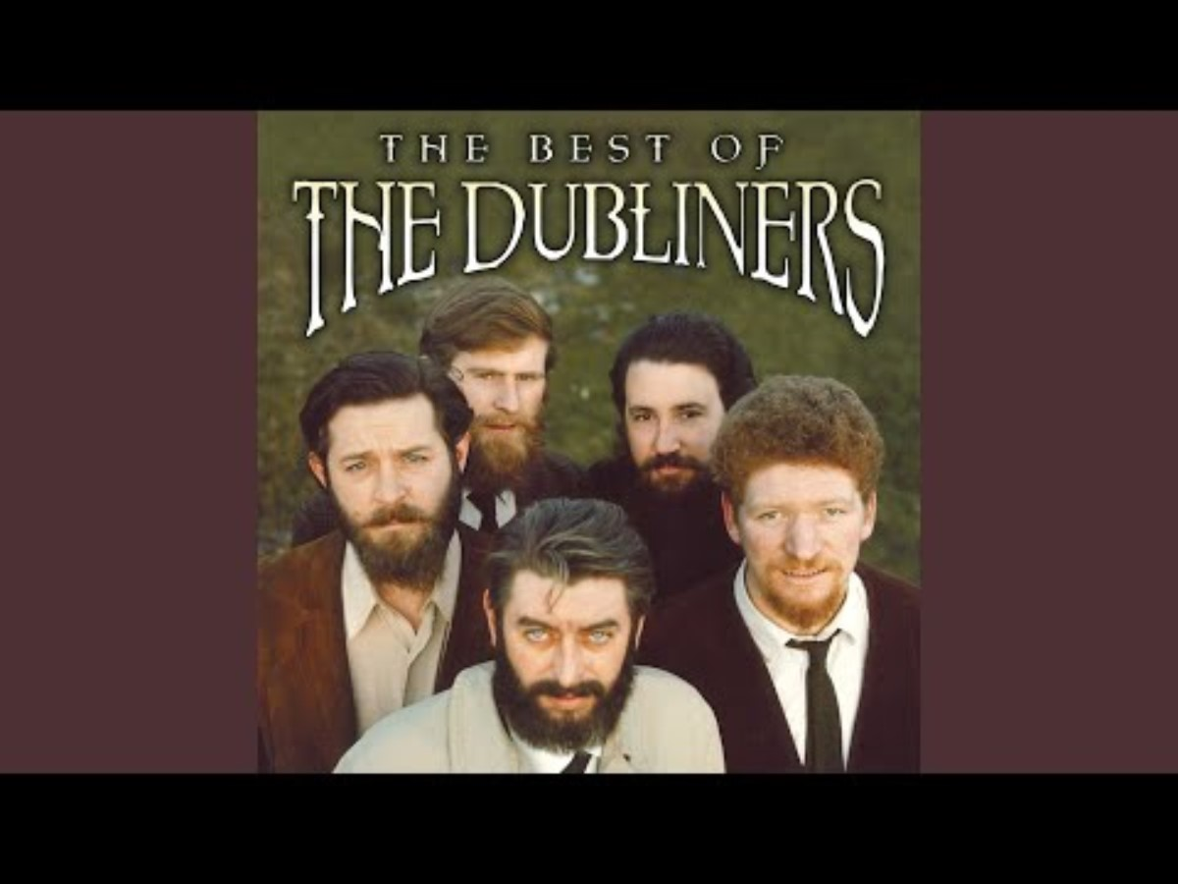
Listen

Slide 5
Motifs & Images
The highwayman is a common figure in Irish songs and stories. He is used to romanticize rebellion and outlawry.
The Irish focus a lot of love and loss of love. The betrayal by the highwayman's lover creates a patriarchal motif that paint women as "femme fatales."
Like many Irish Folk songs, there is mention of alcohol. Whiskey is a very popular Irish alcohol.
Whiskey functions as both a literal object and a symbol:
  Camaraderie, escape from hardship, cultural identity

Slide 6
Emotions
Pride, bravery – Irish people are known to be resilient and clever
Joy – the culture is very expressive and friendly
Bitterness – from the story of the song, this is primarily an aspect of the storytelling culture.

Slide 7
Social Obligations
Community
  In the song, you can hear ensemble participation, as if the storytelling culture is meant to be a tradition that all partake in.
Loyalty
  Because of the emphasis on camaraderie and betrayal from a lover, it suggests that loyalty is almost a moral obligation.
Masculine virtues
  Men are portray as daring, brave, and courageous.

Slide 8
Social Contexts
“Whiskey in the Jar” comes from an storytelling culture where songs preserved history, values, and dissent.
Through the Dubliners revival, it helped reframe the song as a marker of Irish cultural pride. In this context, the song becomes less about actual crime and more about cultural resilience and storytelling.
Due to the colonial history of this song, the song resonates strongly in contexts shaped by British rule.
Who enjoys this song?
  Variants exist across Ireland, Scotland, Australia, & the US.
  Many pubs sing folk songs such as these.

Slide 9
Conclusions
Irish folk music functions as a collective emotional language.
Spirit of coping through hardship by reinforcing generational connection / contuinity.

Slide 10
References
https://en.wikipedia.org/wiki/Whiskey_in_the_Jar
https://www.liverpoolirishfestival.com/traditional-irish-music-short-history/
https://www.irishcentral.com/roots/history/irish-traditional-music-history
https://www.britannica.com/place/Ireland/Daily-life-and-social-customs
https://en.wikipedia.org/wiki/Culture_of_Ireland

