Slide 1
LA JOTA LEONESA
Traditional Folk Music and Dance from
the region of Leon, Spain

Slide 2
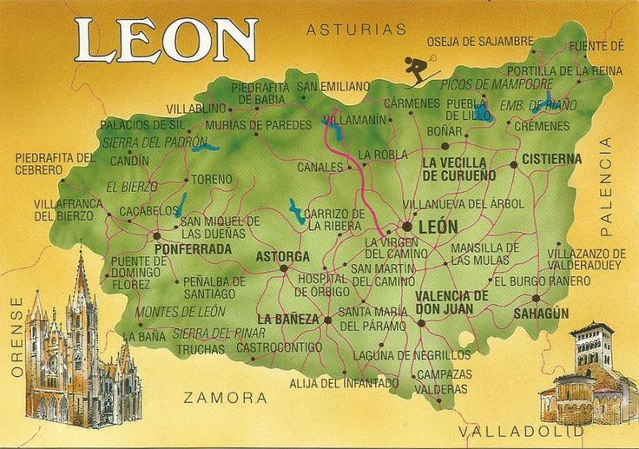
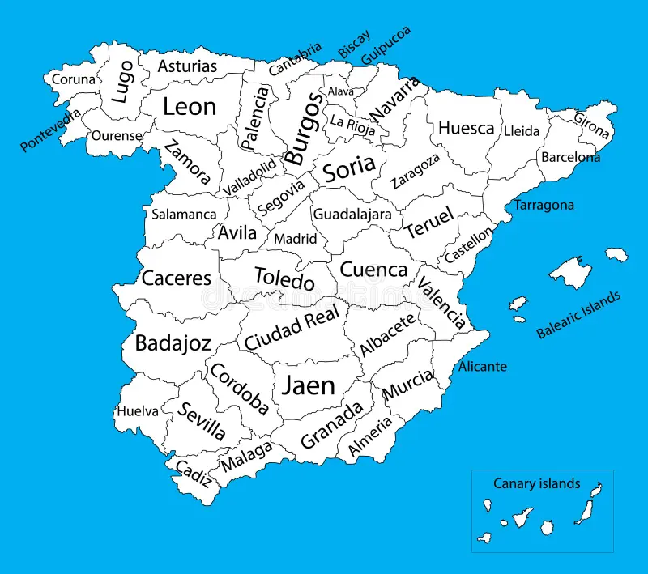
WHERE IS IT PERFORMED?

Slide 3
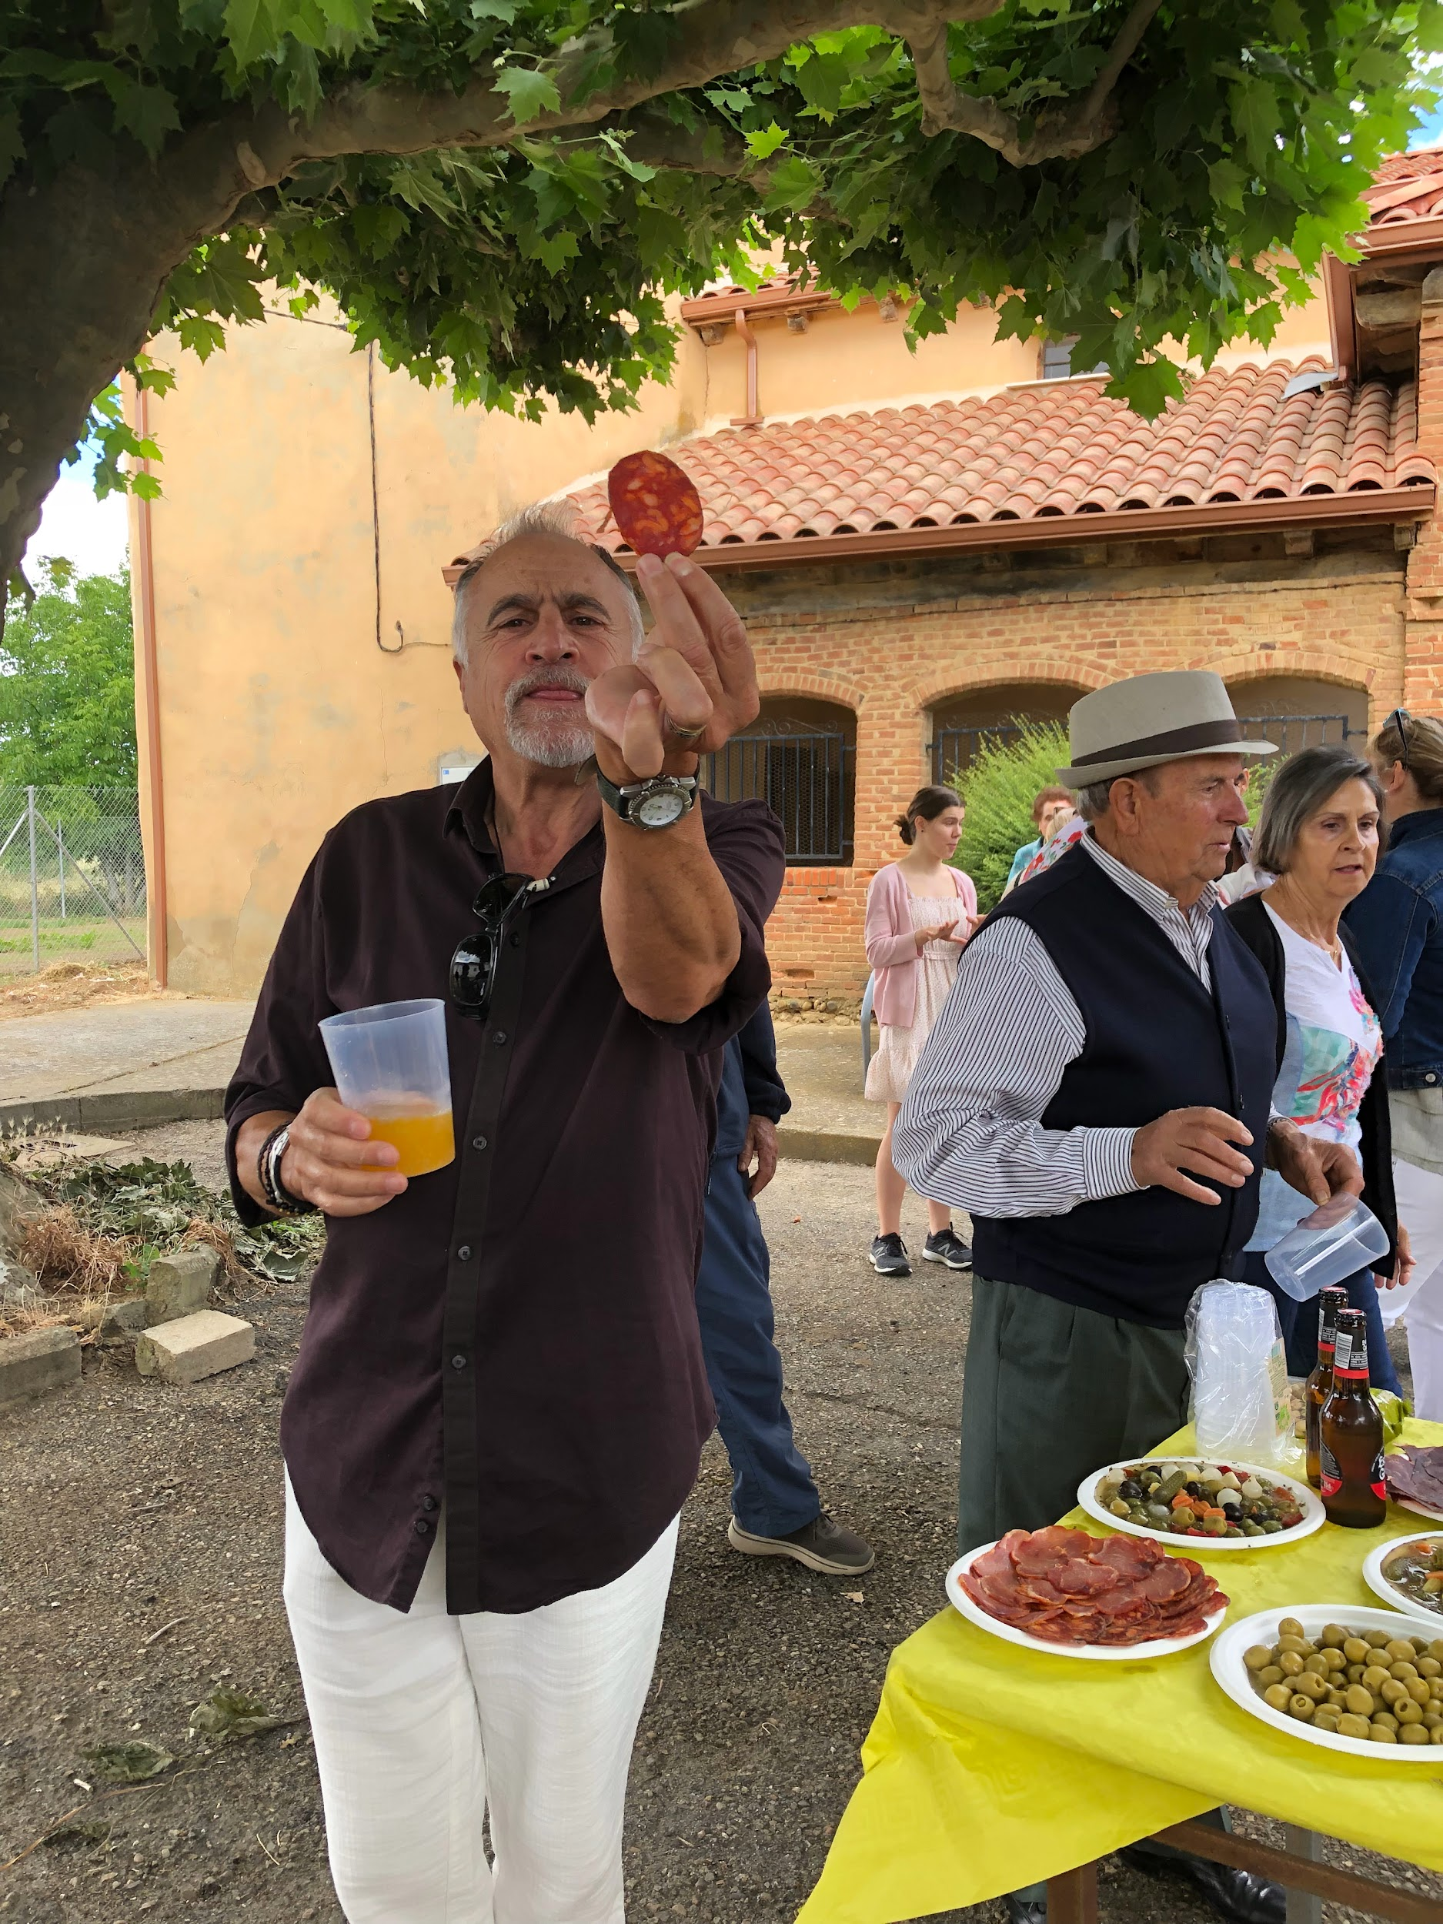
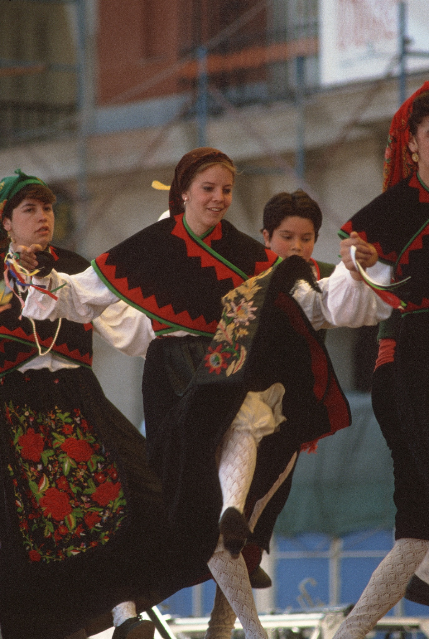
What is la jota?
La Jota is a folk dance widely practiced across Spain. While la Jota originated in Aragon, it is widespread in many provinces.
La Jota involves an lively, energetic tune usually in ¾ or 6/8
Jotas reflect the pride people have in their community, and also often tell a story about joys, sorrows, and love.
People dance with their arms up in the air adding to the joy created by the music
Typically they are danced at big events including
  Weddings
  Baptisms
  Religious Festivals/Village Festivals

Slide 4
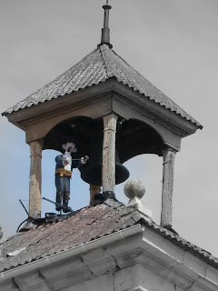
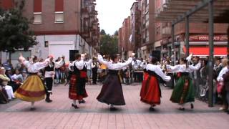
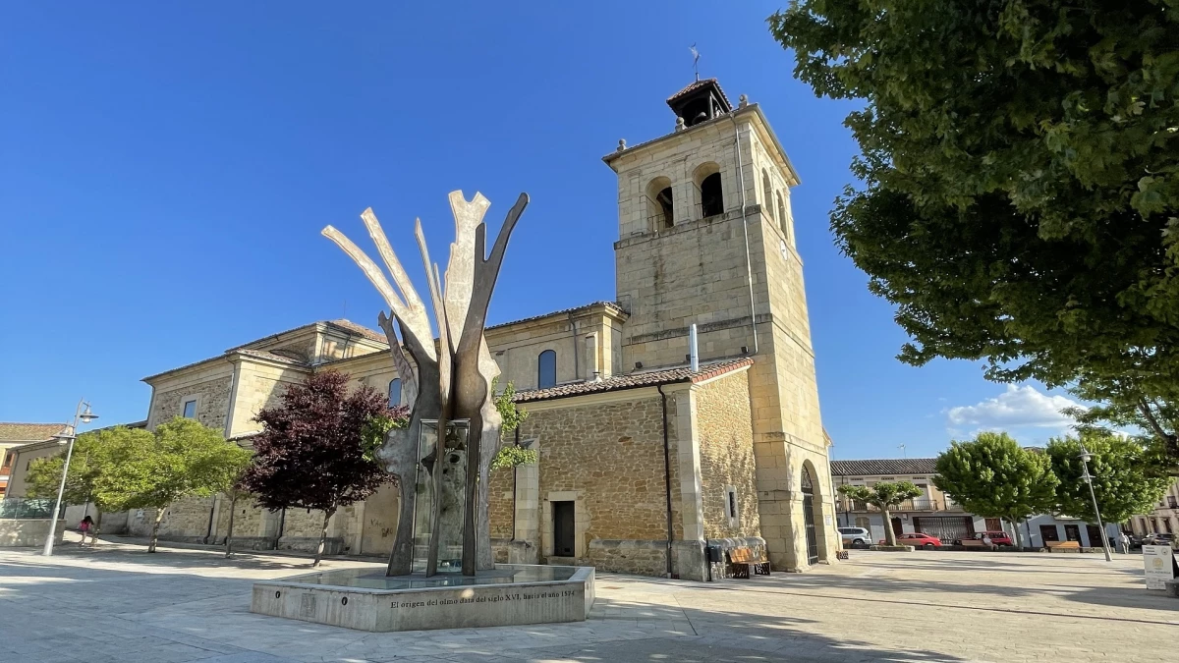
LA JOTA DE BOÑAR
Dos cosas tiene Boñar,
dos cosas tiene Boñar
que no las tiene León:
el maragato en la torre
y en la plaza el negrillón,
el maragato en la torre
y en la plaza el negrillón.
Boñar has two things,
Boñar has two things
that León doesn't have:
the Maragato in the tower
and the elm tree in the square,
the Maragato in the tower
and the elm tree in the square.
This phrase reflects the pride the people have in their municipality
El negrillon was a big elm tree in the main square that people identified themselves with
El maragato is a statue they also find comfort in
*La jota de la bañeza is also about another large town in Spain

Slide 5
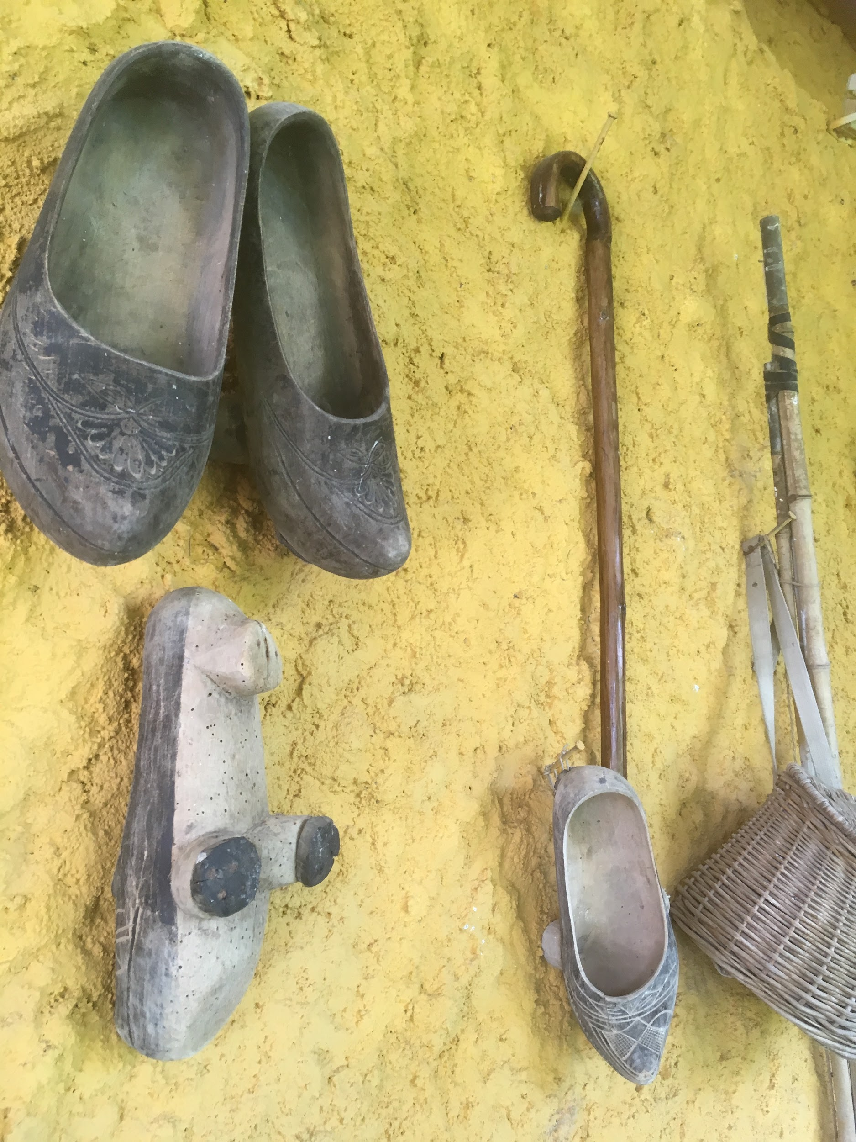
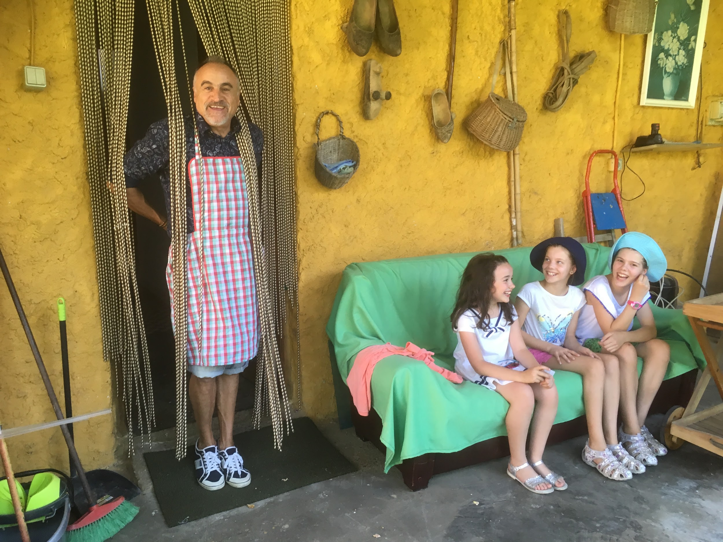
Que cuando llueve, leré, calzo madreñas
suenan los clavos, leré, sobre las peñas,
sobre las peñas leré, sobre las rocas,
que cuando llueve, leré, calzo galochas.
When it rains, leré, I wear wooden clogs,
the nails clatter, leré, on the rocks,
on the rocks, leré, on the stones,
when it rains, leré, I wear galoshes.
THE
REFRAIN
Many villages in Leon up until the past century were agricultural.
Most of the villagers were farmers and some were shepherds.
This song emphasizes the pride or “orgullo” that they had in their lifestyle consisting of hard work using the tools they had.
Madreñas keep feet elevated/dry in wet/muddy conditions

Slide 6
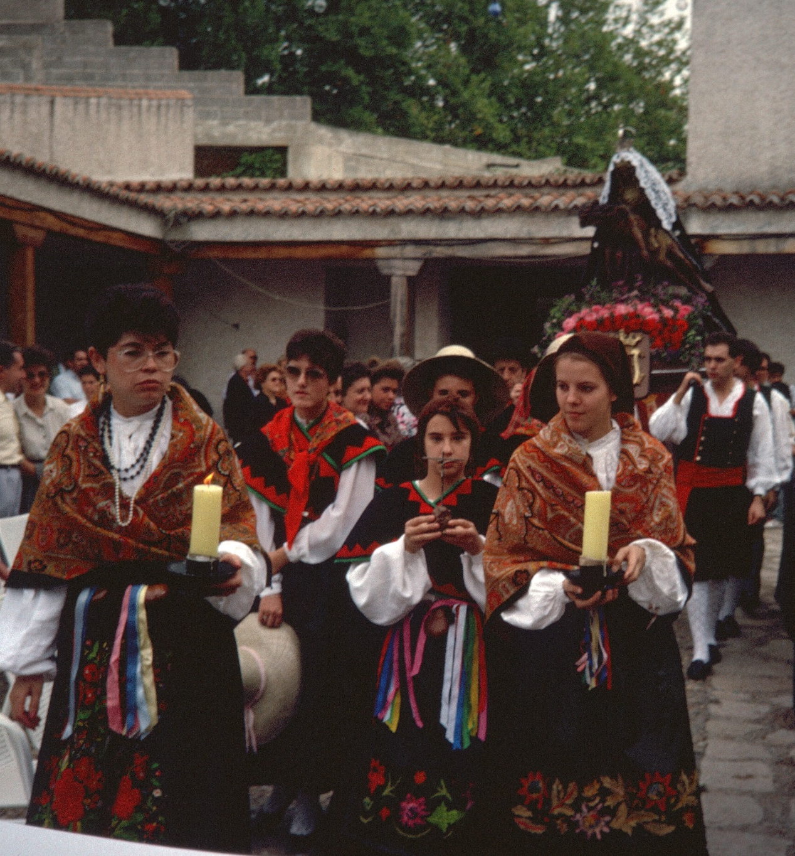
THE “Story”
Por bailar y no bailé
A la romería fui
por bailar y no bailé,
perdí la cinta del pelo,
¡mira lo que yo gané!
perdí la cinta del pelo,
¡mira lo que yo gané!
I went to the pilgrimage to dance,
but I didn't dance.
I lost my hair ribbon,
look what I gained!
I lost my hair ribbon,
look what I gained!
A romeria is a short communal pilgrimage where the people of the village carry the patron saint around
  They often leave it in ‘el campo’ or a field where they then dance
Many jotas revolve around religious festivals and celebrations
  This shows how religion and la jota were an intertwined rhythm of life
Romería de San Froilán
c.1988

Slide 7
No te debe entristecer,
Perder la cinta del pelo
no te debe entristecer,
que una mujer en el baile
¡qué menos puede perder!
que una mujer en el baile
¡qué menos puede perder!
Que cuando llueve calzo madreñas....
Un galán me la escuchó,
Una jota canté un día
y un galán me la escuchó;
esa jotica, señores,
no la vuelvo a cantar yo.
esa jotica, señores,
no la vuelvo a cantar yo.
You shouldn't be sad,
Losing your hair ribbon
shouldn't make you sad,
what else could a woman lose
at a dance?
what else could a woman lose
at a dance?
A suitor heard me,
I sang a jota one day
and a suitor heard me;
that little jota, gentlemen,
I won't sing it again.
that little jota, gentlemen,
I won't sing it again.

Slide 8
Tres arbolitos planté
Debajo de mi ventana
tres arbolitos planté:
un romero y un olivo
y un "jamás te olvidaré"
un romero y un olivo
y un "jamás te olvidaré"
Y con esta se acabó,
Ahora va la despedida
y con esta se acabó,
que se cansan los que bailan
y también me canso yo.
que se cansan los que bailan
y también me canso yo.
And with this it's over,
Now comes the farewell
and with this it's over,
those who dance get tired
and I get tired too.
those who dance get tired
and I get tired too.
I planted three little trees
Under my window
I planted three little trees:
a rosemary and an olive tree
and a "I will never forget you."
a rosemary and an olive tree
and a "I will never forget you."

Slide 9
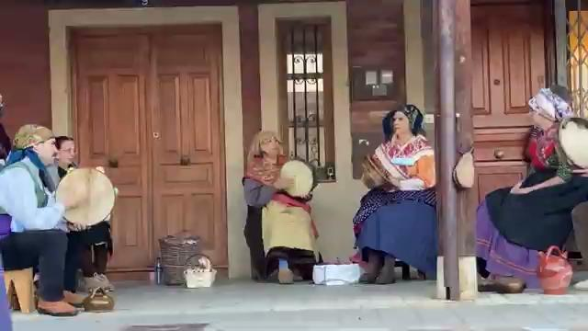
La Pandereta- Tamborine
Mansilla de las Mulas

Slide 10
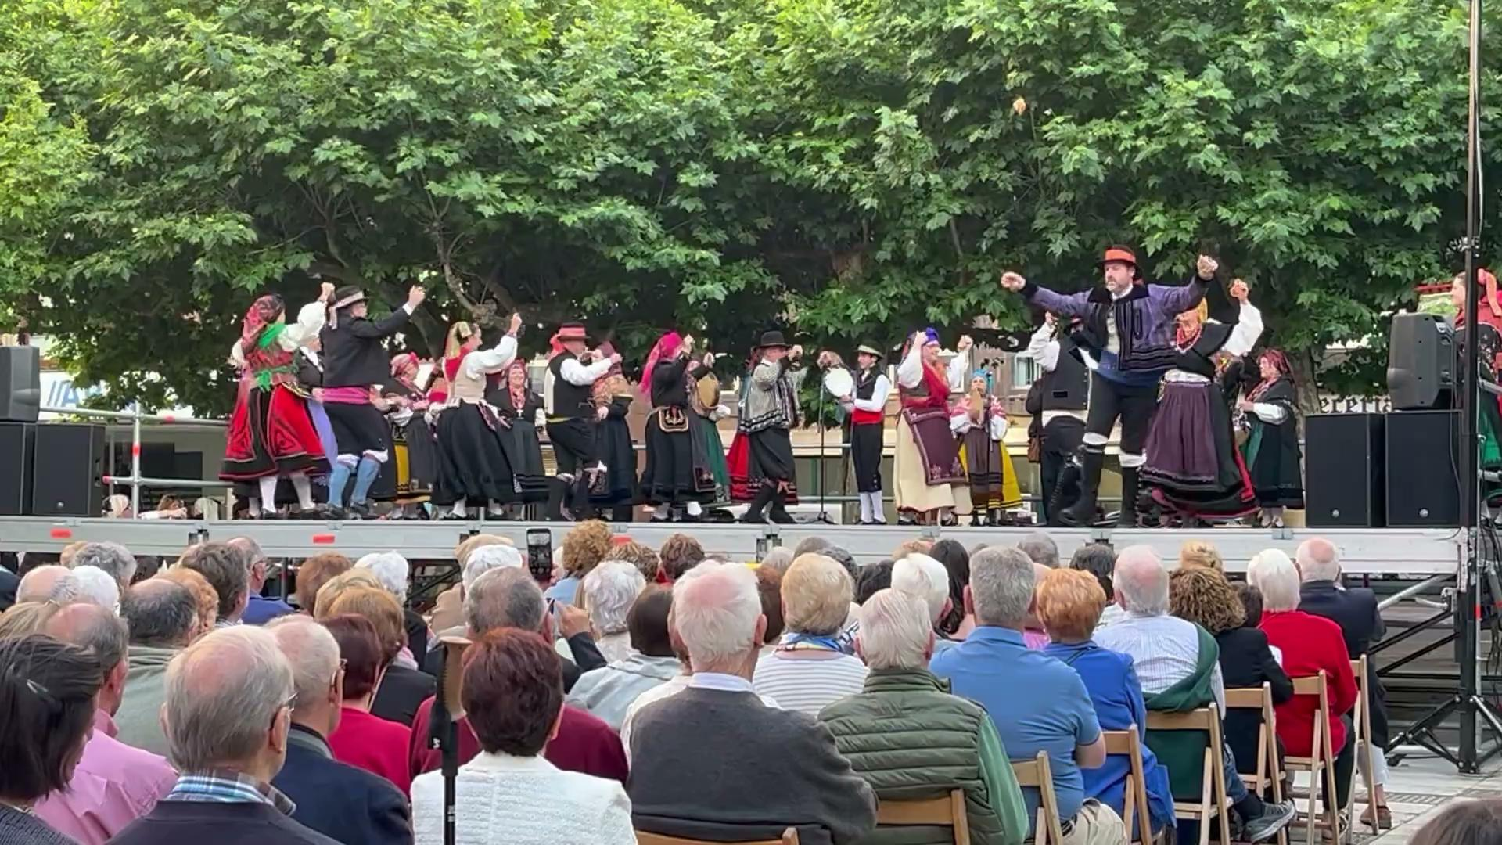
LAS CASTSÑUELAS- the Castanets
Castañuelas
In la jota you put it in your middle finger and whack it up against the palm of your hands as opposed to flamenco where it is strummed with right hand
Las fiestas de San Pedro y de San Juan en León capital
The rhythm in la jota is
“Bar-bar- A”

Slide 11
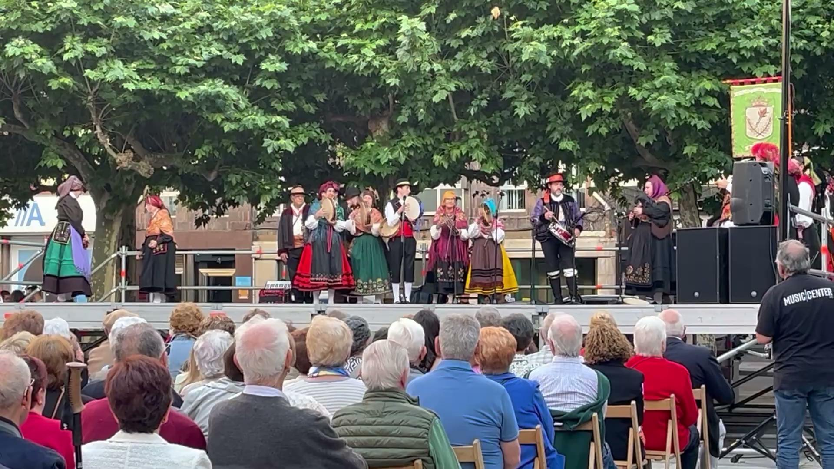
La Gaita- Bagpipes
Tambor- The Drums
Las fiestas de San Pedro y de San Juan en León capital

Slide 12
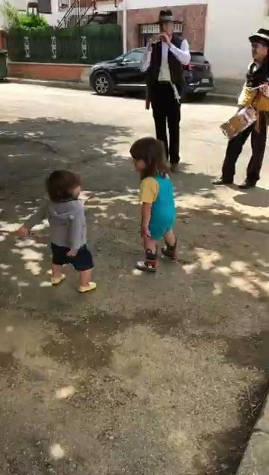
LA DULZAINA-
A typical
Clarinet-like
Instrument
from the region
Las fiestas del pueblo

Slide 13
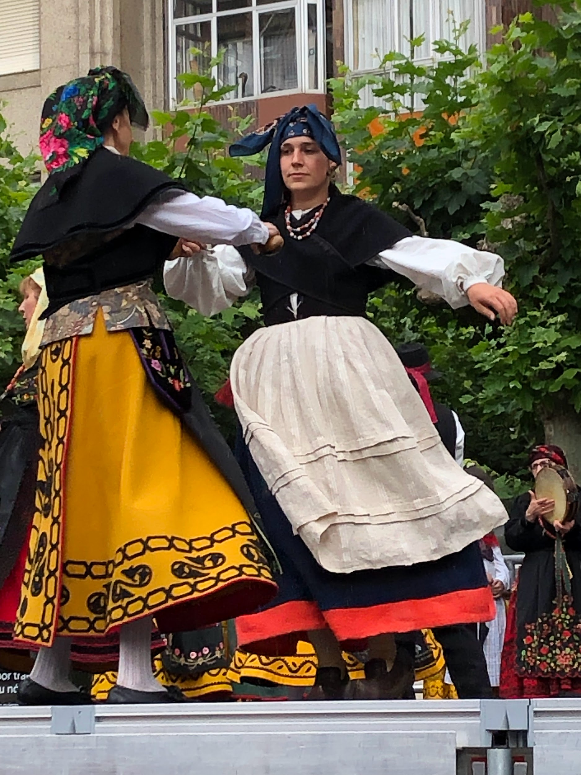
Threats to la jota
España Despoblada
Loss of Way of Life
Disinterest in Youth
It is important to value and perpetuate this cultural tradition before it is lost forever!

Slide 14
THANKS
Does anyone have any questions?
Please keep this slide for attribution

Slide 15
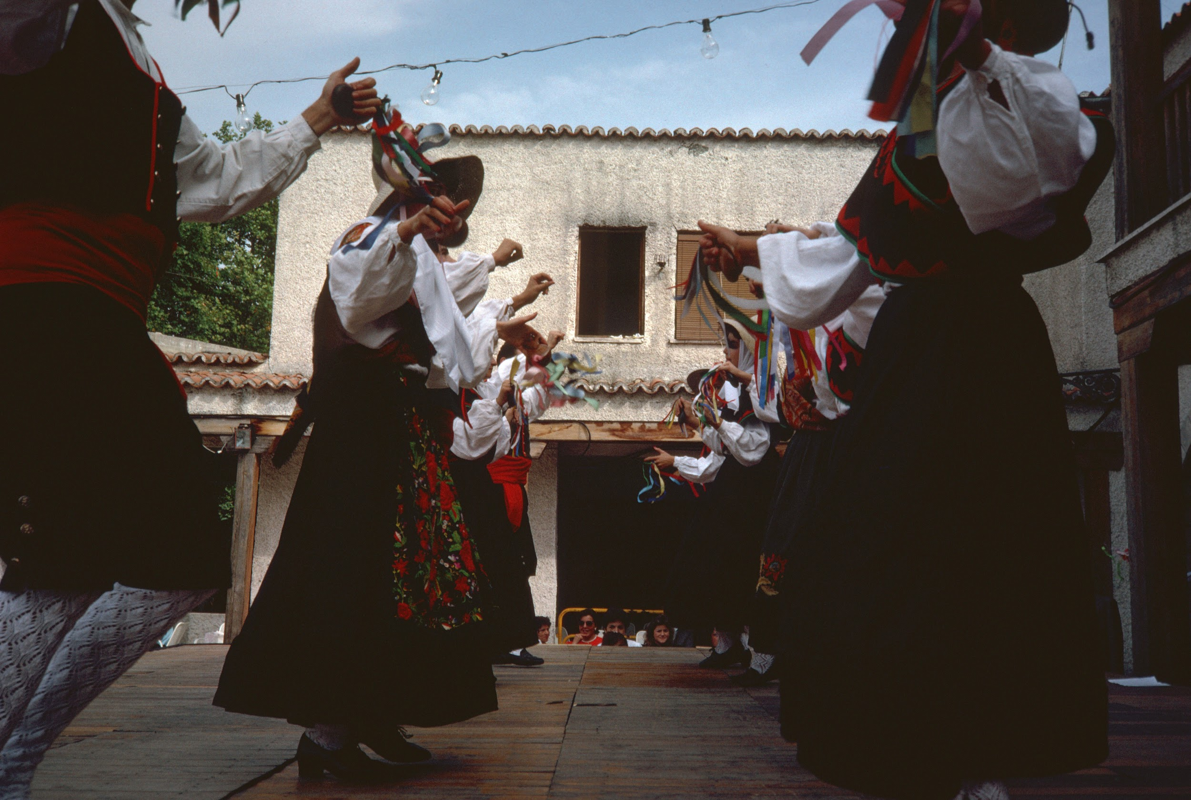
Sources
La Braa, Canción Tradicional Leonesa, Desde La Mi Ventana, grupolabrana.com/labrana04/lamiventana/jotaalegria.htm. Accessed 13 Jan. 2026.
Merche. Jota de Boñar, 1 Jan. 1970, cancioneroleones.blogspot.com/2007/07/jota-de-boar.html.
Rodriguez Adan, Jesus Acadio. “Jota de Bonar.” YouTube, YouTube, 2014, www.youtube.com/watch?v=x7pAw3lZ2xs.

