Slide 1
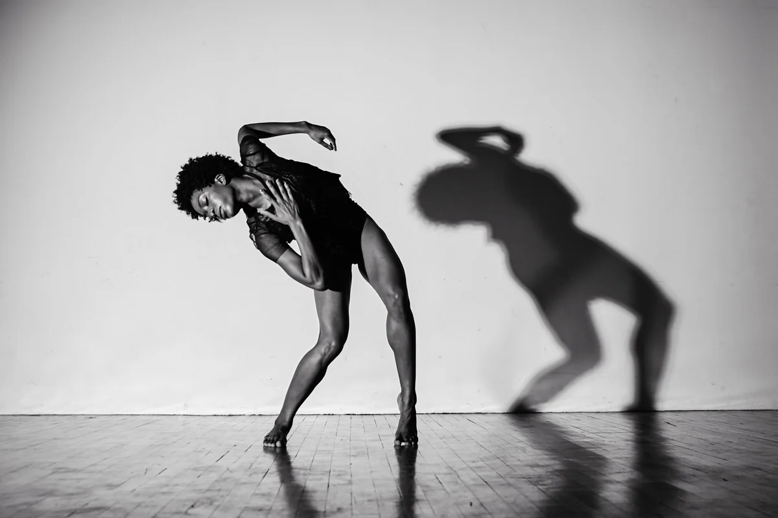
The movement of Modern Dance
Estelle Spira
Notes:
Modern dance began as a rebellion in the late 1890s. At a time when women were fighting for the right to vote, and the Industrial Revolution was changing the world, classical ballet felt like a relic of the 18th-century aristocracy. Dancers like Isadora Duncan threw away their corsets and shoes to reclaim bodily autonomy. Their goal was to create an art form that looked like the modern world: individualistic, free, and grounded in reality.

Slide 2
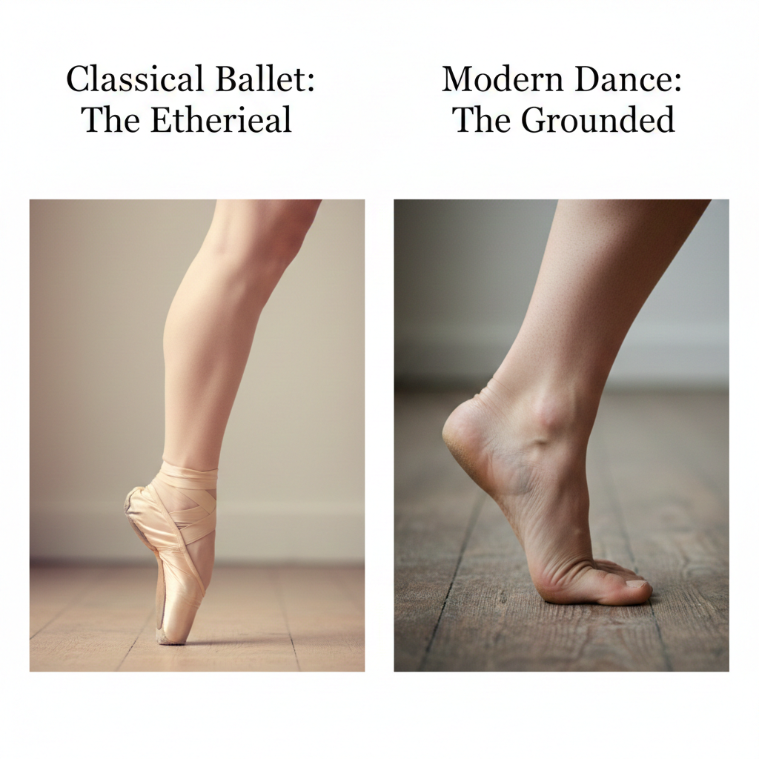

Motif: The Bare foot and floor
The bare foot is a rejection of the aristocracy associated with ballet shoes
Trying to connect more with with Earth and reality
Notes:
The most radical shift in Modern dance was the rejection of the ballet shoe in favor of the bare foot. Ballet shoes were meant to make women look like fairies or birds that could fly away from the Earth. This represented an aristocratic ideal of perfection and escapism. By dancing barefoot, early pioneers of modern dance, such as Isadora Duncan, were making a political statement: I am a woman, I am human, and I am not a fairytale. This was a cultural shift in dance toward realism. Not only did people start dancing barefoot, but they started dancing with flexed feet instead of the traditional pointed foot in ballet. This represented strength and resistance by showing the body physically pushing against the floor. The image of a pointed foot represented an elite world where the flexed foot was meant to be the “people’s foot” by looking functional and rugged. Finally, in ballet, gravity is something that you try to hide: you want to land as softly as possible, and you want to make every move look effortless. In modern dance, they embraced gravity, using the floor as a partner. They started crawling, falling, and flexing their feet to show the physical reality of the human form.

Slide 3
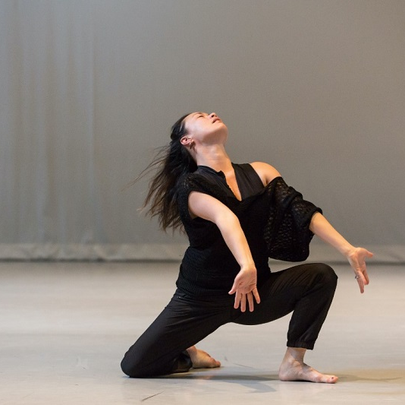
Emotion: Contraction and inner truth
Contraction and release - based on the breath and sob
Showing the work of the body
The idea that “the body never lies”
Notes:
In the early 20th century, the dance culture shifted toward psychological realism. Martha Graham famously said, 'The body never lies.' She developed the contraction and release, a movement based on the physical act of sobbing or gasping. Unlike classical ballet, which hides effort in order to look pretty and well-composed, Modern dance makes the struggle visible. It tells us that in modern culture, emotional honesty is more important than surface-level perfection. By showing tension and weight, these dancers weren't just performing; they were revealing the 'inner landscape' of the human soul by showing fear, grief, and resiliance.

Slide 4
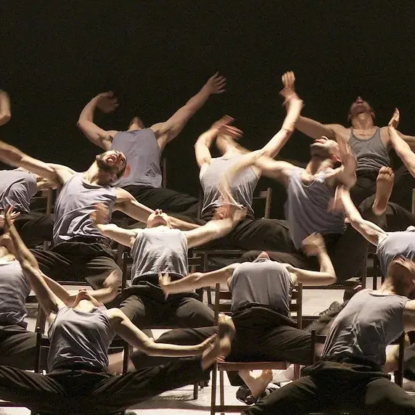
Social context: Democracy and identity
Decentralizing the movements so there isn’t one leader, but instead creating an equal playing field
Using dance as a tool for social justice
Alvin Ailey specifically trying to bring the Black experience to the center of art
Notes:
The social context of Modern dance is a timeline of rebellion. It began with the Industrial Revolution and the Women’s Rights movement. Early pioneers literally threw away their corsets and shoes in an attempt to appear less rigid and mechanical in a time when machines were becoming much more prevalent. They were also the physical version of the Suffragettes, proving that a woman’s body was her own, not a decorative object for the male gaze. As the 20th century progressed into the 1950s and 60s, this idea of freedom expanded into Social Justice. Alvin Ailey’s 1960 masterpiece, Revelations, is the peak of this social evolution. Ailey choreographed a piece called “Wade in the Water.” A lot of people think this piece is only about the Underground Railroad, and while the song has those historical roots, Alvin Ailey used it here to show a Baptism. This piece is based on his childhood memories of growing up in the segregated South (Texas) in the 1930s and watching people get baptized in the local creek. By putting a Southern Black baptism on a prestigious global stage in 1960, he was saying: "Our private, religious, and cultural rituals are 'High Art.' They are worthy of the same respect as a European ballet. From the factories to the Civil Rights front lines, Modern dance has always been a social tool for reclaiming identity.

Slide 5
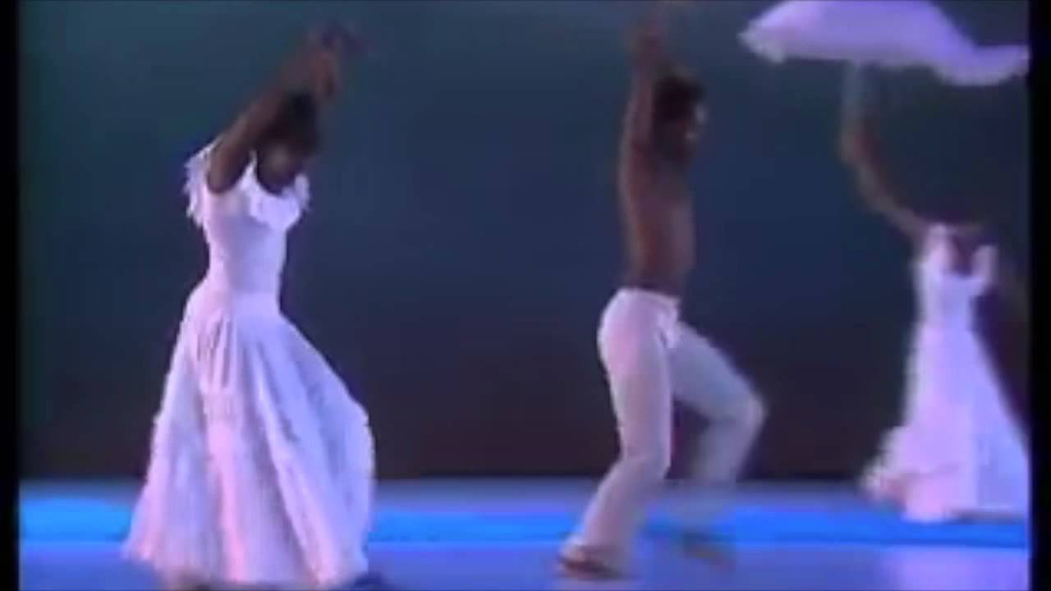
Aivin Ailey: Wade in the water
https://youtu.be/Fzq5kX6OT_s?si=ROPNvyuUwiEjHy5I

Slide 6
  A manifesto in motion
Individualism over tradition
Authenticity over artifice
Humanity over perfection
“Dance is the hidden language of the soul” - Martha Graham
Notes:
To conclude: Modern dance is the physical manifesto of the 20th century. By trading tutus for tunics and slippers for bare feet, these artists showed that our culture values individualism, psychological depth, and social equality. It teaches us that to be 'modern' is to be grounded in our own truth.

Slide 7
Citations
https://human.libretexts.org/Bookshelves/Dance/So_You_Think_You_Know_Dance_-_Fundamentals_of_Dance_(Whipp_Spears_Perlis_and_Kanamoto)/01%3A_Sections/1.04%3A_Modern_Dance
https://sciendo.com/2/v2/download/article/10.2478/njd-2017-0009.pdf
https://artsintegration.com/wp-content/uploads/2015/05/Modern.pdf
https://atomicballroom.com/blog/2017/05/30/the-dos-and-dont-of-barefoot-dance/
Images:
https://www.dancepaw.com/monthly-announcements/2019/2/8/litvakdance-master-class-with-tamisha-guy-contemporary-ballet
https://www.critical-stages.org/29/visions-and-gifts-martha-graham-memory-and-practice/
https://www.iabarcelona.com/stageculture/dance/history-of-contemporary-dance/

