Slide 1
The Charleston
James P. Johnson
Arya Adusumilli

Slide 2
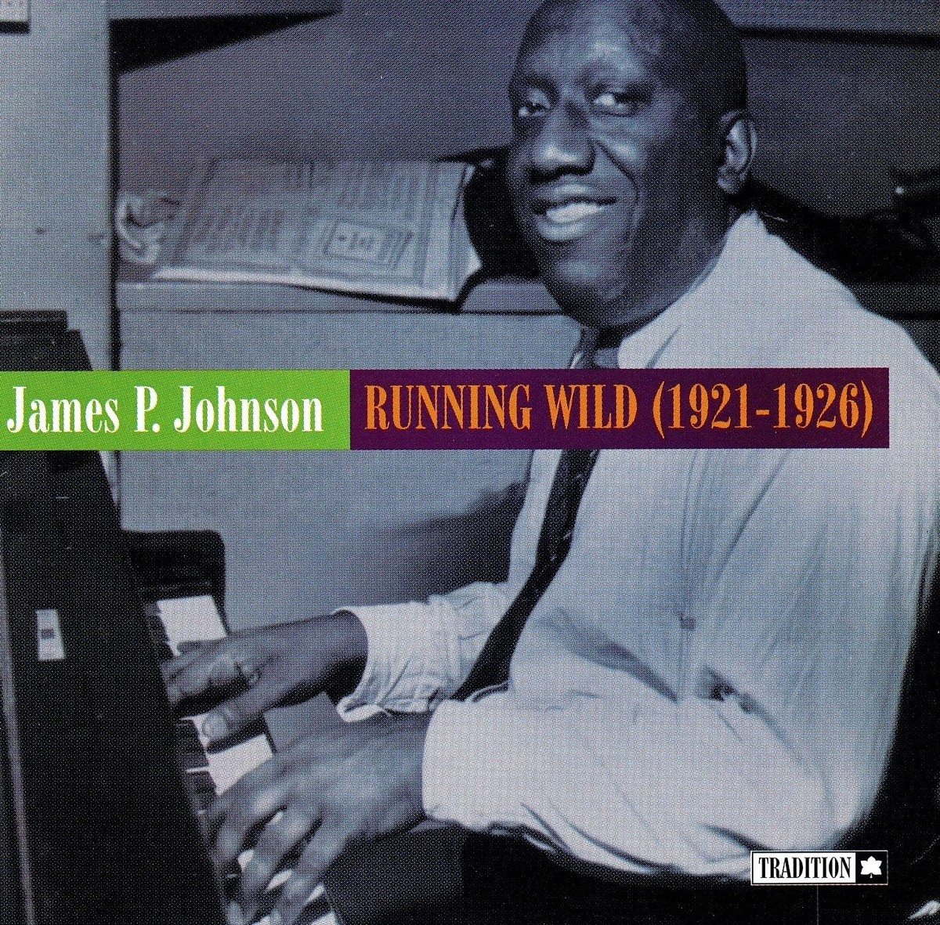
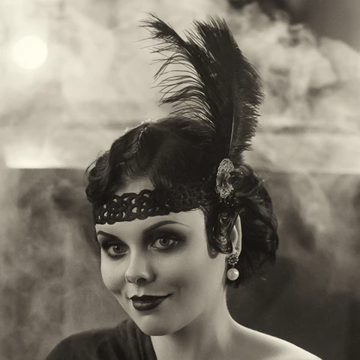
Context
James P. Johnson, for Runnin’ Wild (1923)
Originally tied to black dance spaces
Dance craze among “flappers” in prohibition, jazz-age “roaring 20s” speakeasies
  Term originally English slang, reclaimed by young women

Slide 3
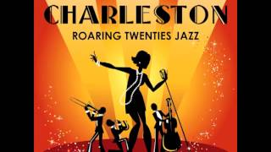
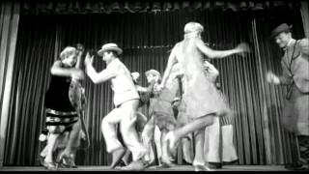
Represented cultural shift away from constricting norms in favor of expressiveness, freedom of young women
Social belonging associated with dance, rejection of obedience and old guard

