Slide 1
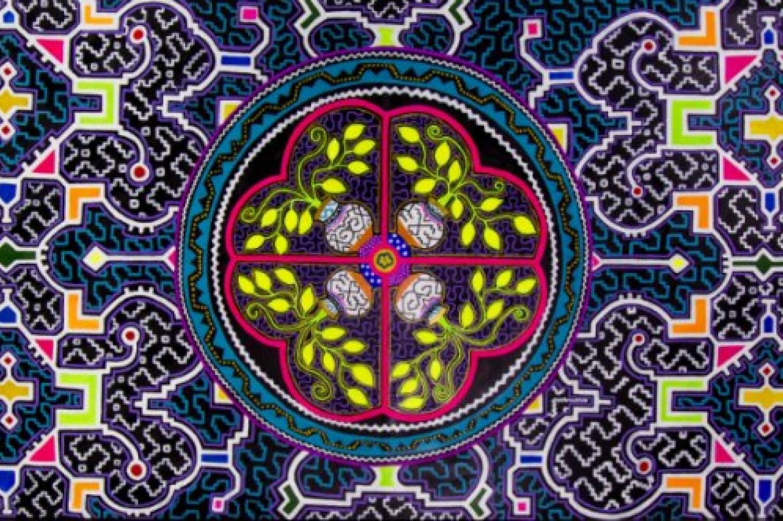
Shamanism in the Shipibo-Conibo
Presentation by Solomon Wechter

Slide 2
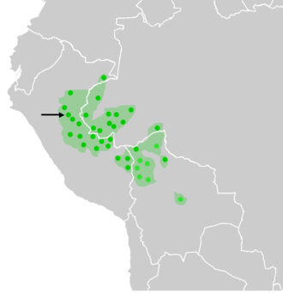
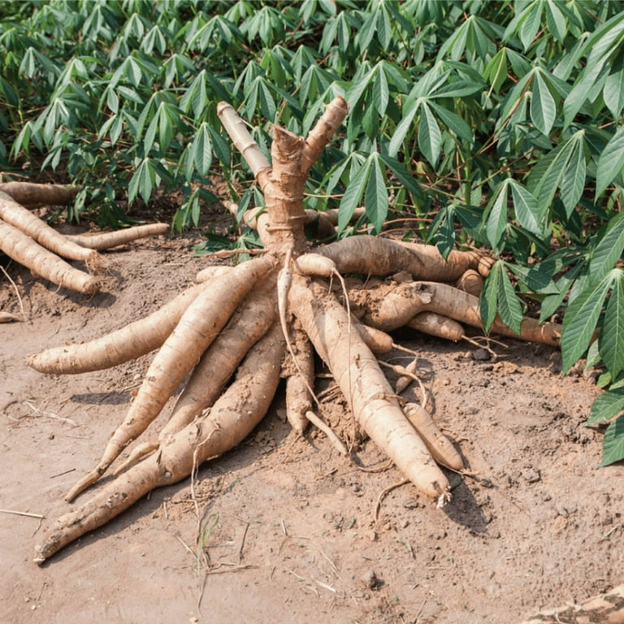

The Shipibo-Conibo
Indigenous group from the Amazon Rainforest in Peru
20,000-40,000 in population
Date back about 3,000 years
Diet of fish, yucca plant, and fruits
Located on Ucayali river

Slide 3
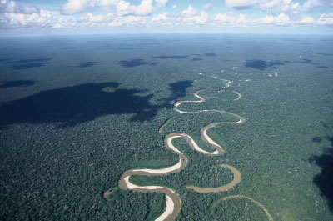
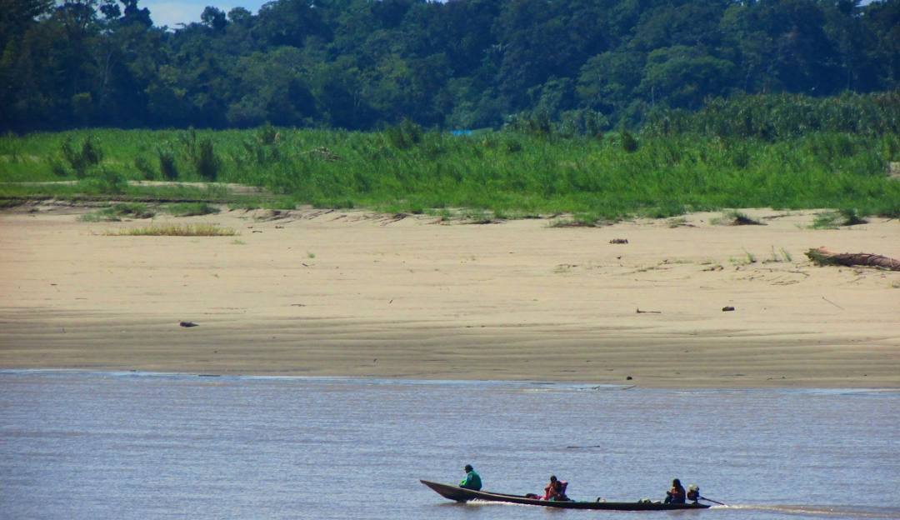
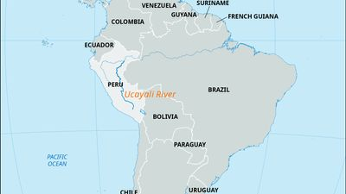
The Ucayali River
The main highway for travel and trade
Strong part of the identity
Shipibo-Conibo cosmology describes the Ucayali as a life-giving mother
  Yearly floods replenish soil for crops
  Fish

Slide 4
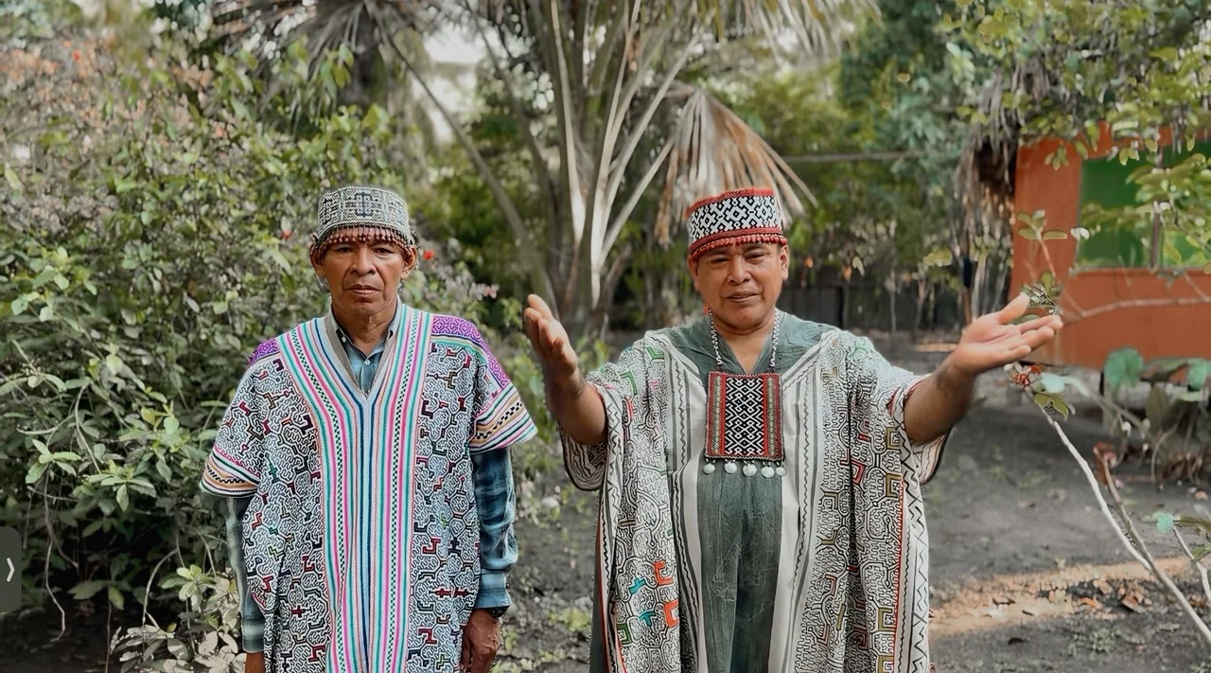
Shamanism
Famous for their Ayahuasca ceremonies
Traditionally community-based, in recent decades many ceremonies also occur in retreat centers serving international visitors
"In Shipibo culture, healing is not an event but a way of living. The plants teach through diet, silence, song, and discipline. Ayahuasca is only one part of a much larger medical and spiritual system that has been refined over generations."
Becoming a shaman is a rigorous process that often begins in adolescence and can take many years
Deep apprenticeship under experienced shaman
Dieta – crucial period of extended isolation in the jungle
  death/rebirth initiation
Develop connection with the plant spirits believed to impart wisdom and guidance

Slide 5
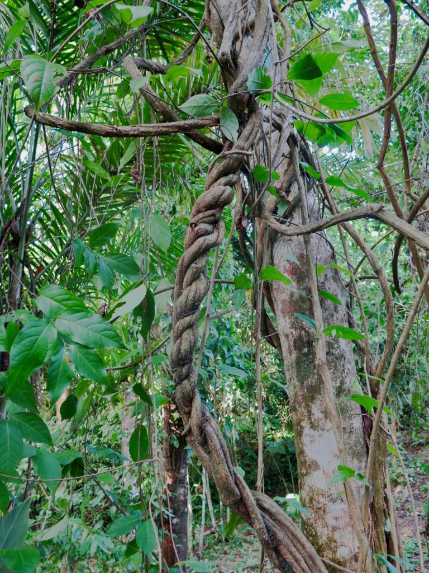
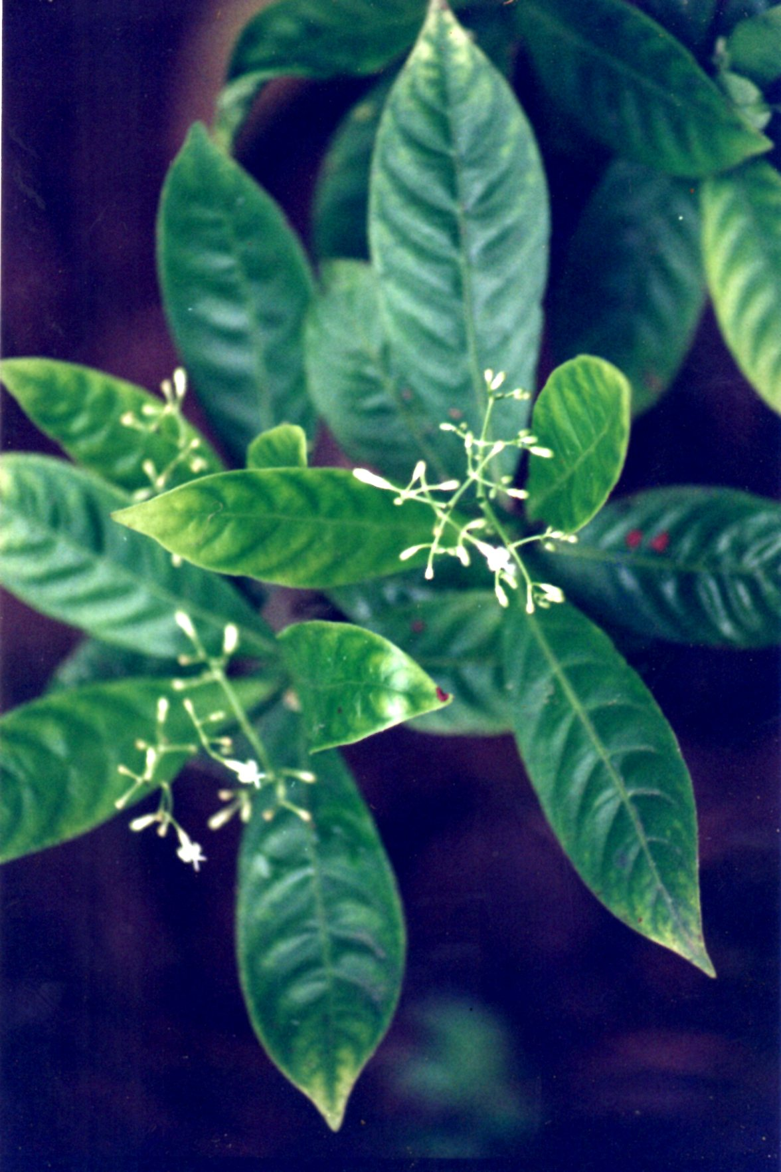
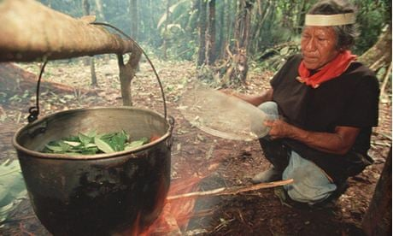
Ayhuasca
The ayahuasca vine - Banisteriopsis caapi
The DMT-containing leaf - Psychotria viridis
Both grow in the surrounding jungle
The vine is pounded, combined with the leaves, and boiled for many hours in large pots over a wood fire until reduced to a concentrated brew.
Consumed within a ceremonial context, often at night
Shaman drinks with you
Deeply intense experience
Lasts 4 – 6 hours

Slide 6
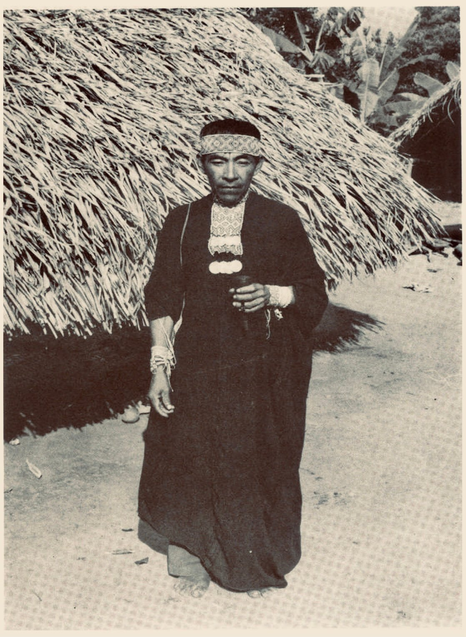
Shamanism
View nature as a living entity, with every plant, vine, river, and animal holding spiritual significance
Ceremonies are traditionally conducted for spiritual and physical healing
Shamans are considered healers (Onaya: “one who has knowledge/vision.”)
An Onaya leads ceremonies, sings icaros (healing songs), diagnoses spiritual imbalance, and works with medicinal plants.

Slide 7
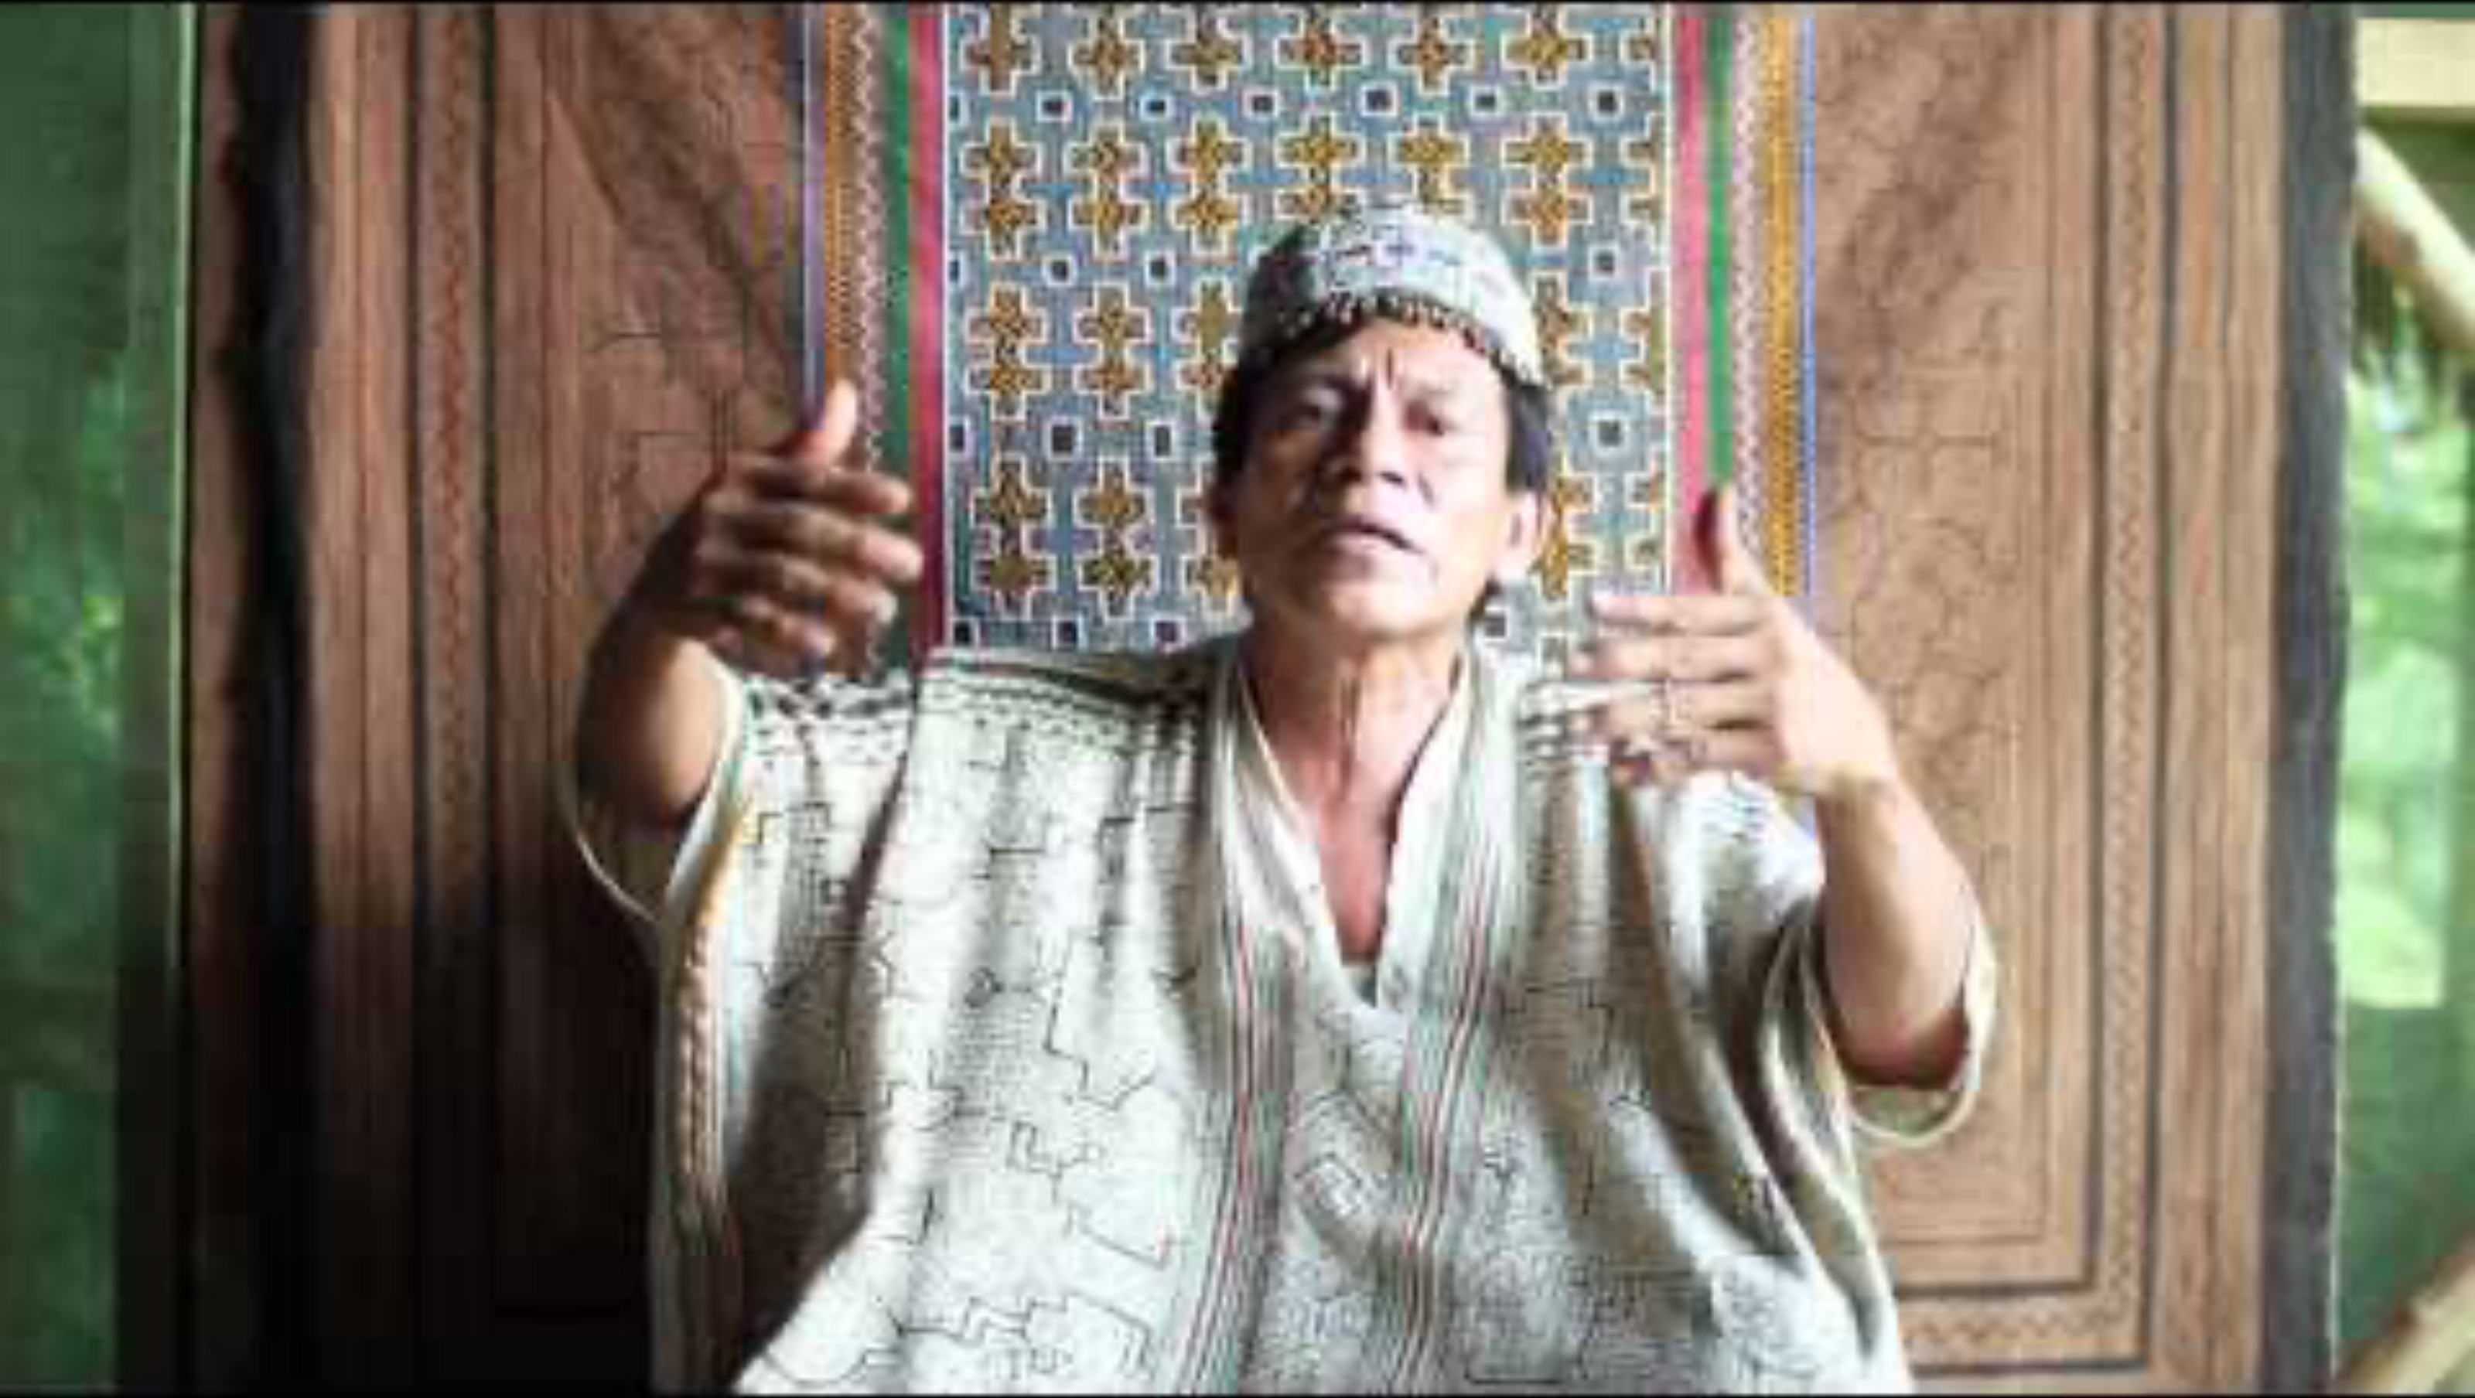
Icaro song

Slide 8
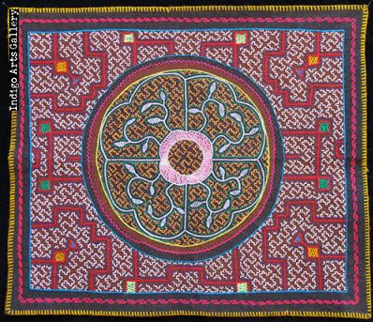
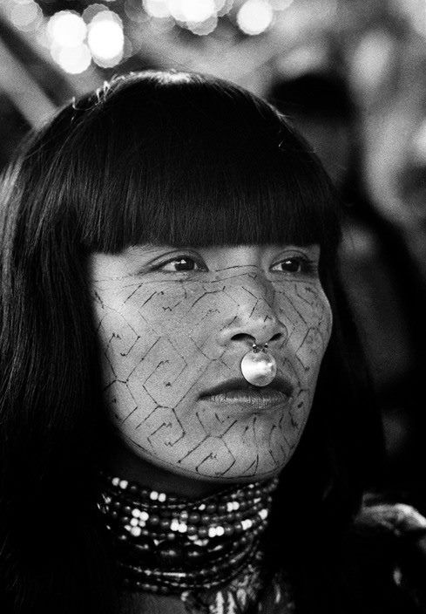
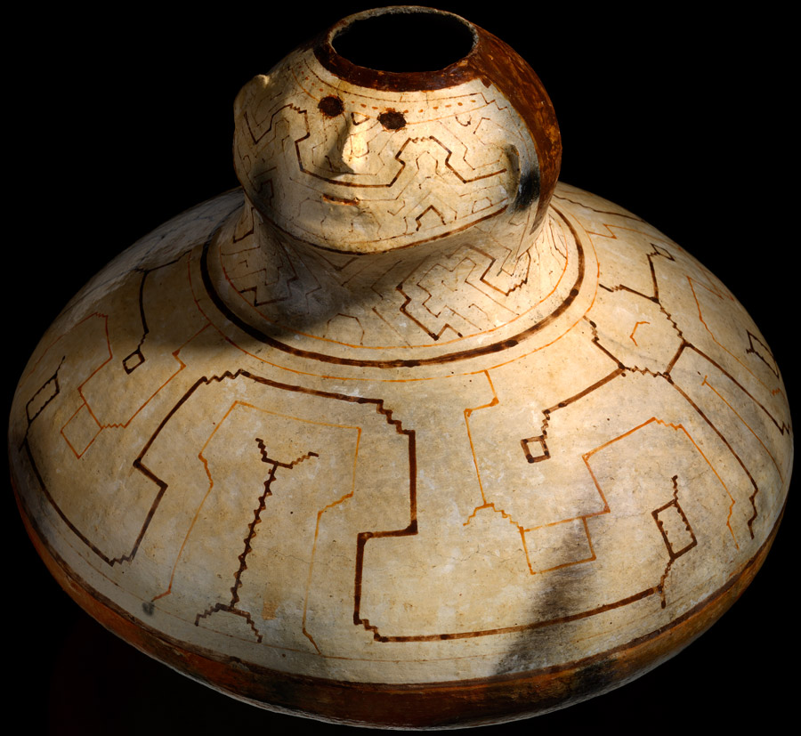
Artwork
The geometric kené designs are often described as visual patterns perceived during vision
Usually mandala and circular shape

Slide 9

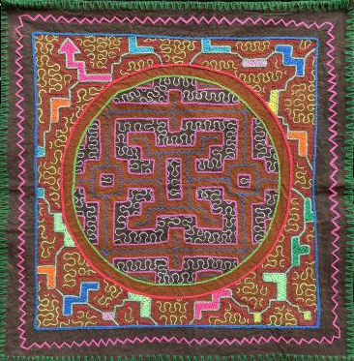
Mandalas
Microcosm, inner world, reflection of the macrocosm

Slide 10
Mandalas
Microcosm, inner world, reflection of the macrocosm

Slide 11
Shamanism’s Role in Society
Shamanism is a pursuit of more authentic states of being/consciousness
Source of knowledge based on direct, subjective, immediate experience that is revelatory in nature (different from objective and large sample sizes)
Spiritual and transcendent experience as the connection to the meaning of our human life
Institutions/groups dedicated to the exploration of the unknown
  Intellectual, scientific, avant garde artistic communities
  Just one or a few people in an indigenous society
Generators of culture
We’re a society desperately in need of a shamanistic approach, of the healing experience of being alive
“God is dead and we have killed him, and we will never wash the blood off our hands” –Nietzsche
  cultural collapse of shared meaning structure
Visionary experience as myth making, meaning making, imagination, art, relation to what is beyond, transcendent

Slide 12
Sources
“Shipibo-Conibo.” Wikipedia, Wikimedia Foundation, 6 Nov. 2025, en.wikipedia.org/wiki/Shipibo-Conibo.
“Shipibo Culture.” Shipibo Culture: Ayahuasca Tradition, Art, and Spiritual Heritage, www.apljourneys.com/shipibo-culture. Accessed 11 Feb. 2026.
“Precarious Resilience: An Ethnography of Shipibo Communities.” Precarious Resilience: An Ethnography of Shipibo Communities | Tropical Resources Institute, tri.yale.edu/tropical-resources/tropical-resources-vol-39/precarious-resilience-ethnography-shipibo-communities. Accessed 11 Feb. 2026.
Chatgpt.com

