Slide 1
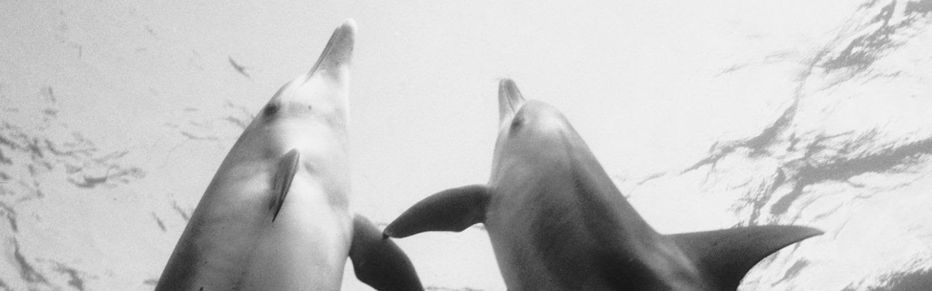
The Bajau People
A people shaped by the sea
Kate Smigie

Slide 2
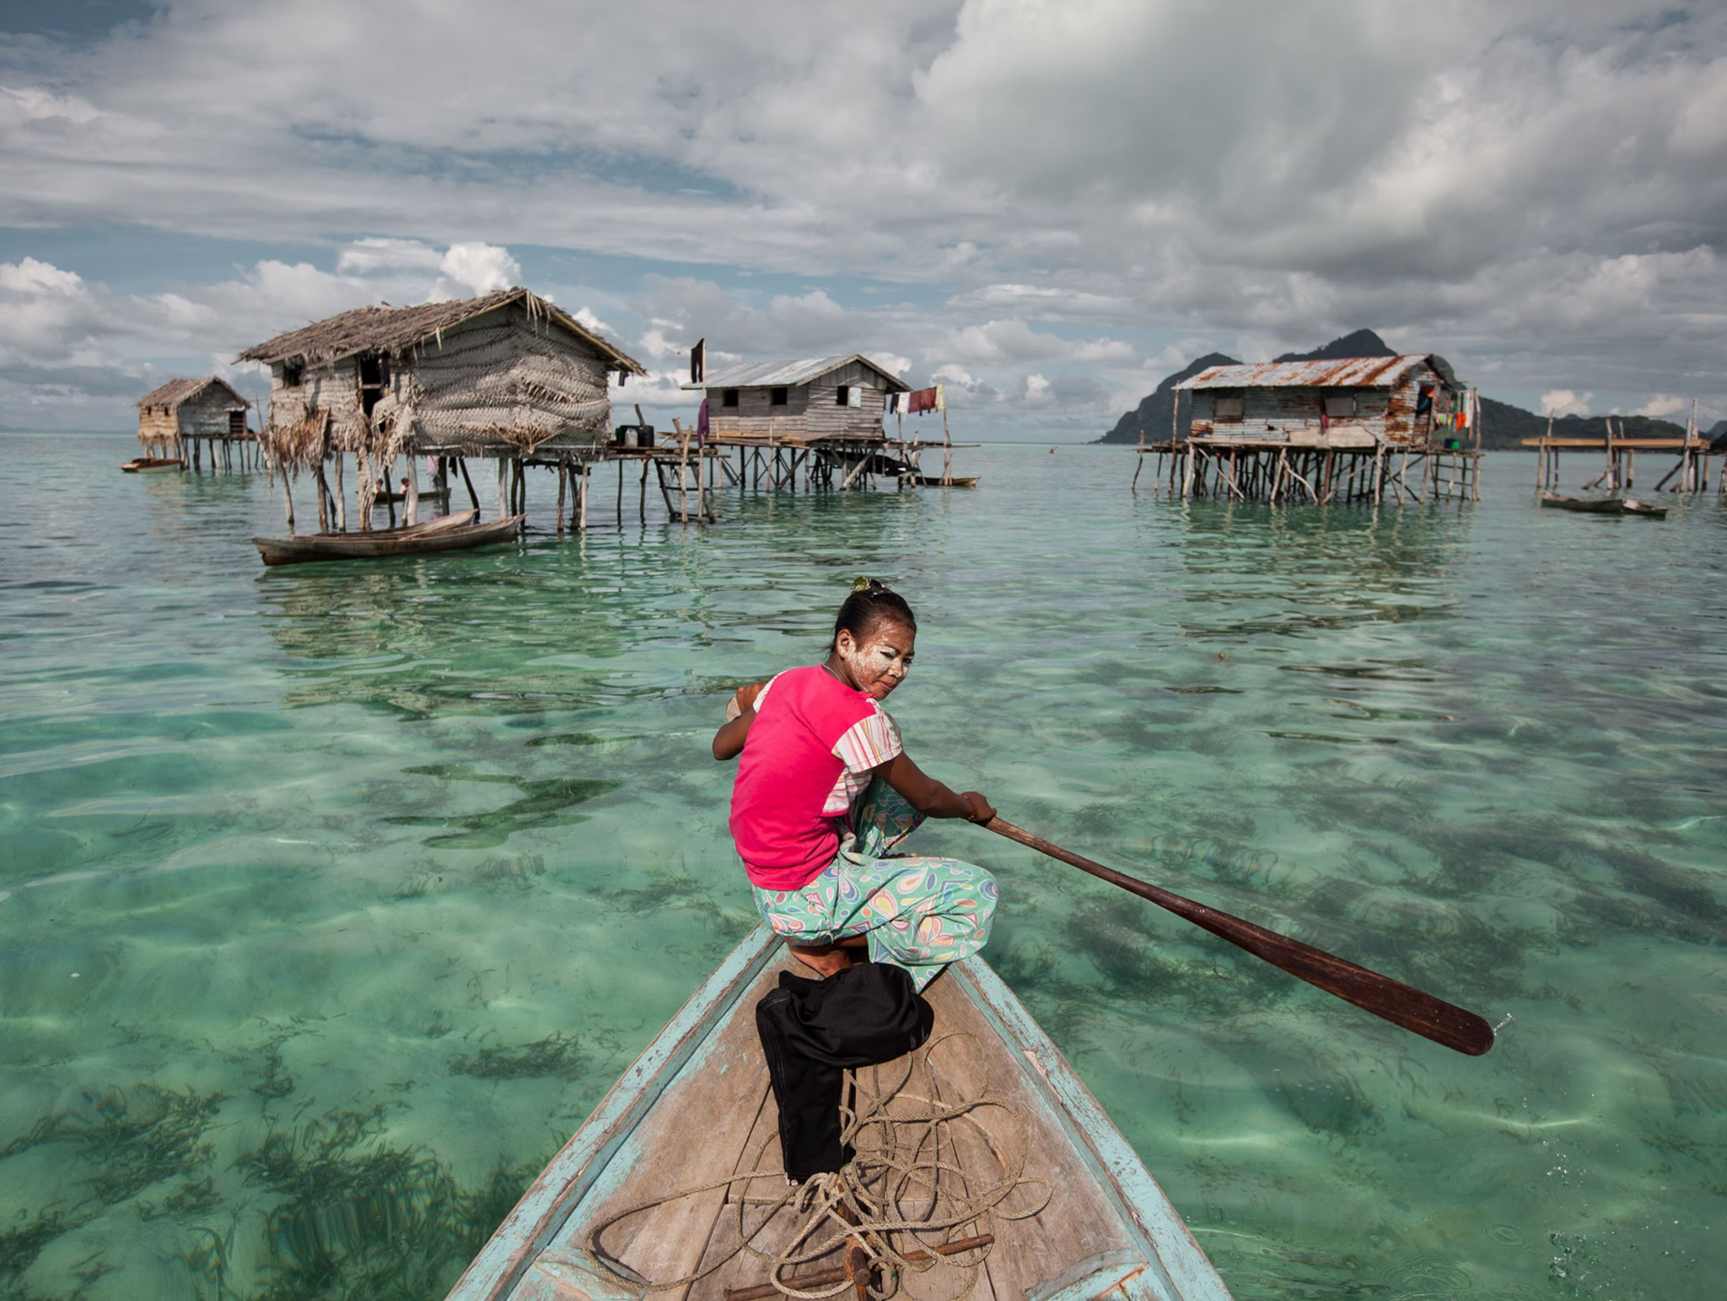
Who are they?
“Sea Nomads”
For the Bajau, the sea is not just a resource. It is not merely their home, but also a material that shaping their identity and worldview.
The Bajau people are indigenous, nomadic people that reside in the Sulu Sea which is bordered by Indonesia, Malaysia, and the Philippines.
For centuries, many Bajau lived in the ocean house boats(lepa- lepa) or in stilt houses built in shallow water.
The physical environment and available resources within the sea has deeply shaped their culture, daily life, and beliefs.

Slide 3
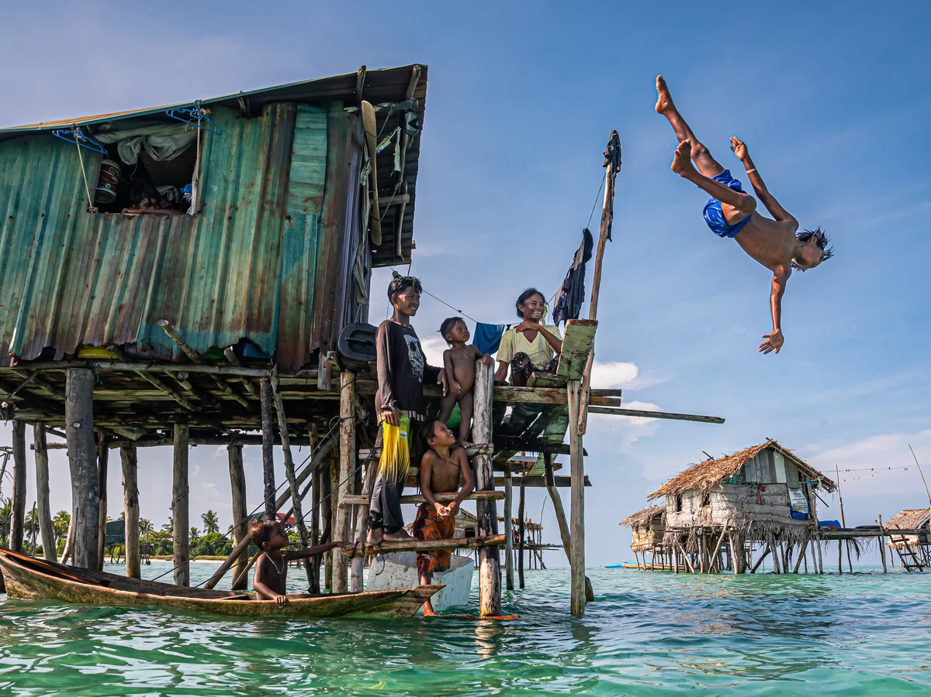
Changes to Material Base
Section 1
Climate change
  Increased intensity of storms, coral reefs threatened/many disappearing
Pirates(attacks intensifying)
Commercial fisherman/overfishing
  Less access to food
Access to technology
  Motor boats, sodium cyanide fishing, etc.
Rigid government/borders
  ‘Stateless’ status, so they might be arrested if they sell their fish ashore
  People are beginning to assimilate feeling pressure to move to the mainland

Slide 4
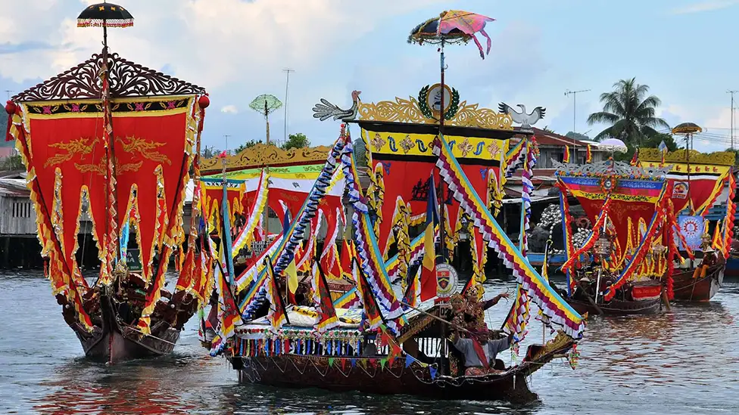
Social Life
Gender roles
  Men typically catch food
  Women typically take care of children, do cooking, and household chores.
Borak Buas(sunscreen) typically used by younger, unmarried women.
Marriages are usually arranged
Some people who move ashore have started to pursue a traditional education and professions whereas people living on the boats typically do not.
  Bajau face discrimination
  Bajau on land practice more arts such as weaving
High infant mortality rate due to lack of healthcare/drowning
Families typically move in “clusters” of 2-6 families
Begin working at a young age, children help to occasionally sell to local merchants
  agar agar in exchange for money or other goods like rice
Regatta Lepa- annual boat racing

Slide 5
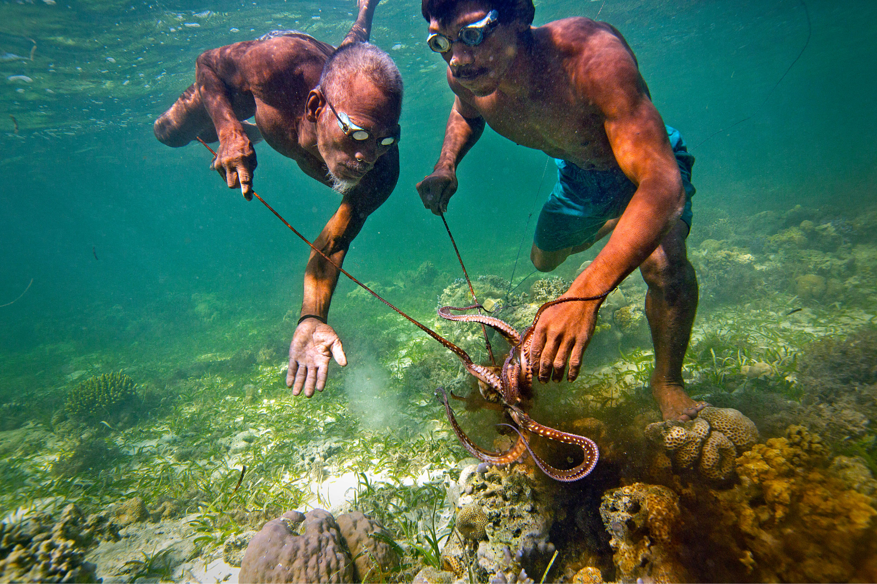
Daily Practices
Life at Sea
Skilled artisans create boats
Ecological wisdom allows them to navigate the waters with GPS
Bajau people spend hours a day diving for food (and diving for fun)
  Eardrums are ruptured at a young age
  Enlarged spleen allows for them to dive at greater depths
  Use spears, nets, etc.
Consuming their catch
  Build small fires to grill fish
  Sometimes let the fish dry up on the roof
  Not only fish eaten but also stingrays, sea cucumber, and other crustaceans
Bajau people on land tend to practice agriculture
  Rice, cassava, bananas harvested

Slide 6
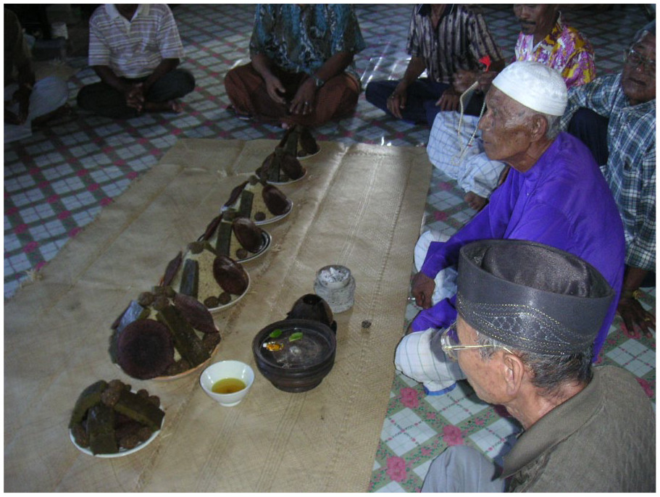
Beliefs and Spirituality
The Bajau are pacifists in nature as they tend to flee from danger instead of fighting it(ex: pirate attacks)
“Simple “ lifestyle, less focus on material gain
They practice a combination of islam and animism
  Those that live on land are typically more rooted in islamic traditions
    Attend services at mosques
    Observe ramadan/ celebrate eid
  Those at sea are more connected to spirits and the god of the sea
    Magigal jin: seances @ night
    Pamatulikan: spirit boat during epidemics
    Pray to the god of the sea when children fall ill https://www.youtube.com/watch?v=hE-CzRvWJ2E(7-8)
mag-paii-bahau-Magduwata (yellow rice seance- annual thanksgiving ritual)

Slide 7
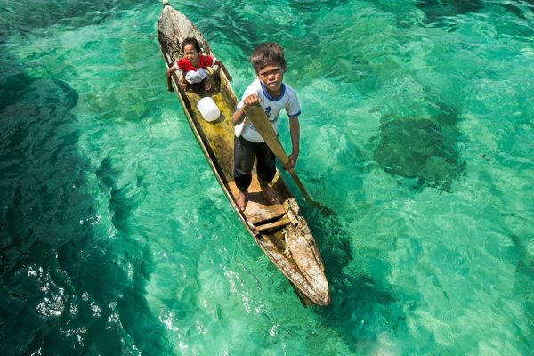
Resources
“Bajau.” ISEMPH, isemph.org/Sea-Nomads. Accessed 20 Jan. 2026.
Cira. “Sea Nomads No More: The Sama-Bajau and the Climate Crisis.” Journal of Foreign Affairs at Carolina, Journal of Foreign Affairs at Carolina, 20 Mar. 2024, jfacunc.org/oceana-pacific/sea-nomads-no-more-the-sama-bajau-and-the-climate-crisis.
.“." Encyclopedia of World Cultures. . Encyclopedia.Com. 6 Jan. 2026 .” Encyclopedia.Com, Encyclopedia.com, 21 Jan. 2026, www.encyclopedia.com/humanities/encyclopedias-almanacs-transcripts-and-maps/bajau.
“Swimming with Sharks.” EarthDate, www.earthdate.org/episodes/swimming-with-sharks#:~:text=Episode,their%20catch%20and%20escape%20storms. Accessed 20 Jan. 2026.
“The Last of the Sea Nomads.” The Guardian, Guardian News and Media, 17 Sept. 2010, www.theguardian.com/environment/2010/sep/18/last-sea-nomads.
YouTube, YouTube, www.youtube.com/watch?v=hE-CzRvWJ2E. Accessed 20 Jan. 2026.
YouTube, YouTube, www.youtube.com/watch?v=V6f82UA78Co&t=19s. Accessed 20 Jan. 2026.
Thank you!

