Slide 1
Material Culture and Environmental Determinism among the Mbuti of the Ituri Forest
Based on: Pygmies of the Rainforest by Kevin Duffy

Slide 2

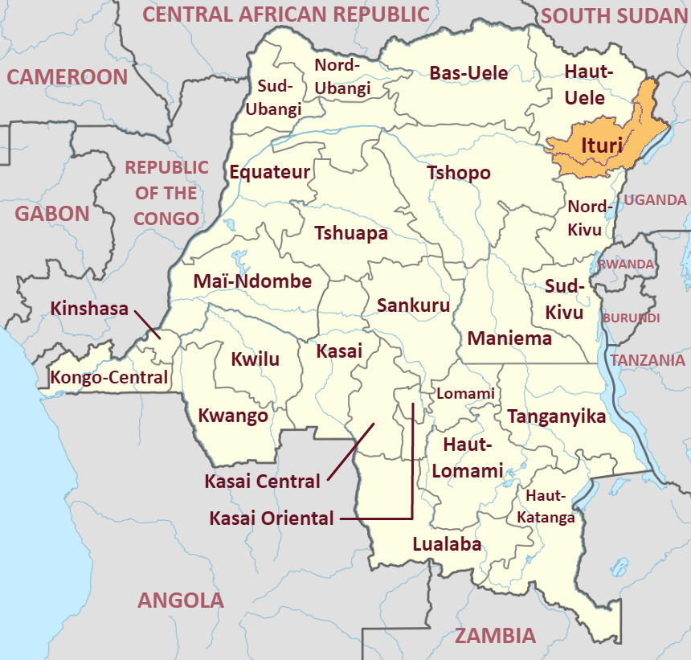
Ituri Forest

Slide 3
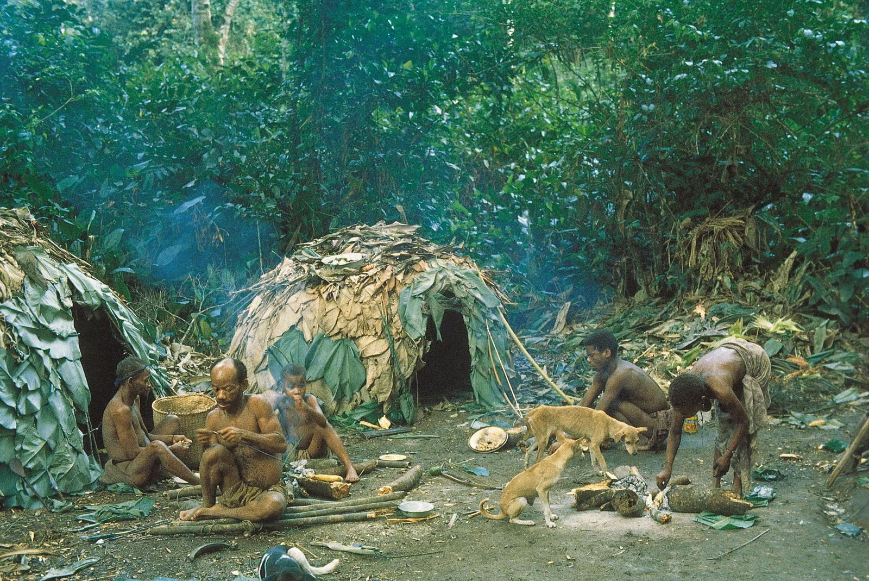
Material Base
Environment is very humid, food isn’t stored and there’s a lack of material accumulation
Forest provides raw materials, technology is simple but effective
Their homes made out of leaves are built in hours and are abandoned when they move to a different location

Slide 4

How Environment Shapes Social Structure
Forest undergrowth is super dense - most effective way to hunt is as a group with nets
Requires cooperation from men and women
Very egalitarian society - no chiefs and instead a system of interdependence

Slide 5


The Elephant Hunt
Extreme risk for a massive pay off
Don’t own the elephant but tail is taken as a trophy of bravery
Paint themselves with ash as a way of camouflage and also a ritual of asking forest for protection

Slide 6

How Environment Shapes Belief
Refer to forest as “mother” or “father”
Believe forest is benevolent
  If tragedy strikes, it’s because the forest is “sleeping” so they wake it up with the molimo trumpet
This belief system shows spiritual connection to environment which supersedes material attachment

Slide 7

Conclusion
Don’t stay in one place for very long
Culture and nature aren’t separate
Forest provides food, shelter, and order

Slide 8
Sources
https://youtu.be/-X5cD6jd914?si=cfmTm_BK76C0-9q1
https://idh.org/news/forest-conservation-in-the-project-direct-market-access-for-ituri-smallholder-farmers-producing-deforestation-free-premium-cacao
https://africacenter.org/spotlight/ituri-becomes-congos-latest-flashpoint/
https://cdn.britannica.com/80/5380-050-5D54666D/Efe-camp-Ituri-Forest-Democratic-Republic-of.jpg

