Slide 1


Gauchos
Deeya Bachani

Slide 2
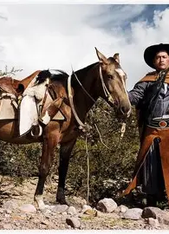
History of Gauchos
Nomadic horsemen from Argentina and Pampas (grasslands)
Began in the 18th and early 19th century
Usually mestizos (people of mixed Indigenous and European descent)
Culture shaped by their land, livestock, and mobility
Notes:
Can be compared to North American cowboy

Slide 3
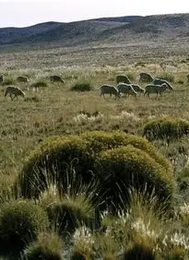
The Pampas
The Pampas are vast and flat grass with fertile soil
The vastness allows for easy mobility
Used horses to get around
Climate ideal for animals

Slide 4
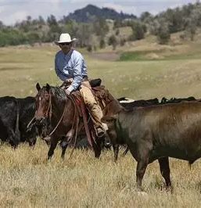
Livelihood
Lived amongst cattle and horses who roamed freely
Economy based on tallow, hides, and meat
Livestock shaped work, diet, and daily life

Slide 5
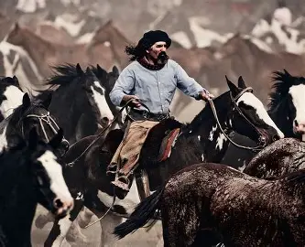
Who the Gauchos Were
To survive, all Gauchos were skilled with animals
They lived independently, not tied to any one ranch
Gauchos were known for toughness and self-reliance

Slide 6
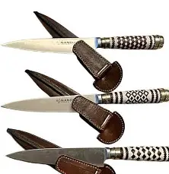
Work Skills
All were expert horse riders and cattle herders
They used tools such as lassos, knives and boleadoras
They gained skills for work such as precision, strength, and endurance
Their status was based on their abilities, not wealth

Slide 7
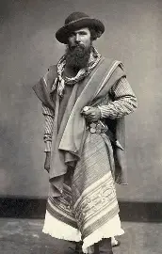
Daily Life
Gauchos lived in huts and slept on animal hides
Diet was centered on beef, and they used open-fire cooking
They wore ponchos, bombachas, boots, and hats

Slide 8
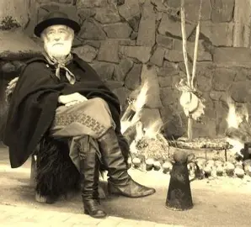
Beliefs
They valued their freedom and independence
They had a strong sense of reputation and honor
Their religion was a blend of Indigenous and Catholic beliefs
Storytelling, music, and poetry were important

Slide 9
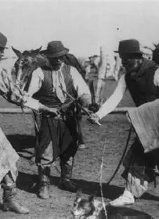
Decline of the Gauchos
Land started to become fenced
Laws restricted independence and movement
Gauchos were hired as ranch workers

Slide 10
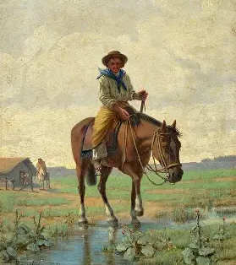
Legacy
Became national symbols of Argentina
Celebrated today through festivals and tourism
Seen in literature, art, and music

Slide 11
References
Alex. “Gauchos Guide: Culture, Tradition, Lifestyle of Argentina Cowboys.” Vamos Academy, 4 Nov. 2023, vamospanish.com/discover/discovering-gauchos-argentina-culture-tradition-and-lifestyle/.
Battistoni, Fiona. “Cowboys of the Pampas: A Brief History of the Gaucho.” TheCollector, www.thecollector.com/history-gaucho-argentina-cowboy/. Accessed 5 Feb. 2026.
Britannica Editors. "gaucho". Encyclopedia Britannica, 13 Apr. 2024, https://www.britannica.com/topic/gaucho. Accessed 5 February 2026.

