Slide 1
The Todava
Arya Adusumilli

Slide 2
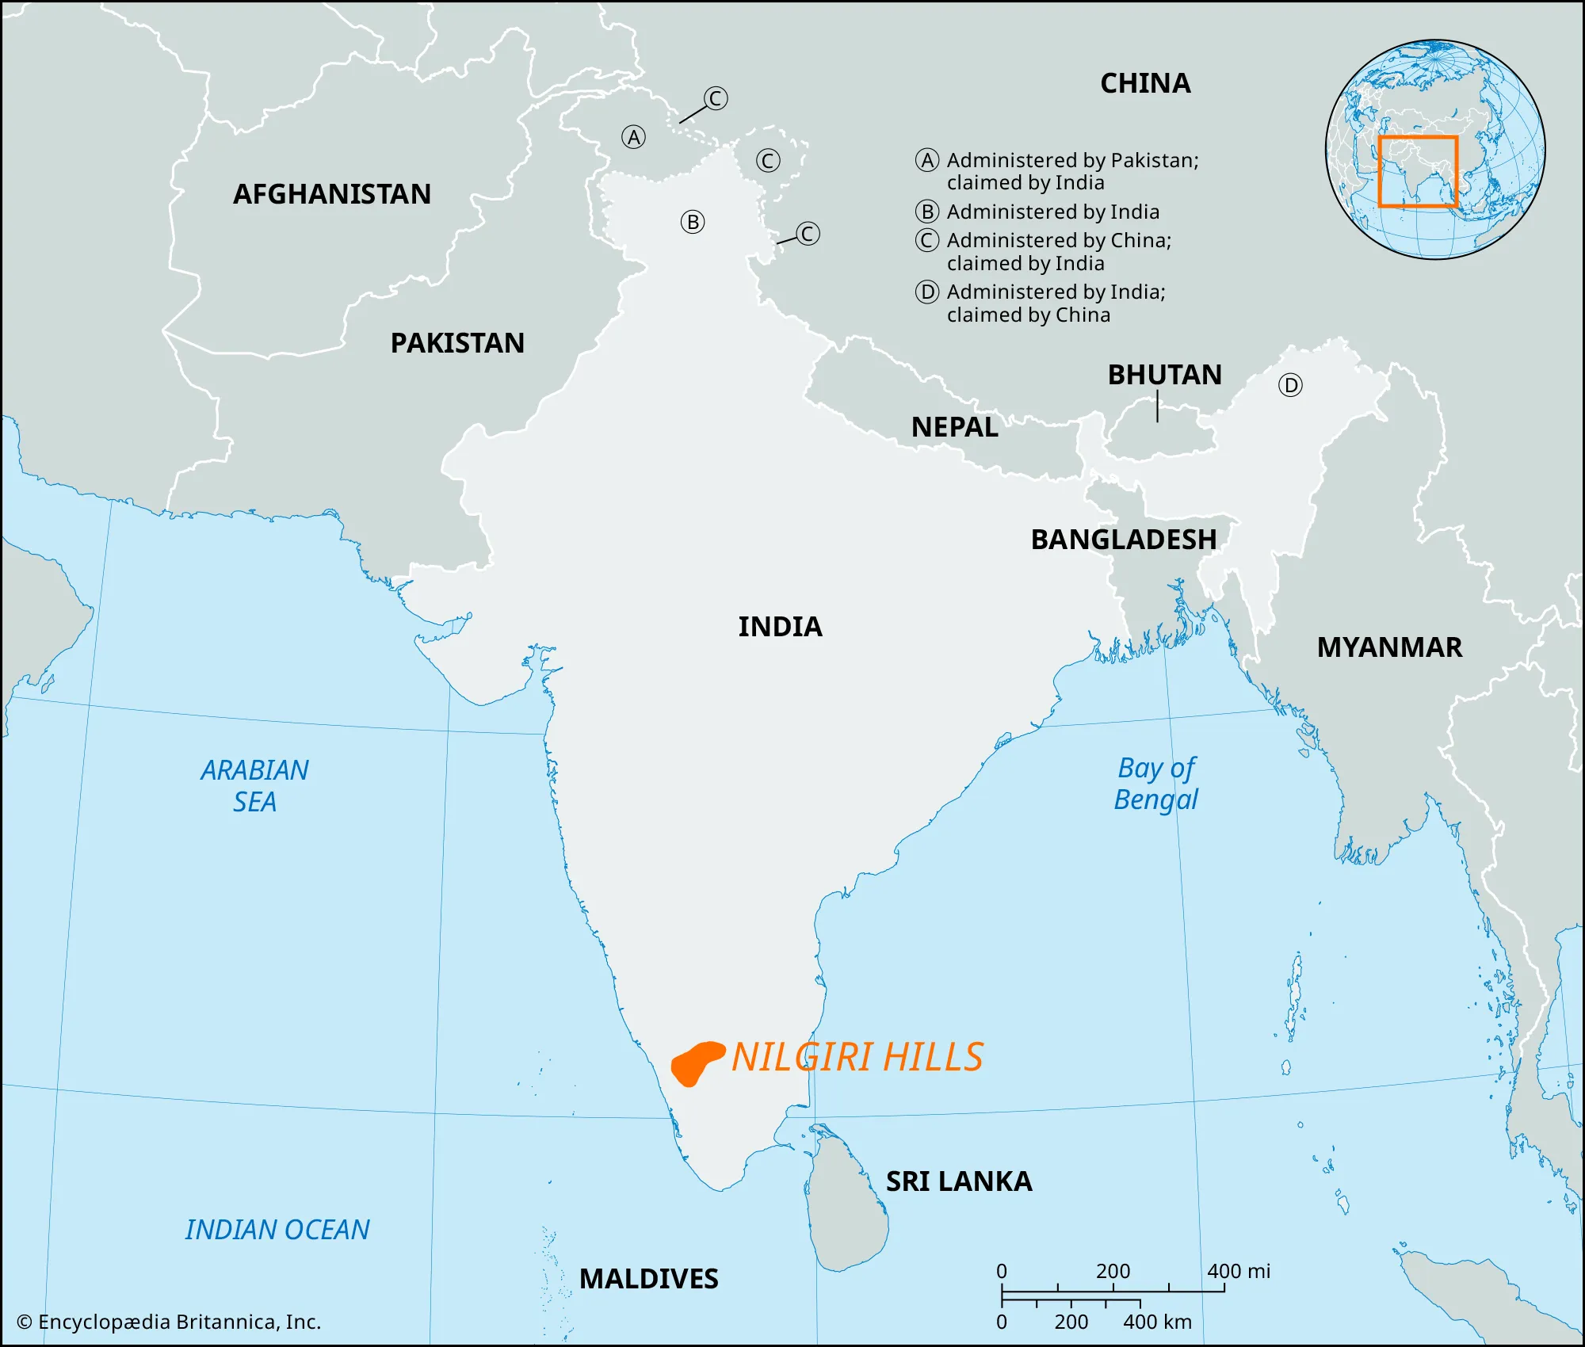
Geography
Nilgiri Hills of the Western Ghats mountain range
Temperate monsoon climate
Rolling grassland, patches of forest shared with neighboring communities
Isolation from major urban centers of Tamil Nadu

Slide 3
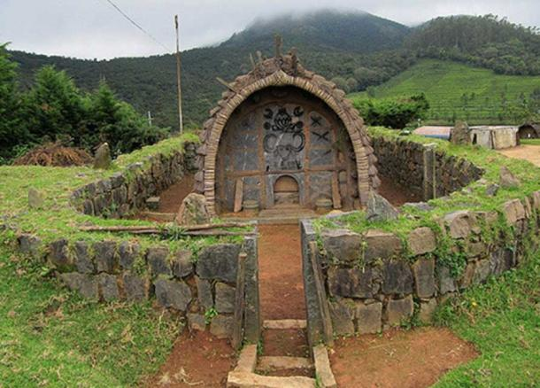
Pastoral Society
Agriculture was unsustainable and culturally denounced as a sin
Life revolved around prevalence of mountain buffalos native to the hills
Pantheon of gods, but ritualistic practice occurred in “sacred dairies”
Priests were dairy workers

Slide 4
Social Conformity and Desire for Certainty (prior to British intervention)
Life on Nilgiri mountains is unpredictable with harsh climate and fluctuating buffalo populations
Group decisions made collectively, familial ones by male heads of household
Elder rule/authority of those most knowledgeable of ritual practice
Girls betrothed at young age to young boys, married and sent to male household upon reaching adulthood
(antiquated) population regulation
Polygamy

Slide 5
References
Walker, A. R. (2010). Culture summary: Toda. Human Relations Area Files. https://ehrafworldcultures.yale.edu/cultures/aw60/documents/000.
Wikipedia contributors. (2026, January 26). Toda people. In Wikipedia, The Free Encyclopedia. Retrieved 23:56, February 5, 2026, from https://en.wikipedia.org/w/index.php?title=Toda_people&oldid=1334890687.

