Slide 1
Patients With Left Spatial Neglect Also
Neglect the “Left Side” of Time
By Solomon Wechter

Slide 2
How do we represent time?
• In left-to-right reading cultures, past is associated with the left and future with the right
• This suggests time may be represented using spatial structure
• Question: Is spatial ability necessary for representing time?

Slide 3
Spatial Neglect
• Left spatial neglect occurs after damage to the right hemisphere of the brain.
• Patients ignore or fail to attend to the left side of space.
• Examples include leaving food on the left side of a plate or missing words on the left side of a page.
• Suggests the brain’s representation of space can become asymmetrical.

Slide 4
Hypothesis
• People may organize time along a mental spatial timeline.
• In left-to-right cultures, past events are mentally placed on the left.
• Future events are placed on the right.
• Prediction: patients with left spatial neglect will struggle to represent past events.

Slide 5
Methods
• Participants: 7 patients with left spatial neglect, 7 stroke patients without neglect, and 7 healthy controls.
• Participants learned whether items belonged to a made up person’s past (10 years ago) or future (10 years from now).
• Items included things like foods, objects, clothing, and activities.
• Later they had to recall or recognize the items and label them as past or future.

Slide 6
Results
• Patients with neglect recalled far fewer past items correctly.
• They often misidentified past items as future items.
• Their ability to remember future items was relatively normal.
• Control participants showed balanced recall of past and future events.

Slide 7
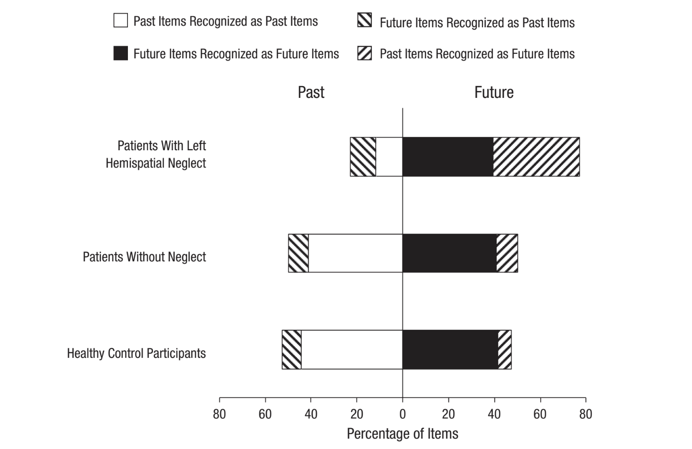
Results

Slide 8
Interpretation
• Neglect patients appear to shift events toward the right side of the mental timeline.
• Because they struggle with left spatial representation, the past becomes harder to access.
• This creates a bias where past events are mislabeled as future events.
• Suggests time representation relies partly on spatial brain systems.

Slide 9
Conclusion
• Distortions in spatial representation can also distort representations of time.
• The findings suggest space and time share neural mechanisms.
• Brain areas involved in spatial processing likely contribute to how we mentally organize time.
• Overall, the study supports the idea that humans think about time using spatial structure.

Slide 10
Rival hypotheses
Memory explanation: Patients may have had more difficulty remembering items associated with the past, rather than a problem with spatial time representation.
Response bias: Because neglect patients show a rightward attentional bias, they may have been more likely to choose the “future” response, which could distort the results.
General attentional asymmetry: The deficit may reflect impaired attention to the left side of mental representations, not necessarily a spatial timeline for time.
Shared magnitude system: Damage to parietal areas involved in processing multiple magnitudes (space, time, number) could affect time judgments without implying that time itself is spatially organized.

Slide 11
Sources
Bisiach, Edoardo, and Claudio Luzzatti. “Unilateral Neglect of Representational Space.” Cortex, vol. 14, no. 1, 1978, pp. 129–133.
Driver, Jon, and Patrik Vuilleumier. “Perceptual Awareness and Its Loss in Unilateral Neglect and Extinction.” Cognition, vol. 79, no. 1–2, 2001, pp. 39–88.
Bueti, Domenica, and Vincent Walsh. “The Parietal Cortex and the Representation of Time, Space, Number and Other Magnitudes.” Philosophical Transactions of the Royal Society B: Biological Sciences, vol. 364, no. 1525, 2009, pp. 1831–1840.
Walsh, Vincent. “A Theory of Magnitude: Common Cortical Metrics of Time, Space and Quantity.” Trends in Cognitive Sciences, vol. 7, no. 11, 2003, pp. 483–488.

