Slide 1
Metaphors We Think With: Language and Thought
CROSSCULTURAL PSYCHOLOGY
Roy Park

Slide 2
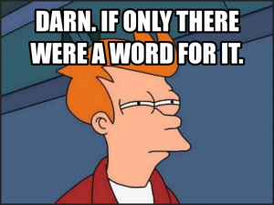
What is Linguistic Relativity?
CROSSCULTURAL PSYCHOLOGY
The idea that language influences how people think and interpret the world
Often associated with the Sapir-Whorf hypothesis
Language may affect:
Perception
Memory
Judgments
Decision making
Research Question:
Can the metaphors we use in language change how people reason about social problems like crime?

Slide 3
How the Experiment Worked
CROSSCULTURAL PSYCHOLOGY
Participants read a short report about crime in a fictional city.
Only one word changed in the description:
Crime is a virus ravaging the city
Crime is a beast ravaging the city
Everything else in the report was identical, including crime statistics.
Participants were then asked:
How should the city reduce crime?

Slide 4



Metaphors Changed Policy Suggestions
01
02
Crime framed as virus
Crime framed as beast
Participants suggested:
Investigate root causes
Improve education
Address poverty
Social reform
Participants suggested:
Increase police
Build prisons
Punish criminals
Stronger law enforcement

Slide 5

Other Key Findings
CROSSCULTURAL PSYCHOLOGY
A single word was enough to influence reasoning
The effect was not caused by simple word associations
Metaphors also influenced what information people wanted to investigate
Metaphors were most powerful when presented early
Most participants did not realize the metaphor influenced them

Slide 6
What This Study Shows
CROSSCULTURAL PSYCHOLOGY
The study suggests language can influence reasoning by:
Creating mental frames
Activating different knowledge structures
Shaping how people interpret information
Guiding policy solutions
Even a single metaphor can change how people understand complex social issues.

Slide 7

Possible Rival Hypotheses
CROSSCULTURAL PSYCHOLOGY
Framing effect
The results may reflect general framing effects rather than linguistic relativity.
Cultural associations
People already associated disease with treatment and animals with capture.
Demand characteristics
Participants may have guessed what the experiment expected.
Artificial setting
Real policy opinions involve ideology, experience, and media influence.

Slide 8
Conclusion
01
02
03
Metaphors can strongly influence how people reason about social problems.
Language may guide how we interpret information and generate solutions.
However, alternative explanations like framing effects and cultural schemas should also be considered.

