Slide 1


Russian blues reveal effects of language on color discrimination
Jonathan Winawer, Nathan Witthoft, Michael C. Frank, Lisa Wu, Alex R. Wade, and Lera Boroditsky

Slide 2
Introduction
Background Information: Distinct languages divide color differently
English: used one word for blue
Russian: two different words are used for blue
  siniy= dark blue
  goluboy = light blue
Previous Research: How does language shape thinking or how we perceive the world? (looking at cross-linguistic differences)
Differences in subjective color similarity judgements
Color confusability in memory
Limitations: possibility for confounding variables
Gap:
A design that tested for the effects of language on color perception in an objective task, with an implicit measure and minimal memory demands.
Main Hypothesis:
If language influences perception, then Russian speakers will distinguish between siniy and goluboy faster than English speakers distinguish between shades of blue, and this advantage will disappear when language processing is disrupted.

Slide 3
Methods
Participants
Recruited from the Boston area, confirmed native speaker level at MIT
English: 24 speakers, mean age = 26.3 yrs, sd=9.2 yrs
Russian(native speakers):26 speakers, mean age =28.9 yrs, sd= 10.2 yrs
  Russian speakers has learned English ranging from 7-21 yrs old
Materials & Design
Color naming task: as quickly/accurately as possible
Goal: determine subjects color boundaries
  Instructions in English, tested in a quiet/dimly lit room on computer
  20 stimuli(twice each) in random order
  Participants asked to classify each color (pressing a key)
    English: dark blue vs. light blue
    Russian: siniy vs. goluboy
Color discrimination tasks: order of the blocks was randomized
  One block of color discrimination trial w/out secondary task
  One block w/ a secondary verbal interference task
    Eight-digit number series to rehearse during the color task
  Control: one block w/ a spatial interference task
    Think of a grid pattern that was presented

Slide 4
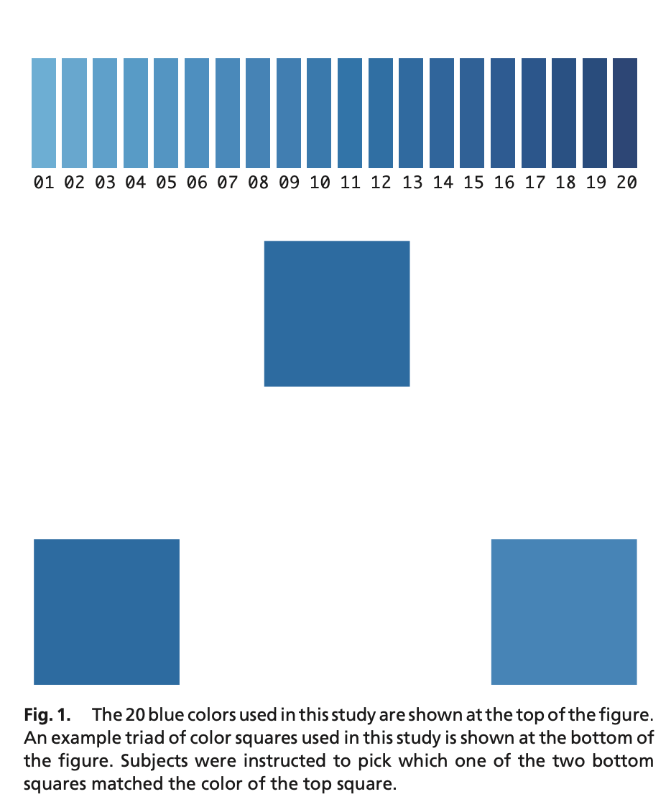
Color
DiscriminAtion
Task
Two types of color differences:
Near colors(hard to compare)
vs
Far colors(easy to compare)
Researchers predicted language effects would be stronger for harder comparisons.

Slide 5
Results
Color naming task:
  Slower reaction time was used to disambiguate the boundary of colors closest to boundaries of light/dark
    Differences in overall speed between the two language groups were not responsible for the cross- linguistic differences of interest between the two language groups(determined by univariate ANOVA)
  English and Russian speakers had nearly identical division lines for goluboy(light) vs siniy(dark blue)
    Russian: mean: 8.7 sd= 2.2
    English: mean: 8.6 sd= 2.5

Slide 6
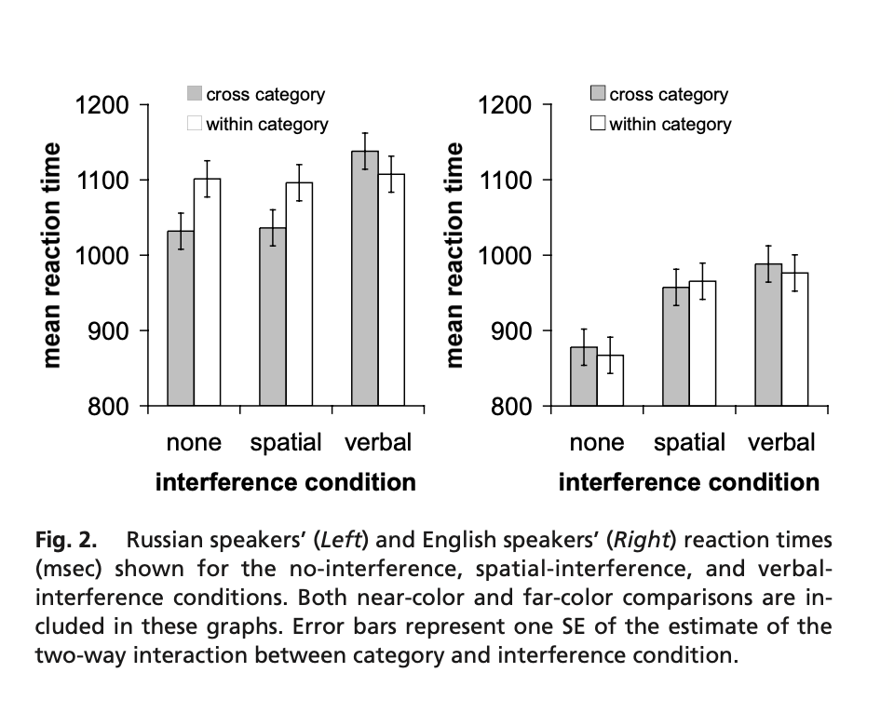
Results
Color discrimination task:
Category advantage w/out interference
  Russian speakers showed an advantage
    [1,164 vs. 1,288 msec; t (20) 2.59; P 0.0176]
  English speakers did not
    [F (1, 20) 0.150; P 0.703]
  Category advantage found for Russian speakers was disrupted by verbal interference
    [124 vs. 64 msec; t (20) 2.93; P 0.0082]
  English speakers did not have a significant interference advantage connection
    [F (2, 40) 0.422; P 0.659]

Slide 7
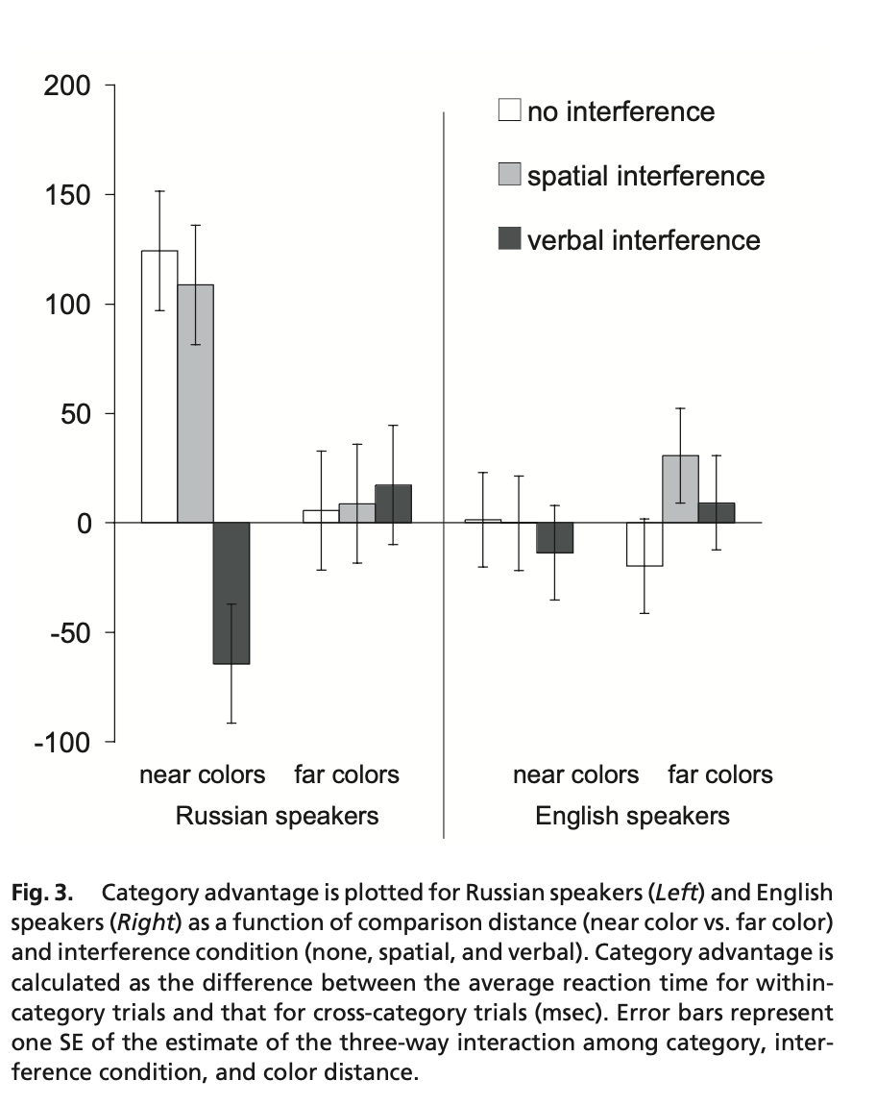
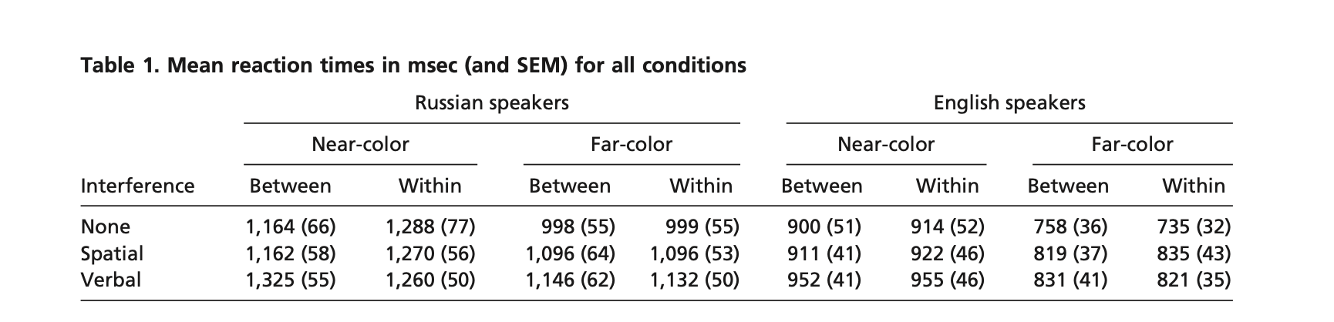
Results:
The language effect was strongest when the colors were very similar and harder to distinguish

Slide 8
Discussion/Conclusion
Main Finding: Language categories can influence color perception during the process of making perceptual decisions
Potential mechanisms: Results suggest that language-specific distortions in perceptual performance arise as a function of the interaction of lower-level perceptual processing and higher-level knowledge systems (e.g., language) online, in the process of arriving at perceptual decisions.
*************************************************************************
This study supports linguistic relativity.
Different language speakers performed differently on the tasks
Language can affect certain aspects of perception
*Moderate version of theory b/c light blue vs dark blue and siniy vs goluboy were practically the same boundary in English and Russian

Slide 9
Thanks!
Do you have any questions?

