Slide 1
English and Spanish Speakers Remember Causal Agents Differently
Caitlin M. Fausey, Lera Boroditsky

Slide 2
Agentivity, Participants
“The vase broke” = non-agentive statement
“They broke the vase” = agentive statement
Paper examiners whether or not differences in agentivity across languages can account for differences in memory of causal events
Participants were English speakers, Spanish speakers, and bilinguals; speakers of both languages tend to describe causal events agentively, but Spanish speakers describe accidental events with less aggression

Slide 3
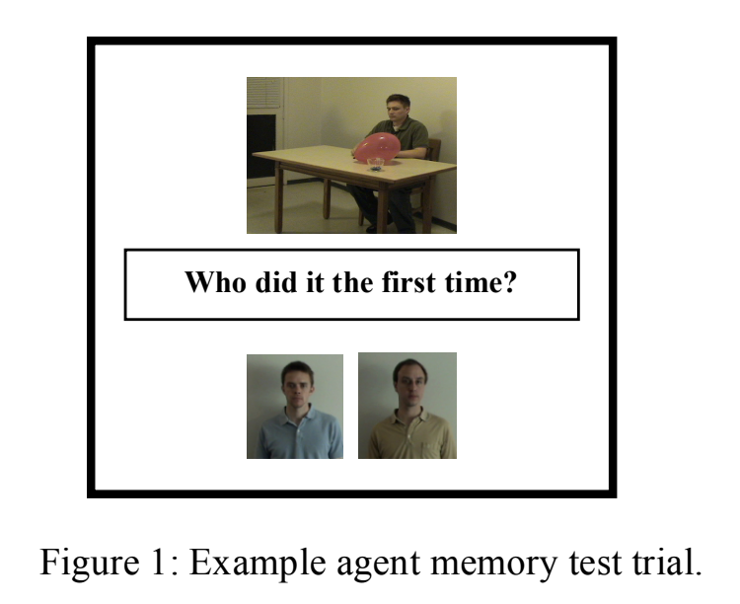
Study 1 Method
63 monolingual English speakers, 87 monolingual Spanish speakers, and 38 bilinguals
Control memory task, a task measuring memory for causal agents, and a task asking participants to describe what happened in a causal event, intentional and accidental

Slide 4
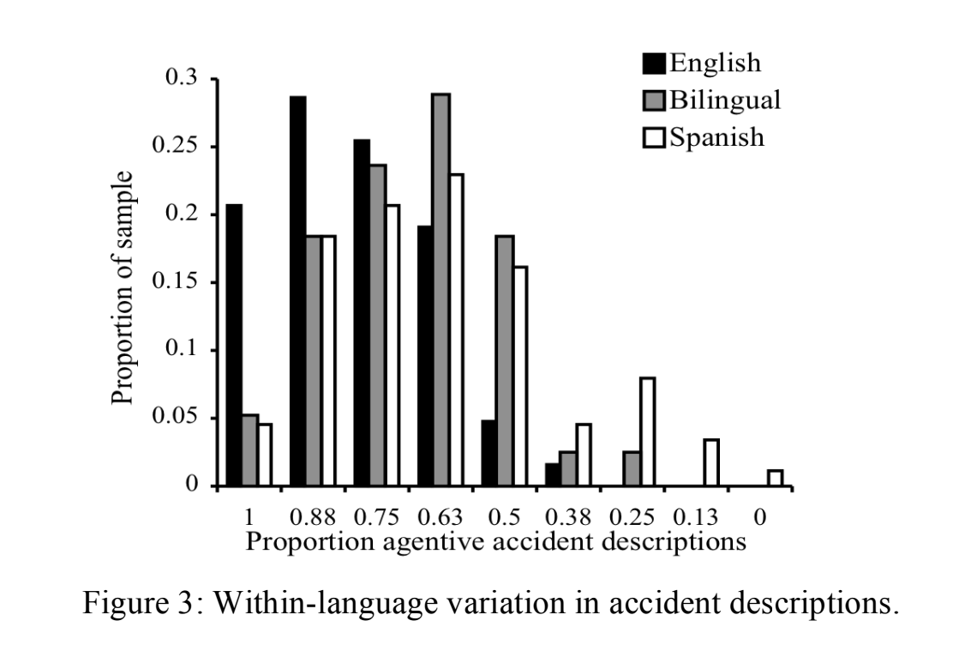
Study 1 Results
Speakers of both languages described intentional events similarly, but differed in that English speakers described accidental events more agentively
Bilinguals behaved as monolingual Spanish speakers did
English speakers more likely to remember causal agents
Therefore, a relationship exists between the way people talk about causal events and what they remember

Slide 5
Study 2 Method/Results
Participants were exclusively English speakers
Listened to 24 sentences, either all agentive or non-agentive; while listening, they viewed two images, one before and one after the causal event
Instructed to write down as many sentences as they could remember
Found that participants primed with agentive sentences remembered agents better than the non-agentive condition
Non-agentive language therefore shifts attention from causal agents; language use shapes attention to and memory of causal agents
Alternative hypothesis, supported by research:
  Cultural differences in norms of blame and responsibility for causal events and accidental events shapes attention instead

