Slide 1
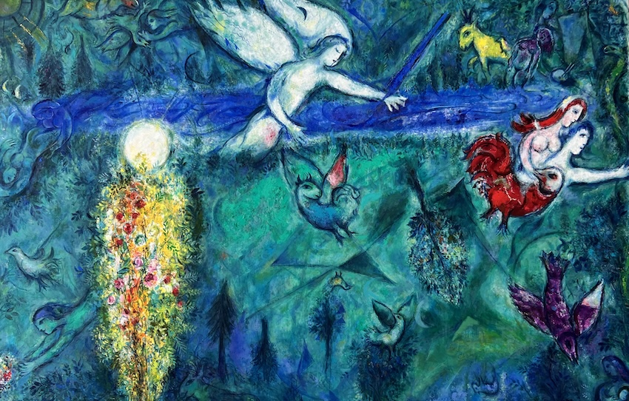
The Religious Instinct and Inclination of Human Beings
Presentation by Solomon Wechter

Slide 2

Why is humanity often religious?
Tendency to seek relation to that which it experiences as ultimate, sacred, greater than oneself
Is religion a response to the fear of death and the fear of meaninglessness?
”God never was invented, it was always an occurrence, a psychological experience - and mind you, it is still the same experience today.” - Carl Jung
Religious/spiritual experience of something sacred about life
  Registers as true in itself with no need for further explanation

Slide 3
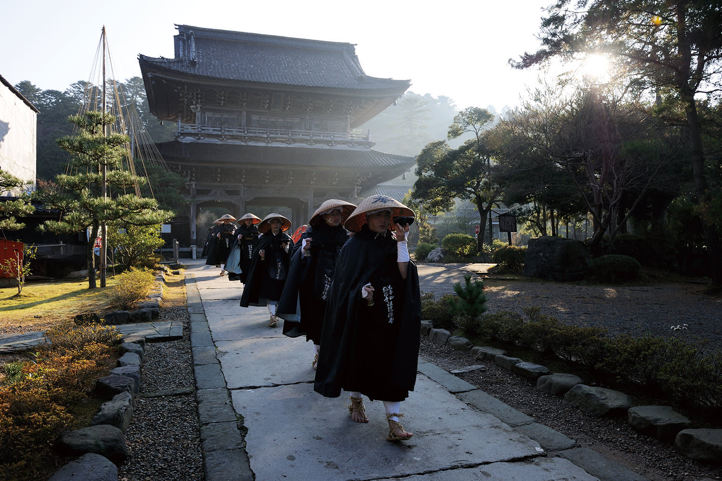
Variation in the trait
Different people have different levels of sensitivity to religious experience
  This is partially independent from whether they are officially religious or not
  Being a part of a religion has no direct association with spiritual experience
    Religion as an institutional way of facilitating it
  Monastic life

Slide 4
Independent of other psychological characteristics?
Whether repressed or heeded to, either way has a massive impact on the psychology of an individual person
When repressed, gives way to psychopathology
  Tends to reappear in distorted forms (fanaticism, inflation, ideological extremism irrational belief systems)
  Or depression, anxiety, regret
When heeded to, leads to a deeper orientation to life, through connection between the ego and the Self

Slide 5
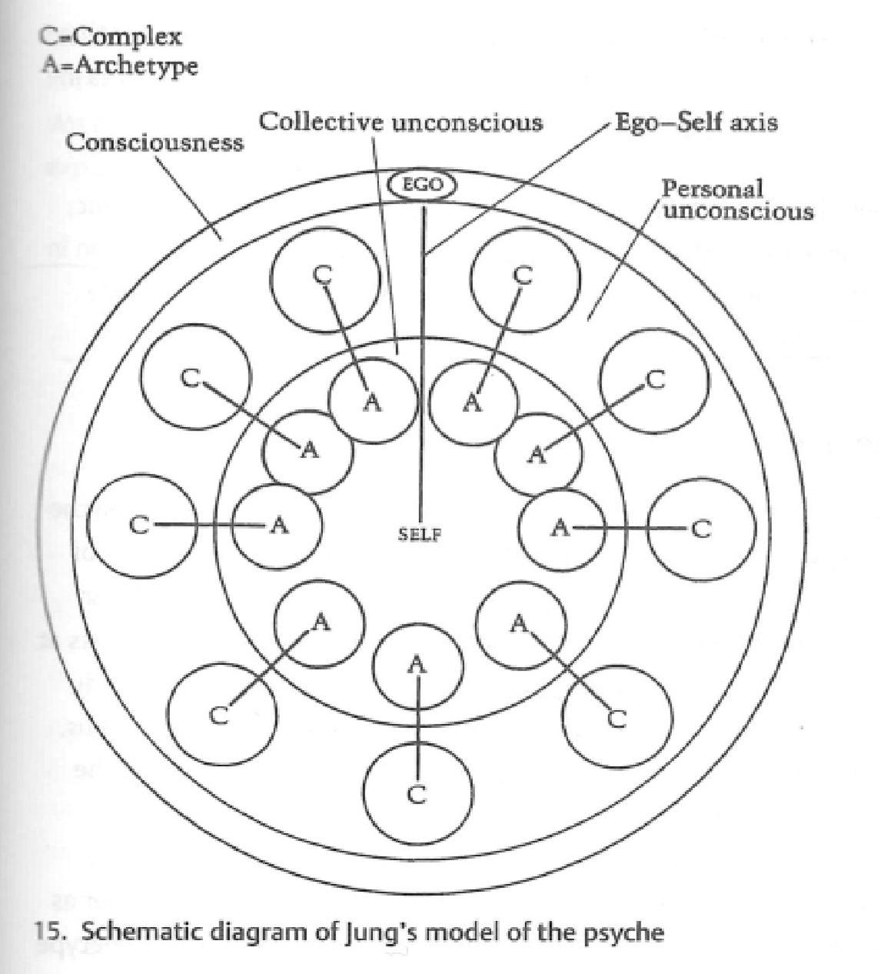
Jung’s model of the psyche
The archetype of the Self is the entire picture
  Total personality, conscious and unconscious
Orientation to the world as a whole
Microcosm of a macrocosm (the world)
Religious function is the ego-Self axis
Shapes personality development by determining how one relates to meaning, suffering, one’s life as a whole

Slide 6
What are the cultural impacts or ramifications of the trait?
Value generating process
  Experience of one another as sacred
The cornerstone of individuation, of creating one’s own way in the world
In a way countercultural, as it is a revelation of one’s inner truth, which usually challenges the outer, cultural, perspective
Jung looked at the story of the individual as paramount to the health of a society
  Christian symbolism
  Also Abraham, Moses, Buddha, Arjuna, etc

Slide 7

What are the selection pressures?
Religious/spiritual life as a channel of communication between the ego and the unconscious
Connection to the macrocosm through connection to the microcosm
Religion as a means of survival
  Meditation, prayer, ritual, study of religious texts, dance, singing, ceremony, art etc.,
  All behaviors of our ancestors
  Looked at connection to metaphysical ideas as vital to human life

Slide 8
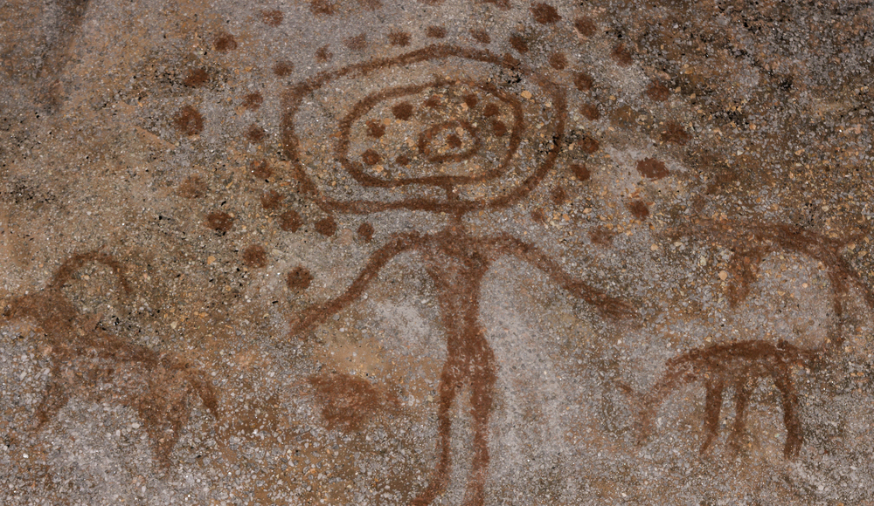
Was selection operative only to Paleolithic times, or does it continue?
Religion has always been important
Agricultural societies intensified religious institutionalization, possibly amplifying selection for religiosity
As long as we have a psyche that is organized by the Self we will have religion?

Slide 9
Why don’t more of us have the relevant trait?
The modern western psyche
  Disconnection from the unconscious: instinctual, embodied life, (like hiking, dancing, manual labor, etc.)
The unconscious as the source of spiritual symbolism
  Art, myth, dreams
We all have a religious function
  Everyone has a God
  Project “God” onto many things: money, career, children, romance, drugs, sex, countries, politics, race, religions
Depression and anxiety are often the unconscious’s means for communication with a disconnected ego
  Suffering incites change and deeper confrontation with ourself
  Psyche often demands connection with the sacred

Slide 10
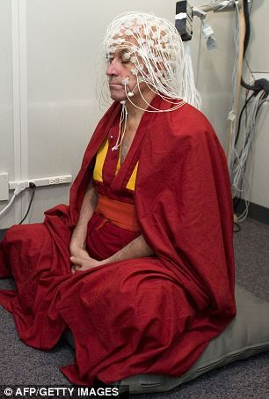
Do we have any evidence for a genetic and/or neural basis for the trait?
Science and metaphysics are antithetical in nature
  Natural sciences studies the world of matter
  Religions differentiate between a metaphysical, spiritual, reality and a material world accessible to the senses
Alterations in default mode network
Meditation science supports the idea that:
  Brain has built-in networks capable of producing self-transcendent states of consciousness
  These states can be reliably induced
Psychedelic studies and drug addiction

Slide 11
Can we argue that this trait and its related behaviors have a memetic basis, as opposed to only a genetic basis?
Both?
The flow and change of culture is largely religious in basis
Evolution in humanity’s consciousness as intertwined with religion
Spirituality is moderately heritable (20-40%)
Cultural evolution operates faster than genetic evolution, explaining rapid religious change
Religious institutions are replicators of symbolic systems across generations

Slide 12
Sources
Brewer, J. A., Worhunsky, P. D., Gray, J. R., Tang, Y.-Y., Weber, J., & Kober, H. (2011). Meditation experience is associated with differences in default mode network activity and connectivity. Proceedings of the National Academy of Sciences of the United States of America, 108(50), 20254–20259.
Jung, C. G., et al. The Collected Works of C. G. Jung. Pantheon Books, 1953.
Tang, Y.-Y., Hölzel, B. K., & Posner, M. I. (2015). The neuroscience of mindfulness meditation. Nature Reviews Neuroscience, 16(4), 213–225. https://doi.org/10.1038/nrn3916
Chatgpt.com

