Slide 1


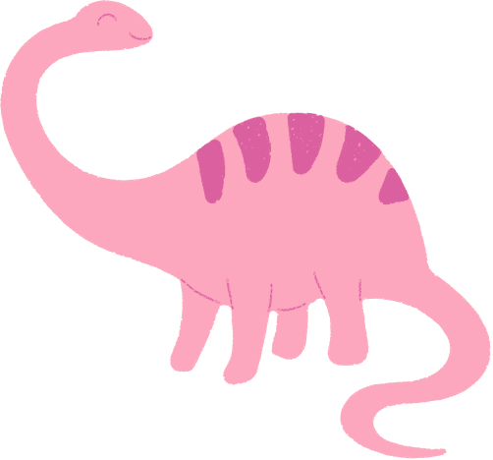
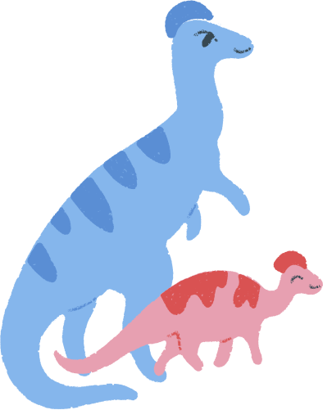

Roy Park
Conformity

Slide 2
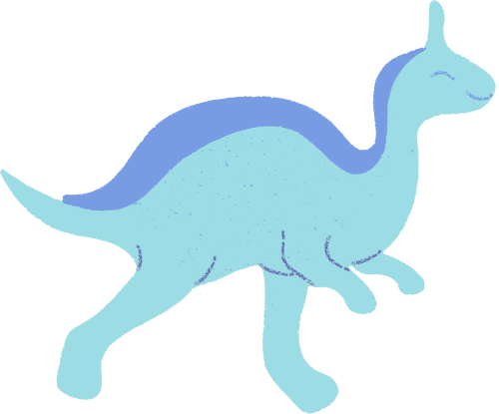
What is Conformity?
Evolutionary Psychology Lens
Core EP Claim
Definition
Conformity = tendency to align behavior, beliefs, and norms with a group
Natural selection favored minds that track and follow social norms.
Conformity evolved because
belonging = survival
In ancestral environments:
Humans depended on groups for food, protection, and mating
Being rejected often meant death

Slide 3

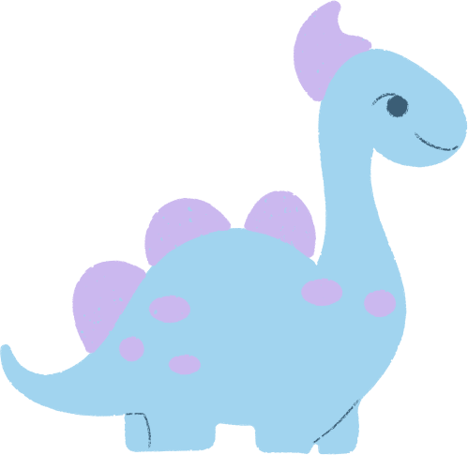


Nature of Variation (Why People Differ)
High conformists:
Low conformists:
Partly independent but linked to:
Strongly follow rules
Sensitive to social approval
Avoid standing out
Independent
Innovative
Willing to challenge norms.
Risk tolerance
Social anxiety
Leadership tendencies

Slide 4


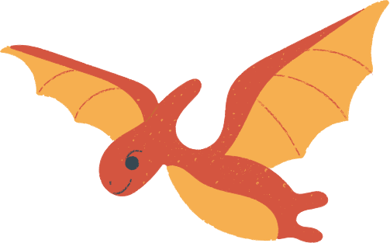

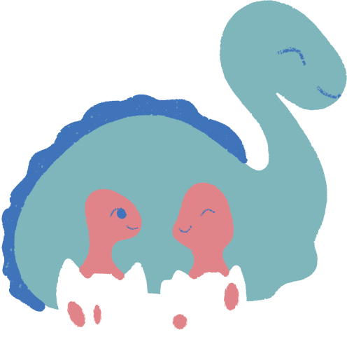

Selection Pressures
Conforming helped by:
Learning safe food practices, following hunting strategies
Respecting hierarchies, avoiding punishment or exile
Nonconformity helped by:
Discovering new resources, creating tools, adapting to change
Evolution favored a mix, but with a strong bias toward copying the group.

Slide 5
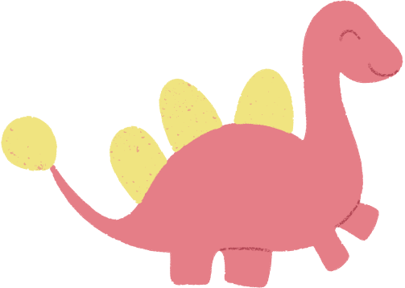

Why Don’t We All Think Independently?
Because independence is dangerous.
Ancient cost of nonconformity:
Exile, loss of protection, no mating opportunities
Which often = death.
So evolution built in:
Discomfort when standing out
Fear of social rejection
Pleasure from belonging
Conformity is emotionally reinforced by biology.

Slide 6
Cultural & Modern Impacts
Today, Conformity Shapes
Now We Conform to
Result
Groupthink
Polarization
Herd behavior
Fashion
Politics
Social media trends
Workplace behavior
Moral norms
Millions of strangers
Algorithms
Viral opinions

Slide 7
Genetic, Neural & Learned Components
Memetic (cultural transmission):
Genetic:
Neural:
Social sensitivity & risk aversion partly heritable
Social rejection activates pain centers in the brain
Approval triggers dopamine (reward)
Norms copied rapidly
Children absorb behaviors automatically
Trends spread like “mental viruses”

Slide 8
Evidence from Psychology
Classic experiments show how powerful conformity is:
People will:
Agree with obviously wrong answers
Follow group opinion over reality
Demonstrated by Solomon Asch
This reflects an ancient adaptation:
Trust the group, even over your own senses.

Slide 9
Big EP Takeaway
Conformity evolved because it:
Kept humans inside protective groups
Transmitted survival knowledge
Reduced dangerous individuality
But today it can:
Suppress critical thinking
Enable harmful social movement
Amplify misinformation
Final EP conclusion:
Conformity is not weakness, it’s an evolved survival instinct that once kept humans alive, now shaping modern society.

