Slide 1

Anxiety
Deeya Bachani

Slide 2
What is Anxiety?
Evolved emotional defense system
Prepares body for fear of present or possible threat
Helps activate coordinated changes is attention, behavior and physiology
In dangerous situation, anxiety increases fitness
Originally designed to help our ancestors survive

Slide 3
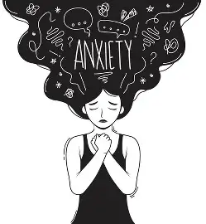
The Selection Pressures
In the Environment of Evolutionary Adaptedness (EEA)
  Predators
  Hostile rival groups
  Environmental threats (storms, heights)
  Social exclusion (which could mean death)
Defensive mechanisms are biased toward false alarms because missing real danger is more costly
Notes:
Example:
Kael sees a shadow in the savanna — anxiety spikes.
False alarm = minor energy cost.
Missed predator = death.

Slide 4
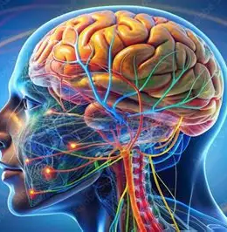
Biological Mechanism
Anxiety is physiological
Sympathetic Nervous System (Fight or Flight):
  Adrenaline increases heart rate
  Noradrenaline increases focus
  Cortisol increases energy mobilization
These evolved into
  Increased muscle readiness
  Heightened threat detection
  Suppress non-urgent systems

Slide 5
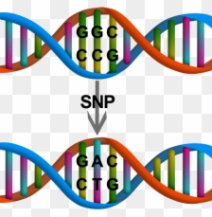
Why is There Variation?
Genetic variation (30-40% heritability)
Trade-offs
Environmental calibration
Mismatch

Slide 6

Culture Impacts
Social anxiety evolved to prevent ostracism
In today’s world, certain experiences increase social anxiety
  Social media
  News cycles
  School and workplace evaluations
  Modern “stressors” activate ancient systems
  Mismatch between ancient mind and modern world

Slide 7

How Anxiety Became a Disorder
Anxiety is a dysregulation of adaptive systems
Systems should trigger even if danger probability is 1/1000
Environments still vary in danger
Social competition continues
Some anxiety may still provide reproductive advantages
Mismatch dominates chronic deadlines, abstract stresses. information overload

Slide 8
References
Nesse, R. M. (2022). Anxiety disorders in evolutionary perspective. In R. T. Abed & P. St John-Smith (Eds.), Evolutionary Psychiatry: Current Perspectives on Evolution and Mental Health (pp. 101–116). Cambridge University Press.
RefreshMH. “Understanding Anxiety: Evolution, Biology, and Action.” Oakland Psychological Clinic of Michigan, 16 June 2025, www.oakpsych.com/2025/06/16/understanding-anxiety-evolution-biology-and-action/.
Singh, Chandan Kumar. “The evolutionary psychology of Mental Health: Adaptive Roots of anxiety and depression.” International Journal of Innovative Research in Technology, vol. 12, no. 5, 28 Oct. 2025, https://doi.org/10.64643/ijirtv12i5-186020-459.

