Slide 1


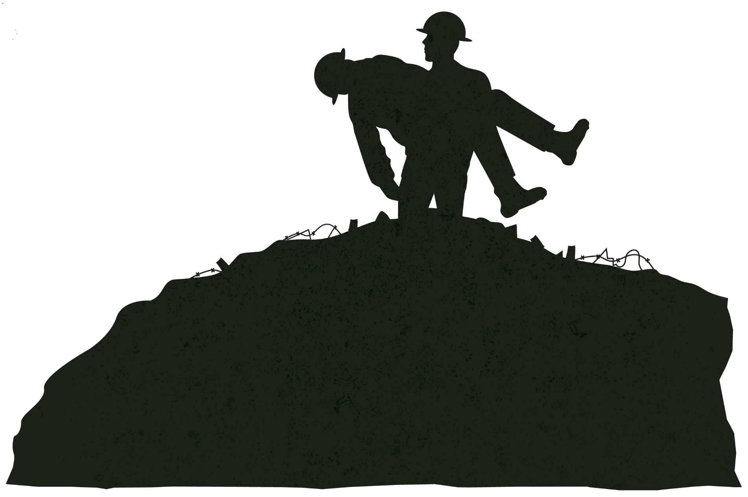
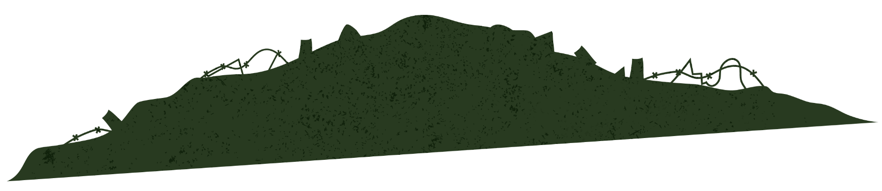

The Rwandan Genocide
Ethnic conflict within a nation
Roy Park

Slide 2

BLUF
A government-led campaign turned ethnic tension into mass killing in just 100 days
Shows how propaganda + leadership can rapidly mobilize violence

Slide 3
BACKGROUND
Two Main Groups
RWANDA
Hutu (majority), Tutsi (minority)
Centra/East Africa
Colonial rule (Belgium) intensified divisions

Slide 4


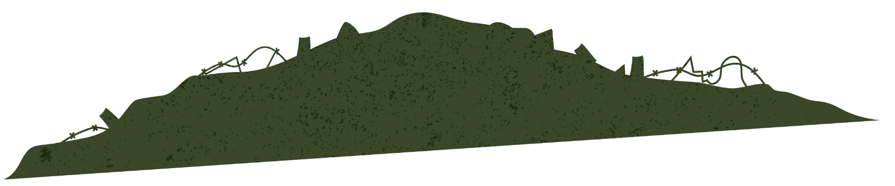
Causes of the Conflict
Long-term ethnic tension
Colonial favoritism toward Tutsis
Economic crisis + political instability
Rising extremist ideology

Slide 5

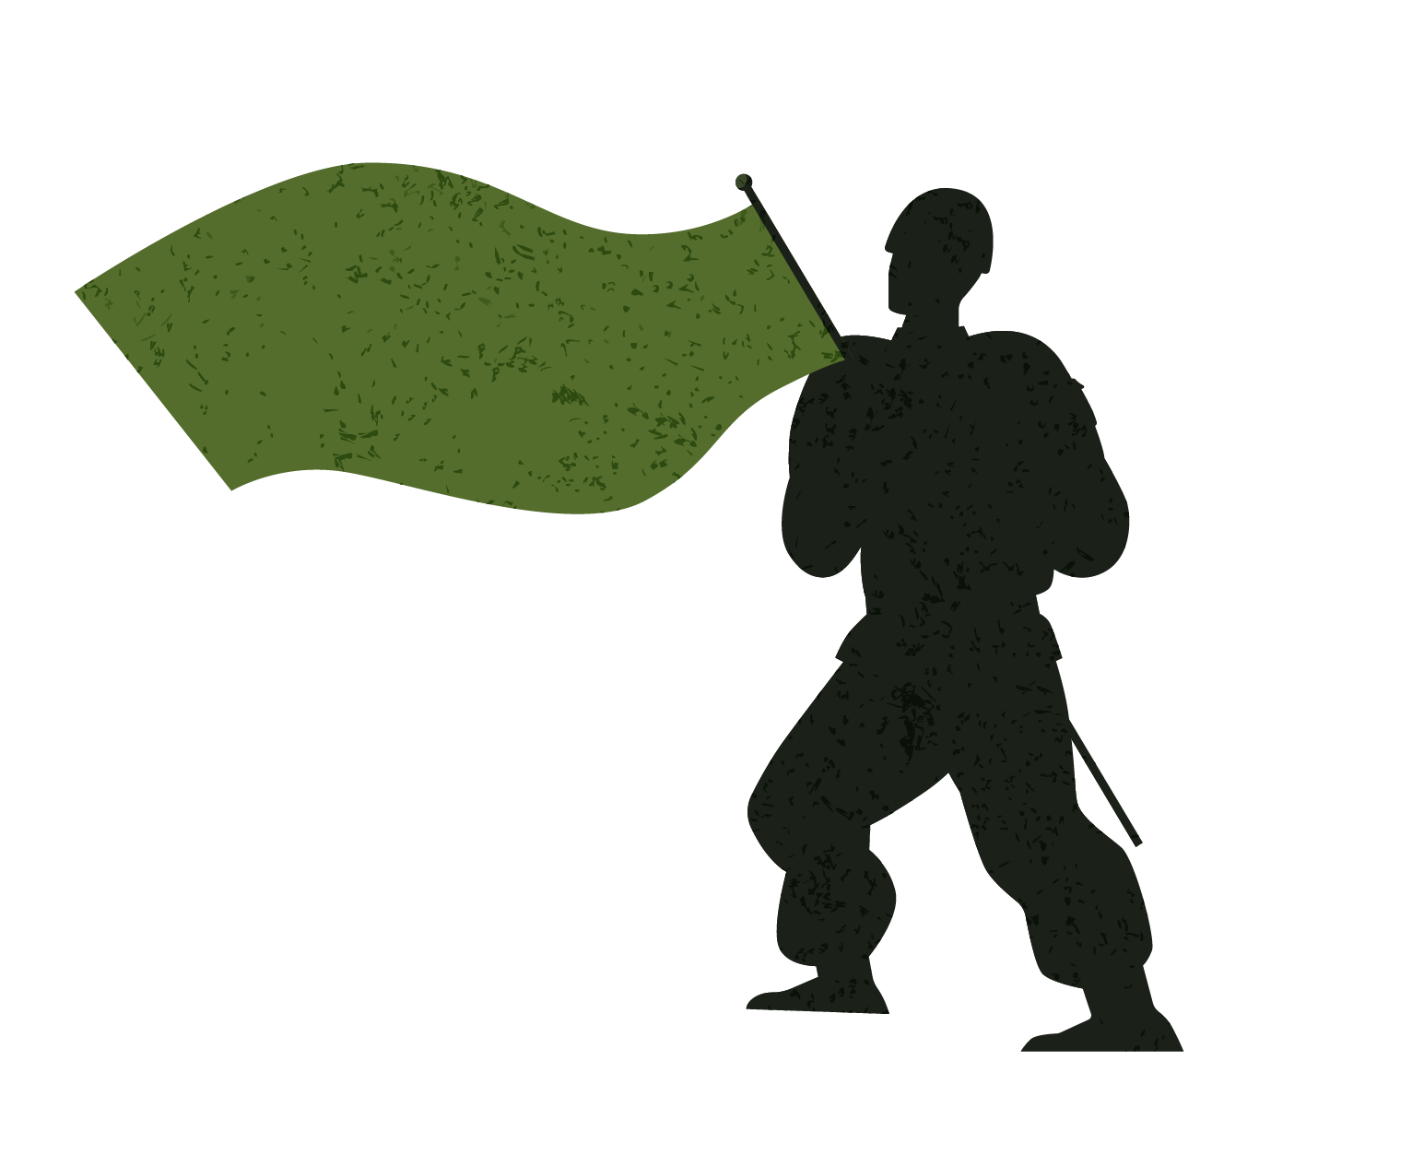
TRIGGER EVENT
Plane carrying Juvénal Habyarimana shot down (April 1994)
Immediately blamed on Tutsis
Coordinated violence begins within hours

Slide 6
MAIN ACTORS & GOALS
Militias (Interahamwe)
Hutu extremist leaders
Rwandan Patriotic Front
Carry out killings
Eliminate Tutsis
Keep power
Stop genocide
Seize control

Slide 7
Leadership & Mobilization
Government organized killings
Radio propaganda encouraged violence
Civilians pressured to participate
Violence framed as “defense” of the nation

Slide 8
Impact on People
~800,000 killed in ~100 days
Families and communities destroyed
Extreme trauma and fear
Neighbors turned against each other

Slide 9

PEOPLE CAUGHT IN THE MIDDLE
Moderate Hutus killed for resisting
Civilians forced to choose sides
Massive refugee crisis

Slide 10
Could It Have Been Avoided?
Warning signs existed (hate speech, militias)
International community failed to intervene
UN peacekeepers had limited power

Slide 11
Resolution
RPF takes control, ends genocide (July 1994)
New government established
Focus on rebuilding and stability

Slide 12
Long-Term Consequences
Strong centralized leadership under Paul Kagame
Ongoing reconciliation efforts
Debate over political freedoms vs. stability

Slide 13

Conclusion
Leadership + propaganda can rapidly escalate violence
Ethnic divisions alone don’t cause genocide, they must be activated
Importance of early intervention

Slide 14
The Gorotire Kayapo organized their resistance in a strategic and collective way, relying less on direct violence and more on coordination and negotiation. They held meetings and discussions to unify their approach and carefully managed their response to the miners. Instead of immediately forcing them out, they allowed the miners to remain temporarily, using their presence as leverage to strengthen their position and gain more control over the situation.
The two Kayapo groups differed in both strategy and perspective. One group chose to engage with the miners, seeing them as an opportunity for trade and a way to learn about outside culture. In contrast, the other group prioritized preserving their traditional way of life and sought to expel the miners, aiming to limit outside influence as much as possible.
Traditional aspects of Kayapo life are gradually shifting due to increased interaction with Brazilian society. Housing is becoming more modernized, reflecting Brazilian styles rather than traditional structures. The men’s hut, once a central place for leadership and decision-making, is losing its importance as social organization changes. Naming ceremonies are becoming less frequent and carry less cultural significance over time. Dances are increasingly performed for tourists rather than for their original ritual purposes. More broadly, rituals are being shortened, altered, or abandoned, leading to a weakening of spiritual practices. Additionally, traditional dress is now mostly reserved for special ceremonies, while everyday clothing has become more Westernized.

