Slide 1
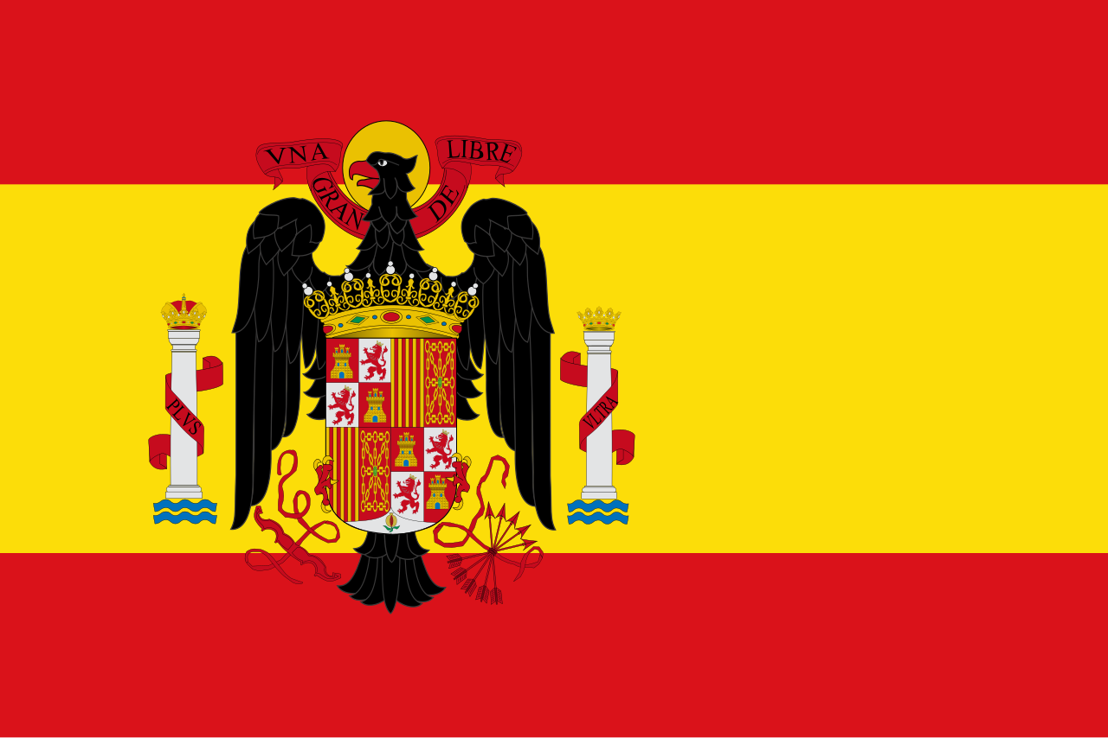
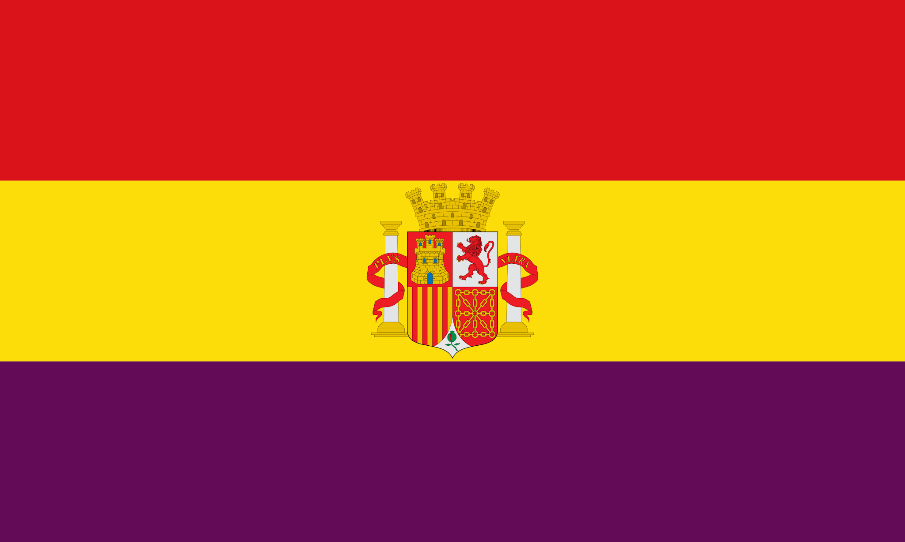
Spanish Civil War
1936-1939

Slide 2
Causes of the Conflict
Regional Conflicts
  Basque and Catalonian people wanted to break way from Spain
Constitutional monarchy (Alfonso XIII)
  Inefficient & corrupt
General Primo de Rivera(bloodless coup) ruled as a dictator, but introduced public work and industrialization to the country, ruled until 1930
April 1931, the King abdicated and monarchy was abolished (Republicans are now in charge)
Great Depression affected unemployment and support of republicans
Roman Catholic church did not like that its influence was being reduced (ex: church teachings not taught as much in schools)
Republicans wanted to lessen strength of army (army officials forced to retire)

Slide 3
Goals of the Parties Involved
Republicans “Reds” (supported by communists in Soviet Union, anarchists, and socialists i.e. intellectuals, artists, working class, peasants) (Second Spanish Republic)
Infighting between them in May 1937 (communist vs anarchist)
Preserve a democracy
Promote social reform
Reduce traditional power structures
Modernization
Nationalists (supported by fascists in Italy and Germany, monarchists, conservatives i.e. landowners, military, industrialists & Roman Catholic Church)
Overthrow the republic
Restore social order
National unity/centralized power
Anti-communism

Slide 4
How did the leaders of the conflict motivate people to take up arms? Was the war triggered by the leaders or by the people or both?
Franco initially was not in favor of a military rebellion, but he was eventually convinced by other military friends
Franco wrote a manifesto and staged a military coup in 1936
It was framed as a “crusade”
People were motivated by a sense of regional identity and social class
Excerpt from the July 17,1936 manifesto:
Spaniards! The nation calls to her defense all those of you who hear the holy name of Spain, those in the
ranks of the Army and Navy who have made a profession of faith in the service of the Motherland, all
those who swore to defend her to the death against her enemies. The situation in Spain grows more
critical every day; anarchy reigns in most of the countryside and towns; government-appointed authorities
encourage revolts, when they do not actually lead them; murderers use pistols and machine guns to settle
their differences and to treacherously assassinate innocent people, while the public authorities fail to
impose law and order.

Slide 5
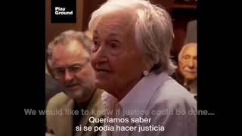
Impact on people's personal lives, attitudes, and beliefs
Outsiders were compelled to volunteer in the war
  Abraham Lincoln Brigade included Ernset Hemingway
Mass death and displacement
  Spain holds one of the highest number of mass graves, second only to Cambodia
“Brother against brother”
Daily hardships(food shortages,etc.)
Culture of fear and distrust created
Normalization of violence
Long term trauma and “amnesia”

Slide 6
Changes to personal relations and social structures
Families were divided and friendships were lost
People were exiled or disappeared
  Some babies were taken from their mothers and replaced into officials households
During the subsequent dictatorship
New, unified “Spanish Identity”
  Suppressed identities ex: basque country
Restoration of power to the church
  Double names/religious names (catholic identity was BIG) b/c of catholicism being prominent
Gender roles became stricter
More surveillance
  Tarjeta de DNI - legally prove who you are
People conformed to the norms and were often suspicious of those surrounding them

Slide 7
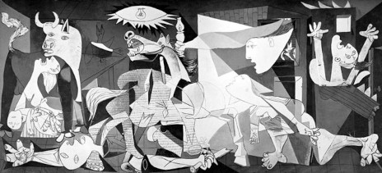
What happened to people who were caught between the warring parties?
Bombing of Guernica (April 26th, 1937)
Civilians were targeted on market day.
Nazi’s tested their bombing technology on this.

Slide 8
Could the conflict have been avoided? Were there attempts to avoid it?
Not really…
Polarization/radicalization (people would not listen to moderate views)
Franco’s coup was not immediately successful
Although…
Fear of Escalation
  Led conservatives to try legal opposition to the Republic
Diego Martinez Barrio (Prime minister)
  Tried to form a compromise and negotiated with rebel generals
Manuel Azana(President of the Republic) called for reconciliation in 1938
Miguel de Unamuno
  Initially supported the nationalists, but became disillusioned and denounced them

Slide 9
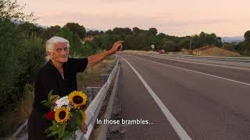
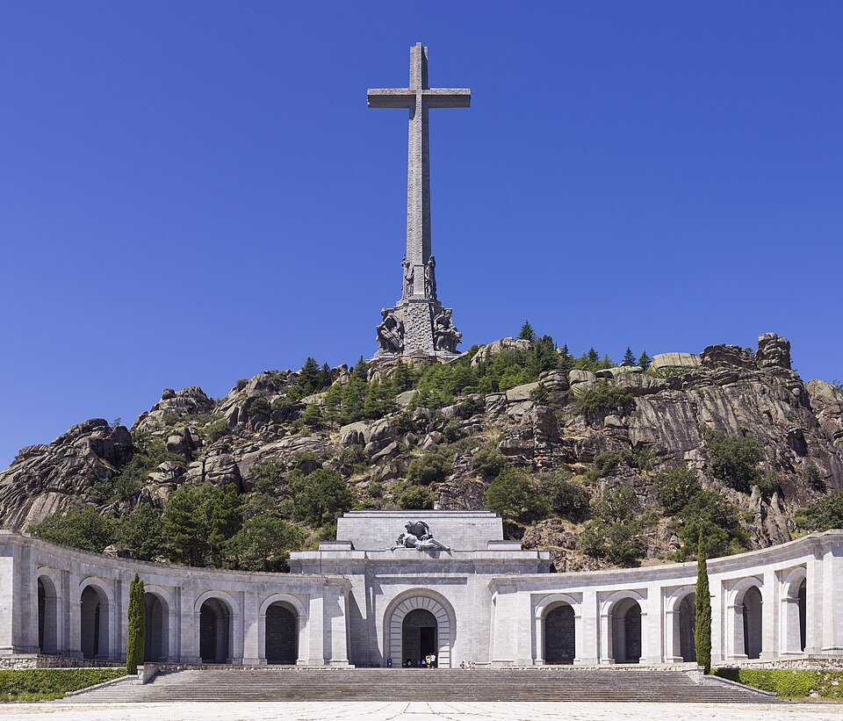
“El Pacto del Olvido”
1977 Amnesty Law(it has not been lifted or repealed)
  Marked a peaceful transition of power after Francisco Franco(Spain’s dictator) to a democracy
  This law gave immunity to those who committed human rights and humanitarian law violations during the Civil War (1936-1939) and during the dictatorship(1939-1975).
The Silence of Others, a 2019 film
Valley of the Fallen
Franco’s remains removed in 2019

Slide 10
Sources
https://schoolhistory.co.uk/modern/the-causes-of-the-spanish-civil-war/#Lets_know_more_about_The_Causes_of_the_Spanish_Civil_War
https://melaproject.org/blog/336
https://www.zinnedproject.org/news/tdih/bombing-of-guernica/
https://www.britannica.com/biography/Manuel-Azana?utm_source=chatgpt.com
https://www.thesilenceofothers.com/
https://www.nationalww2museum.org/war/articles/social-revolution-spanish-civil-war
https://libcom.org/article/1936-1939-spanish-civil-war-and-revolution

