Slide 1
Partition of India
Deeya Bachani

Slide 2
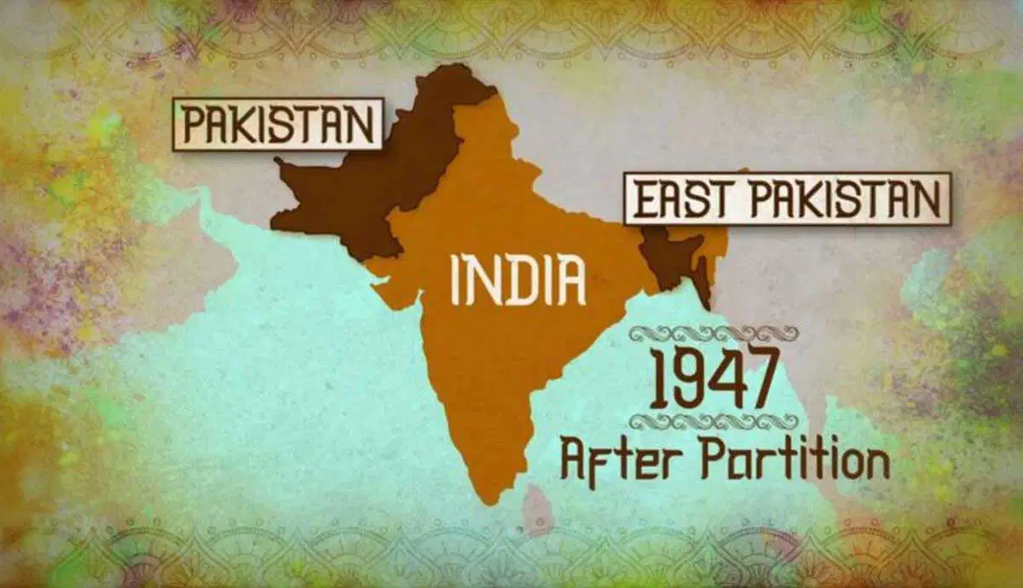
Type of Conflict
The Partition of India represents a conflict between cultures, especially between Hindus and Muslims.
It also reflects conflict between groups within a nation and conflicts based on oppression under colonial rule.

Slide 3
Causes of the Conflict
The conflict was caused in part by British colonial policies that encouraged division between religious groups.
Religious differences between Hindus and Muslims became more politically significant over time.
The push for independence created urgency around how power would be distributed after British rule ended.

Slide 4
Goals of the Parties Involved
The Indian National Congress wanted a unified and independent India.
The All-India Muslim League wanted a separate Muslim state called Pakistan.
These competing goals made compromise increasingly difficult.

Slide 5

Role of Leaders vs People
Political leaders played a major role by emphasizing religious identity and fear.
1
Tensions among ordinary people already existed before the final decision to partition.
2
Violence resulted from both top-down leadership decisions and bottom-up reactions from communities.
3

Slide 6
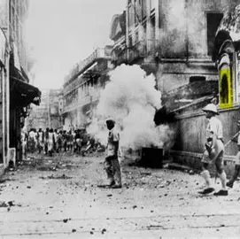
Motivation to Take Up Arms
Many people were motivated by fear of being attacked by the other group.
Rumors and propaganda increased panic and encouraged preemptive violence.
Religious identity became tied to survival, making neutrality extremely difficult.

Slide 7
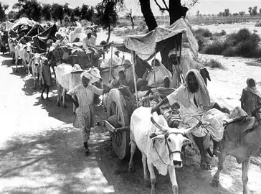
Impact on Personal Lives
The Partition displaced over 10–15 million people and caused around 1 million deaths.
Families were separated and forced to leave homes and communities behind.
Everyday life was disrupted as people faced violence, loss, and uncertainty.

Slide 8
Changes to Society and Beliefs
The conflict destroyed long-standing relationships between religious communities.
Trust between groups was replaced with fear and suspicion.
Religious identity became more rigid and central to social life.

Slide 9
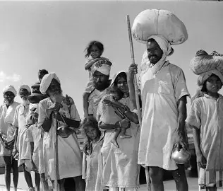
People Caught Between Sides
Many people living in mixed regions were forced to choose sides quickly.
Some individuals faced violence regardless of their personal beliefs or actions.
Minorities in both India and Pakistan became especially vulnerable.

Slide 10
Could the Conflict Have Been Avoided?
There were attempts to create a unified government with shared power.
Deep mistrust between groups made compromise difficult to achieve.
The rushed British withdrawal limited the possibility of a peaceful solution.

Slide 11
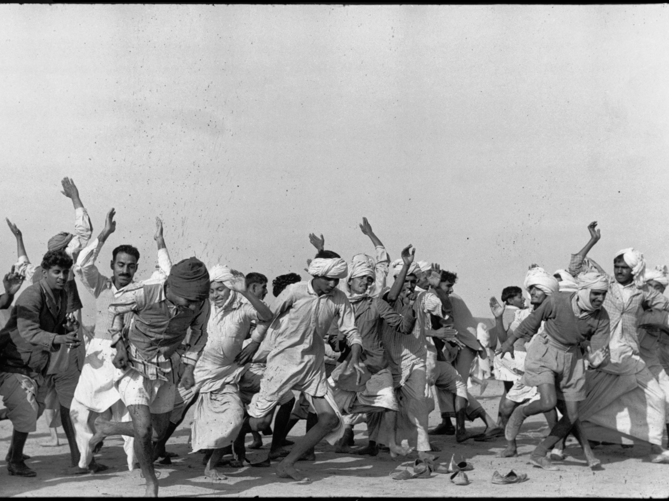
Duration, Resolution and Consequences
The Partition officially occurred in 1947, but violence continued for months afterward.
The conflict resulted in the creation of India and Pakistan, and later Bangladesh.
Long-term consequences include ongoing tensions and conflicts such as those over Kashmir.

Slide 12
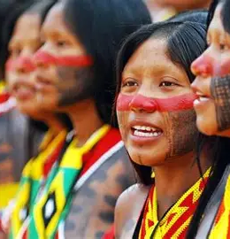
Kayapo Organized Resistance
The Gorotire Kayapo organized their resistance by forming a unified group that confronted the miners directly and asserted control over their territory.
They used negotiation as a strategic tool, allowing miners to remain temporarily in exchange for goods, money, and resources.
The Kayapo turned the invasion into an opportunity to gain access to industrial materials such as tools, weapons, and manufactured goods.
They also used media attention and outside interest to strengthen their political visibility and defend their land rights.

Slide 13
Differences Between Groups
One Kayapo group chose to cooperate with the miners in order to gain material benefits and economic advantages.
The other group resisted more strongly because they were more concerned about protecting their land, traditions, and autonomy.
These differences were influenced by leadership styles, past experiences with outsiders, and differing priorities regarding tradition versus adaptation.
The divide shows how even within one culture, groups can respond differently to outside pressure and opportunity.

Slide 14

Changes to Kayapo Life
Traditional housing structures are being altered as new materials and building styles are introduced.
The men’s hut is losing some of its central role as social and political organization shifts.
Beautiful name ceremonies are becoming less frequent or are being modified due to outside influence and changing values.
Traditional dances and rituals are sometimes shortened or performed for outsiders rather than purely for cultural purposes.
Dress is changing as Western clothing becomes more common alongside or instead of traditional body paint and ornaments.
Overall, cultural practices are being adapted, combined with outside influences, or in some cases gradually lost.

