Slide 1
Partition of India
Arya Adusumilli

Slide 2
Causes/Goals
End of British Raj, division of Bengal and Punjab
Decades of Hindu-Muslim tension: 1905 division of Bengal and political violence
Greater enfranchisement (WWI), formation of All-India Muslim League
Rai and Savarkar (Hindutva), beginnings of two-nation theory, desires for expulsion of Muslims, prohibited conversion
Pakistan Resolution of 1940 demands Muslim sovereignty
Years of growth of Muslim League during jailings of Hindu congressmen during WW2
Eventual two-nation split in 1947 along Radcliffe Line

Slide 3
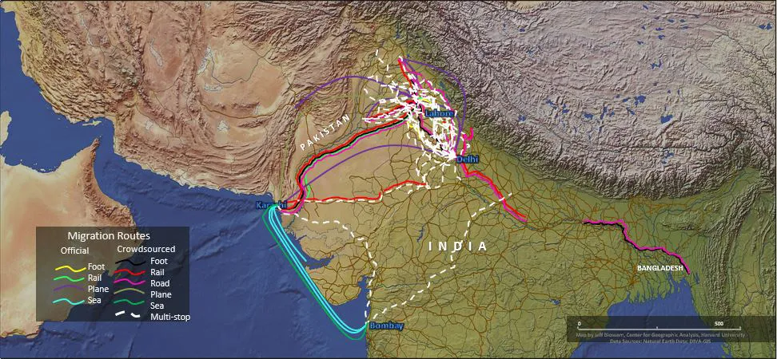
Displacement and Violence
15 million people displaced; calls for coordinated migration were rejected, people forced to do it themselves
Massive violence, especially against women, on border, in diverse towns
1 million dead who were displaced or living on the border
Gradual end to violence credited to Gandhi
Few surviving Muslims in East Punjab, few surviving Hindus/Sikhs in West Punjab
3 million missing and never accounted for

Slide 4
Radicalization, Assignment of Blame
Strong stigma associated with interaction with opposite religion/nation, ongoing even today
Distrust between remaining minority Muslims in India and majority, inverse in Pakistan
Some blame partition itself; others argue that it was inevitable, but that governmentally coordinated migration could have prevented death
Violence occurred most strongly in successive months, but continued sparsely along border and in diverse towns for successive years

Slide 5
References
Agarwal, A. (n.d.). Partition of british india 1947. https://www.graduateinstitute.ch/communications/news/partition-british-india-1947.
Wikipedia contributors. (2026, March 31). Partition of India. In Wikipedia, The Free Encyclopedia. Retrieved 20:57, April 5, 2026, from https://en.wikipedia.org/w/index.php?title=Partition_of_India&oldid=1346371180.

