Slide 1
Chinese Buddhism as a Belief System
Yiyao

Slide 2
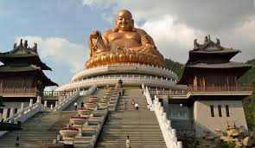
What is Chinese Buddhism?
Chinese Buddhism is a form of Buddhism that developed in China by integrating Indian Buddhist teachings with Chinese cultural traditions such as Confucianism and Daoism.
It is not just a religion, but a comprehensive belief system that explains:
  The nature of suffering
  The cycle of life and death
  The path to liberation (enlightenment)
It functions as both:
  A spiritual system (explaining existence)
  A practical guide for daily life

Slide 3
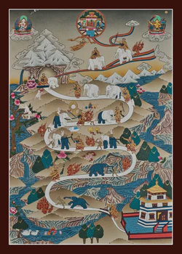
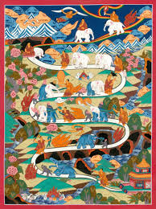
Major Tenets
Four Noble Truths:
  Life involves suffering
  Suffering is caused by desire
  Suffering can end
  There is a path to end suffering
Karma:
  Actions have moral consequences across lifetimes
Rebirth:
  Individuals are reborn in a cycle (samsara)
Enlightenment (Nirvana):
  Liberation from suffering and rebirth
Compassion & Detachment:
  Reduce attachment and cultivate kindness

Slide 4
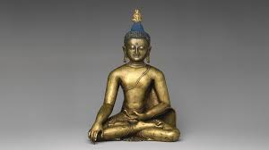
Origins and Spread
Founded by Siddhartha Gautama (the Buddha) in India (~5th century BCE)
Entered China during the Han Dynasty through trade routes (Silk Road)
Spread through:
  Translation of scriptures into Chinese
  Support from emperors and elites
Developed into uniquely Chinese schools:
  Chan (Zen), Pure Land, Tiantai

Slide 5
Adherents and Motivation
Practiced by millions in China and East Asia
Includes:
  Monks/nuns (devoted practitioners)
  Laypeople (everyday believers)
Why people believe:
  Provides meaning and explanation for suffering
  Offers moral guidance
  Helps cope with uncertainty, death, and injustice
  Reinforces cultural identity and tradition

Slide 6
Ecological, Economic, Cultural Influences
Cultural integration:
  Combined with Confucian values (family, hierarchy)
  Integrated Daoist ideas (harmony, nature)
Economic conditions:
  Karma explains inequality (wealth, suffering)
Social instability:
  During war and chaos, Buddhism offered psychological comfort
Result: Chinese Buddhism became more practical, ritual-based, and community-oriented

Slide 7
Example
Example: The Foolish Old Man Moves Mountains
A story where an old man believes that even if he cannot finish a task, future generations will continue
Reflects a worldview where:
  Effort extends beyond one lifetime
  Individual limits are less important than long-term continuity
Connection to Chinese Buddhism:
This cultural mindset evolved from Buddhist ideas such as:
  Rebirth (life extends beyond a single existence)
  Karma (actions have long-term consequences)

Slide 8
Structure of Beliefs
Core principle:
  Life is suffering (dukkha)
Underlying cause:
  Desire and attachment
Mechanism:
  Karma and rebirth
Solution:
  Follow the path (ethical living, meditation, wisdom)
Goal:
  Enlightenment (nirvana)

Slide 9
Structure of Characters
The Linguistic "Rank" Indicators
gao(告) — "To Tell": Used by a Superior to an Inferior.
bai(白) — "To Address": Used by an Inferior to a Superior.
The Four-Tier Hierarchy
The Buddha (Supreme): Always "Tells," never "Addresses." He is the undisputed peak.
Bodhisattvas (The Elite): Spiritual "middle-management" who defer only to the Buddha but command all others.
Disciples (The Inner Circle): Respected followers who hold higher status than worldly figures.
Kings & Deities (Worldly Power): Despite their earthly/heavenly status, they occupy the bottom tier, frequently using bai to address monks and Disciples.

Slide 10
Function
Individual level:
Provides meaning in suffering
Encourages emotional regulation (detachment)
Guides moral behavior
Social level:
Promotes harmony and compassion
Reinforces ethical norms (do good, avoid harm)
Stabilizes society by encouraging acceptance of circumstances

Slide 11
Evidence and Justification
Believers rely on:
Personal experience:
  Meditation, inner peace, spiritual insight
Scriptures and teachings
Cultural tradition
Observations of life:
  “Good actions lead to good outcomes” (karma)

Slide 12
Handling Challenges
When beliefs are challenged:
Reinterpretation:
  Teachings adapted to modern contexts
Integration:
  Coexists with science and other beliefs
Faith and practice:
  Emphasis on personal experience over proo
Example:
Karma is sometimes understood psychologically (actions shape mindset), not just literally across lifetimes

Slide 13
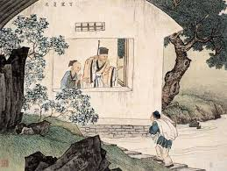
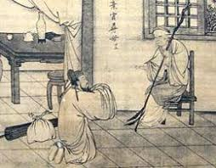
Example: Filial Piety
Challenge
Core Confucian value
  Respect and duty to parents and ancestors
Early Buddhism was criticized in China because monks:
  Left families
  Didn’t continue lineage
How people handled
Created stories and teachings emphasizing:
  Repaying parents’ kindness
  Saving parents spiritually
Example
  Mulian Saves His Mother

Slide 14
Conclusion
Chinese Buddhism is a highly structured belief system that explains life, suffering, and morality
It persists because it:
  Provides meaning
  Helps people cope with uncertainty
  Aligns with cultural values
It functions both as:
  A philosophy of life
  A social system shaping behavior and relationships

Slide 15
References
References
Aich, T. K. (2013). Buddha philosophy and western psychology. Indian Journal of Psychiatry, 55(6), 165. https://doi.org/10.4103/0019-5545.105517
Brown, W. (2025). Introduction to Buddhism. Stanford.edu. https://spice.fsi.stanford.edu/docs/introduction_to_buddhism?utm_source=chatgpt.com
Lee, J., & Wong, T. (n.d.). Hierarchy of Characters in the Chinese Buddhist Canon.
Wikipedia Contributors. (2019a, October 17). Chinese Buddhism. Wikipedia; Wikimedia Foundation. https://en.wikipedia.org/wiki/Chinese_Buddhism
Wikipedia Contributors. (2019b, November 10). Karma. Wikipedia; Wikimedia Foundation. https://en.wikipedia.org/wiki/Karma

