Slide 1
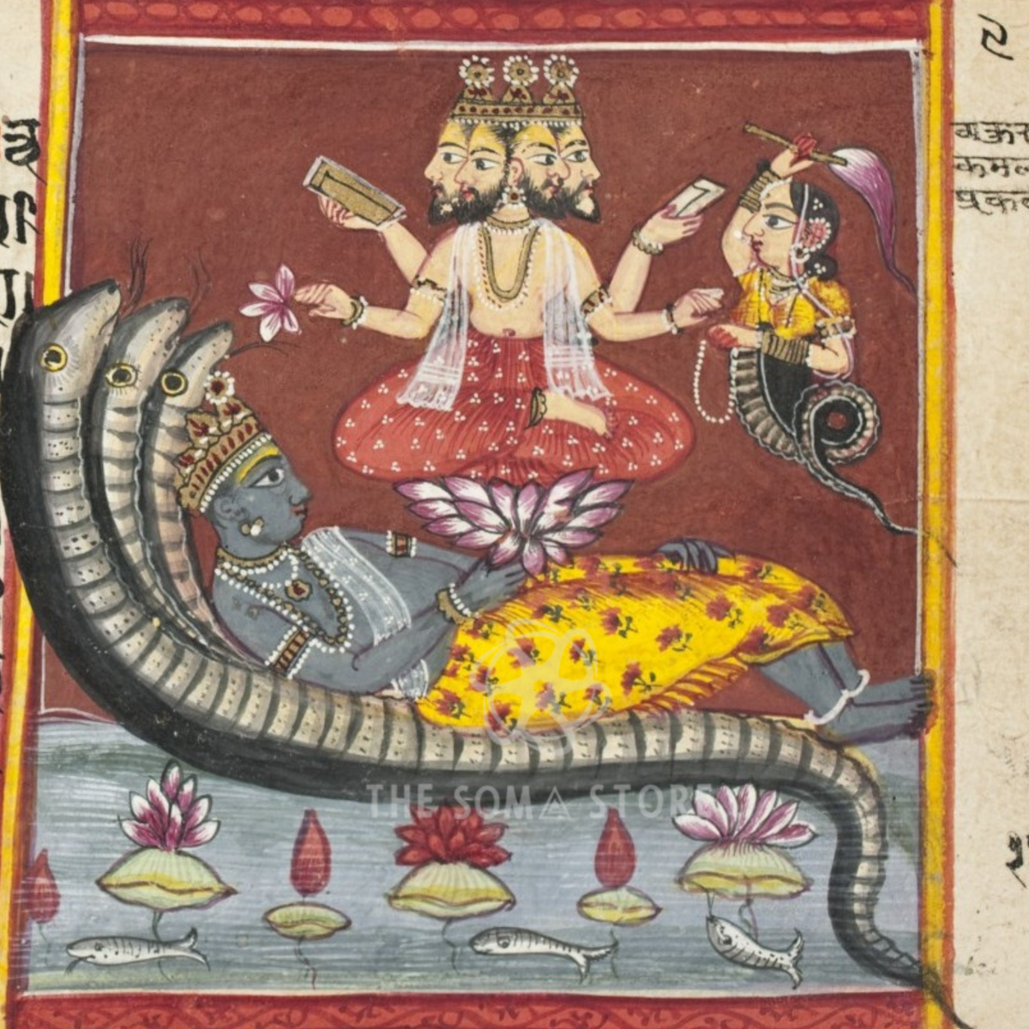
Advaita Vedanta
Presentation by Solomon Wechter

Slide 2
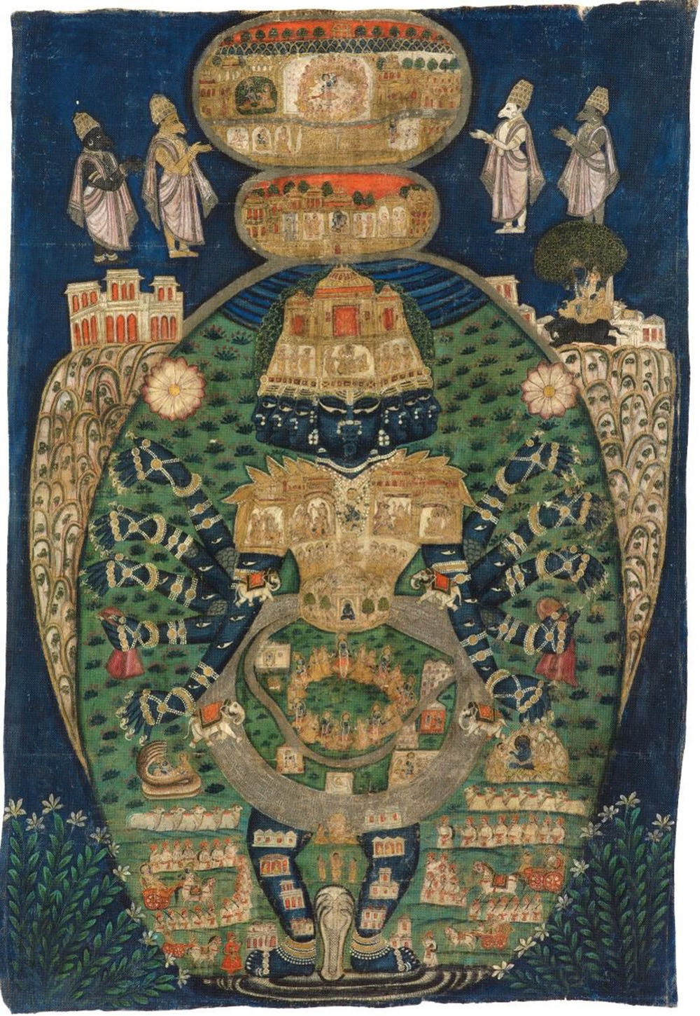
Major Tenets
Ultimate reality (Brahman) is characterized as
  Pure being (sat)
  Pure awareness (chit)
  Pure bliss (ananda)
Brahman: the ground of being out of which even God himself arises and creates the world
The true Self/soul (Atman) is identical with this reality
  Atman is Brahman, as the ocean is within a raindrop and vice versa

Slide 3
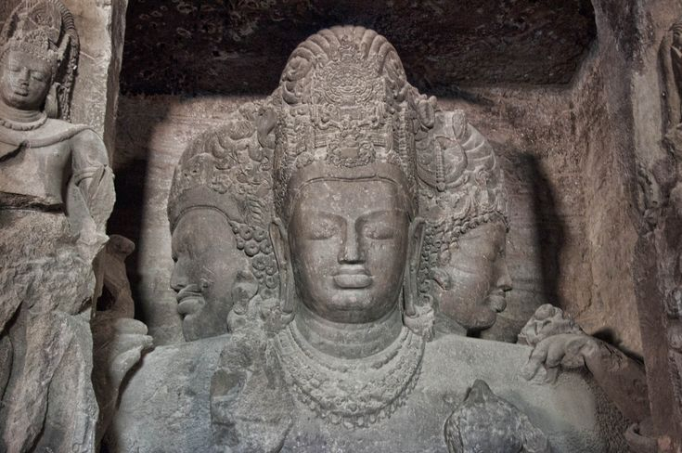
Non-Dualism
Pairs of opposites: good/evil, joy/suffering, male/female, matter/spirit, old/young, me/you, etc.
The veil of Maya (dualism) is placed over our eyes during birth, and allows one’s lifetime to play out
“But where there is unity, one without a second, that is the world of Brahman” – Brihadaranyaka Upanishad
Brahman as the unification of all opposites, the underlying unity as the other side of the multiplicity
“Mask of Eternity” in the Elephanta Caves (6th cent. CE); representing the One behind good and evil (two)

Slide 4
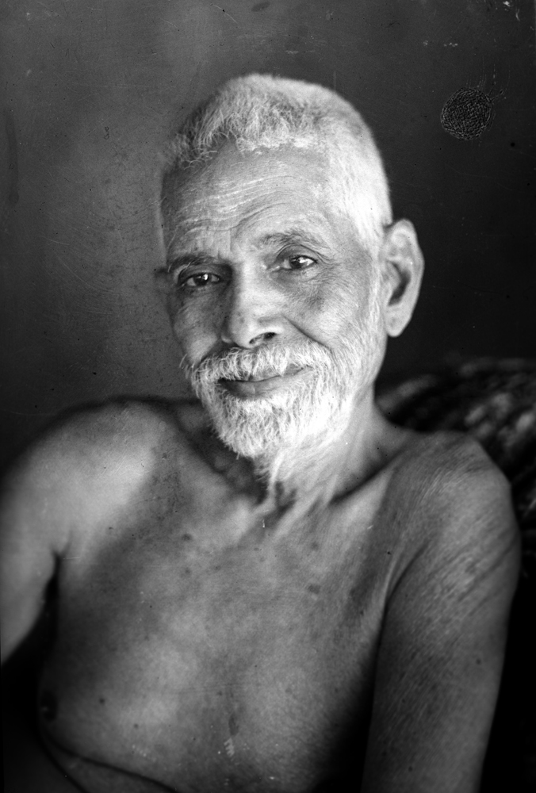
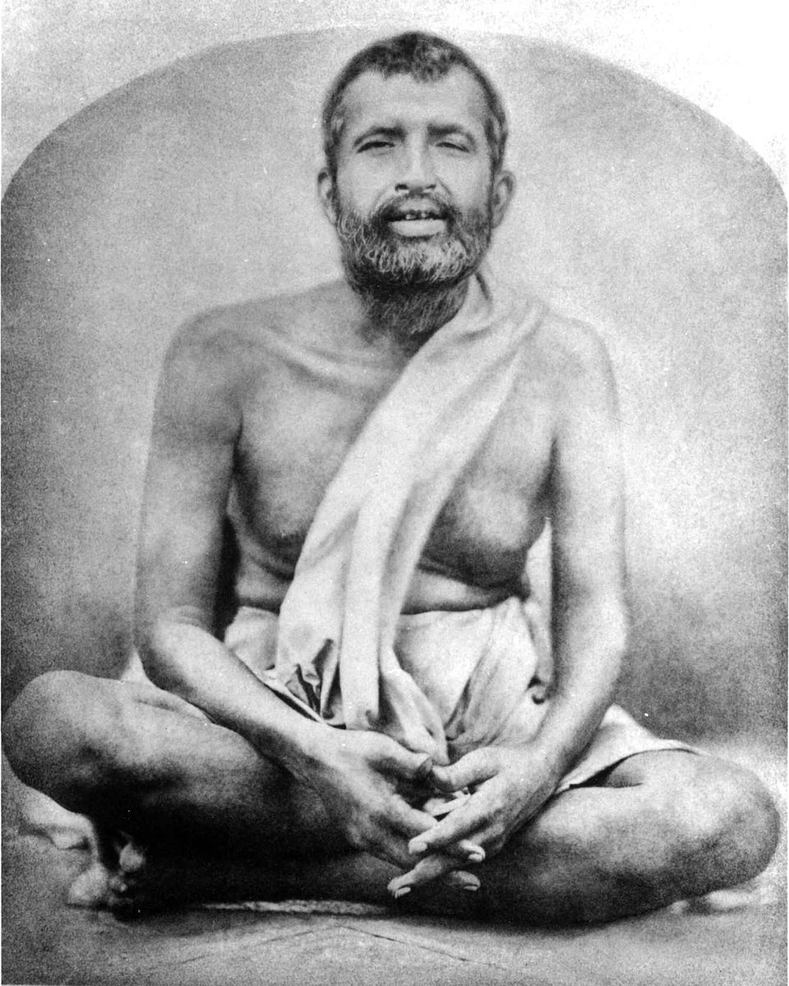
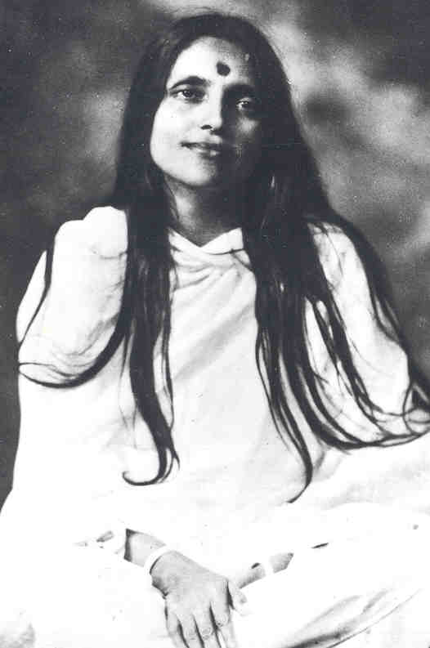
Who invented it, promoted it, etc.,?
Advaita Vedanta philosophy, a subsect of Hinduism
Originates in the Upanishads
  Part of the foundational texts of Hinduism
Spread primarily through Indian monastic traditions
In the 19th and 20th century, saints like Ramakrishna, Anandamayi Ma, and Ramana Maharshi are widely considered to be fully realized beings, giving spiritual teaching to millions of followers and devotees
Sri Ramakrishna (1836–1886)
Ramana Maharshi (1879 – 1950)
Anandamayi Ma (1896 - 1982)

Slide 5
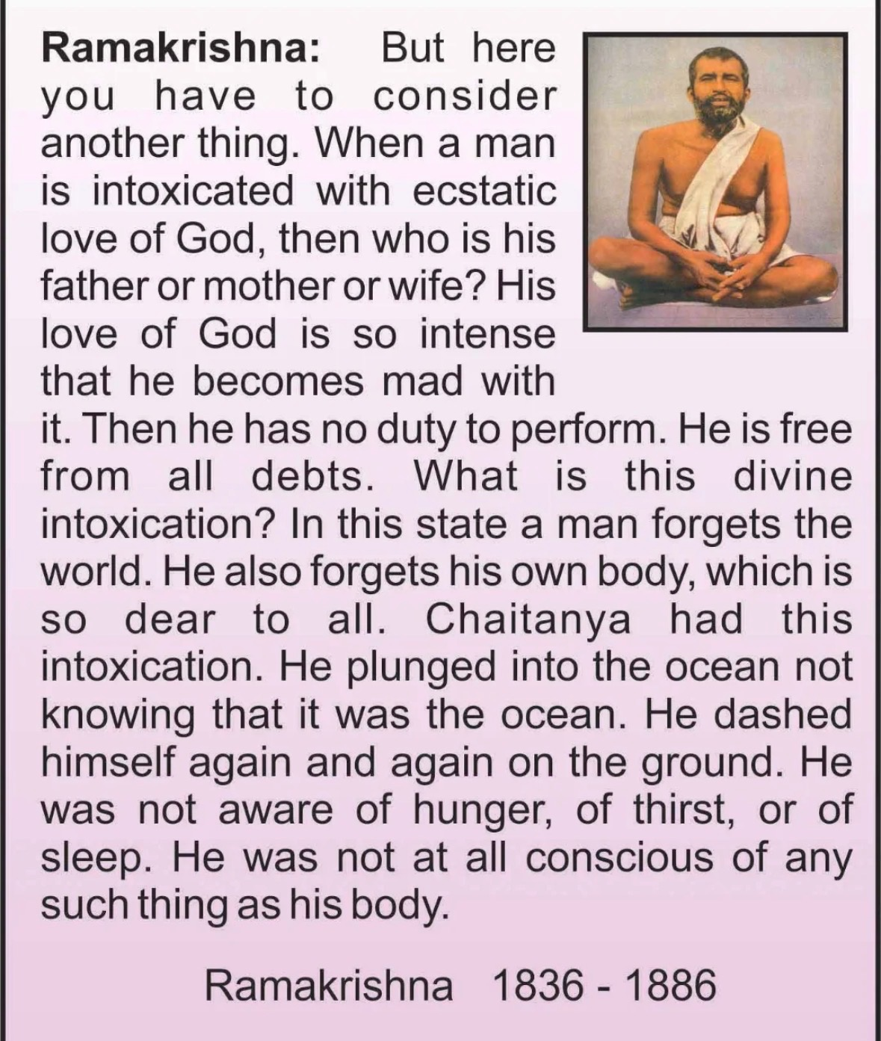
Perspective of Self-realization

Slide 6
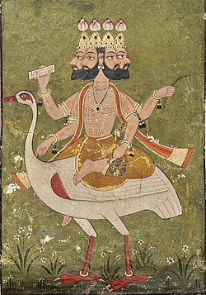
Shaped by ecological factors?
Developed in:
agrarian societies
Supported by:
caste/social structures (division of roles, including renunciation)
Ascetic traditions:
value withdrawal from material life
Later shaped by:
colonialism → systematization, defense against Western philosophy
globalization → simplified “yoga/spirituality” forms
But, if Brahman is really outside of form and time, then perhaps it is not shaped by ecological factors at all?
Painting of Brahma (c. 1700 CE)

Slide 7
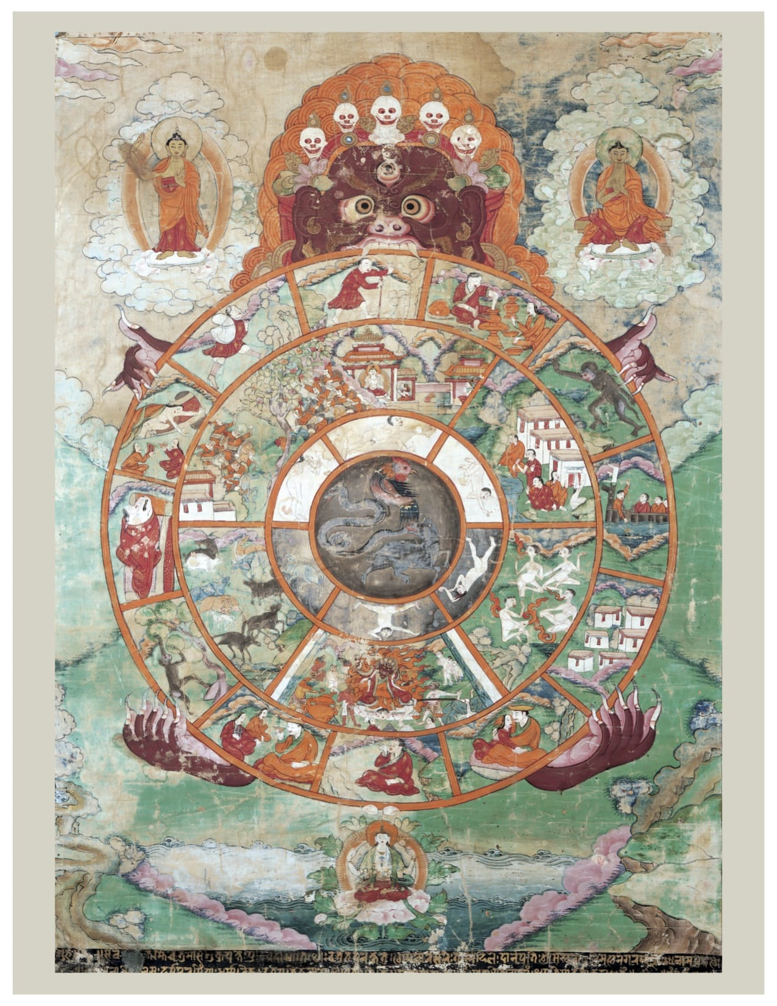
Is there a hierarchical structure?
Top level: Brahman (ultimate reality)
Next: Brahman = Atman
Next: human condition (ignorance, karma, samsara, maya, grace)
Next: Spiritual practice as a way to embody this philosophy/religion
Finally: moksha (liberation) (eventually, maybe after like 50,000,000 lifetimes)

Slide 8
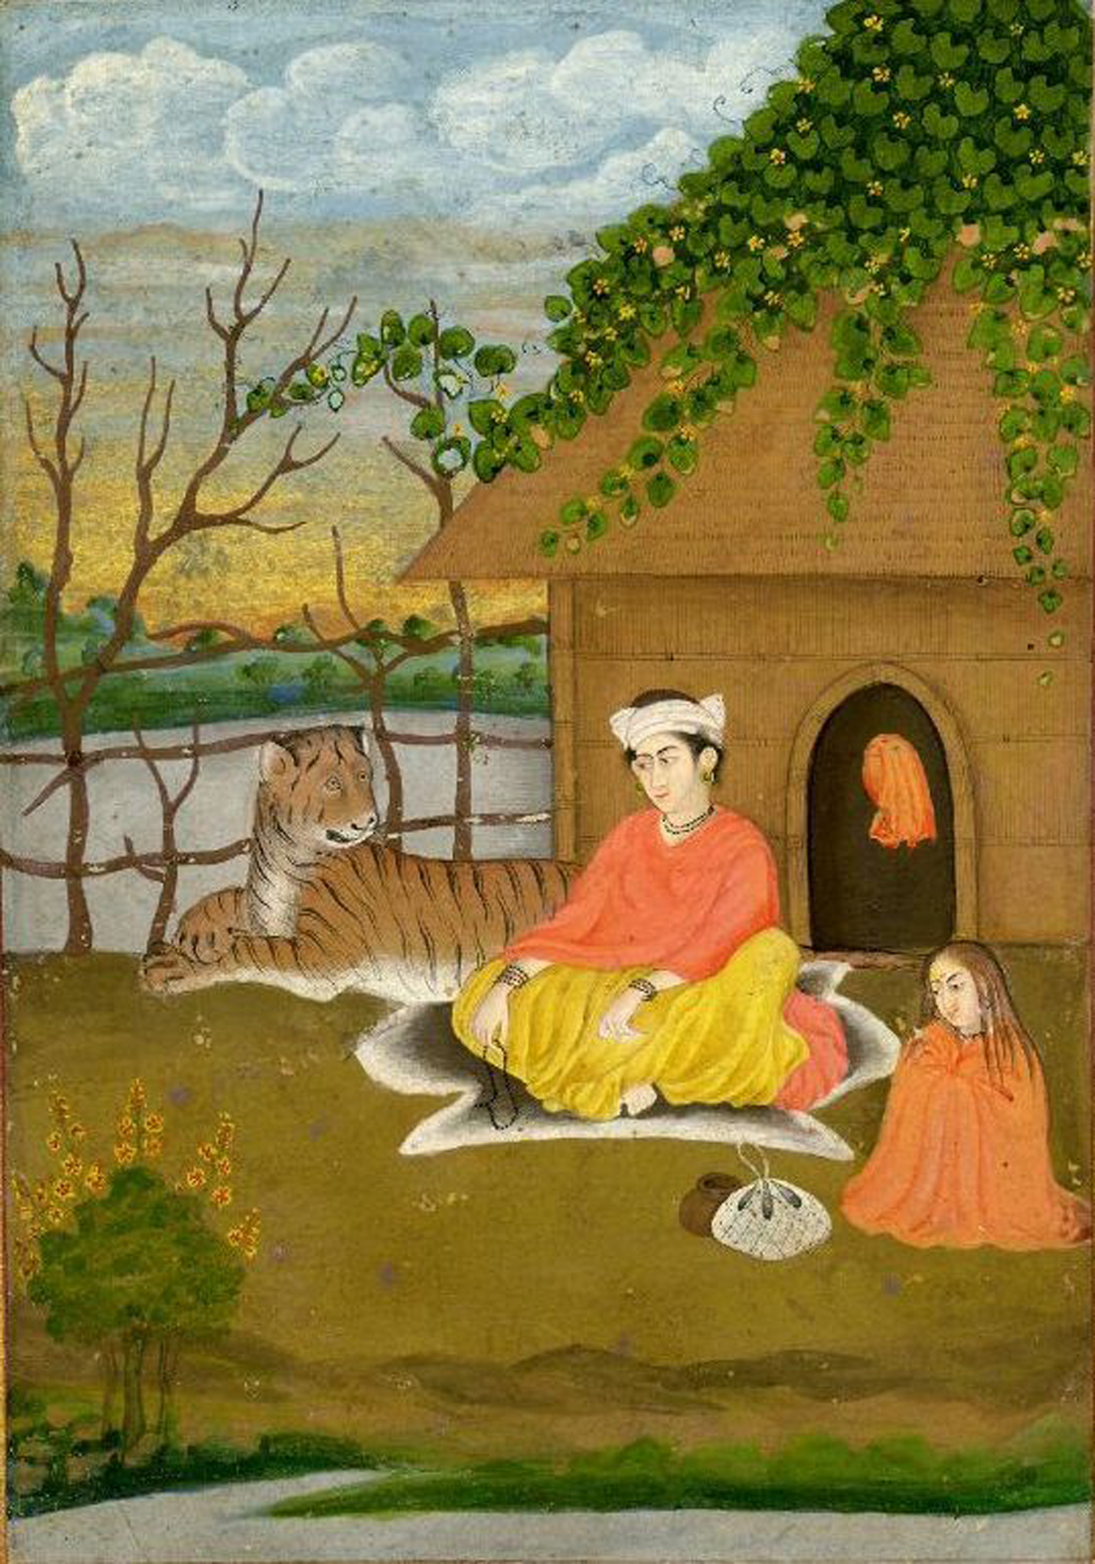
How does this belief influence action?
Encourages spiritual practice among those who seek Self-realization and liberation from Samsara
  Meditation (Raja Yoga)
  Study (Jnana Yoga)
  Service (Karma Yoga)
  Devotion (Bhakti Yoga)
Relationship with the Self --> change in consciousness
Loosening of ego control
  Giving up who you think you are and what you want;
  Surrender to the world
Drawn deeper into love of others

Slide 9
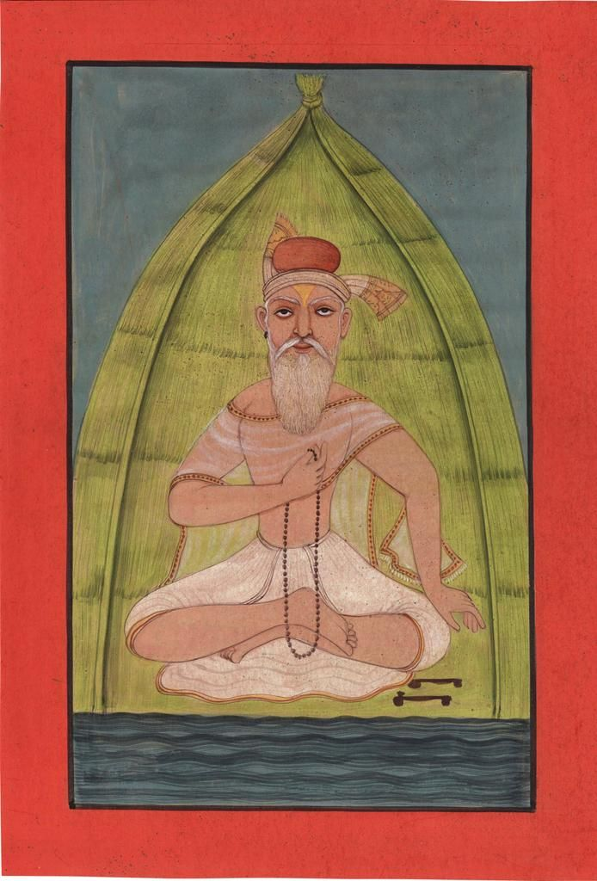
Evidence believers have?
Inner experience
Named differently in traditions across the world
  Self-realization
  Samadhi
  Nirvana (Buddhism)
  Satori (Zen Buddhism)
  Enlightenment
  Theosis (Christian mysticism)
  Fana (Sufism)
“Faith is what is left after all your beliefs have been blown to hell.” – Ram Dass
Meditating yogi

Slide 10
How do believers deal with challenges to their beliefs?
Internal disagreements (between Vedanta schools):
Different schools (Advaita, Vishishtadvaita, Dvaita) debate:
  whether Atman = Brahman or not
  These are treated as interpretive differences, not total refutations of the system
Often absorbs other religions as partial expressions of the same ultimate truth (e.g. Brahman = Godhead = Tao = the One)
Frames differences as different paths suited to different people

Slide 11
Sources
“Chaitanya Mahaprabhu.” Wikipedia, Wikimedia Foundation, https://en.wikipedia.org/wiki/Chaitanya_Mahaprabhu. Accessed 29 Mar. 2026.
“Brahma.” Wikipedia, Wikimedia Foundation, https://en.wikipedia.org/wiki/Brahma. Accessed 29 Mar. 2026.
“Vishvarupa.” Wikipedia, Wikimedia Foundation, https://en.wikipedia.org/wiki/Vishvarupa. Accessed 29 Mar. 2026.
“Vedanta.” Wikipedia, Wikimedia Foundation, https://en.wikipedia.org/wiki/Vedanta. Accessed 29 Mar. 2026.
ChatGPT. ChatGPT, OpenAI, 2026, https://chat.openai.com/.
The Upanishads. (Add translator/editor if known), Publisher, Year.

