Slide 1

Existentialism
“Hell is other people” - Jean- Paul Sartre

Slide 2

The Major Tenants
Existence precedes essence (humans are not born with a set purpose, but instead must create meaning for themselves)
Existentialism as a response to nihilism(life has no meaning) and the rise of modernity (a new secular/scientific world)
Relies on engagement(vs detachment) the individual to interpret their own struggles(anxiety, alienation, uncertainty)
Freedom and responsibility
Authenticity
“No God”
Existentialism is humanism(in a way…)
The famous line “hell is other people” from No Exit captures a core existential tension: our identities are shaped, judged, and often constrained by others.

Slide 3
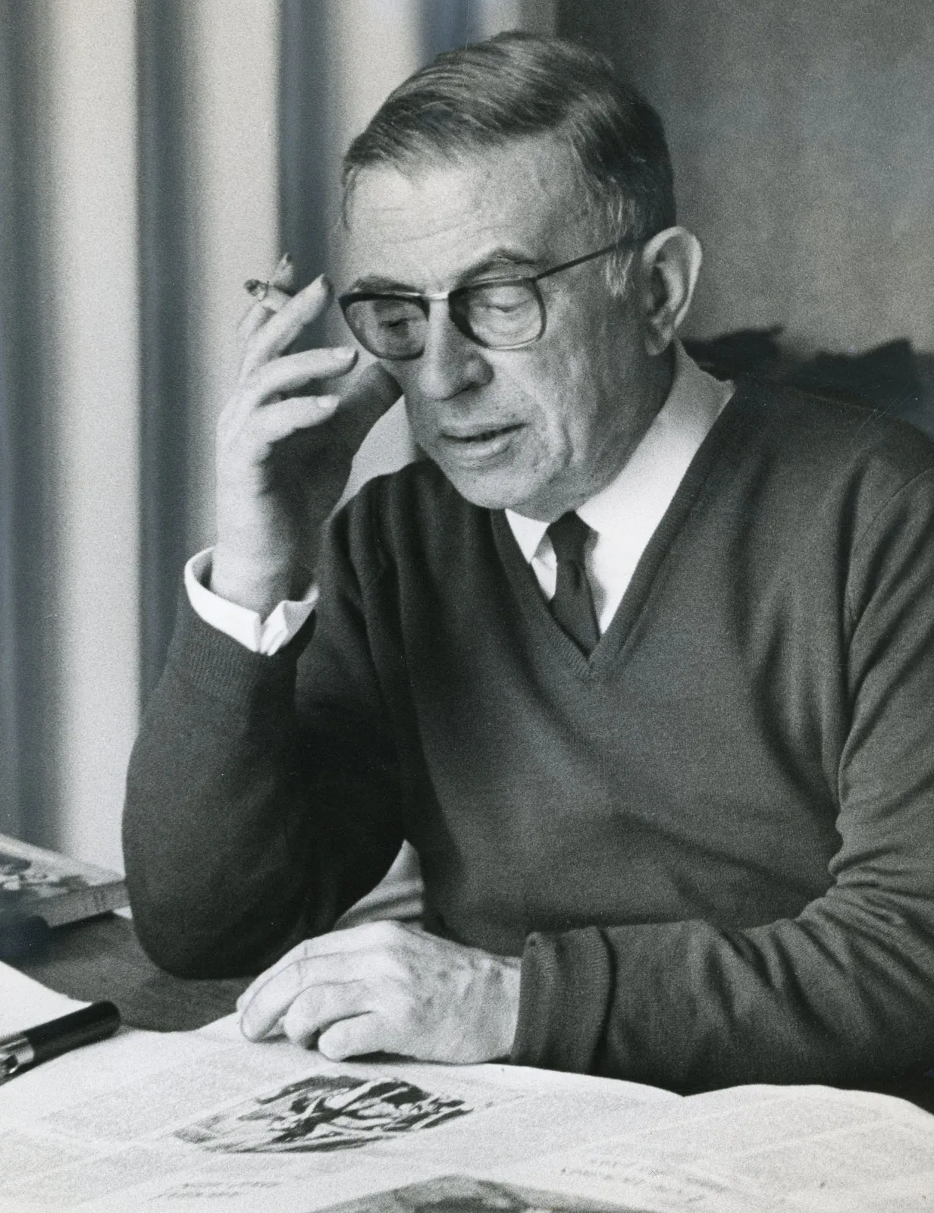

Inventors/Spreaders/Adherers
Seen often as a response to aftermath of WWII(the chaos/destruction)
Movement originated in France, but drew upon German philosophers(Nietzsche) and Spanish writers(Miguel de Unamuno)
The movement spread through literary works (ex: Kafka’s works) and artistic movements (expressionism)
People often follow the movement who want to feel empowered to find purpose/meaningfulness in a chaotic/ amoral world
Jean Paul Sartre
Simone de Beauvoir

Slide 4

Hierarchy of Beliefs
Overall Structure: Loose structure that is left up to interpretation
Main principle: existence precedes essence
Additional principles: freedom, responsibility, absurdity
Applied values: authenticity, ethical self-creation

Slide 5

Beliefs have an impact on actions and relationships
Because individuals are encouraged to act authentically rather than conform, they are more likely to act in accordance with their truest self
  Focus on self awareness
  Accountability
  Intentionality
Relationships are usually viewed through a dialectic lens: they both affirm and limit us
  The quote “hell is other people” reflects how social judgment can trap individuals in fixed identities

Slide 6

Evidence for this belief
No empirical evidence… instead…
  Acknowledgement of death
  Lived experience
  Introspection as evidence
  Literature and art

Slide 7

Responding to Challenges
Accepting the challenge
  Existentialists believe that uncertainty (doubt/ambiguity) is unavoidable and fundamental
  Ex: Soren Kierkegaard describes how anxiety is the “dizziness of freedom” meaning that it is not a weakness but instead inherent
Challenging the imposed meaning:
  Confronting societal norms
  Ex: Jean-Paul Sartre says that humans are “condemned to be free”
Confronting the challenge:
  Instead of avoiding the problem and deeming it meaninglessness, existentialists face it directly
    Ex: Albert Camus argues we must imagine Sisyphus happy despite his endless struggle
Overall:
Challenges are not resolved with certainty but met through conscious choice and continued self-definition

Slide 8

References
https://plato.stanford.edu/entries/existentialism/
https://iep.utm.edu/existent/

