Slide 1
Hare Krishna
Deeya Bachani

Slide 2
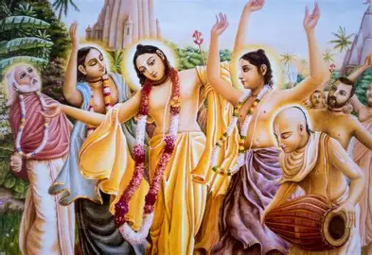
Major Tenets of the Belief System
The Hare Krishna movement teaches that Krishna is the Supreme Lord and that all humans are eternal spiritual beings trapped in a cycle of reincarnation determined by karma.
The system emphasizes that liberation from this cycle can be achieved through devotion, especially by chanting the Hare Krishna mantra and practicing bhakti yoga.
The belief system also promotes ethical living, including compassion, self-discipline, and detachment from materialism.

Slide 3
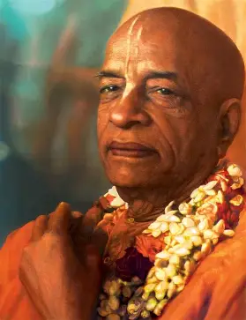
Founder, Spread and Adherents
The Hare Krishna movement was founded in 1965 by A. C. Bhaktivedanta Swami Prabhupada, who brought the tradition from India to the United States.
The movement initially spread among hippies in New York City and later expanded globally through temples, public chanting, and organized outreach.
The adherents include both formally initiated members and a larger group of regular participants who engage in worship and community activities.

Slide 4

Who Promotes it and Why People Believe
The movement is promoted by gurus, temple leaders, and the Governing Board Commission, which organizes and guides the system internationally.
Followers believe in the system because it provides a way to connect with Krishna and achieve spiritual fulfillment.
Believers are also drawn to the movement because it offers practical benefits such as reduced stress, inner peace, and a sense of purpose.

Slide 5
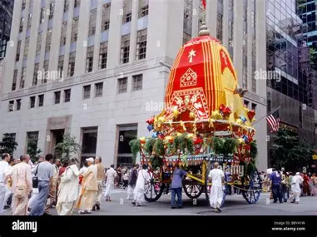
Cultural and Historical Influences
The beliefs of the Hare Krishna movement are shaped by its origins in the Indian bhakti tradition, which emphasizes devotion through chanting.
The movement was also shaped by cultural factors in the 1960s, particularly its appeal to countercultural groups in the United States.
Its global spread reflects its ability to adapt traditional practices to modern societies and different cultural contexts.

Slide 6
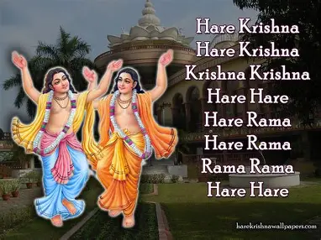
Hierarchical Structure of Beliefs
The belief system has a hierarchical structure in which the core idea of devotion to Krishna leads to specific practices such as chanting, ethical behavior, and ritual observance.
Higher-level beliefs about karma and reincarnation directly inform lower-level rules about daily life and behavior.
This structure shows that individual practices are derived from broader spiritual principles rather than existing independently.

Slide 7
How Beliefs Motivate Actions
The beliefs of the Hare Krishna movement motivate followers to engage in daily chanting, temple worship, and study of sacred texts.
The system also requires adherents to follow strict behavioral rules, including vegetarianism and avoiding intoxicants.
These beliefs shape how followers interact with others by encouraging compassion, service, and participation in community life.

Slide 8
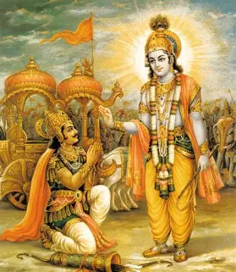
Evidence Used by Believers
Believers support their beliefs through sacred texts such as the Bhagavad Gita and the Srimad Bhagavatam, which provide the foundation for the system’s teachings.
They also rely on the personal effects of practices like chanting, which are believed to reduce stress and bring mental clarity and joy.

Slide 9
Responses to Challenges and Criticism
The Hare Krishna movement has been criticized by anticult organizations, which have accused it of brainwashing and attempted to deprogram members.
Former members have also brought legal challenges against the movement, but these cases have been unsuccessful.
Despite these challenges, the movement has continued to expand globally and maintain a committed following.

