Slide 1
Scientology
Arya Adusumilli

Slide 2
Major Tenets
Writings of L. Ron Hubbard
Dianetics -> The “Science of Knowledge”
Humans are spiritual beings known as “thetans” who are immortal and have reincarnated countless times
  Can dissociate in “exteriorization”
Auditing track and training track
The Bridge to Total Freedom and “Clear”
Space Opera involving galactic genocide that trapped thetans on Earth; spiritual pain is memories of the event

Slide 3
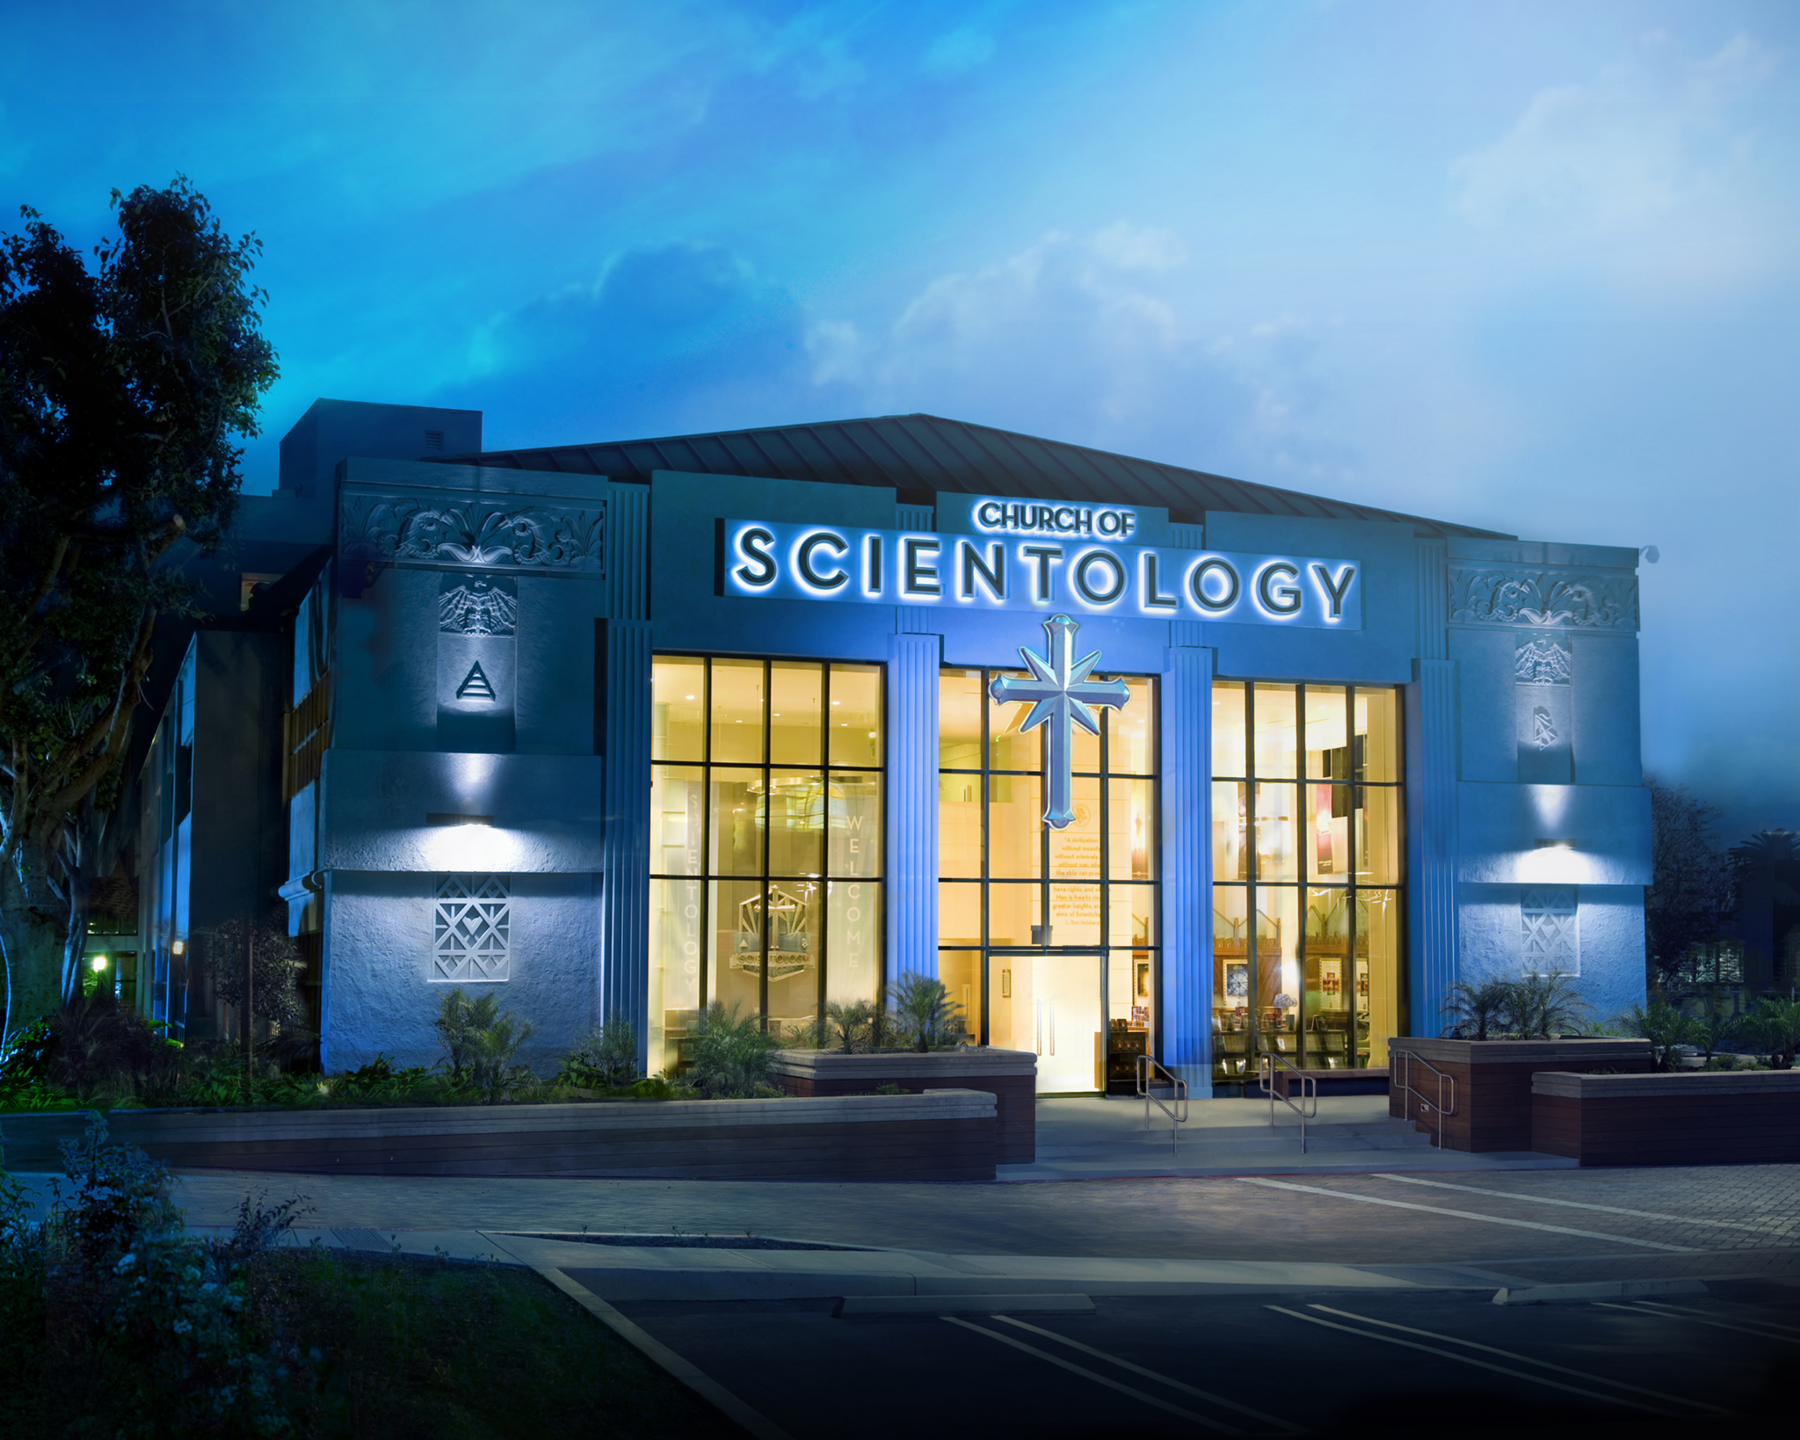
Creators and Proponents
Science fiction author L. Ron Hubbard
Writings are considered scripture
Church of Scientology stations around the world
Celebrity involvement
Individuals with psychological trauma

Slide 4
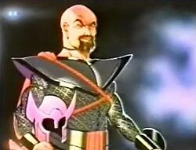
Cultural Factors
Emerged in middle of twentieth century, rampant social change
post-WW2 fascination with mental health, self help
Strong influence of science fiction in pop culture: space opera uses many common tropes
Cultural individualism in US

Slide 5
Resulting Actions and Evidence
Members spend large sums of money to move up Bridge, increase involvement
Those associated with avid critics are forced to “disconnect” and stop associating with them completely
Members take structured courses for extended periods on each track
Evidence lies entirely in anecdotes of sensations felt while being audited, mental clarity
Hubbard’s writing as religious text
Challenges labeled as misunderstanding scientology, forced disconnection
Denies validity of psychology and psychiatry, which rejected it in twentieth century

Slide 6
References
Beyer, C. (n.d.). Who is overlord Xenu? - scientology’s creation myth. Scientology’s Galactic Overlord Xenu. https://www.learnreligions.com/scientologys-galactic-overlord-xenu-95929.
Wikipedia contributors. (2026, March 24). Scientology. In Wikipedia, The Free Encyclopedia. Retrieved 03:10, March 25, 2026, from https://en.wikipedia.org/w/index.php?title=Scientology&oldid=1345153658.

