Slide 1
Classical Ballet Performance
Olivia Werner
85-375
Crosscultural Psychology

Slide 2
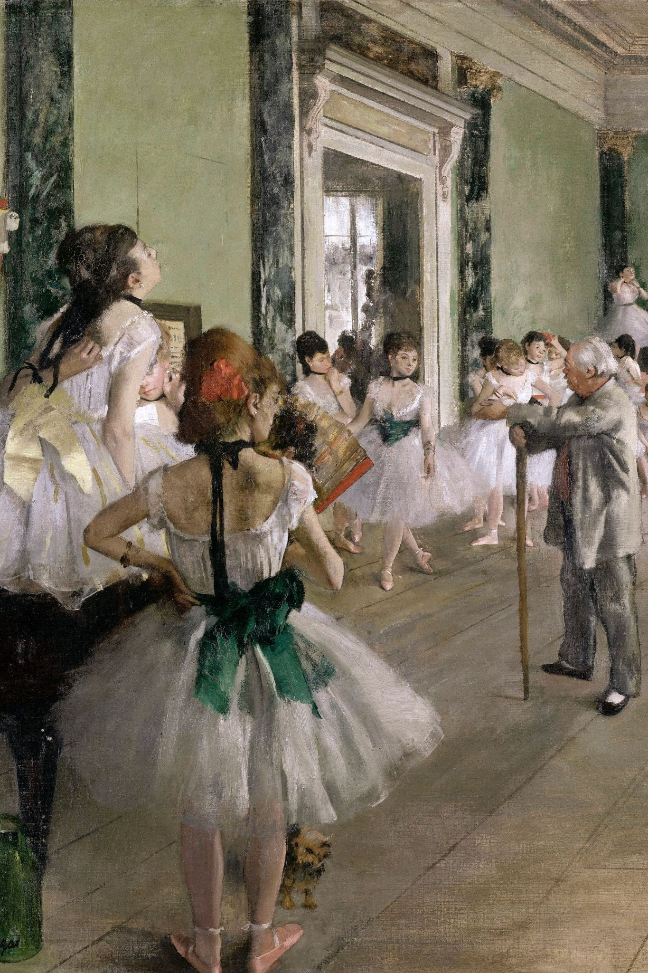
History of Ballet
Originated in Italy and France - Italian Renaissance
The French ballet de cour
  Performance of dance, theater, costume and talking for the noble men and women
First official ballet was in 1573 at the French court for the Queen of France Catherine de' Medici
Classical ballet productions
  The Nutcracker
  Swan Lake
  Sleeping Beauty
Edgar Degas, The Ballet Class

Slide 3
—George Balanchine
Choreographer and founder of New York City Ballet
"Ballet is important and significant—yes. But first of all, it is a pleasure."

Slide 4
01
Motifs and Images

Slide 5
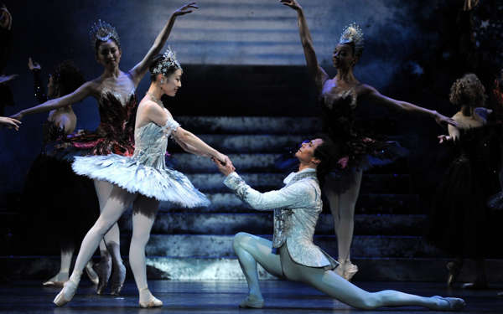
Motifs and Images
Recurring themes in classical ballet
Romance and desire
Good versus evil
Death and rebirth
Gender roles
Social organization
Fragility
Birmingham Royal Ballet Cinderella

Slide 6

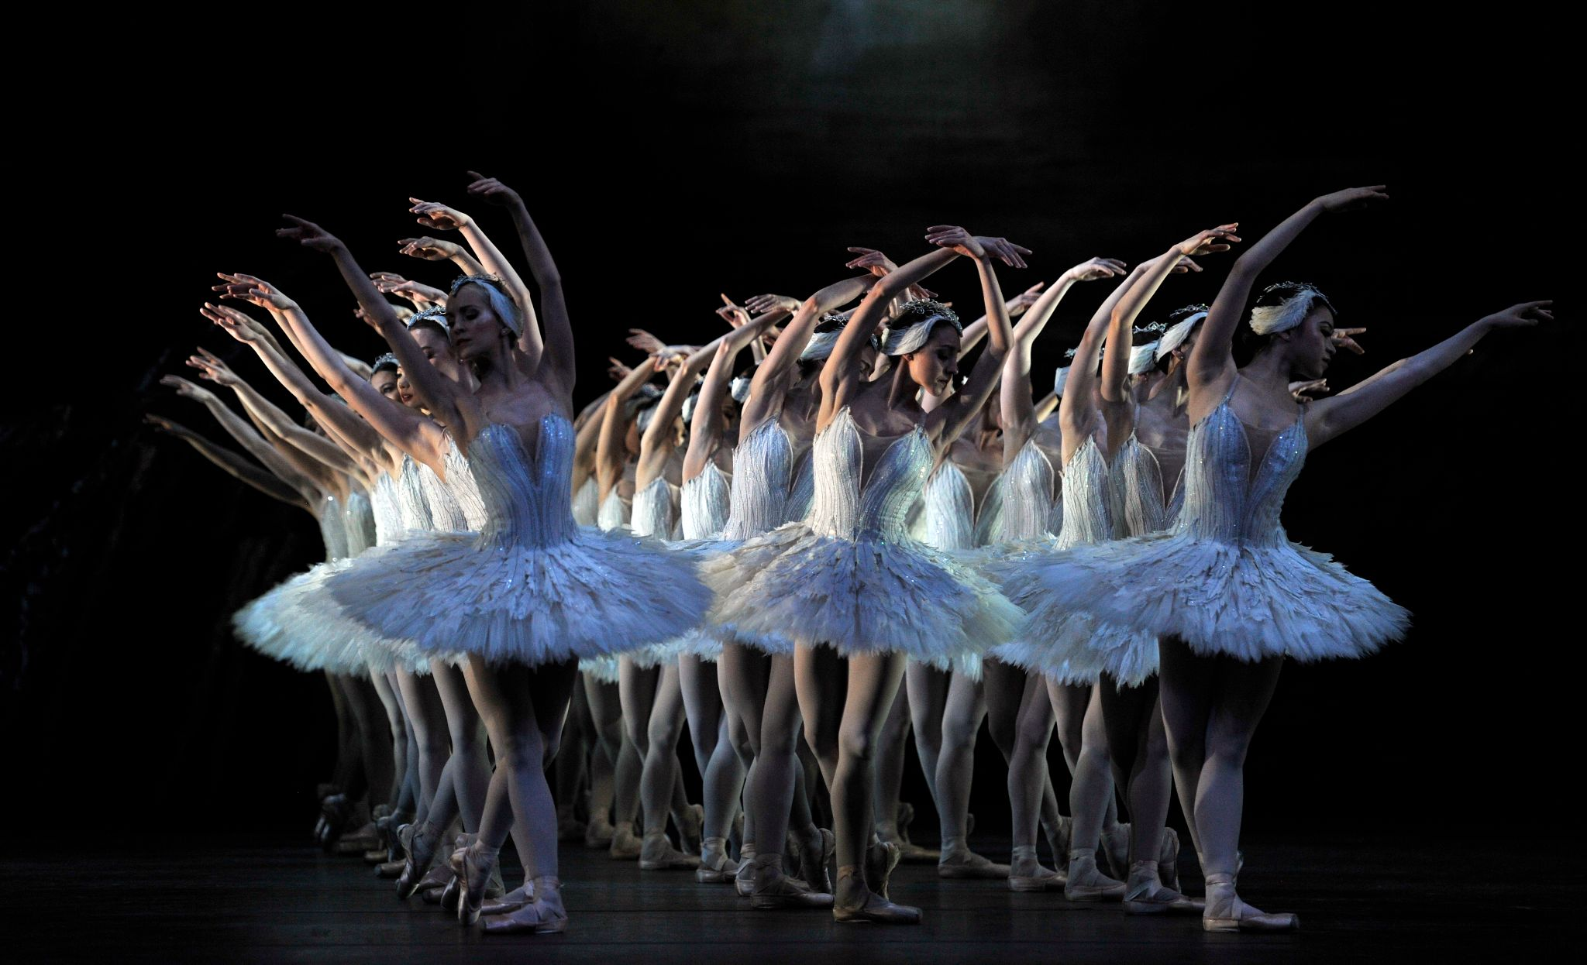
A picture is worth is a thousand words

Slide 7
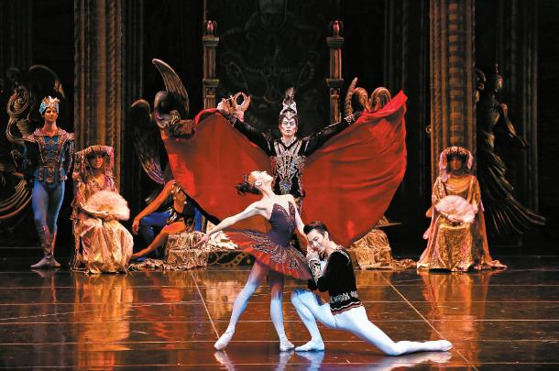
02
Emotional Expression
Universal Ballet Swan Lake

Slide 8
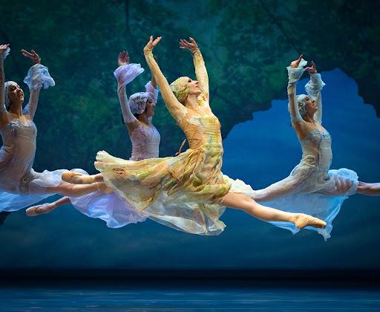
Emotional Expression
Ballet uses movement and facial expression to express the music and emotion
Some have narrative but there is no spoken word
Some focus on choreography and technique
Movement tells the story
Cincinnati Ballet King Arthur’s Camelot

Slide 9
03
Social Obligations
Attending a ballet performance

Slide 10
Social Obligations
It is a theatrical performance
Many people dress up to show respect for the dancers
Watching and listening is done in silence
No disruptive behavior

Slide 11
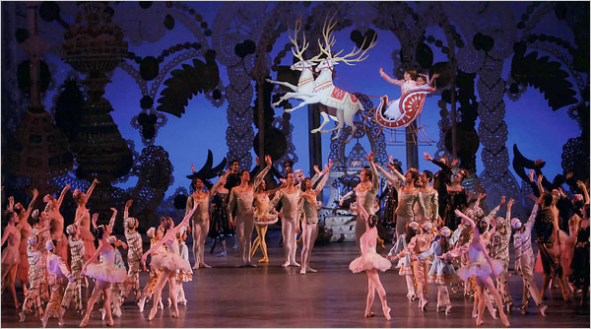
02
Social Context
New York City Ballet The Nutcracker

Slide 12
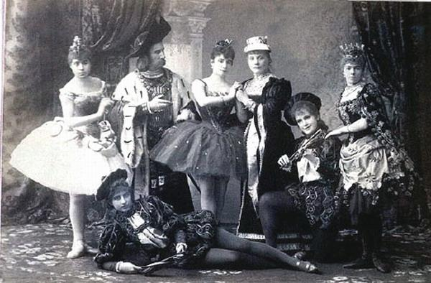
Ballet performance is a celebration of the arts
Extravagant entertainment for the aristocrats
Elitism and classism embedded into the culture due to cost of training
Costly tickets to attend
Many families attend The Nutcracker Ballet during Christmas time as a tradition
Publicity photo for premiere of Tchaikovsky's ballet The Sleeping Beauty (1890)

